Slide 1

The Roma in Serbian
Higher Education:
Barriers and Enablers
Diversity, Democratisation and Difference: Theories and Methodologies
Tanja Jovanovic
www.sussex.ac.uk/education/cheer

Slide 2
Roma…
Constitute largest ethnic minority in Europe -12 million
Social immobility
Marginalisation
Exclusion and discrimination
1% of Roma with tertiary education diploma as opposed to national average of 16%
(Mirga and Gheorghe, 1997).
Notes:
The Roma constitute the largest ethnic minority in Europe and have a long history of marginalisation, exclusion and discrimination. Despite the many political attempts to address these issues, the Roma people in Serbia remain marginalised, excluded and discriminated in key areas such as health, housing, employment and education. Education is of vital importance in combatting social exclusion, and historically the education received by Roma children in Serbia was of poor quality with very high dropout rates that later result in 1%of Roma with tertiary education diploma as opposed to national average of 16%.

Slide 3
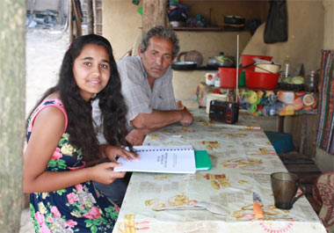
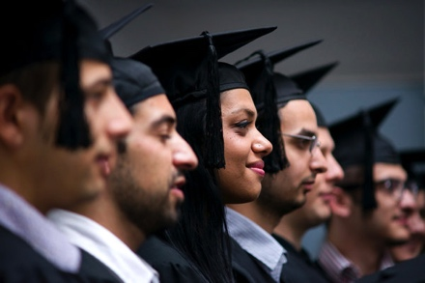

Aims of the study
FROM
TO
Notes:
to explore how minority Roma students succeed
in accessing higher education (HE) in Serbia.
how the context of poverty, institutional and social experiences of racism, and the gendered natured of marginalization
of Roma people all interact to shape Roma
students’ access to higher education
To explore the inspirations of Roma students and how they managed to access HE despite the all challenges they face

Slide 4
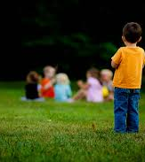
Theorising Roma Exclusion
Post-colonial feminist theories (Mohanty, 1988)
Intersectionality (Collins, 1998; hooks, 1981)
Theory of difference
(Ahmed, 2012)
Notes:
Given the historical relationship that has existed between the Roma and the majority populations in Serbia and other regional countries - a relationship in which the Roma have been demonised as an internal ‘Other’ and excluded from full participation in the nationalistically defined ‘national community’ – theoretical insights from postcolonial theory are of relevance to this investigation.
Postcolonial feminism argues that oppression relating to the colonial experience, in particular racial, class and ethnic oppression, can be seen as being closely related to the power of patriarchal relations within society.
In doing my reserch I am adopting an intersectional approach to consider how etnicity, class and social economic intersect to bring about exclusion of roma people from HE
Intersectionality- how different aspect in socety may intersect to produce Multiply marginalisation
theory of difference- how conceptions of diversity and inclusion play out in the Serbian context in relation to Roma students’ access to higher education
Ahmed -achievement of real diversity for historically marginalized can be undermined by an approach to diversity which is bureaucratic and managerial, and which sees ‘diversity’ as a performance indicator to be used for public relations. Serbian government’s initiatives aimed at widening Roma participation in HE, while laudable, are not primarily driven by a desire to remedy social inequalities in Serbia, but by the EU’s criteria for Serbian accession.
In managerial/bureaucratic circles in HE, it is as if ‘racism’ is seen as a vulgar or impolite term, and the polite term ‘diversity’ functions to deny the reality of racism, individual and institutional, in HE.

Slide 5
Method
10 life history (5 male, 5 female) interviews to explore Roma students’ lived experiences
5 semi-structured interviews with professionals (NGOs, Roma Policymakers)
Law
Medicine/Pharmacy
Engineering
Criminology
Management

Slide 6
Barriers

Slide 7
Poverty
I slept in a garage during that year. It was opened from all sides. I had sofa with water under it. I dig channels in order to survive and pay for my studies (male 25, study Engineering)
I start working when I was 13. I never had lunch at school from elementary till university now (male 25, study mechanical engineering)
Instead of studying we have to spend time on looking for a job…..’ (female 24, Medicine)
Notes:
The above quotes illustrate how financial difficulties play a role in impacting student’s access to higher education. However, the issues of financial difficulties do not end here rather even when in higher education students talked about their initiatives to addressing their financial and material challenges. There were accounts of for instance looking for manual work such as building or cleaning. In some cases, this involved juggling three or four jobs in order for them to earn enough to eat and survive daily.

Slide 8
Racism
I was the only one with different colour of the skin… I would always fear on my back home. I felt like they were hunting me…(male 24, Engineering)
The criminology class professor always used the examples of Roma to illustrate theft …(male 24, studying Criminology)
Notes:
The above quotes illustrate how racism play

Slide 9
Sexism
There is always an expectation that I will be married so no one talked of me studying anything, even applying for places to study you see people look at you like you are wasting time cause you wont succeed…(Female 23, Medicine)
They did not want to let my sister go to study … If I want to go somewhere out of the country to continue study they will not give me permission. (Female 24, Pharmacy)
Notes:
For females students in their access to higher education was coloured by the view that they would not succeed in education as they would be married , hence were not worth the attention or investment in their education
For female student in this study therefore they had to manage multiple discriminating one based on their gender and the other based on the skin colour.
Multiply challenges

Slide 10
Enablers

Slide 11
Aspirations/ Escape
Dream to became somebody and not to suffer anymore. (Female 24,Pharmacy)
Not to suffer like my parents do. (Male 24, Engineering)
To get out of poverty and not being like my mother who was beaten every night from my alcoholic father. (Female 24, Medicine)
Notes:
Desire, hopes to become somebody and to change the live that they experinece so far in their lives. From the quatoes that you can see that the main aspiration was to get out of poverty
Having good future

Slide 12
Desiring Difference
What inspired me for years was that I watched how my parents were tortured because they had only finished primary school …selling fruits and vegetables in the market. Summer and winter, they are always outside in the cold or the heat, and then I thought about whether I want this life for myself.(Male 24, Engineering)
Notes:
This ilustartate how the struggly of family was motivating for struggle for better life.

Slide 13
Structures
Institutional
Scholarships/Bursaries e.g. Roma Education Fund
Affirmative action (quotas)
NGO support e.g. Romaversitas
Social
Friendships
Peer Support
Mentoring
Notes:
Also,

Slide 14
Conclusion
Roma participation in HE impeded by:
Sexism, racism , poverty, violence.
Improving access to HE requires addressing wider socio-economic and political issues.
Shift from ‘fix the Roma’ (Remedial Roma) to fix the institutions, fix civil society and fix the knowledge.
Notes:
As we could see in previous ilustrations that roma participation in HE was impeded with different socio structural diseases that was strongly influencing the access and retention in HE. Also we could see that was not enough only to be personaly motivated to succeed despite all barriers but also is important to have open institutonal access and space.
Ngo INITATIVES are manly focused towerd Roma in order to improve their access in HE but not toward institutions, changing negative attitude.

