Slide 1

Disrupting Internationalisation Discourses – Discussing Equity and Inclusion

Slide 2
Disrupting Internationalisation Discourses – Discussing Equity and Inclusion
Background – established in 2005 by a consortium of donors including Open Society Foundations’ George Soros and World Bank’s James Wolfensohn. Current donors also include SDC, SIDA, KfW, Porticus and EU/EC and partners in knowledge production like the University of Sussex
Mission – to close the gap in educational outcomes between Roma and non-Roma
Spending – approximately EUR 10 million in 2016, with a network including three foundations and two branch offices

Slide 3
Disrupting Internationalisation Discourses – Discussing Equity and Inclusion
How does it achieve its mission?
REF supports policies and programs which ensure quality education for Roma through scholarships, grant making and implementation and advocacy activities.
What educational terrain does REF cover?
Expanding Romani children’s access to quality early childhood education and care
Improving primary education outcomes for Romani children aged six to fourteen
Boosting academic performance and graduation rates from secondary education for Romani pupils
Supporting access to tertiary education, improving graduation levels and strengthening identity of Romani university students
Expanding employment opportunities for young Romani adults
REF operates in close cooperation with civil society and institutional partners in 16 countries of Central and South Eastern Europe. REF reaches thousands of children, families and students every year.

Slide 4
Disrupting Internationalisation Discourses – Discussing Equity and Inclusion
Equity, Inclusion + Employment
2016
Roma International Scholarship Program
– 11 students
National Tertiary Education Scholarships – 1,258 students
RomaVersitas – 1,343 students
Secondary School Scholarships and Mentoring – 3,745 students
Early School Leaving
in Primary/Desegregation – 9,800 pupils
Early Childhood Education and Parenting
– 9,000 children, 57,000 parents

Slide 5
Disrupting Internationalisation Discourses – Discussing Equity and Inclusion
Across REF Scholarship Programs, cumulatively in
academic year 2016-2017
69% progressed successfully to the 2016-17 academic year
4.5% dropped out or interrupted their studies
1.5% could not be reached by REF
71% of final year students graduated (340 out of 476)
28% postponed their graduation
1% dropped out (4 students)

Slide 6
Disrupting Internationalisation Discourses – Discussing Equity and Inclusion
What is Roma International Scholarship Program?
RISP accepted 11 beneficiaries from Bulgaria, Hungary, Macedonia, Moldova, Romania, Serbia, Slovakia and Ukraine who received financial support to study outside their home countries in Bachelor, Master or Doctorate programs in the 2016–2017 academic year. The scholarship awards ranged from €3,784 to €9,050 (with an average of €6,390), taking into consideration students’ secured third-party support, to cover their living and study-related expenses at universities in Austria, Belgium, Denmark, Estonia, Hungary, Italy, Liechtenstein, Netherlands, Russia, UK, and USA.
In the past students have studied as far abroad as Japan and Singapore.

Slide 7
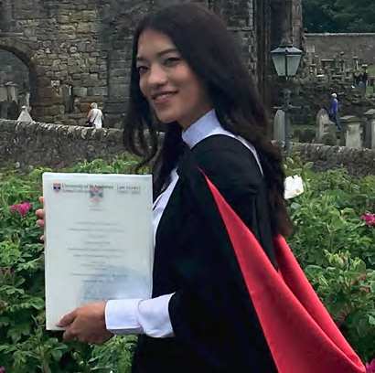
Disrupting Internationalisation Discourses – Discussing Equity and Inclusion
RISP students and alumni are an integral part of REF’s marketing strategy and core messages, important to countering stereotypes and challenging anti-Gypsism. Take the unusual story of Monika Chen from Hungary, BA Business Management St. Andrews, MA Luxury Brand Management in Luxury Brand Management
My mother deeply believed in perseverance and instilled the family with her values of kindness and courage. She taught me to study, be brave and follow my dreams without stepping over other people. … I wanted to be noticed for my accomplishments, not my identity. Even if it was difficult to relate to my Asian origins, my family deeply respected Roma traditions and that was embedded in me as family, community and togetherness. …
Knowledge is the only thing that no one can take from us. I want to be powerful enough to show an example to other Roma young people. As a child I spent a lot of time at the Hungarian Roma Parliament on Tavaszmezô Street in the eighth district. The founder was always close to our family and I assisted the Roma National Council as an assistant to the chairman during high school. This summer I plan to teach English at “Egymi,” a school helping underprivileged Roma children in the eighth district. I like being able to help those who helped me on my journey.

Slide 8
Disrupting Internationalisation Discourses – Discussing Equity and Inclusion
For more information
Web: http://www.romaeducationfund.org
Facebook: RomaEducationFund
Twitter: @romaeducation
Youtube: https://www.youtube.com/romaeducationfundref
Tom Bass
tbass@romaeducationfund.org
Thank you!

