Slide 1
The Global Crisis of Refugee Education: the neglect of young people and adults
CHEER
19 July 2017
Linda Morrice l.m.morrice@sussex.ac.uk

Slide 2
A world on the move …
At the end of 2015 the forcibly displaced population reached a record high of 65.3 million.
This includes 21.3 million refugees, of which approximately half are children (UNHCR 2016).
Almost 1.3 million refugees entered Europe in 2015 (OECD 2016)

Slide 3
Most in the Global South …
86% of refugees remain in developing regions, most hosted in countries neighbouring their conflict – affected countries (Turkey, Pakistan and Lebanon top 3 refugee hosting countries).
The other 14% are hosted in high income countries (US, Canada, Australia and European states).
(UNHCR 2016).

Slide 4
Education for refugees
Access to education is not only a ‘basic right’ but an enabling right, a right through which other rights are realised’ (UNHCR)
But … education of refugee adults and young people has suffered from neglect and false promises.
  Global perspective
  UK perspective

Slide 5
Global promises…
The Universal Declaration of Human Rights, Article 26.1:
Everyone has the right to education. Education shall be free, at least in the elementary and fundamental stage. Elementary education shall be compulsory. Technical and professional education shall be made generally available and high education shall be equally accessible to all on the basis of merit.
(UN General Assembly 1948)
The Convention on the Rights of the Child (CRC) affirmed: the right of all children, regardless of status, to free and compulsory primary education, to available and accessible secondary education, and to Higher Education on the basis of capacity.
(United Nations, 1989, Article 28)

Slide 6
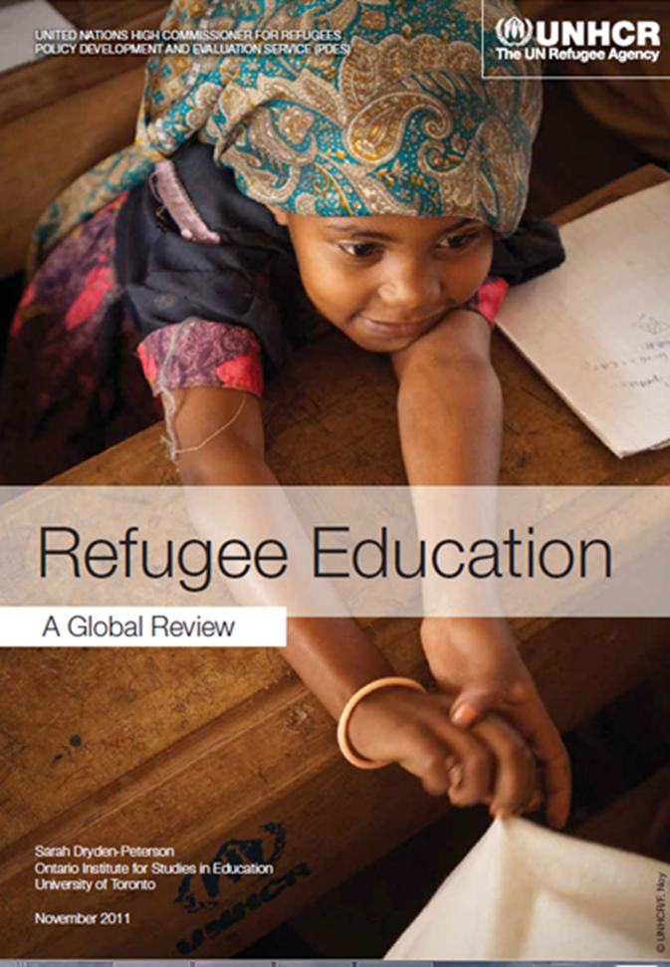
Refugee Education. A Global Review (2011)
No mention of adults, youth or Higher or Tertiary Education

Slide 7
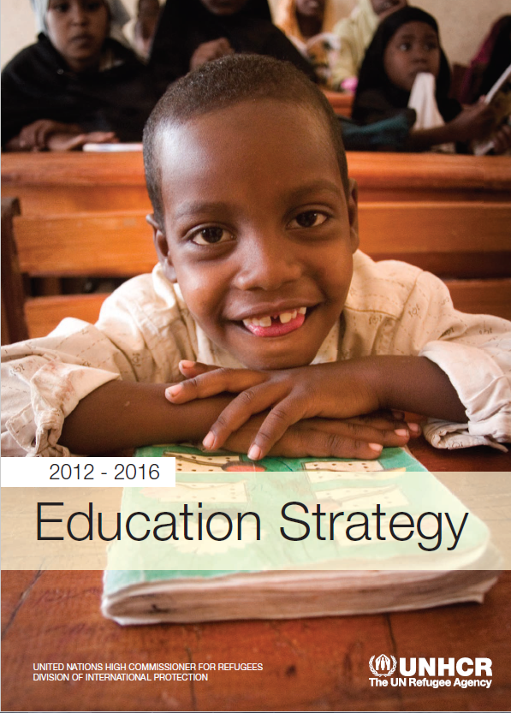
UNHCR Education Strategy 2012-2016
Recognises the ‘huge unmet demand for higher education among refugees … and that [h]igher education is also a critical part of the educational continuum’
(2012: 21 and 22).

Slide 8
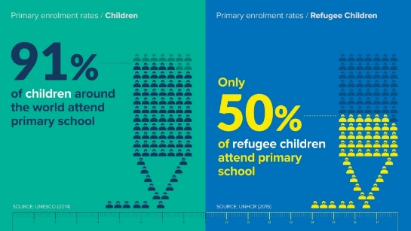
Global figures for participation of refugees in education – Primary level

Slide 9
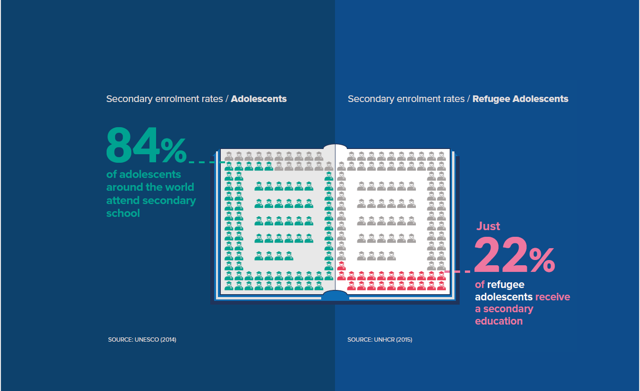
Secondary level – the leaky pipeline

Slide 10
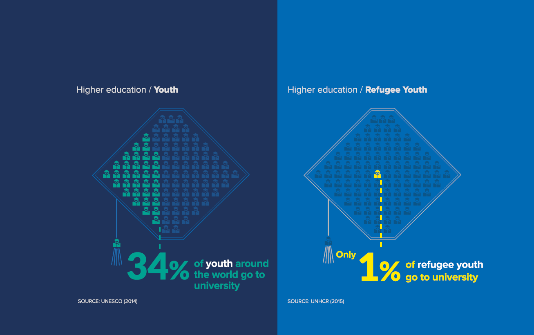
Failed promises …Higher Education

Slide 11
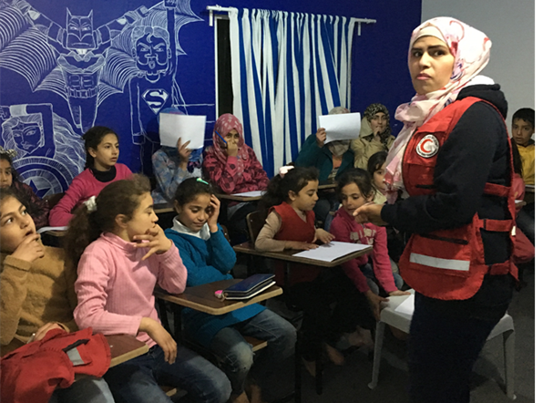
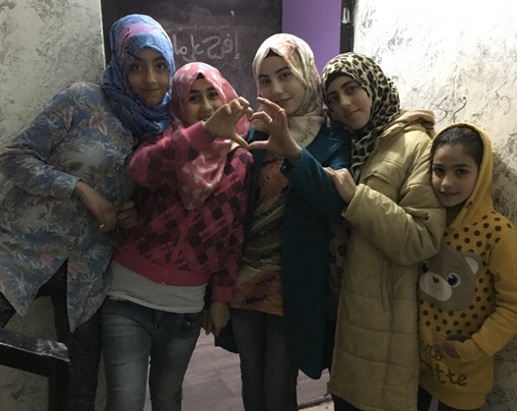
Why is HE critical for refugees?
Incentive to young people to complete primary and secondary education.
Provides pathway to imagined future

Slide 12
Why is HE critical for refugees?
Provides human capital required for re-construction in post-conflict affected areas
Empowers refugee communities
Promotes social, economic and gender equality
UNHCR (2015a)
Mitigate risks of being drawn into sectarian or violent ideologies
(Brookings Doha Centre 2015)

Slide 13
In the UK research has shown:
HE is a route out of poverty (Stevenson and Willott 2007)
Contributes to positive mental health outcomes and builds confidence (Gateley 2015; Murray et al. 2014)
Enables re-qualifying and re-building of professional lives (Morrice 2011)
Sense of belonging and positive identity (Doyle and O’Toole 2013; Morrice 2013)

Slide 14
Barriers to Access
Language skills, legal status*, financial barriers; non-recognition of overseas qualification (Morrice 2009; Stevenson and Willet 2007; Murray et al. (2014)
Lack of documentation (e.g. Dryden-Peterson and Giles 2010)
Lack of support and appropriate advice (e.g.Doyle and O’Toole 2013; Morrice 2009; Refugee Support Network 2012)
Interrupted education and students being ‘university ready’

Slide 15
Resettled refugees & lack of opportunity structures
Lack of expectation that HE might be an aspiration for resettled refugees
No support to achieve foundational qualifications necessary for either tertiary education or HE
‘16 hour rule’ and drive to employment Vs education
Lack of flexibility in college and HE entry requirements
  Low pay, low status, precarious employment

Slide 16
Policy discourses for managing diversity and internationalisation
Widening participation discourses:
- Removing structural barriers to address under-representation of certain groups
- Recognising and addressing issues of poverty, social exclusion and lack of opportunity
International discourses:
Competition for high fee paying non-EU students
Policies and initiatives to support engagement and integration of ‘international students’.

Slide 17
Symbolic access only
Refugees are not generally recognised in either WP or international discourses.
2007 just 6 institutions of 124 explicitly referenced refugees or asylum seekers in their OFFA agreement (Stevenson and Willott 2007)
2016 / 2017 just 10 institutions out of 170+ agreements referenced this group (Office For Fair Access, 2016)
But … 36 universities are currently offering bursaries or scholarship to refugees and asylum seekers (Article 26, HKF 2016)

Slide 18
Distinctive experiences of refugees
Possibilities of post-traumatic stress
Extended displacement in refugee camps
Interrupted and limited education
Years of uncertainty about future, sudden and unplanned movement with little time to make preparations,
Enforced separation from family
Protracted experiences of discrimination and violence based on faith, tribal differences or nationality.
Morrice 2011, 2013; Pastoor 2015, Taylor and Sidhu 2012)

Slide 19
Experiences in HE - Hidden distinctions and exclusion
Managing complex transnational relationships – financial expectations, anxiety about family left behind (Earnest et al. 2010; Morrice 2011)
Poverty, racism and the stress of resettlement (Sidhu and Taylor 2007)
Socio-cultural differences – e.g. gendered expectations (Joyce, Earnest, de Mori and Silvagni 2010), student social life (Morrice 2011)
Unfamiliar teaching styles – more critical and reflexive (Earnest et al. 2010; Morrice 2013)
Fewer personal support networks (Earnest et al 2010)

Slide 20
Meeting the Challenges
Challenge the binaries of ‘traditional’ and ‘non-traditional’; ‘home’ and ‘overseas’ students; ‘inclusion’ and ‘exclusion’.
No longer have analytical purchase in increasingly diverse and globalised system. Multiple, sometimes conflicted subject positions problematises simplistic binaries

Slide 21
Institutional questions
How do universities support students with academic norms and expectations?
How flexibility are admissions criteria – alternative ways of assessing suitability, recognition that certificates might not be available
How international and global is our curriculum?
How do we enable students to be expert so that they can drawn on past experiences knowledges?
What culturally relevant activities, sports, interactive theatre and other creative opportunities are supported (or is our information focused on alcohol and having fun…)
What activities promote positive contacts between and across cultural groups and students?
What psycho-social support do we provide?

