Slide 1
The First Sparks of Romani LGBTQ
Dezso Mate
Researcher on Roma, and
Gypsy/Roma/Travellers LGBTQ issues
University of Sussex (CH E E R)

Slide 2
Prague Declaration- 2015
„ 1. recognise that LGBTIQ Roma, Gypsy, Sinti and Travellers across Europe face multiple marginalisation and discrimination at the intersection of ethnicity, gender, sexual orientation and/or gender identity, an issue that has not been recognised and/or addressed yet by the international human/Roma/LGBTIQ rights community; „

Slide 3
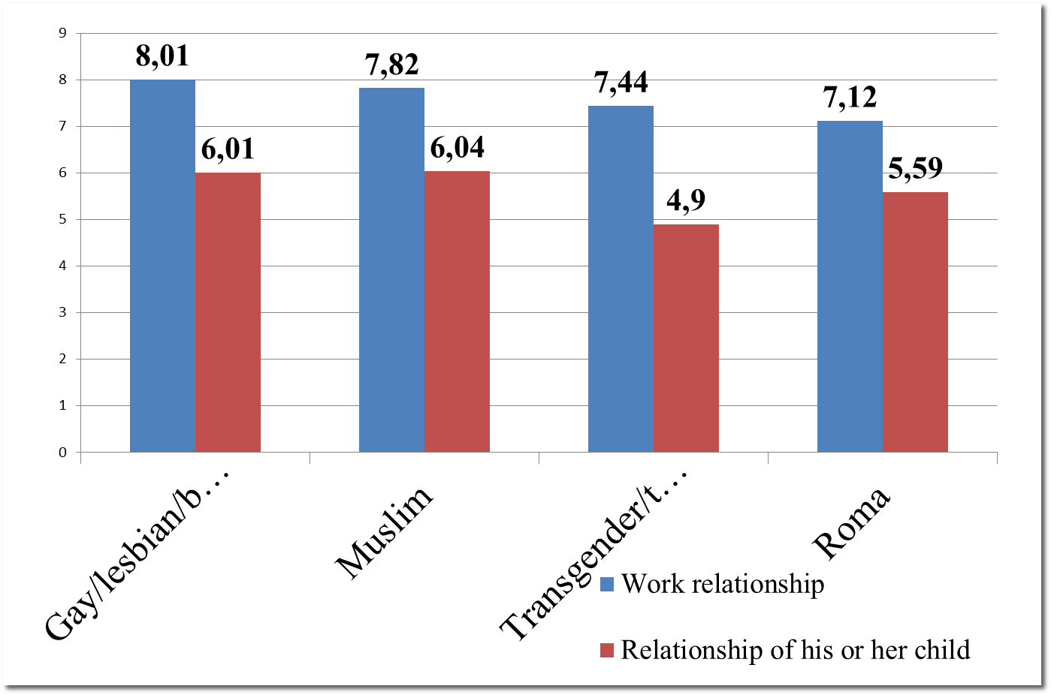
N= 16911 (Anikó Kenéz - data analysis)

Slide 4
Percentages
1 | 64.2% would not agree in Hungary the relationship with Transgender person 51% would not agree in Europe the relationship with Transgender person
2 | 58 % would not agree in Hungary the relationship with Roma person 44.1% would not agree in Europe the relationship with Roma person
3 | 58% would not agree in Hungary the relationship with LGBQI person 39.9% would not agree in Europe the relationship with LGBQI person
4 | 49.5% would not agree in Hungary the relationship with Muslim person 39.6% would not agree in Europe the relationship Muslim person

Slide 5
The trick is in the survey
91.6 % does not know a transgender person
83 % does not know a Roma person
48.7 % of Europeans – heterosexual based on their own statement – knows a gay/lesbian/bisexual person,
71 % knows people with a different religion than their own

Slide 6
Thank you very much!
If you have any questions please find my contacts
Dezso Mate
mate.dezso1984@gmail.com
mate.dezso@tk.mta.hu

