Slide 1
Choice of Field of Studies in Higher Education and Employment Prospects: The Case of Ethnic Roma Students in Eastern and South-Eastern Europe
Stela Garaz
Roma Education Fund
sgaraz@romaeducationfund.org

Slide 2
Implications for affirmative action programs
Bringing the distribution of Roma students per specialization closer to that among the mainstream student population
Diversifying the palette of specializations studied by Roma students in higher education
Clarifying the causes for underrepresentation / overrepresentation in certain fields of studies and implementing intervention tools that would address them (ex.: preparatory courses)

Slide 3
Roma’s Access to Higher Education in Eastern and South-Eastern Europe and their Choice of Fields of Studies

Slide 4
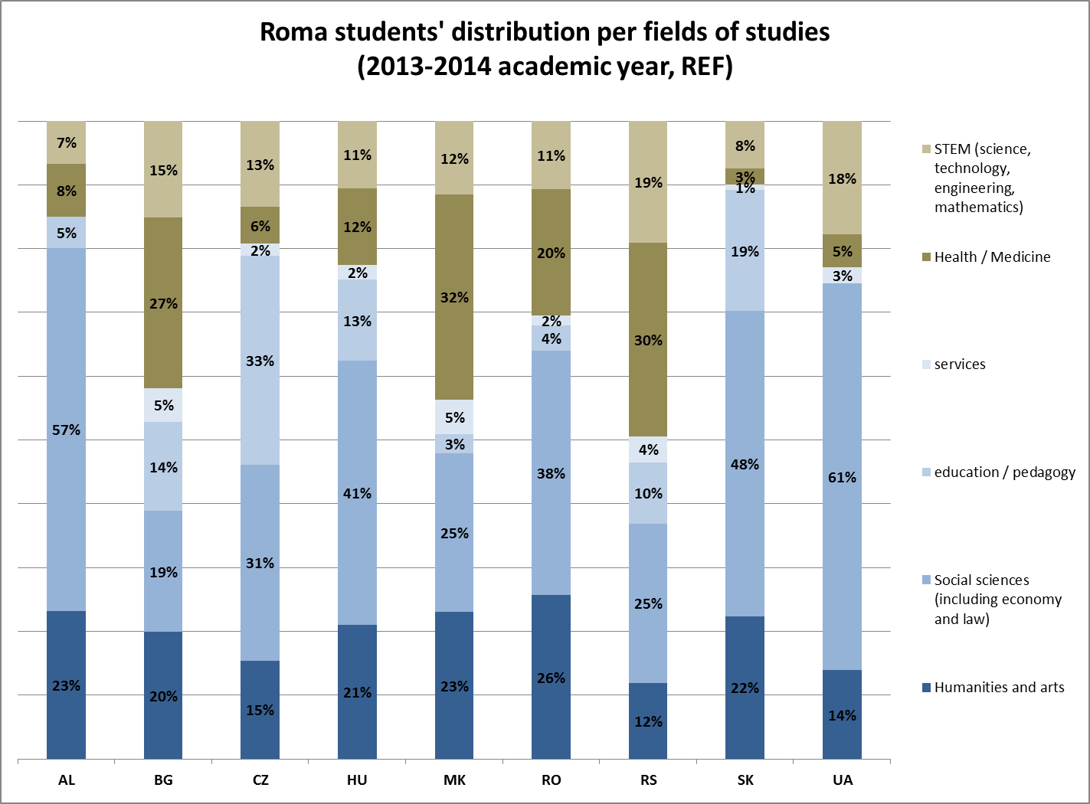

Slide 5
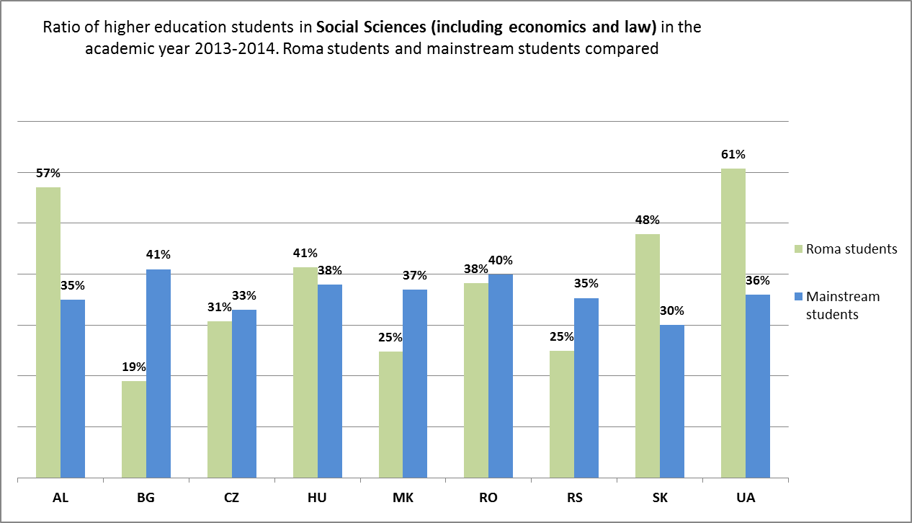

Slide 6
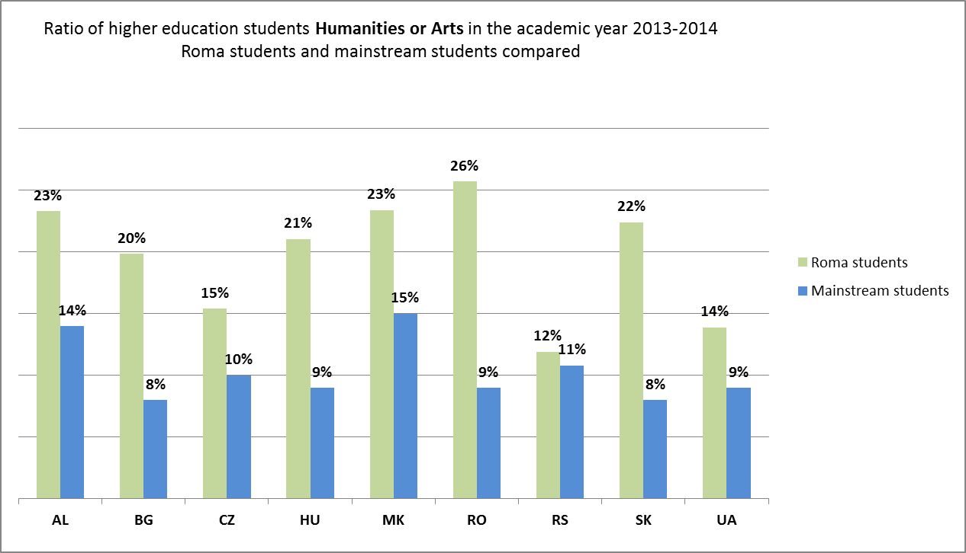

Slide 7
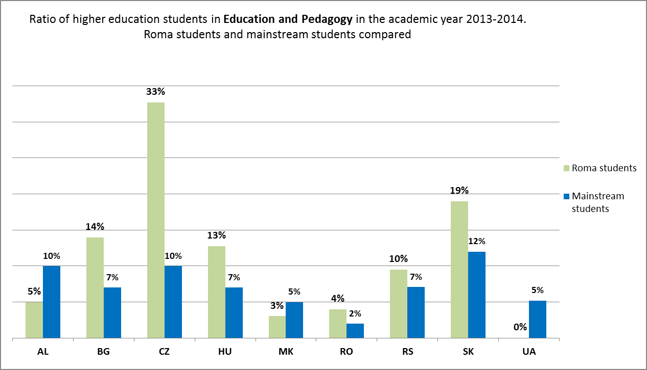

Slide 8
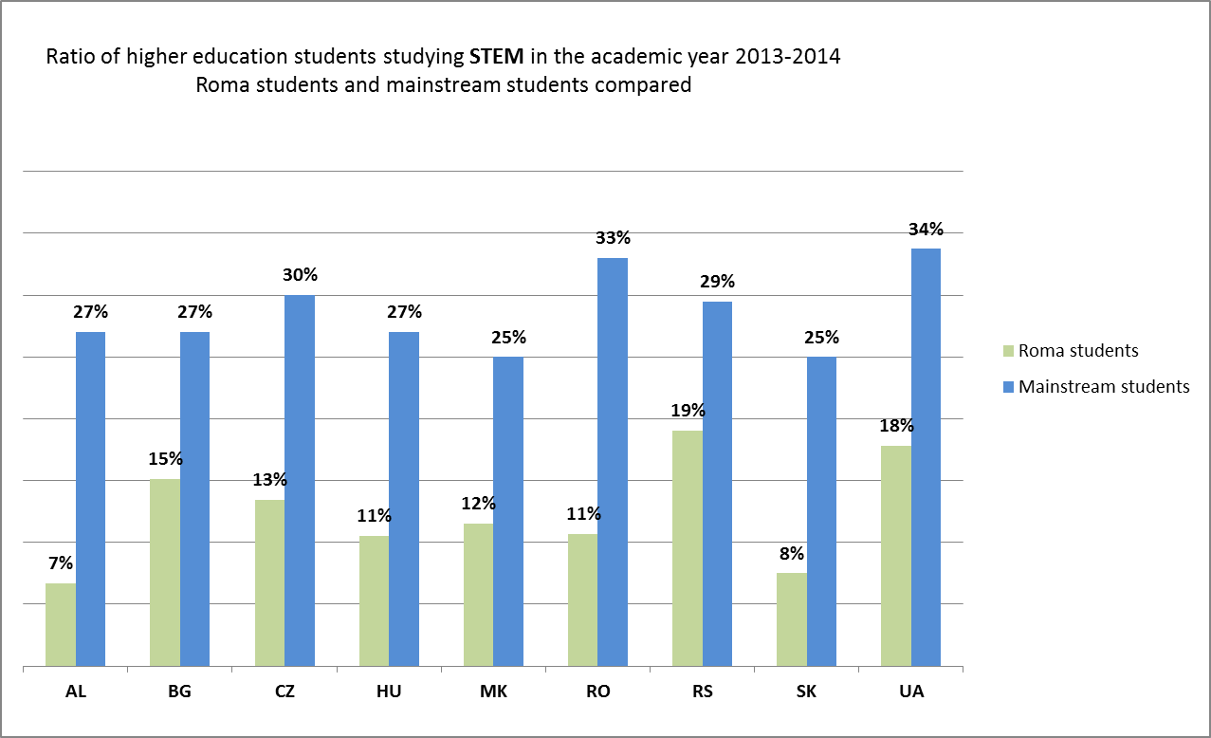

Slide 9
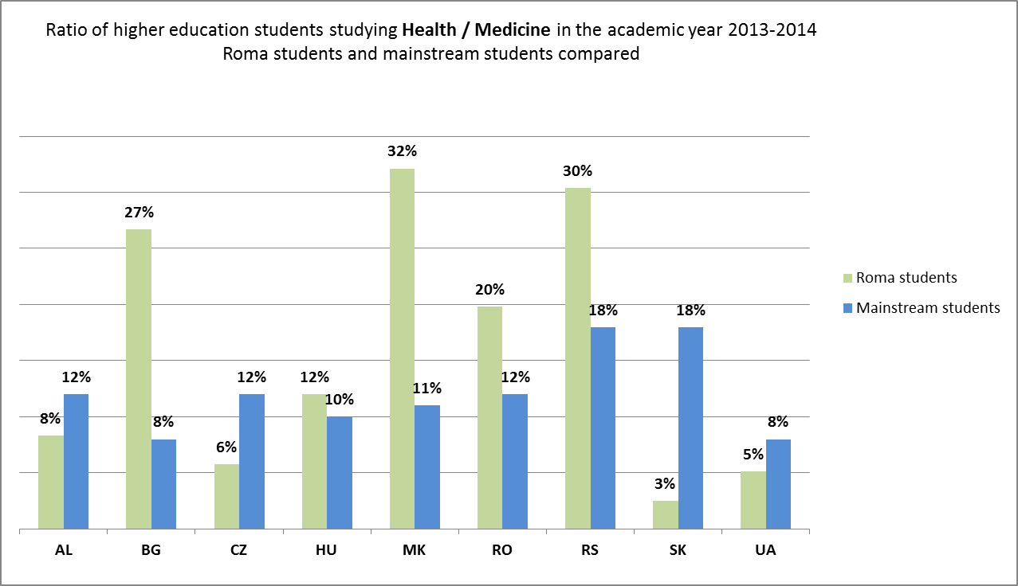

Slide 10
Students’ Socio-Economic Background and their Access to Higher Education

Slide 11
Table 1. Specializations chosen significantly more often by students WITHOUT higher education background than by students WITH higher education background
BA | CZ | HR | HU | MN | RO | RS | RU | SK | UA
Agriculture | None | None | None | None | Humanities | Services | Education | Health and welfare | None

Slide 12
Roma students (REF data):
STEM: Roma students with low parental level of education are underrepresented in case of BG, CZ, HU, MK, SK, UA, and overrepresented in RS.
Medical studies: Roma students with low parental level of education are underrepresented in case of HU, RS, and UA.
Humanities and arts: Roma students with low parental level of education are overrepresented in case of HU and MK.
Education and pedagogy: Roma students with low parental level of education are overrepresented in case of BG and MK

Slide 13
Bachelor students' assessment of their chances on the national labor market (Eurostudent V)

Slide 14
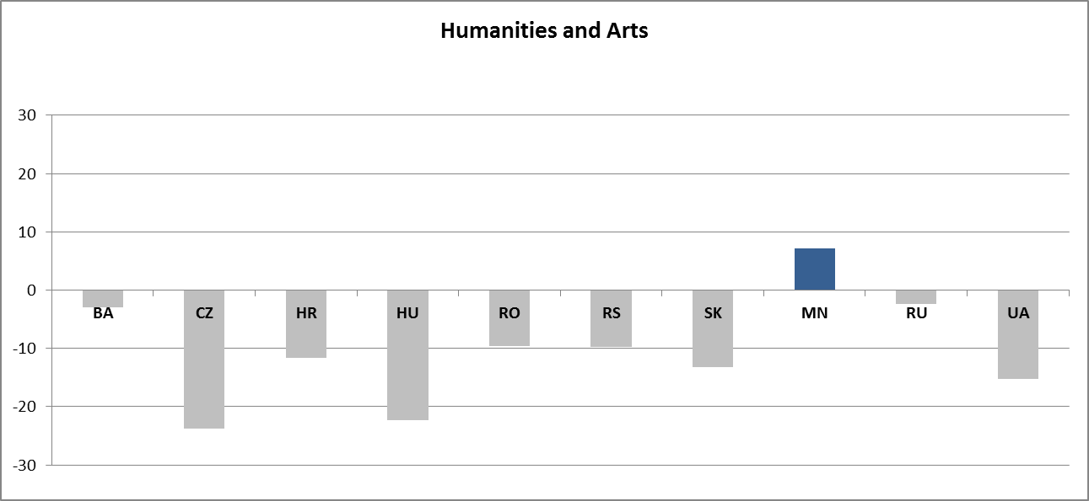

Slide 15
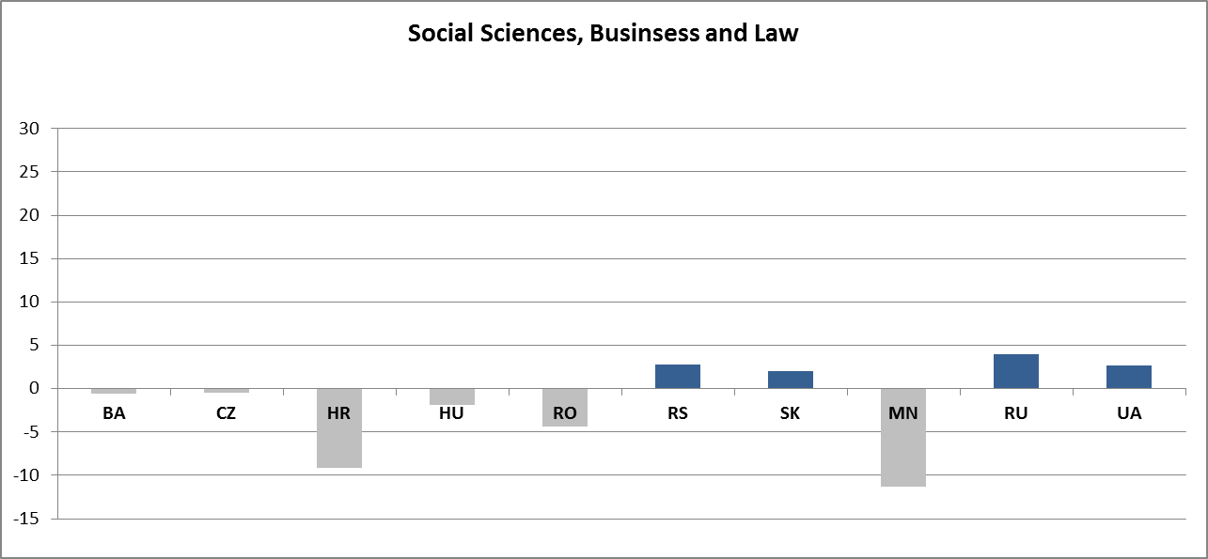

Slide 16
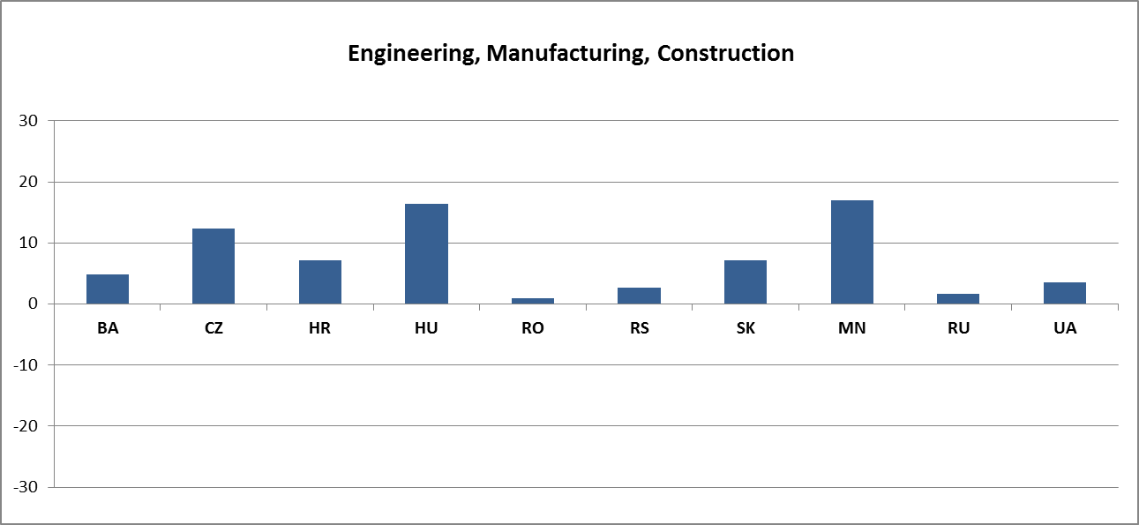

Slide 17
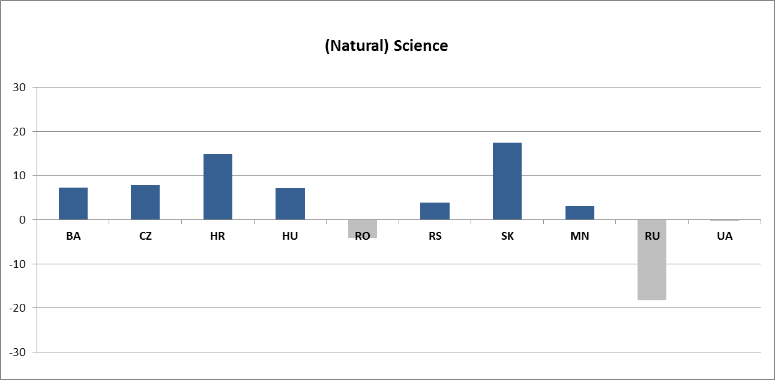

Slide 18
Higher education graduates’ employability by fields of studies

Slide 19
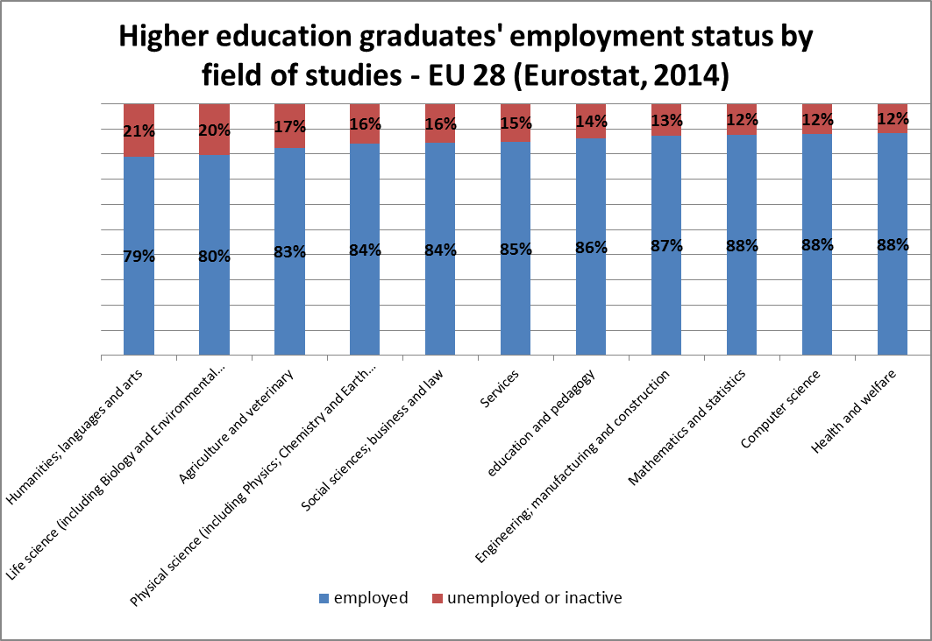

Slide 20
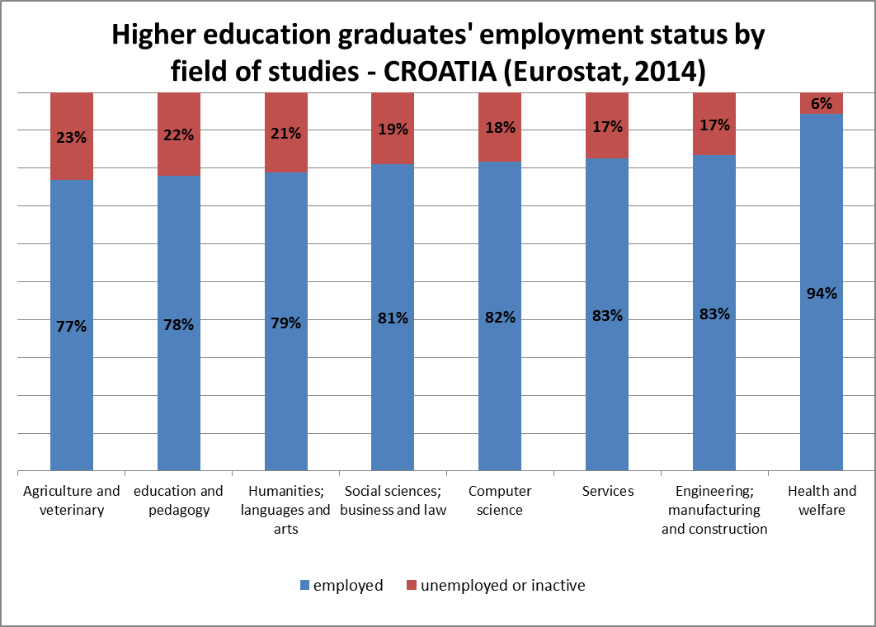

Slide 21
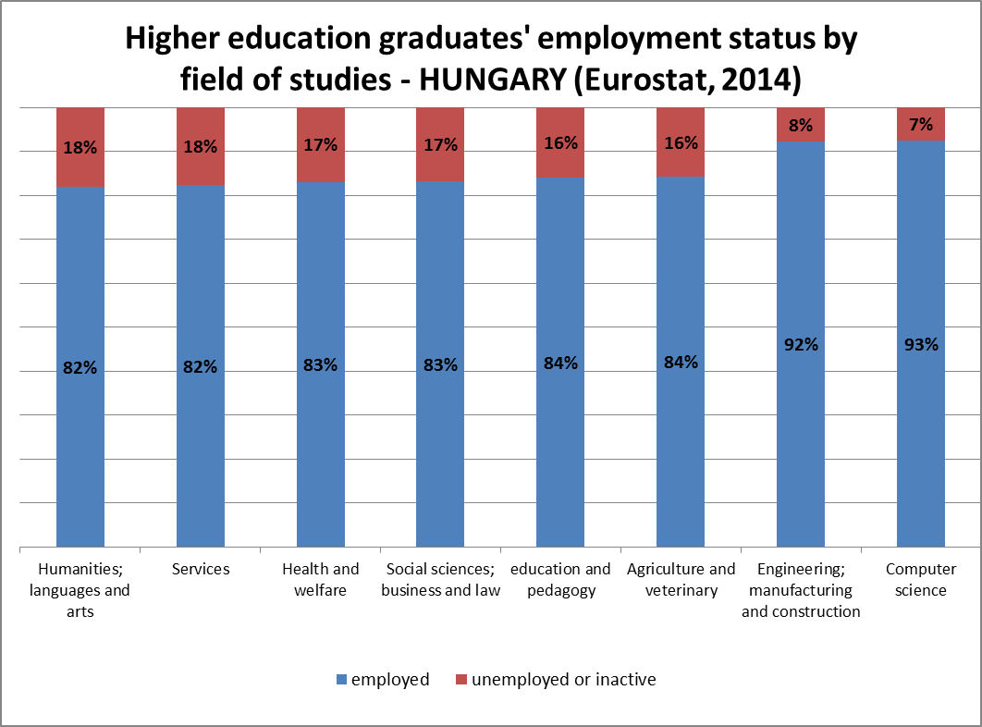

Slide 22
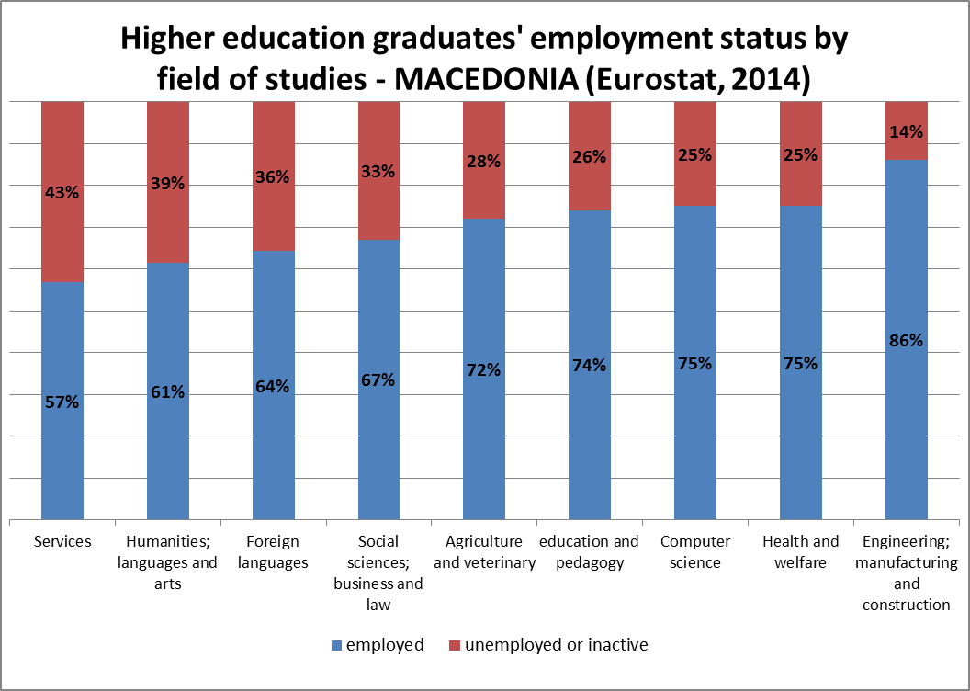

Slide 23
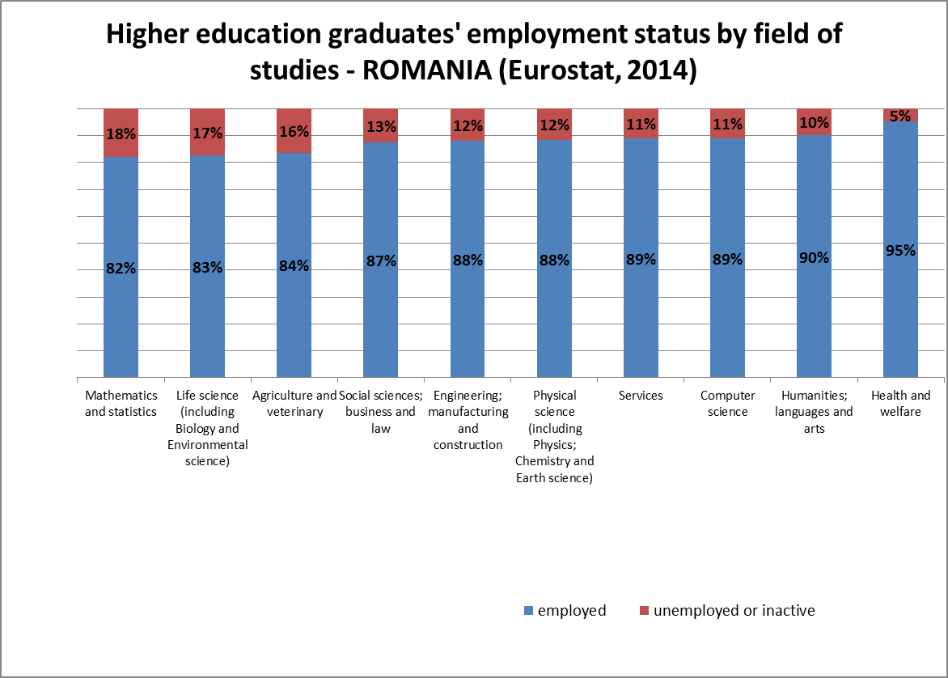

Slide 24
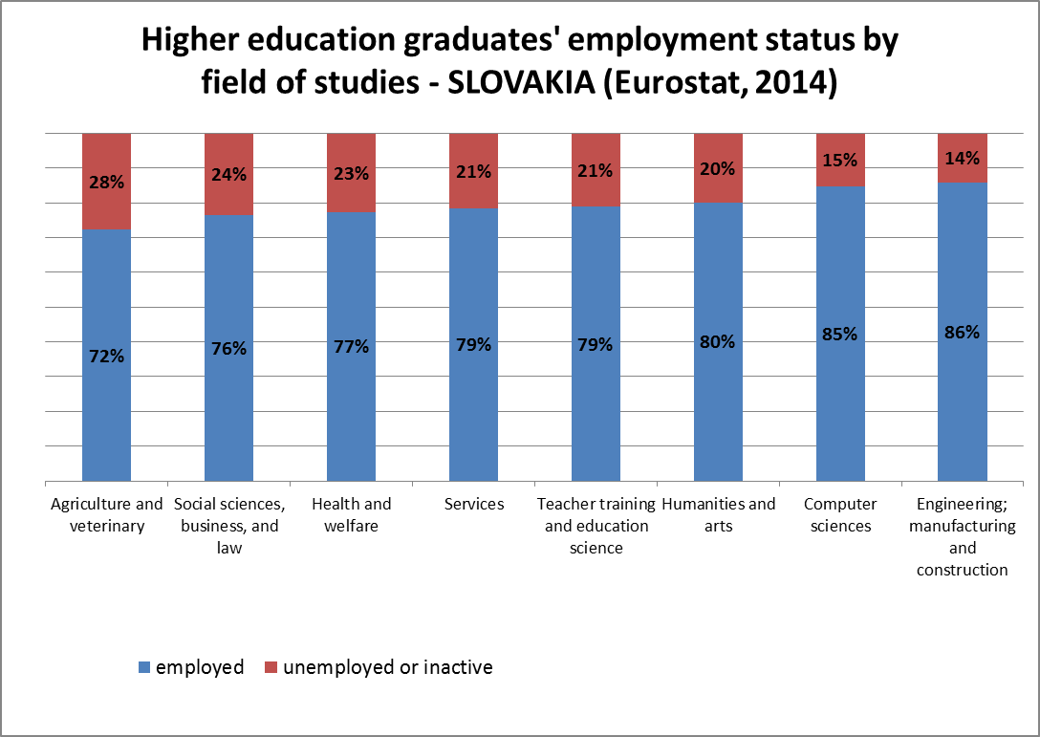

Slide 25
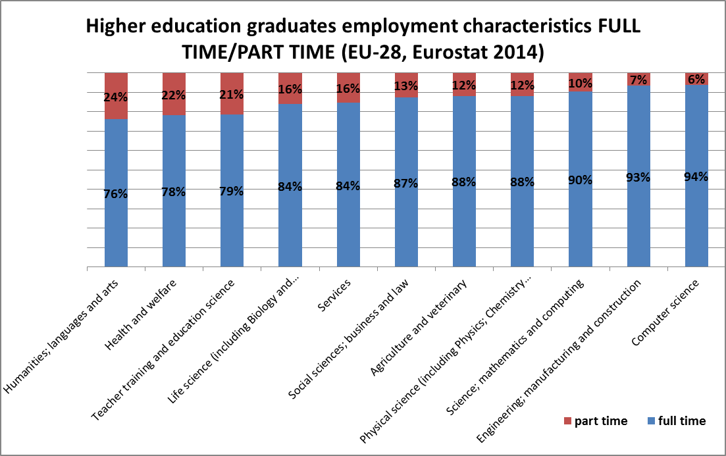

Slide 26
