Slide 1
The Affective Economy of Internationalisation: Migrant Academics in and out of Japanese Higher Education
CENTRE FOR HIGHER EDUCATION AND EQUITY RESEARCH
Professor Louise Morley, Dr Daniel Leyton,
Professor Yumiko Hada and Yasser Kosbar

Slide 2
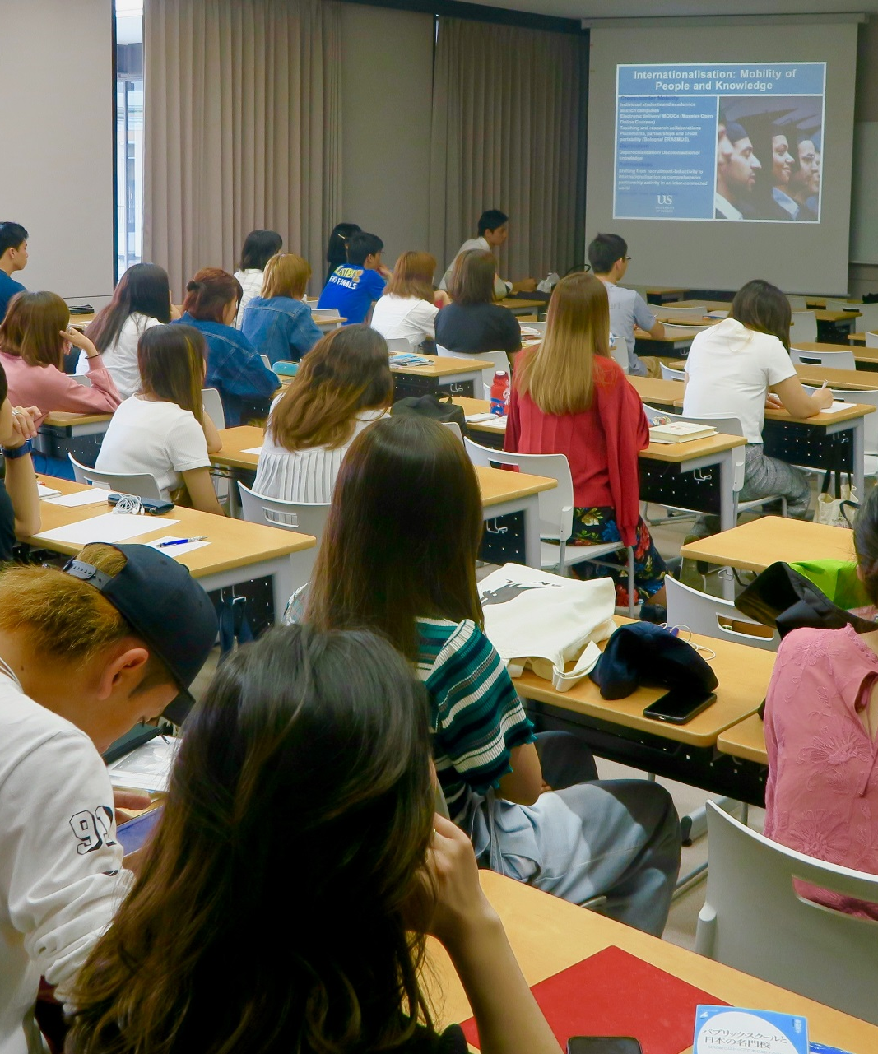
Internationalisation and Migrant Academics: Provocations?
Internationalisation:
Glamorised/ Imagined virtuous flows of knowledge production/ exchange.
Assemblage of:
Detraditionalization
Expansiveness
Opportunity
Linguistic imperialism
Knowledge capitalism
Market dominance
Commodification/ Disposability
Container for multiple aspirations, anxieties, and affordances.
Policy paradigm with performative effects.

Slide 3
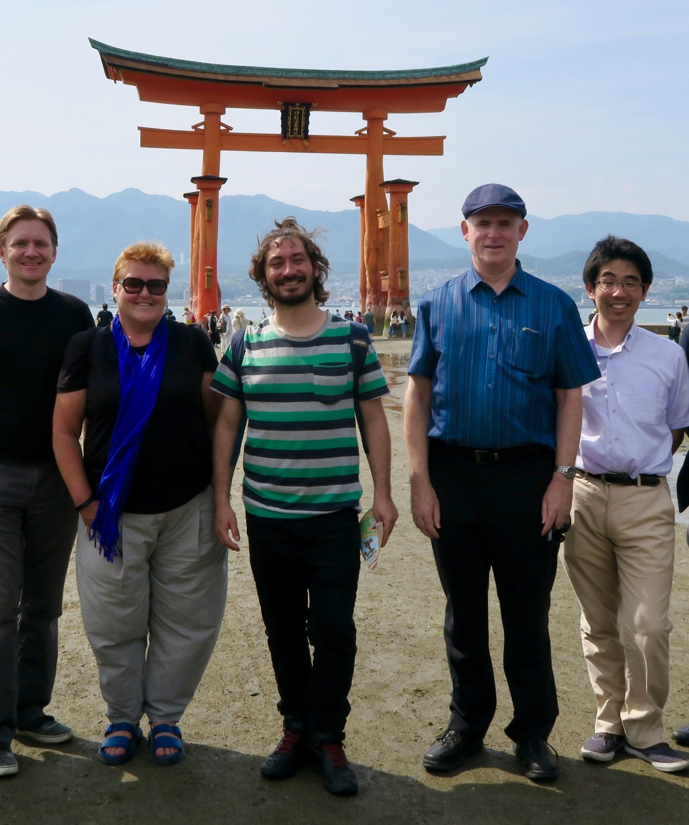
Shadows and Silences in the Internationalisation Policyscape
Motivations, narratives and emerging subjectivities of internationalised academics.
Gendered, racialised, epistemic and affective inequalities constituting academic mobility.
Who is the Ideal International Subject?

Slide 4

Commodification and Clusters of Promises?
Human capital to attract more international students/ marketing enhancers/ disposable labour.
Policy discourses represented as a pleasurable formation.
Multiculturalism/ Prejudice Reduction/ Soft Power
Competitiveness
Prestige
Cosmopolitanism
Global orientation
Added employability value
Affect embedded in policy formation e.g. fear, anxiety, shame.

Slide 5
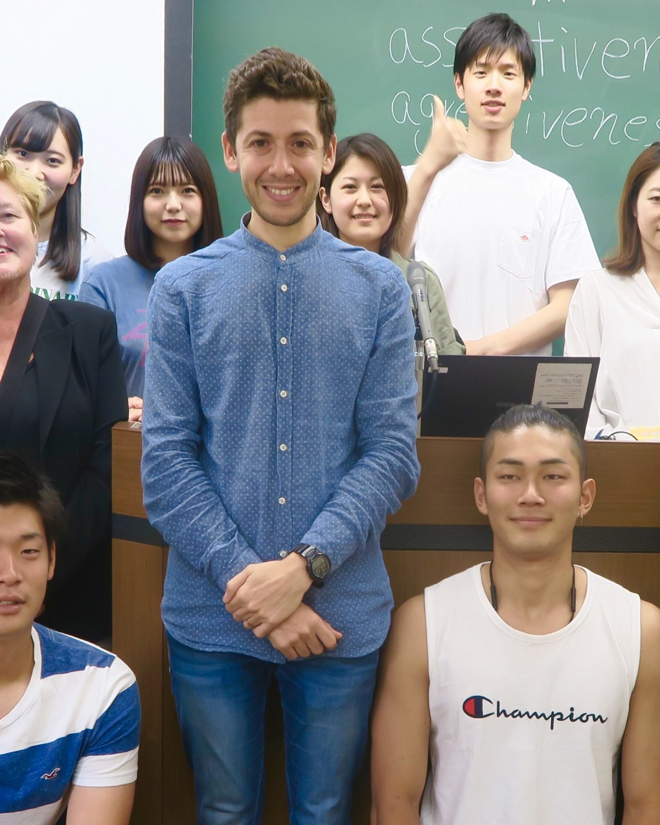
Higher Education, Knowledge Exchange and Policy Learning in the Asian Century: A UK/Japanese Partnership
Interview data gathered in 15 private, 5 national and 8 public universities in Japan with 34 migrant academics (10 women and 24 men).
25 were incoming from Australia, China, France, Germany, India, Nigeria, the Philippines, South Korea, the UK, and the USA, and 9 were Japanese who had worked in Canada, Germany, the UK, The USA.
Questions: what was driving the internationalisation policy agenda in Japan, how it was being implemented; their personal, professional and academic experiences as migrant academics.
Don’t Believe:
An authentic subject is buried beneath the overload of quantification that will surface given the ‘right’ questions, probes and cues.
There is a ‘truth’ about academic mobility.
Do Believe
We offer readings based on call for a new ‘climatology’ of the social’ (Galloway and Thacker, 2007).
See http://www.sussex.ac.uk/education/cheer/researchprojects/japan

Slide 6
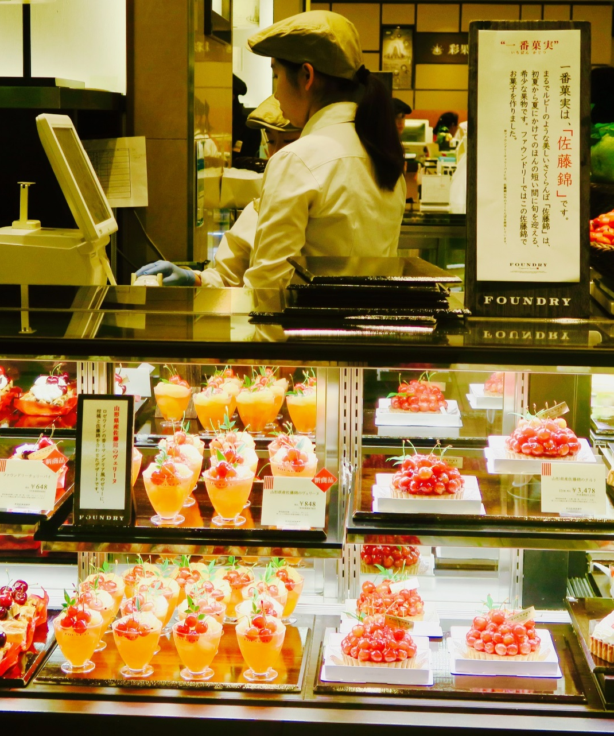
Motivations for Migration
Narratives from the Global North privileged sense of strategy, rational calculation, purposefulness and choice.
Japan = safe orientalised other.
Disciplinary differences e.g. STEM
Employability/ Professional Development.
Narratives from the Global South = faute de mieux logic e.g. EFL, lower value of non-Anglophone qualifications (Gerhards et al. 2018).
Actually, I applied in the United States. But I got a PhD degree in my country so it's really hard to move. (A Korean female lecturer)

Slide 7
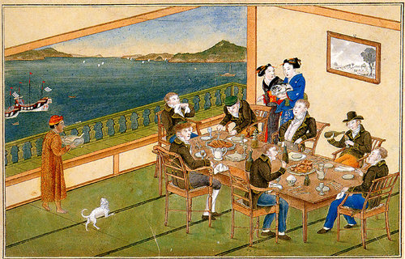
Quarantining and Isolation
They tend to Dejima the foreigners and put them on a little island and I find it very counter-productive because if they want to internationalise they should be embedding us within the rest of the faculty instead of collecting us all in one place …I have heard of situations where larger universities …create a new faculty and they'll put most of their foreigners there and then, especially at private universities where they're more nimble, things don't work out so well, university runs into financial troubles, well, we can cut a whole faculty now. We don't fire person by person and we can't be charged with discrimination, but we can cut a whole faculty and then it's just no, no we're not firing each individual foreigner, we're firing a whole faculty because it's the one that's not helping us out. (Male US lecturer)
N.B. Dejima was a small artificial island built in the bay of Nagasaki in 1634 by local merchants, notable for being the single place of direct trade and exchange between Japan and the outside world.

Slide 8
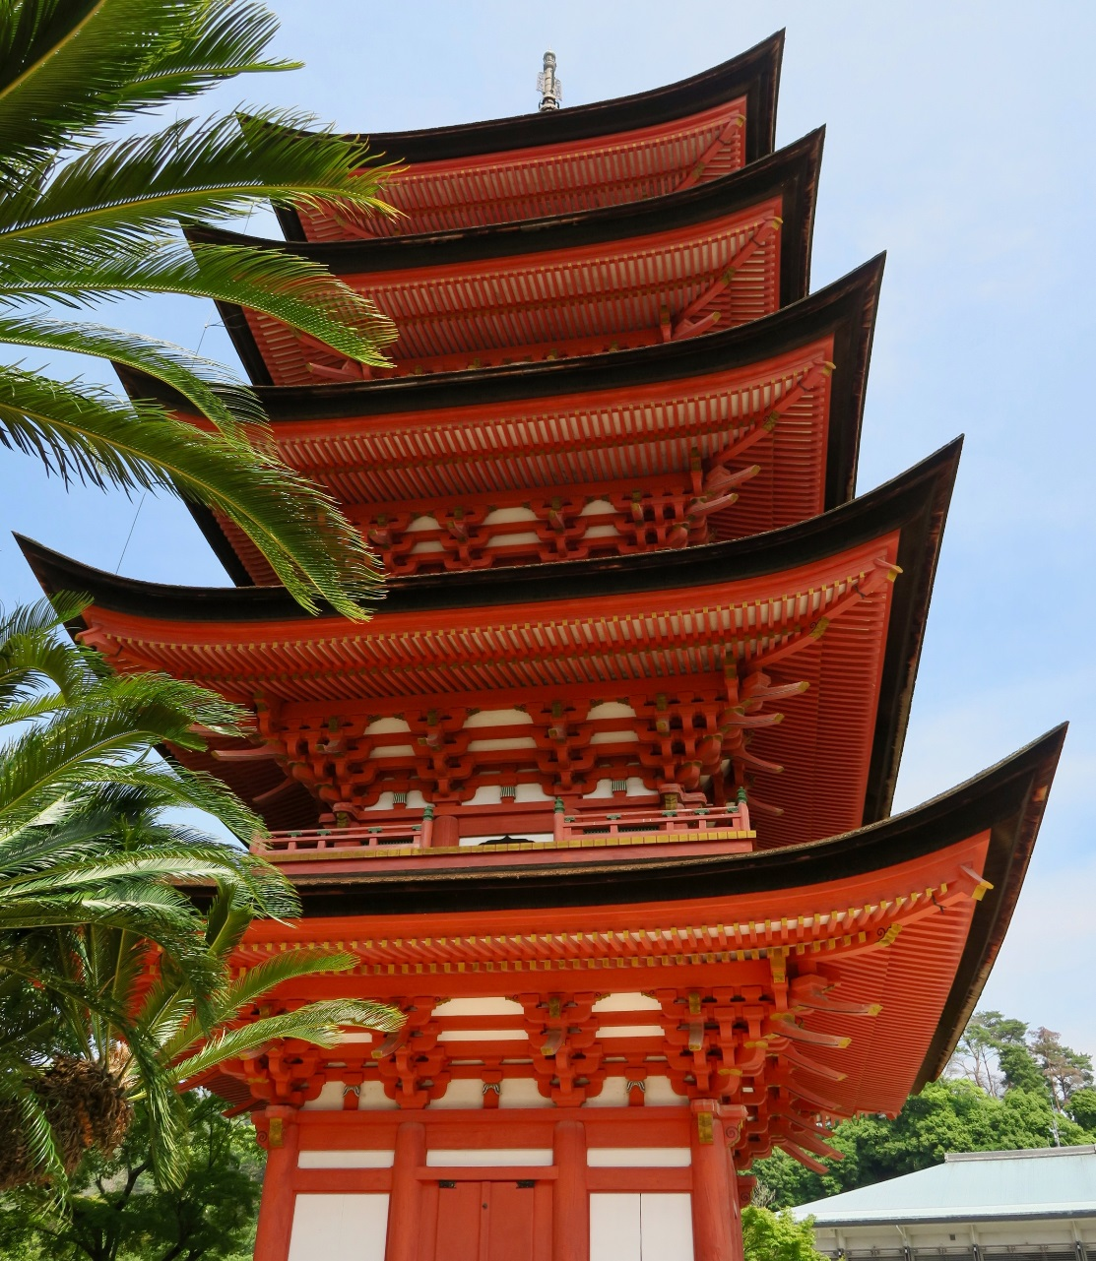
Learning the Lingo: Lines of Opposition, Resistance and Engagement
Japan constructed as:
Suffering from internationalisation deficit.
Mono-lingual/ Wilfully attached to difference.
Peripheralised from a real or imagined global community.
Internationalisation = the English language e.g. EMI, EFL, support for publications.
Resistant: Perfectionism/ Elitism/ Dispositions.
Migrant Academics
Lacking language = non-attunement to the environment/exclusion from decision-making.
Valued for their English language, rather than disciplinary expertise.
Difference deemed disruptive in Japanese systems.
Reported marginalisation from research opportunities, epistemic inclusion, daily operations.
Investment- Language premium for those learning Japanese. Uneven support. Whose responsibility?

Slide 9
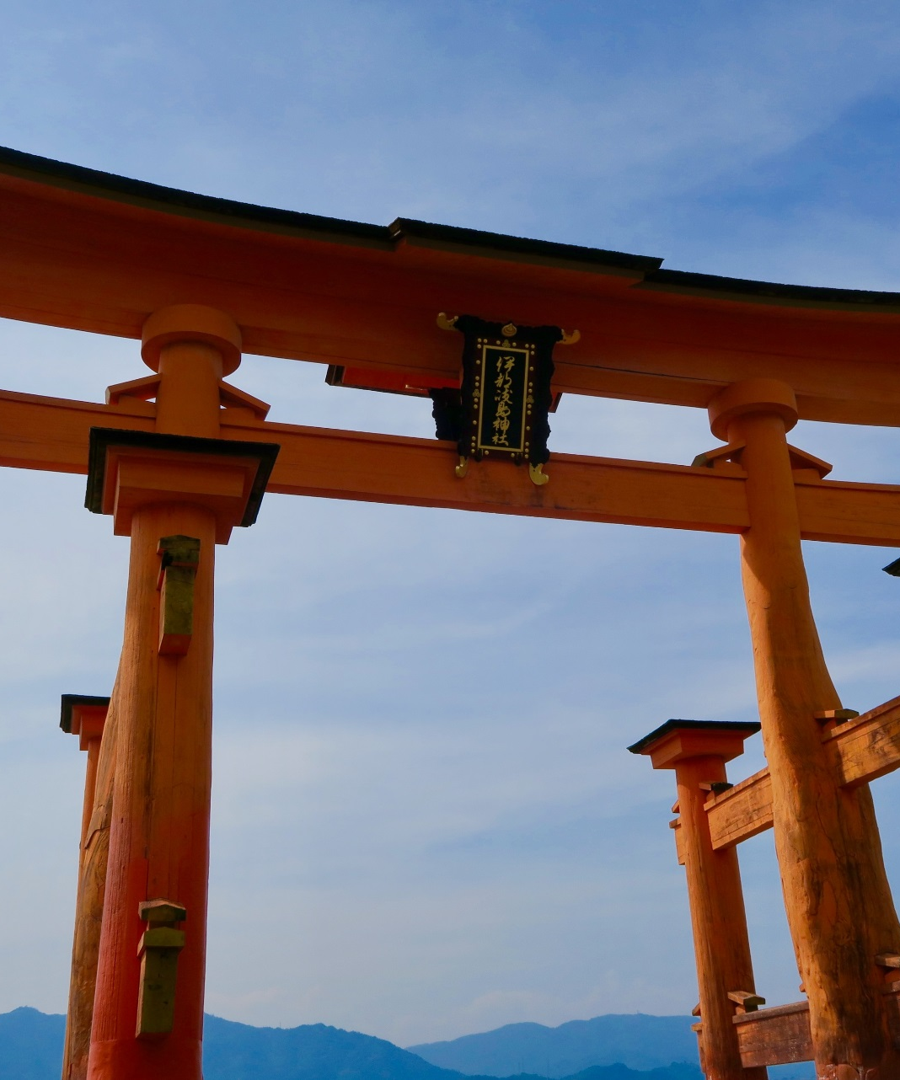
Migrants academics = temporary visitors- teachers, not researchers./ epistemic exclusion/ short-term contracts.
Affective load of liminality, loss, hybridity and being between two identity worlds.
The word ‘precarious’ derives from ‘pray’ = to be held through the favour of another, or dependent on the will of another (Ahmed, 2016).
Right now, our university's dealing with some budget cuts …I'm dealing with maybe less favourable contract renewal conditions… There seem to be …many things out of my control … So, I don’t quite know how to handle this…I don’t know if it's a Japanese thing or it's my situation... Like for example, you don’t know when you're renewed or not. (Korean/US female English teacher)
Hidden Injuries: Precarity, Peripheralisation, Friction and Fragilities

Slide 10

Exilic Thinking: Hybridised Subjectivities and Liminal Spacialities
Japan’s Peripheralization/ Power
Transmission Pedagogy/ Student Passivity
Attractions: civility, security (for some), culture, aesthetics, resources
Academic/ Age-related Hierarchies
Archaic Gender Regimes
Fear of Difference
We had a student a few years ago now, black student from France, and he said to me on the last day that he was in Japan, he said, yes, I've been continually stopped by the police for like the last two months.
(US male Associate Professor)

Slide 11
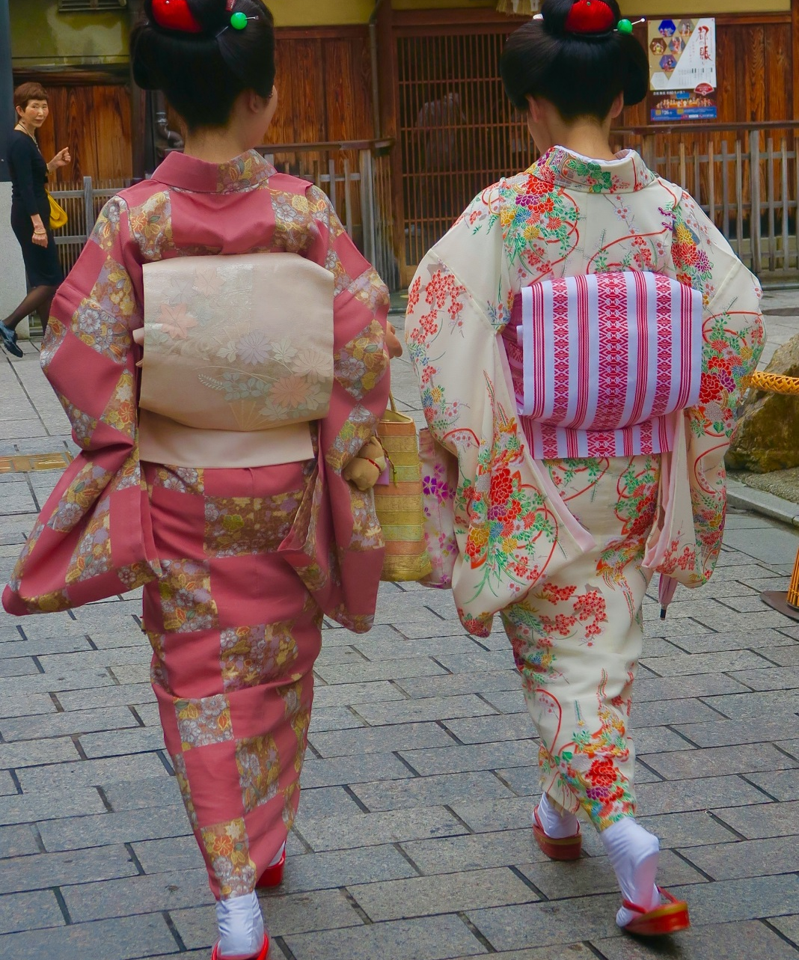
Doing Gender Internationally: the Embeddedness of the Patriarchal Premium
Internationalisation materialises and challenges traditional gender practices and performances.
Four times as many male as female internationalised faculty in Japan (Huang 2017).
Female migrant academics = transgressive subjectivities.
De-centring of the body in hegemonic policyscapes of academic mobility.
Participants cited:
Restrictive professional gender regimes as a motivator for Japanese women to migrate.
New modes of self-governance and self-minimisation for Japan.
Gendered premium for white, heterosexual, Anglophone men.
(Oishi 2012, 2013)

Slide 12
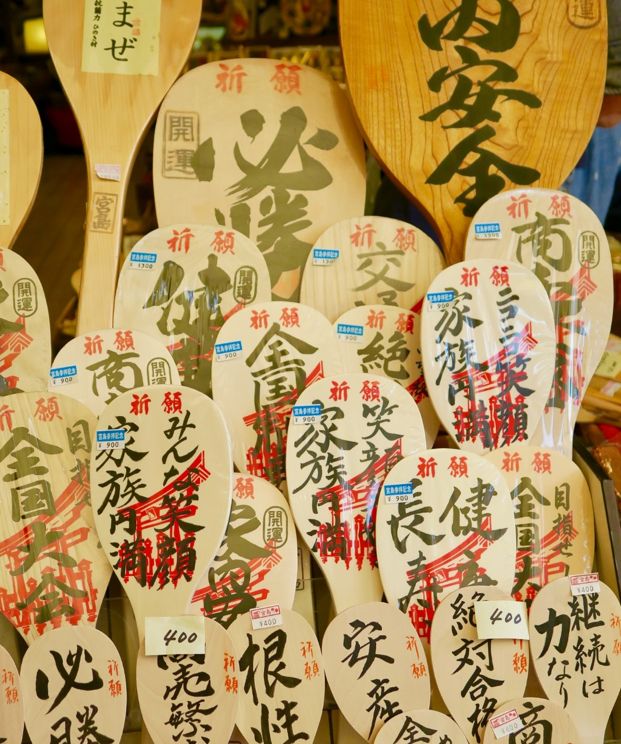
Desired/ Desiring, Different, but Ultimately, Disposable?
When academic mobility is articulated with the affective economy its happiness formula and linearity are disrupted.
Embodied experiences expose gendered, racialised, epistemic and affective inequalities.
Are migrant academics symbolic of the contemporary socio-spatial transformations and intellectual trends of neoliberalised and colonised higher education systems?

Slide 13

CHEER Website: www.sussex.ac.uk/education/cheer
Twitter:
@SussexCHEER
Facebook: www.facebook.com/groups/CHEERSussex/
Follow Up?
Higher Education, Knowledge Exchange and Policy Learning in the Asian Century
A UK/Japanese Partnership
(http://www.sussex.ac.uk/education/cheer/researchprojects/japan)
Morley, L., Leyton, D., Hada, Y. (2019) The Affective Economy of Internationalisation: Migrant Academics in and out of Japanese Higher Education. In press, Policy Reviews in Higher Education.
Centre for Higher Education and
Equity Research (CHEER)

