Slide 1
Teacher Education in a Context of Military Occupation and Siege:
The Power of Purpose
Dr Mariam Attia

Slide 2
TNE and Globalisation
Transnational Higher Education (TNE) as an aspect of globalisation
Curricula exported from one higher education system to another (Montgomery, 2014)
Questioning the suitability of courses developed in one context to very different ones -> Recent TNE scholarship focusing on cultural imperialism and the complex relationship between the local and global (Djerasimovic, 2014, Pyvis, 2011)

Slide 3
Reflecting on TNE Experiences
Rumi (1207 - 1273): “And you? When will you begin that long journey into yourself?”
Dewey (1916): The nature of experience as involving the dual active ‘trying’ and the passive ‘undergoing’.
  The nature of experience can be understood only by noting that it includes an active and a passive element peculiarly combined. On the active hand, experience is trying – a meaning which is made explicit in the connected term, experiment. On the passive, it is undergoing. When we experience something we act upon it, we do something with it; then we suffer or undergo the consequences. (Dewey, 1916, p. 163, italics in original)
Notes:
Rumi (1207 - 1273): “And you? When will you begin that long journey into yourself?” - an invitation to each one of us to reflect on our lives, and derive understandings therefrom.
Following Dewey, an activity in itself does not amount to experience. Rather, it is the extension of the understanding of the activity to also include the impact of such activity on oneself that develops an experience; when our understanding of change comprises both the change caused by our action and that caused upon us as a consequence.

Slide 4
Reflecting on TNE Experiences
To “learn from experience” is therefore, about making these connections of acting and being acted upon (ibid, p. 164).
I question the concept of ‘capacity building’ prevailing in international academic work and ask whose capacity?
Notes:
In the light of Rumi’s invitation and Dewey’s understandings of ‘trying’ and ‘undergoing’ I look back on her experience of working with the teachers under military occupation and siege.

Slide 5
AHRC Large Grant Project
Researching Multilingually at the Borders of Language, the Body, Law, and the State (2014 – 2017)
What happens to research methodologies and teaching pedagogies when these have to operate in politically and emotionally charged contexts?
Notes:
An international team of researchers with different disciplinary backgrounds, research experiences and language skills will conduct international comparative research on translation and interpretation at different kinds of border in order to develop theory, ethical research practices and research methodologies in relation to multilingual research.

Slide 6
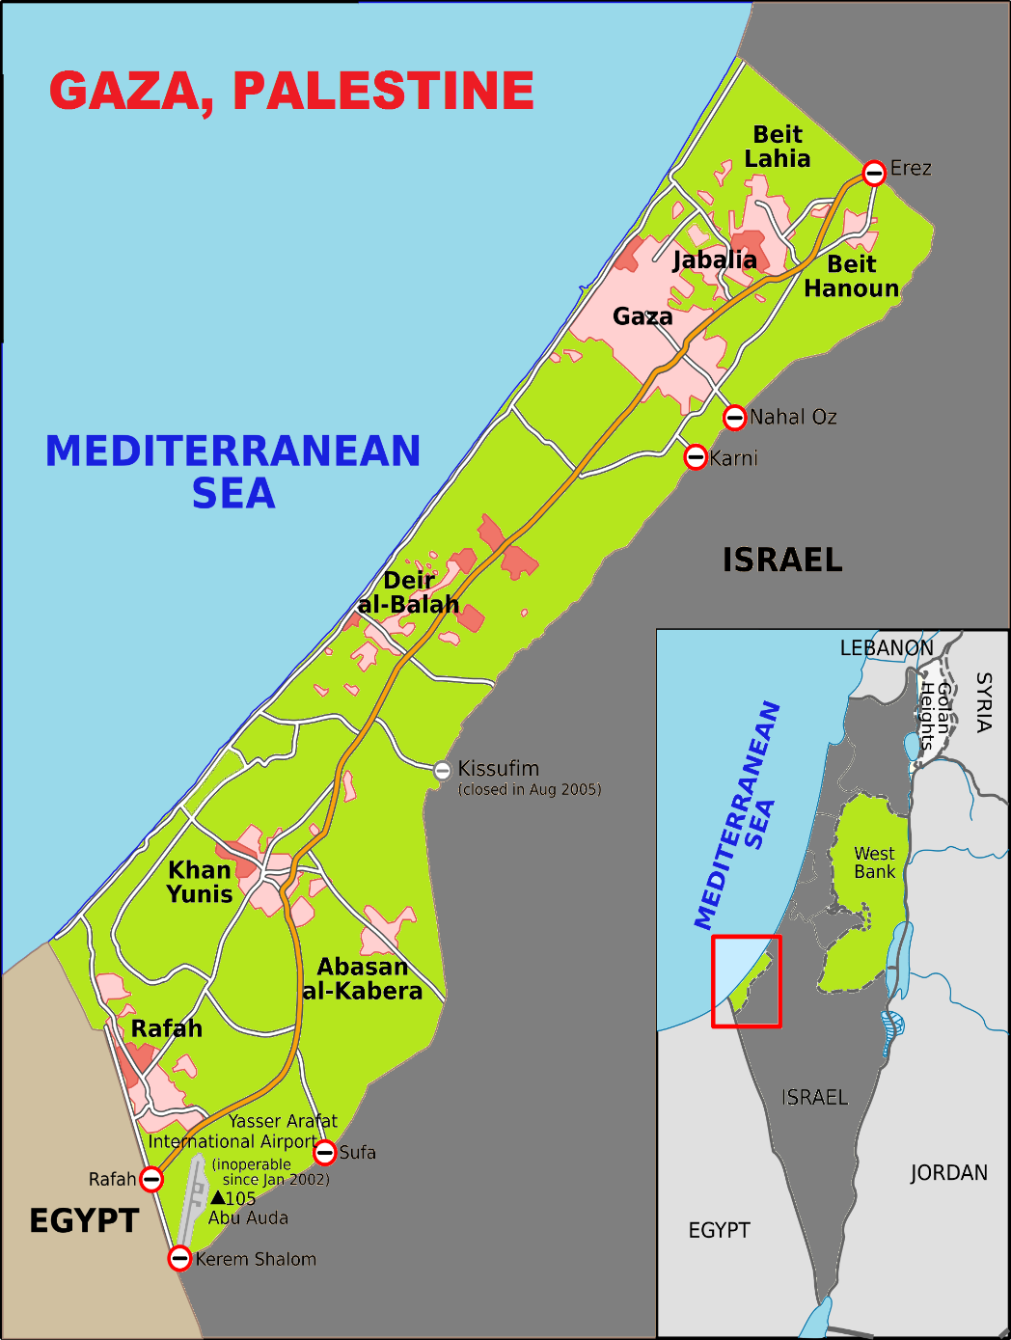
Gaza and Forced Immobility
Gaza Strip: Facts & figures
  1.9 million
  365 km²
12 years under siege (3 wars)
Siege: a violation of human rights
Effects of the Siege:
  Mobility
  Socio-economic life: Unemployment, poverty
  Health & well-being: physical & psychological
  Academic life

Slide 7
Gaza and Forced Immobility
In Gaza, the political and security situation remains volatile with the land, air and sea blockade now in its twelfth year, affecting around 1.9 million people isolated in the 365 square kilometer enclave (UNWRA, 2019).
With employment opportunities stifled by the blockade – the unemployment rate in Gaza remains among the highest rates worldwide - almost 1 million Palestine refugees are dependent on emergency food assistance, a tenfold increase on the 100,000 who required such support in 2000 (UNRWA, 2019).
Notes:
Intercultural language education
Moving from intercultural communicative competence (Byram, 1997) to symbolic competence (Kramsch, 2006) to ‘languaging’ (Phipps & Gonzales, 2004)

Slide 8
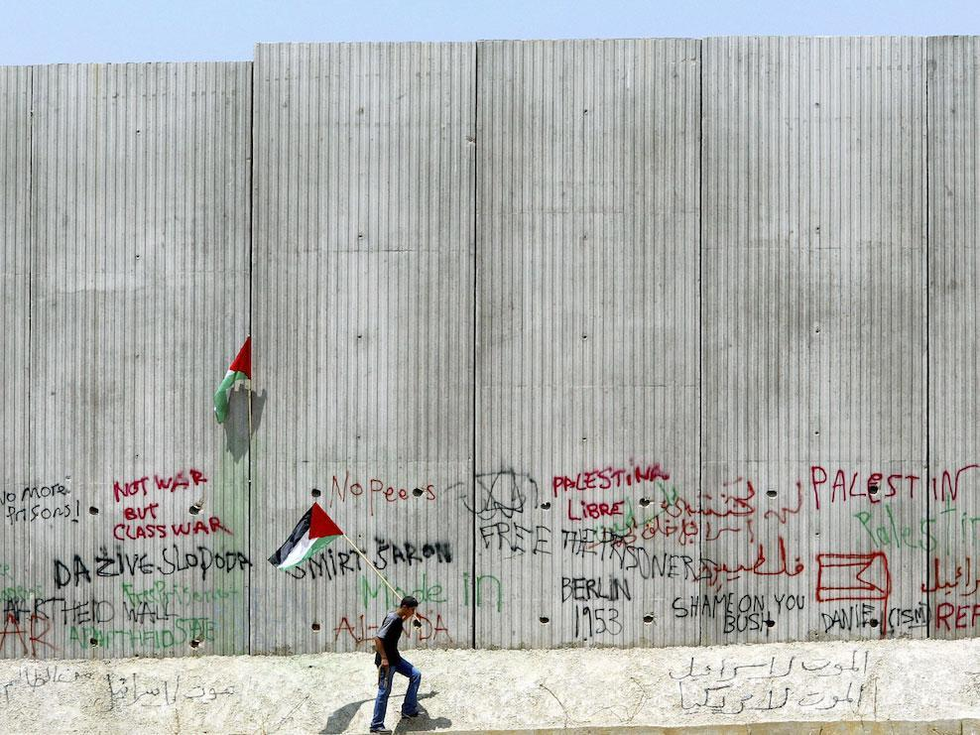
The Independent - David Silverman/ Getty images

Slide 9
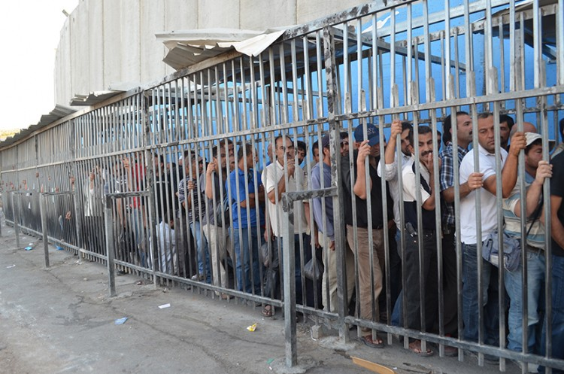

Slide 10
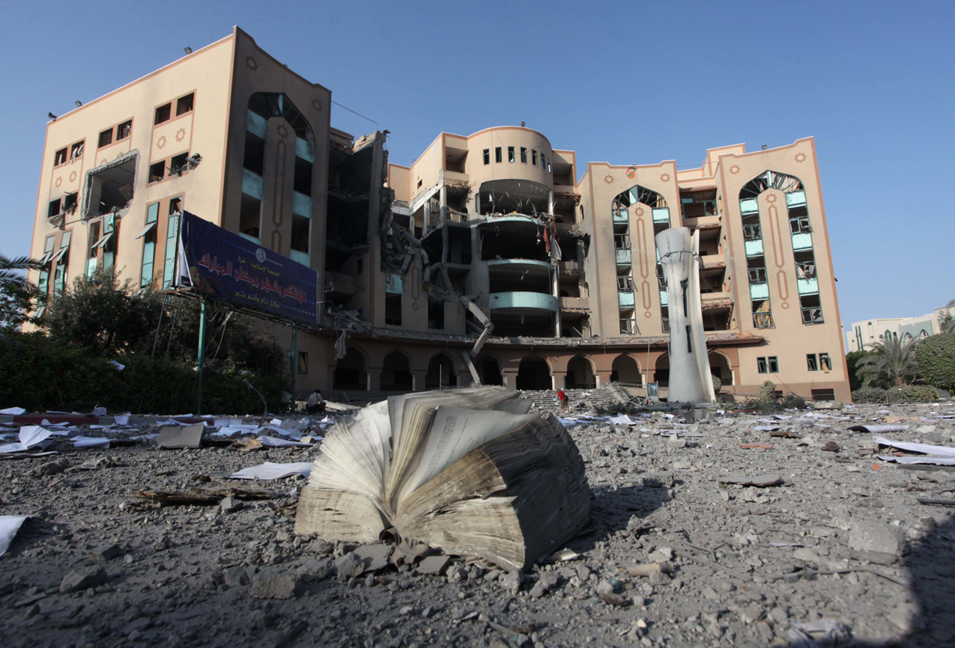

Slide 11
The Purpose of the Training
  The development of a centre for teaching Arabic to speakers of other languages online to increase Palestinian graduates’ employability as a way of overcoming ‘forced immobility’ (Stock, 2016)
  Within this broader scope, the teacher training course was designed and delivered.

Slide 12
Designing the Course
  Understanding specificity of the context of the Gaza Strip
  Exploring relevant theories
  Identifying ethical issues related to design and delivery
  Engaging teacher educators and the trainees themselves
  The internet as the main way of connecting to the ‘outside’ world (Aouragh, 2011; Pacetti, 2008)

Slide 13
Teachers and Teacher Educators
  8 qualified language teachers
  Based in Gaza, Palestine
  Looking to work on the Arabic language online programme
  4 educators with experience in second language teaching

Slide 14
Theoretical Underpinnings
  Critical and ‘engaged’ pedagogy (Freire, 1973; hooks, 1994)
  Acknowledging the trainees’ complex and contested life experiences
  Embedded in the struggles within the learners’ settings
  Includes the exploration of how educational environments sustain oppressive structures that prevent students from flourishing and how they might support moving “beyond such boundaries” (hooks, 1994, p. 12)
  Aims at social and political transformation

Slide 15
Ethical Dilemmas
  A very particular context – no familiarity
  Imposing ‘western’ approaches to teaching
  Not a substitute for ending human suffering
  Making implicit promises for employment
  Language as a method of exclusion
  Documenting reflections -> More purposeful
  hhttps://www.youtube.com/watch?v=uG-ra0rmgpQ
  ttps://www.youtube.com/watch?v=uG-ra0rmgpQ

Slide 16
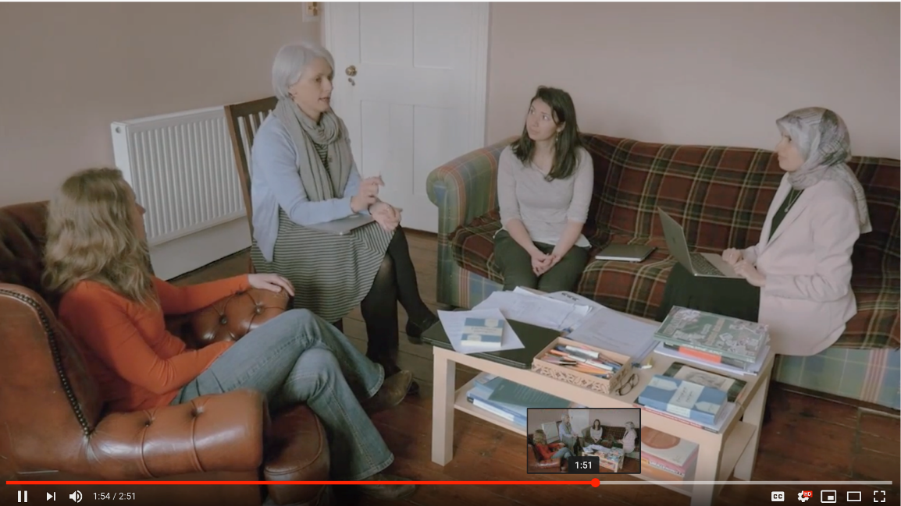
Our Sharing..
  A Film
  Introducing the trainers
  Need to be transparent and develop common learning spaces
  Questions about teacher positionality
  lm
  https://www.youtube.com/watch?v=uG-ra0rmgpQ

Slide 17
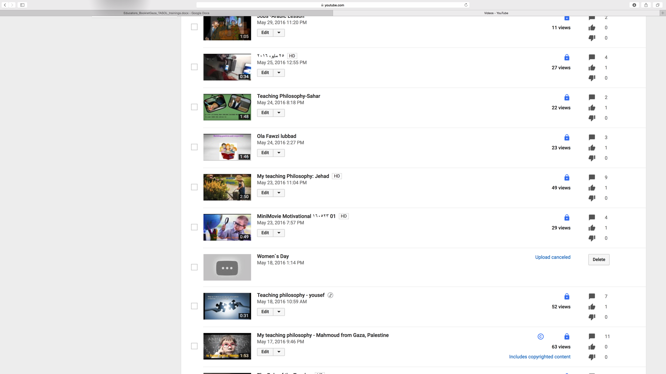
Their Response..

Slide 18
Learning-centered Spaces
A learning-centred classroom:
“One in which the developmental progress of both learners and teacher is respected, as they all strive to learn and grow in their individual and complementary ways”
Edge (1999, p. 44-45)

Slide 19
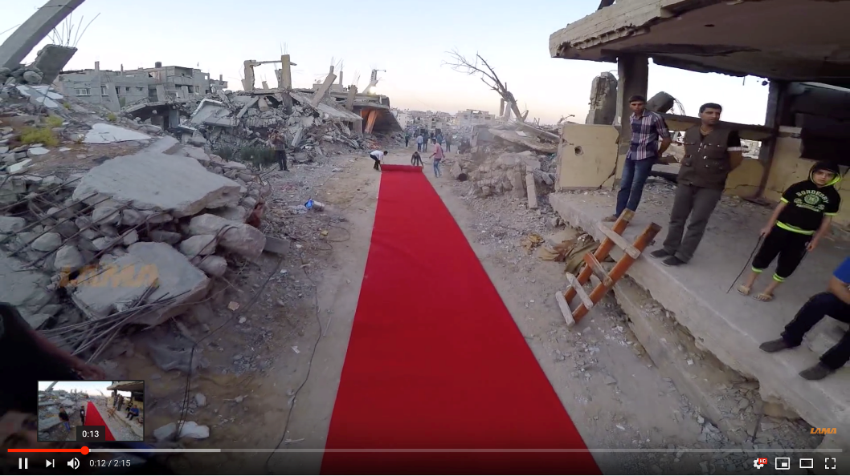
Learning-centered Spaces
  The trainees teaching us about new software
  Inviting us to their world (beauty, resilience, hope)
  We have two questions for you:
  What do you think about the video?
  2) Would you walk on the red carpet?
Notes:
1) Critical digital pedagogy
Reliance on online platforms to facilitate our educational encounters. We wish however to NOT construct this fact as a deficit which might hinder pedagogically meaningful encounters. Instead, we regard technology, much like the creative arts pedagogies mentioned above, as a central critical intercultural pedagogy at the heart of our programme.
2) Technology as a lifeline
Learning from Palestinian teachers who conceptualise the online encounter and digital pedagogies as part of their practices of resistance and hope, we equally embrace and celebrate the potential of digital platforms to facilitate human connection and engagement in shared, meaningful learning spaces.
3) Capacity building in ICT for teachers in Gaza
Given the teachers’ practical, technological expertise, our programme will draw on their advice and feedback on ‘what works best’ in the Gazan context, and assist them in theorising their practice.

Slide 20
Learning-centered Spaces
How HE educators under occupation and siege perceive their roles (Jebril, 2017)
The importance of holistic (whole-person) education in a context of occupation and siege
Drawing on cultural/ spiritual references in teaching
Modeling resilience, as an example of teacher authenticity
Supporting university graduates find online jobs
Supporting disabled students purse their studies
-> Teaching as a form of resistance
-> New ways of being and becoming a teacher

Slide 21
Learning-centered Spaces
I do not select commercial materials/ textbooks, but I compile my own materials to promote context based beliefs, values, principles, aspirations of youth, […] and to promote hopefulness, optimism, perseverance, resilience, etc.
(teacher educator in Gaza, 2019)
Notes:
The role of holistic (whole-person) education in a context of occupation and siege
- Sowing hope in a better future
- Drawing on cultural and spiritual references in the way you address the students
- Modelling resilience to your students, which is an example of teacher authenticity
- Supporting university graduates find jobs
- Supporting disabled students purse their studies
- Teaching as a form of resilience

Slide 22
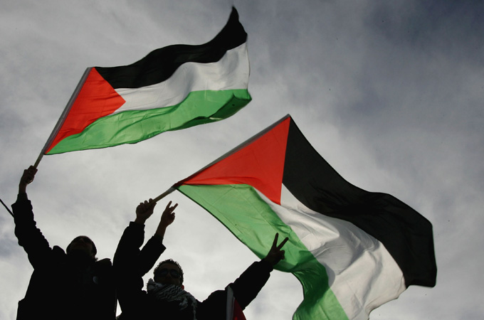
Thank You
www.aljazeera.com

Slide 23
Publications
Fassetta, G., Al-Masri, N. Attia, M., & Phipps, A. (under review). Gaza teaches Arabic online: opportunities, challenges and ways forward. In: Phipps, A., Al-Masri, N. and Fassetta, G. (Eds.) Can you hear me? Engaging multilingually in online international academic collaborations when borders are impassable. Bristol: Multilingual Matters.
Fassetta, G., Imperiale, M. G., Frimberger, K., Attia, M. & Al-Masri, N. (2017). Online teacher training in a context of forced immobility: the case of Gaza, Palestine. European Education, 49 (2-3), 133-150.

Slide 24
References
Aouragh, M. (2011a). Confined offline, traversing online Palestinian mobility through the prism of the Internet. Mobilities, 6(3), 375–397.
Dewey, J. (1916). Democracy and Education. New York: The MacMillan Company.
Djerasimovic, S. (2014) Examining the discourses of cross-cultural communication in transnational higher education: from imposition to transformation, Journal of Education for Teaching, 40(3), 204-216.
Edge, J. (1999). Learner autonomy with a focus on the teacher. In L. Bobb-Wolff (Ed.), Revista canaria de estudios ingleses (Vol. 38, pp. 37-46). Tenerife: Universidad de La Langua.
Freire, P. (1973): Pedagogy of the Oppressed. New York: Seabury.
hooks, b. (1994). Teaching to transgress—Education as the practice of freedom. New York, NY: Routledge.
Jebril, M. (2017). Academic Life Under Occupation: The Impact on Educationalists at Gaza's Universities. Unpublished Doctoral Thesis. The University of Cambridge.

Slide 25
References
Montgomery, C. (2014) Transnational and transcultural positionality in globalised higher education, Journal of Education for Teaching, 40(3), 198-203.
Pacetti, E. (2008). Improving the Quality of Education in Palestine through E-Learning and ICT: The Bottom-up Approach for a Sustainable Pedagogy. In: Knowledge Construction in E-learning Context: CSCL, ODL, ICT and SNA in Education, 1-2 September 2008, Cesena, Italy. Available from: http://ceur-ws.org/Vol-398/ (Last accessed: 8/6/2018).
Pyvis, D. 2011. “The Need for Context-sensitive Measures of Educational Quality in Trans- national Higher Education.” Teaching in Higher Education 16(6), 733–744.
Stock, I. (2016). Trasnational social fields in forced immobility: Relations of young Sub-Saharan African migrants in
Morocco with their families and friends. Identities. Global Studies in Culture and Power, 23(4), 407–421.

