Slide 1
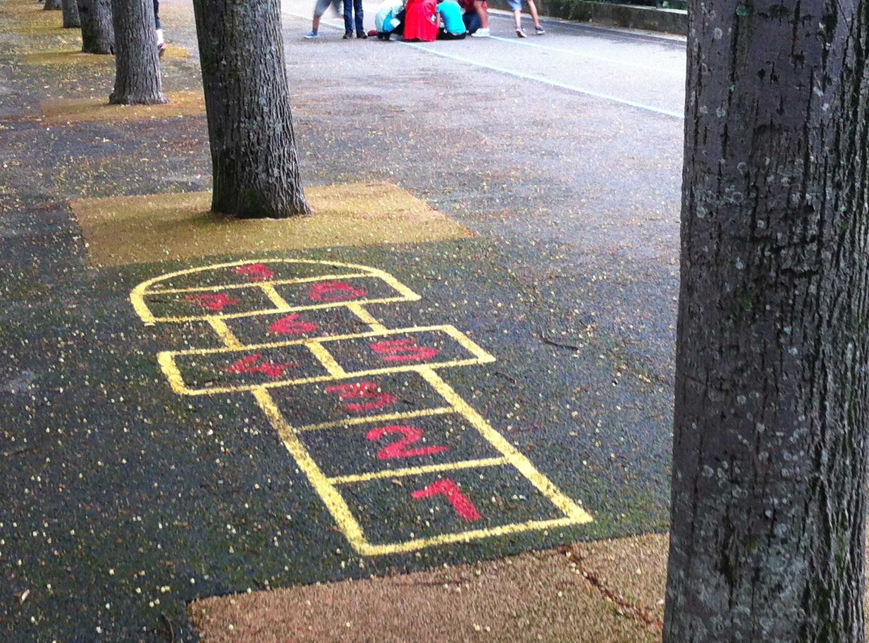
Space, Place and Education
Maria Rönnlund, Applied Educational Sciences, Umeå university
maria.ronnlund@umu.se
Joint seminar week, University of Sussex, 14-17 March 2016

Slide 2
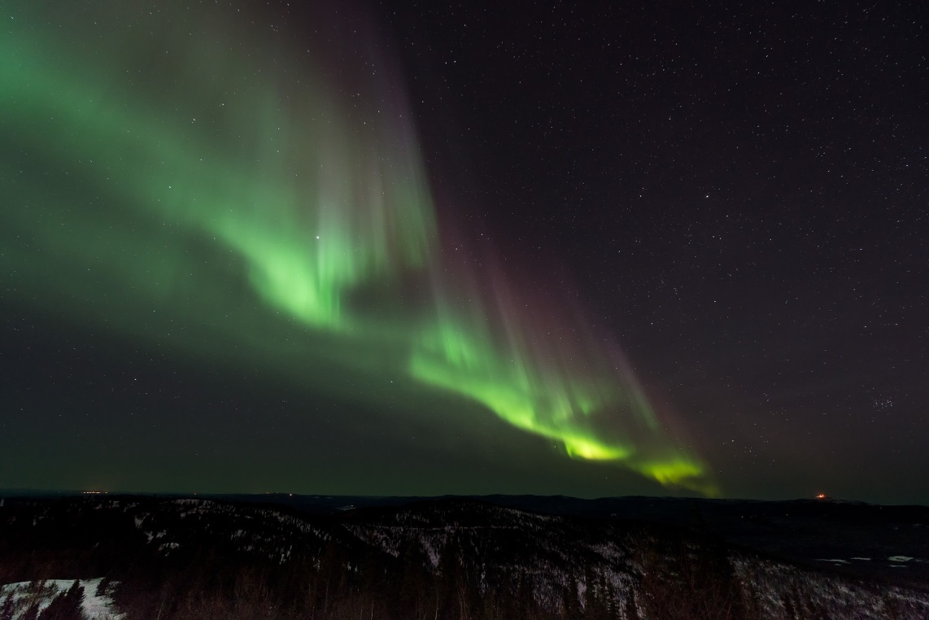
The spatial turn
Space, place, materiality, material cultures …
“Critical Geographies”
“From design to practice in school environments”
“Space for learning”
Globalization …
Aurora Borealis

Slide 3
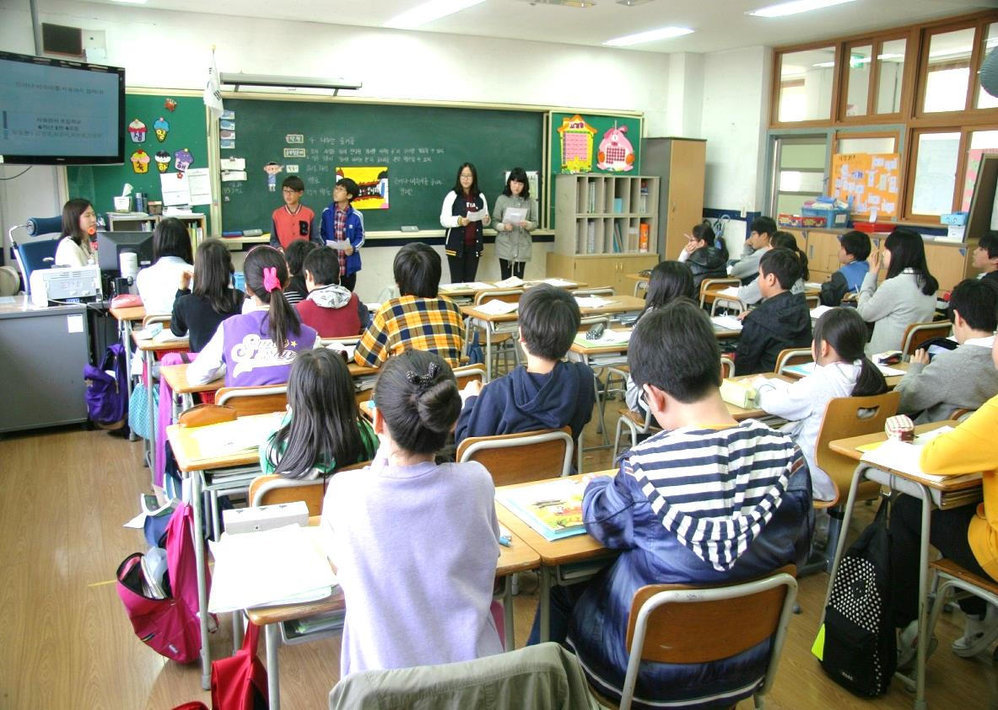
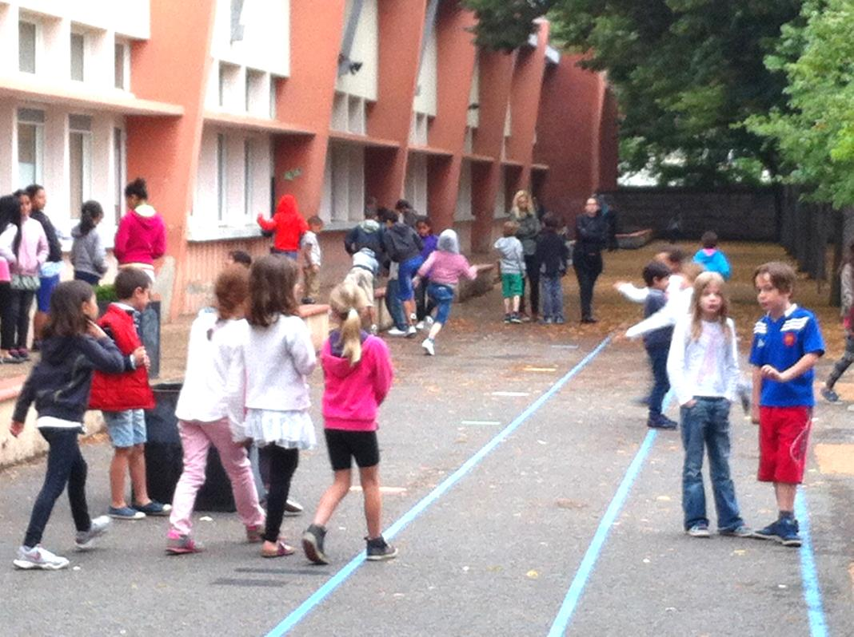
Educational spaces

Slide 4
space as location
space as object of study
space as part of the analysis
”histories of spaces”
”spatial histories” (Elden 2004:194)

Slide 5
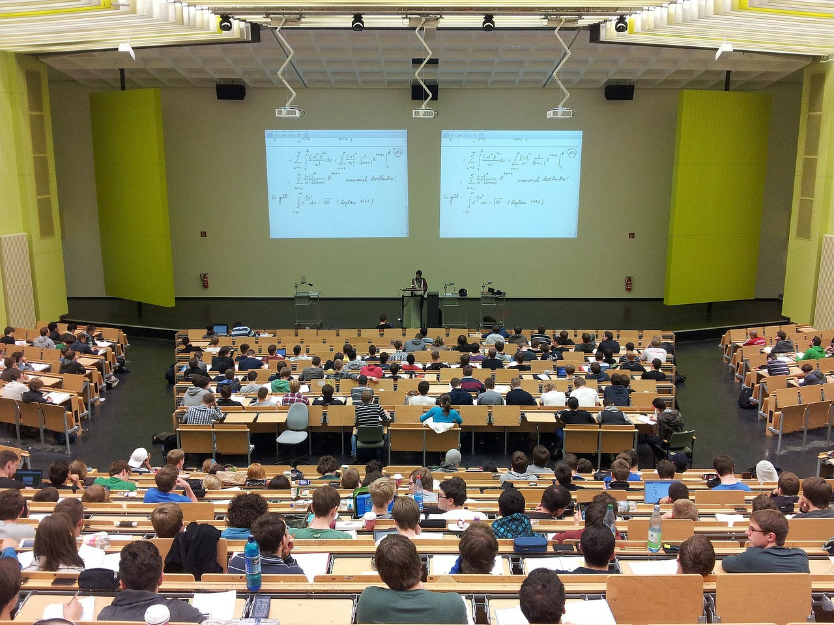
Educational effects of the neoliberalist agenda

Slide 6
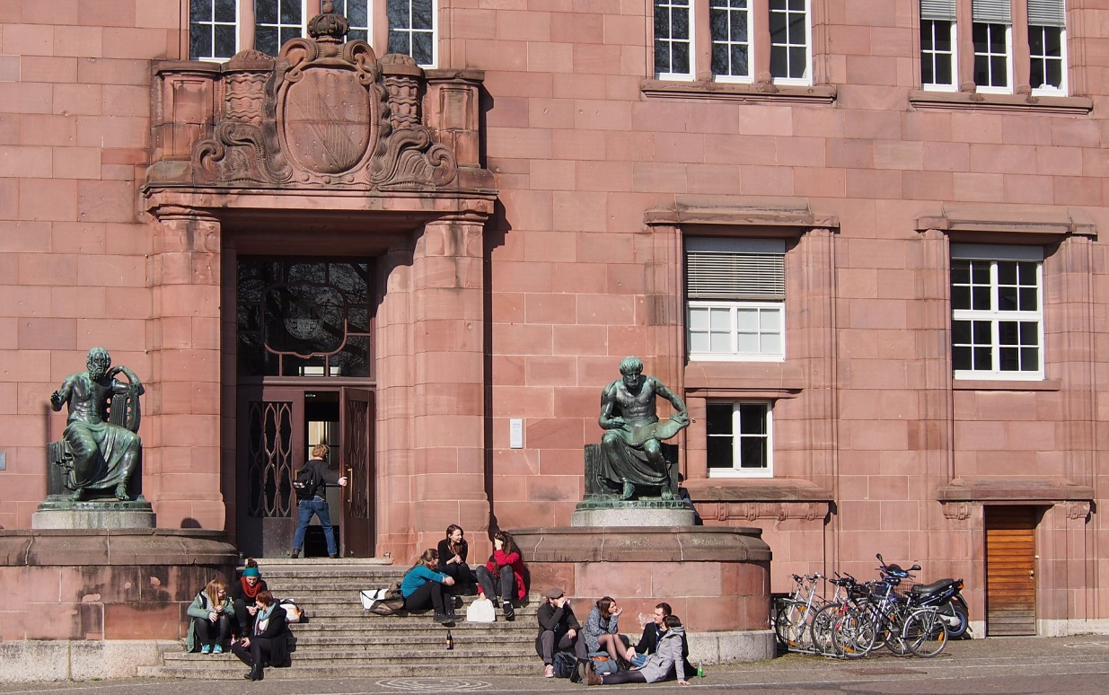
The globalization of education

Slide 7
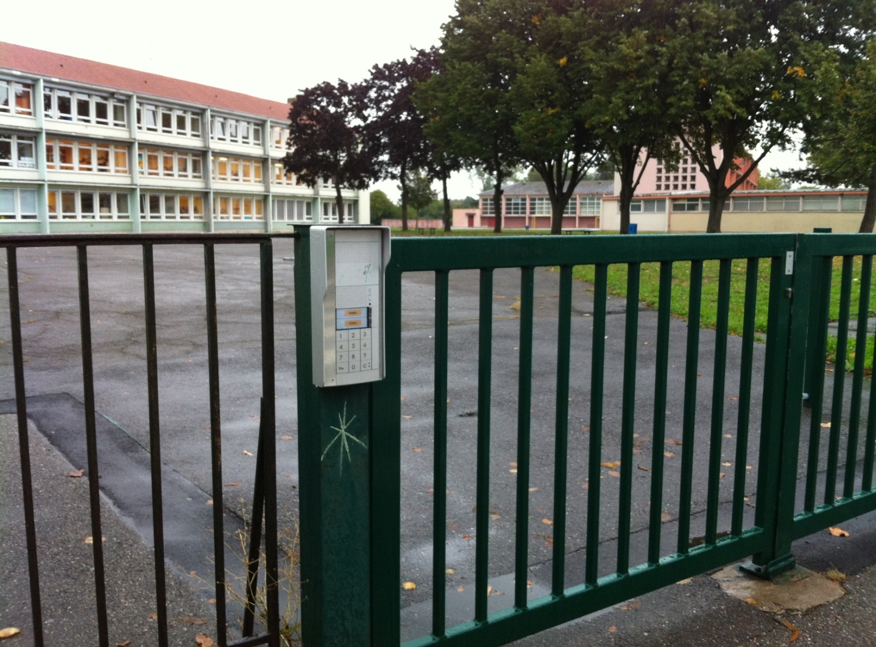
Space, materiality, education

Slide 8
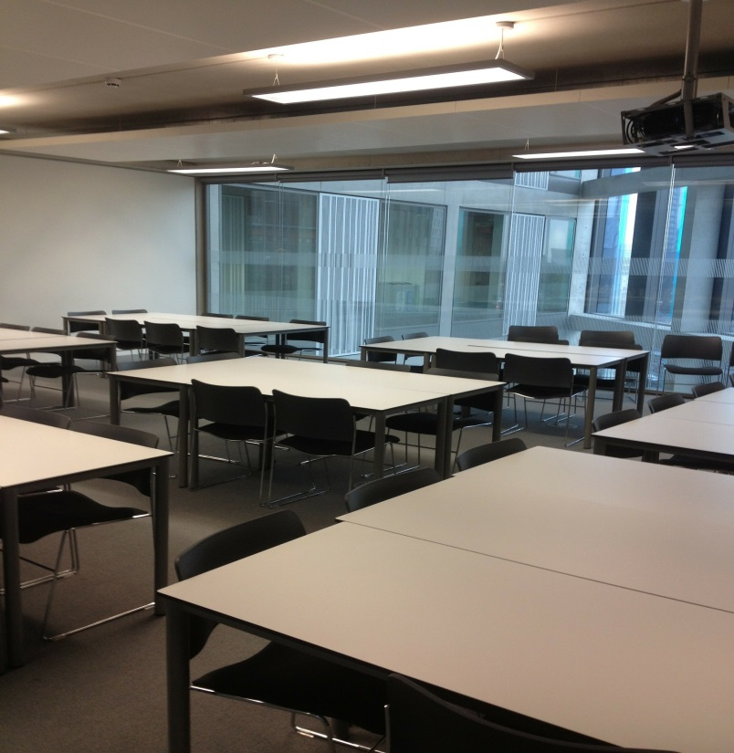
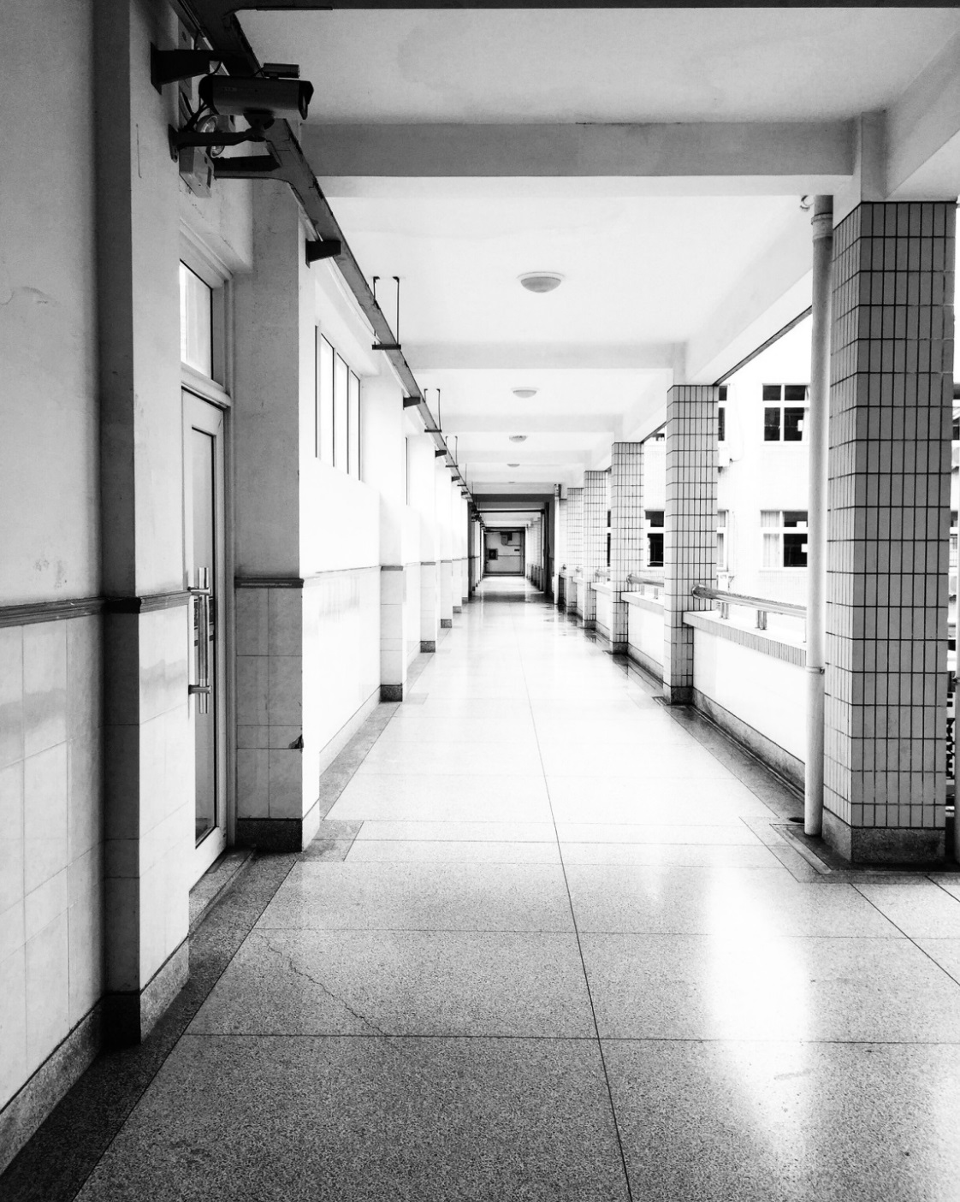

Slide 9
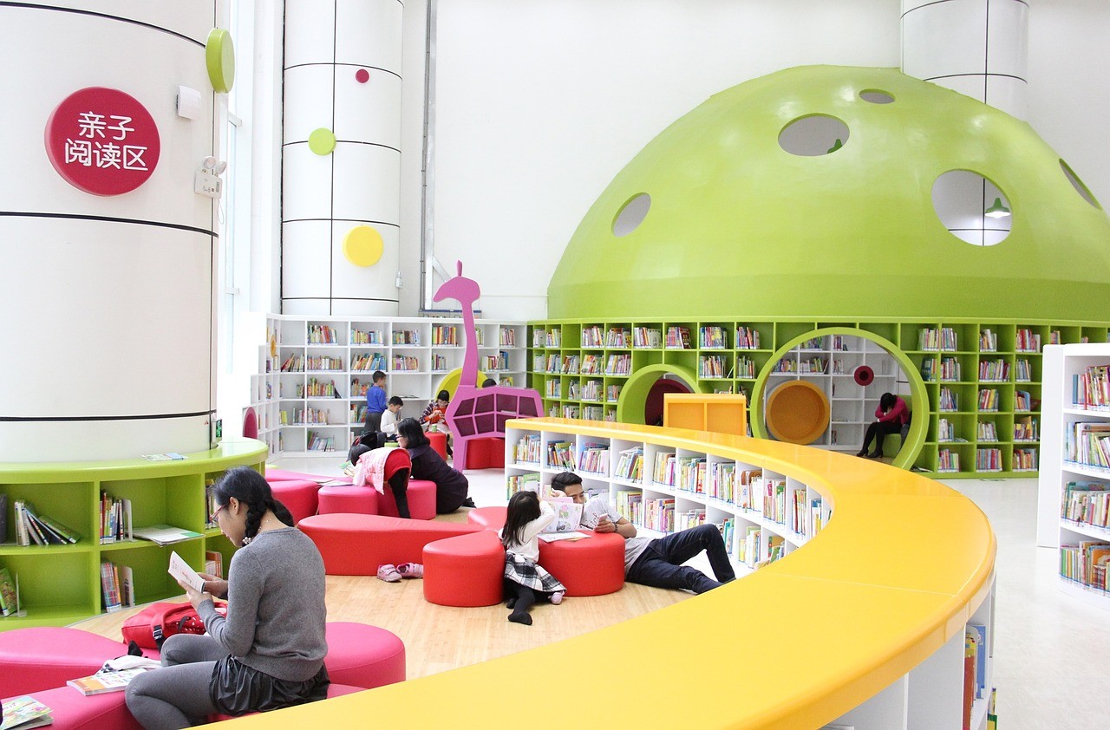

Slide 10
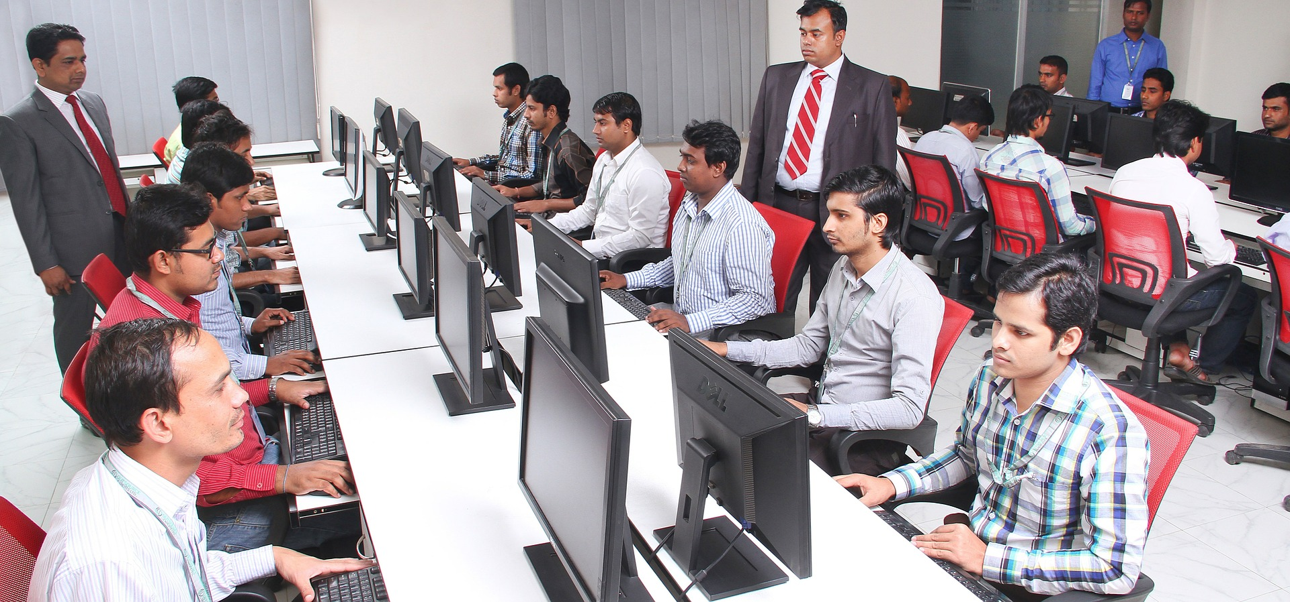

Slide 11
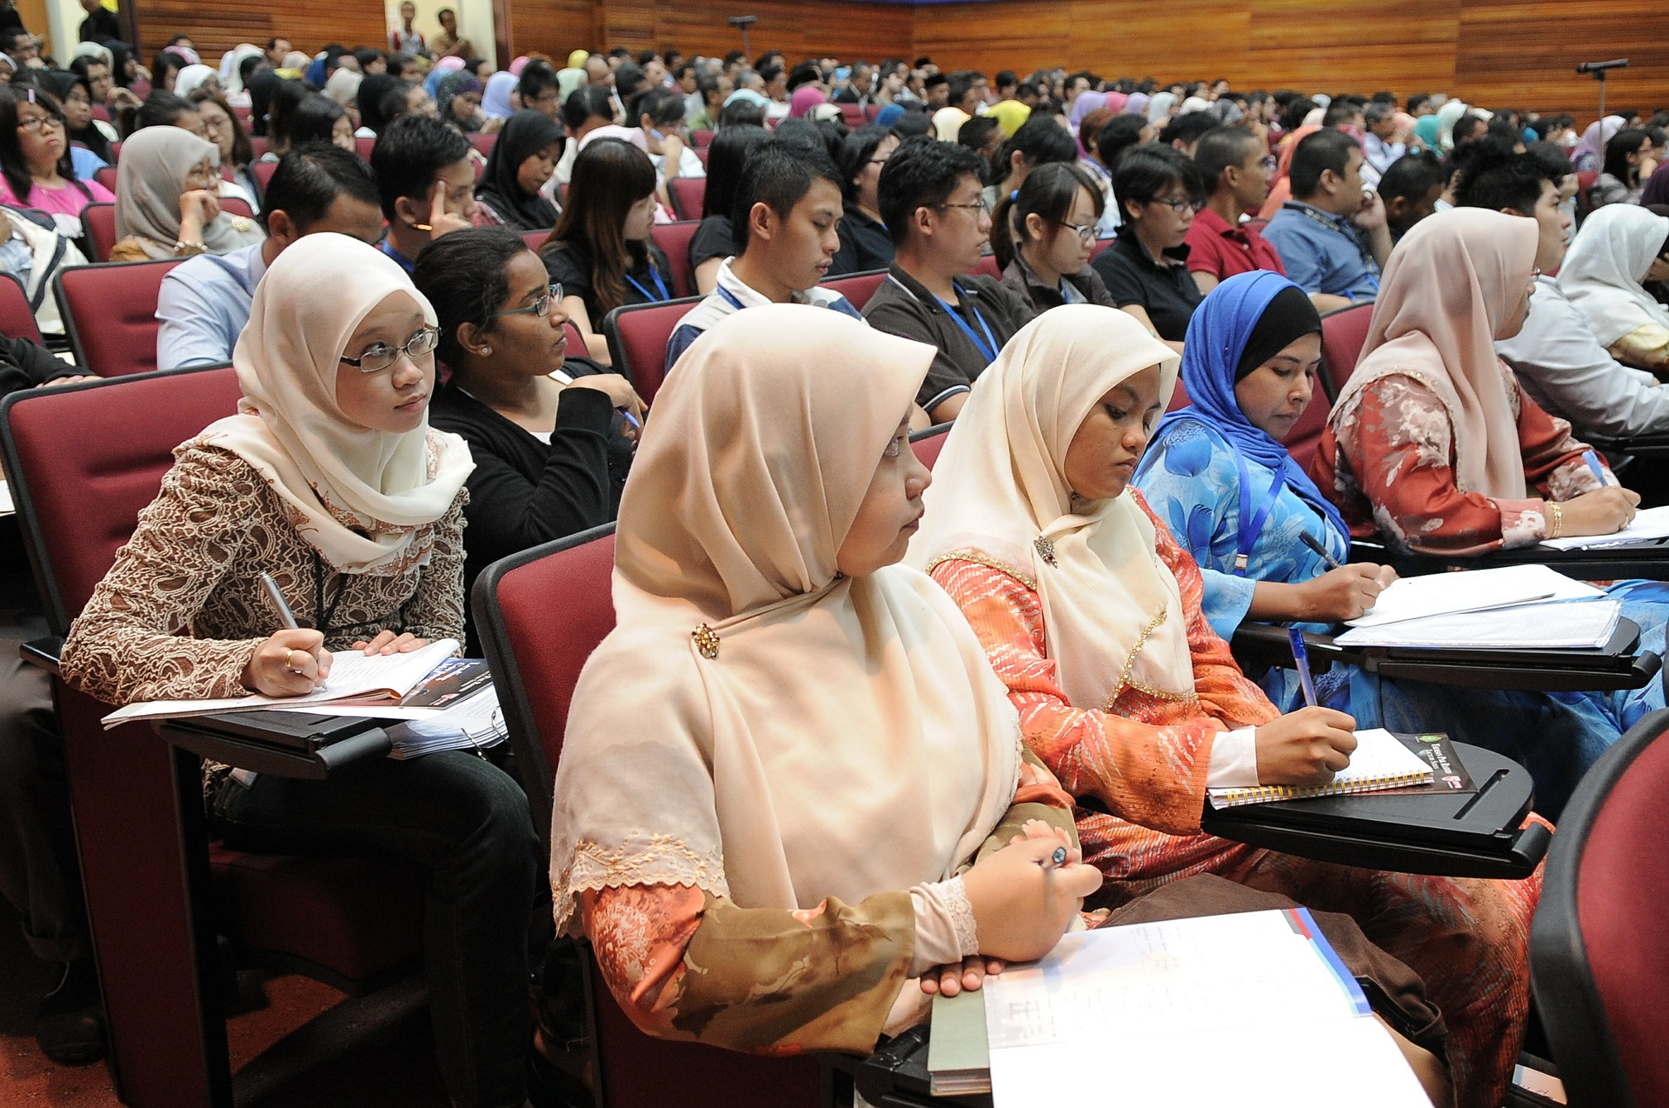
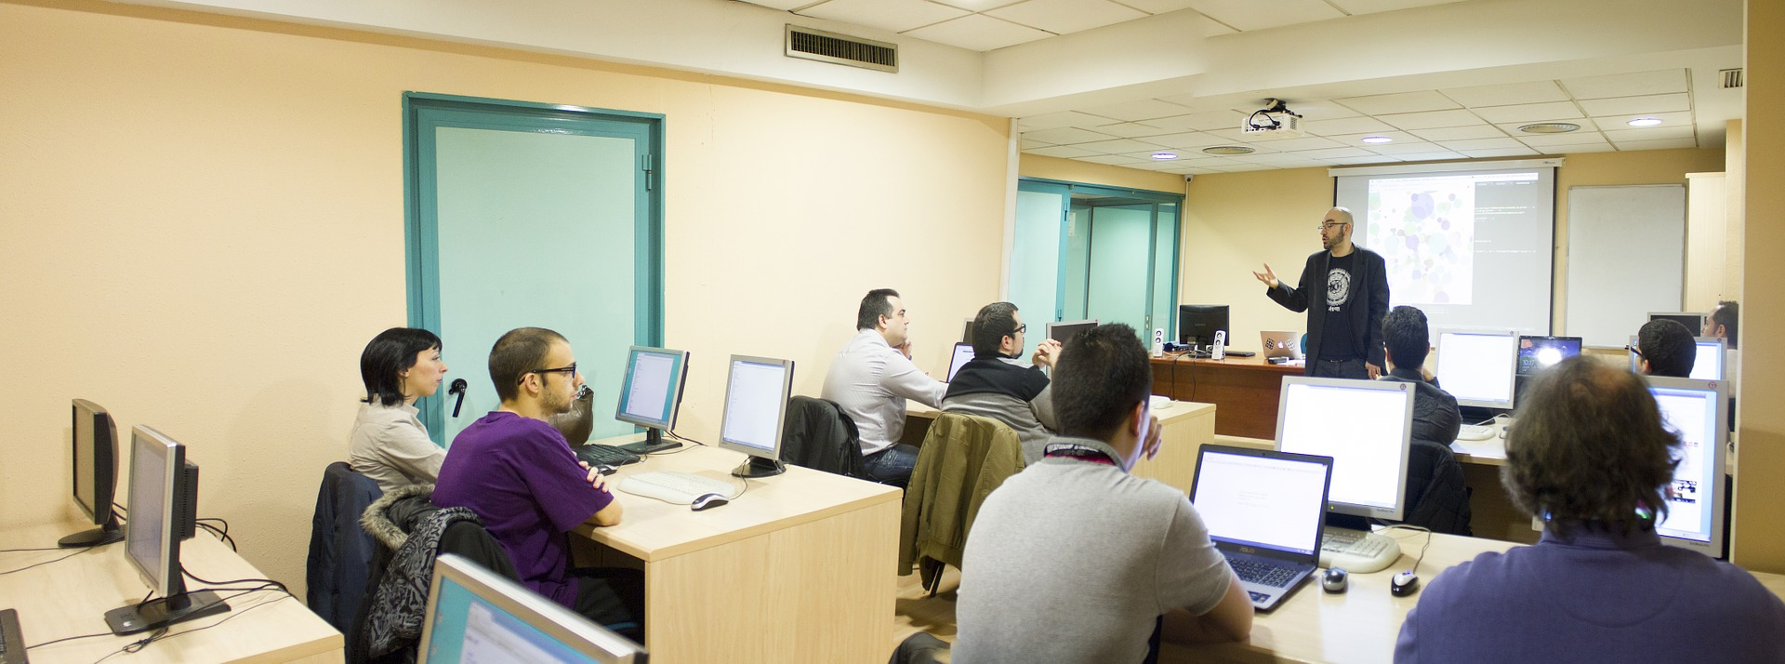

Slide 12
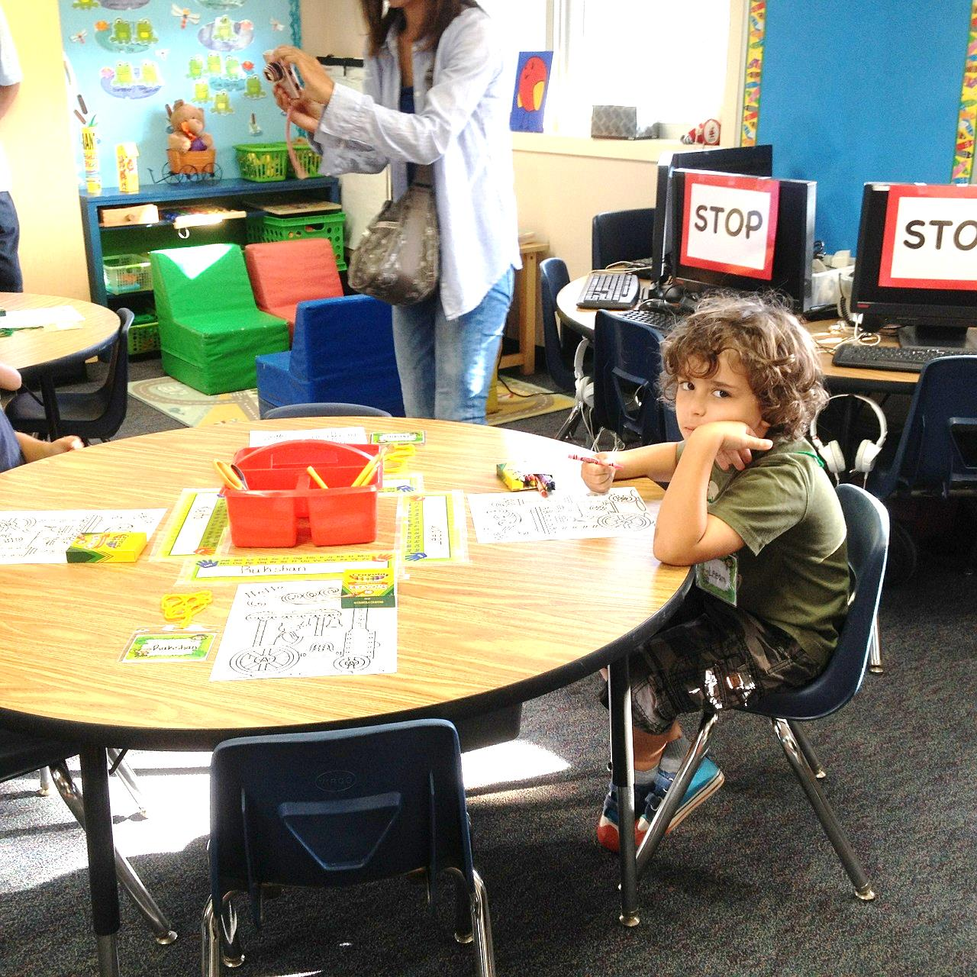

Slide 13
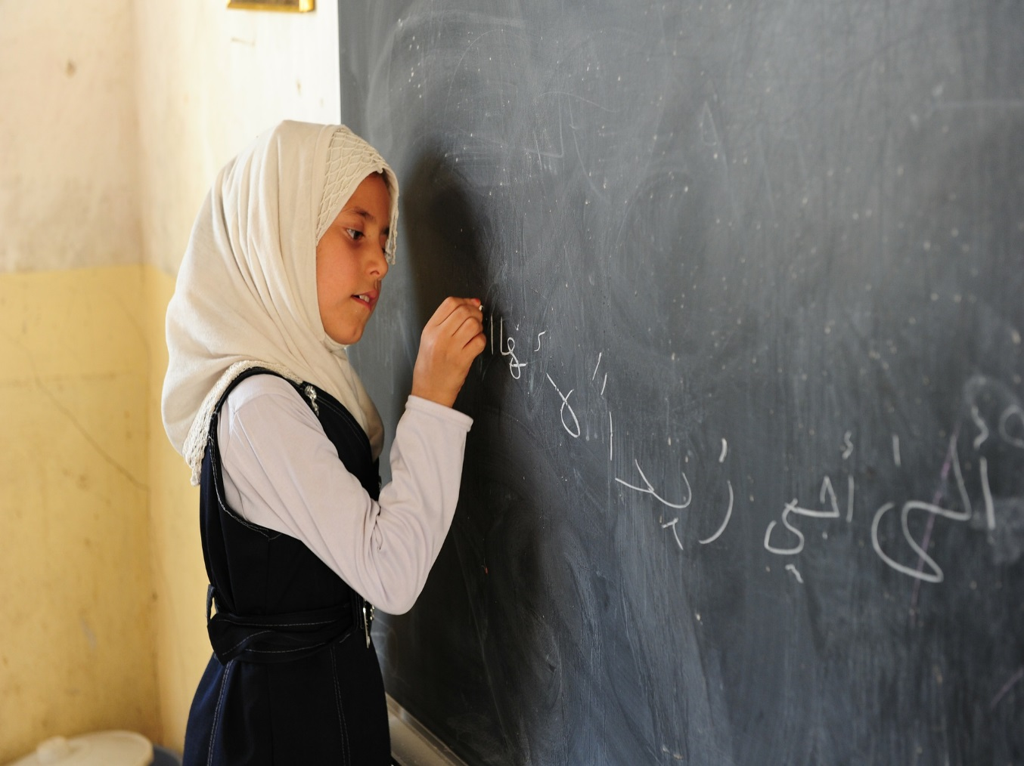
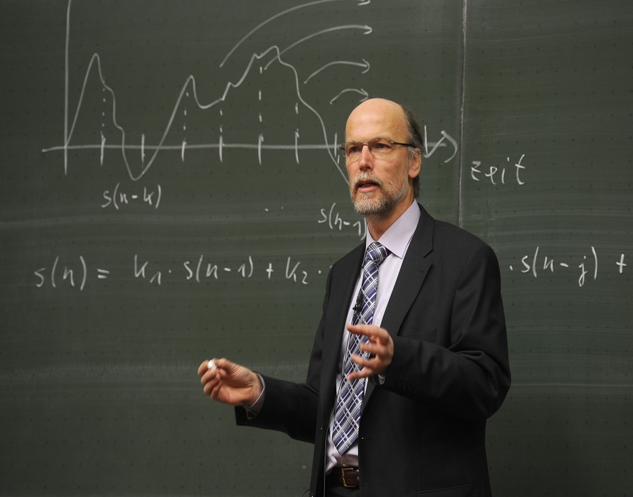
Identity, subjectivity,
citizenship

Slide 14
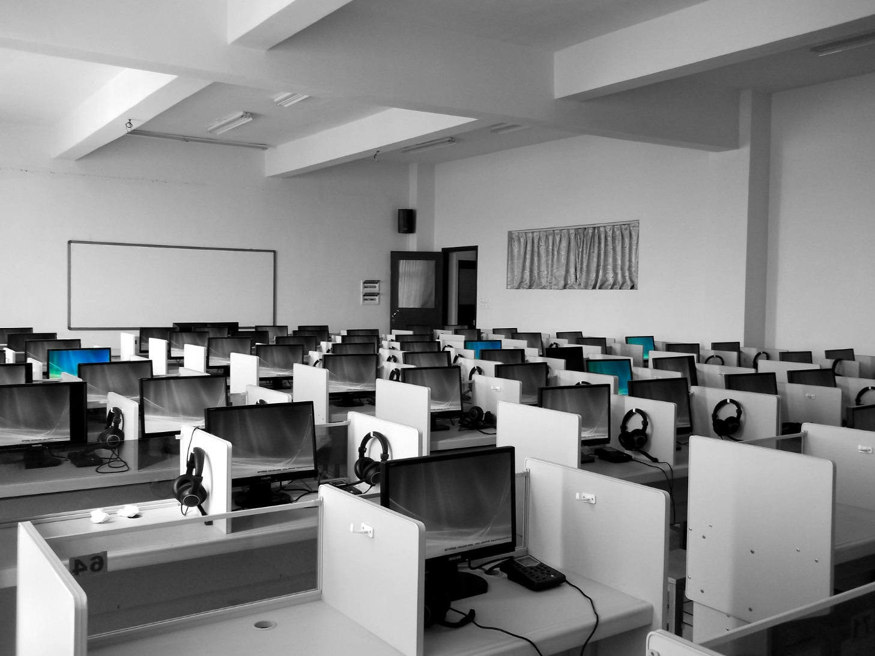
Space as absolute
Space as relative
Space as relational (Harvey 2001, 2006)

Slide 15
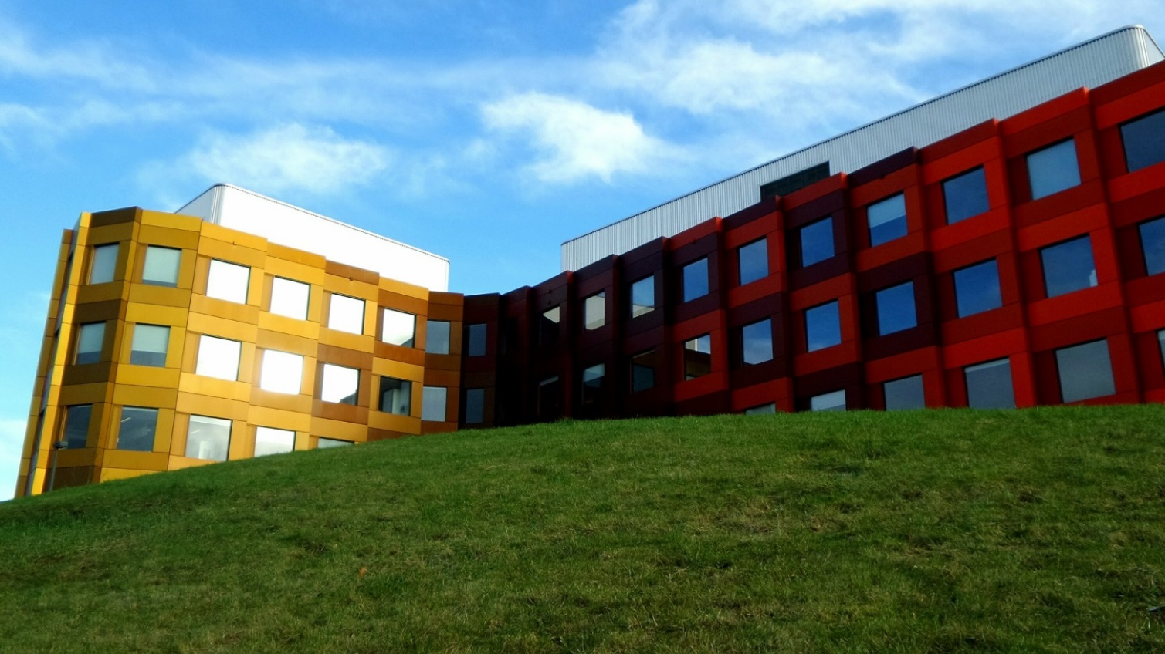
Research design – spatial dimensions
the perceived
the conceived
the lived space (Henri Lefebvre, 1991)

Slide 16



Slide 17
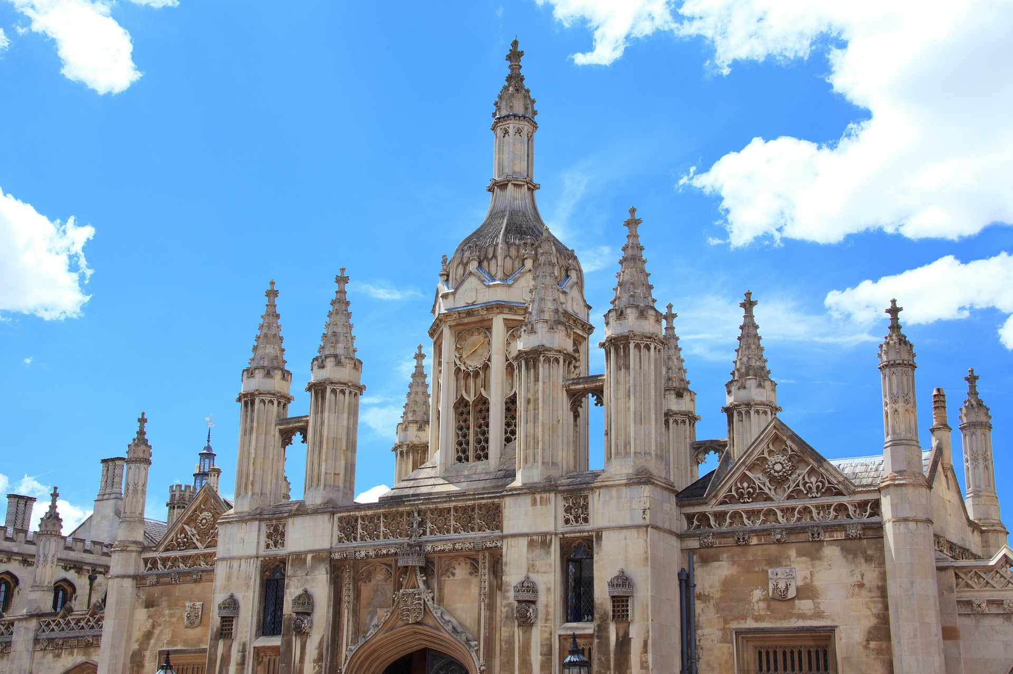
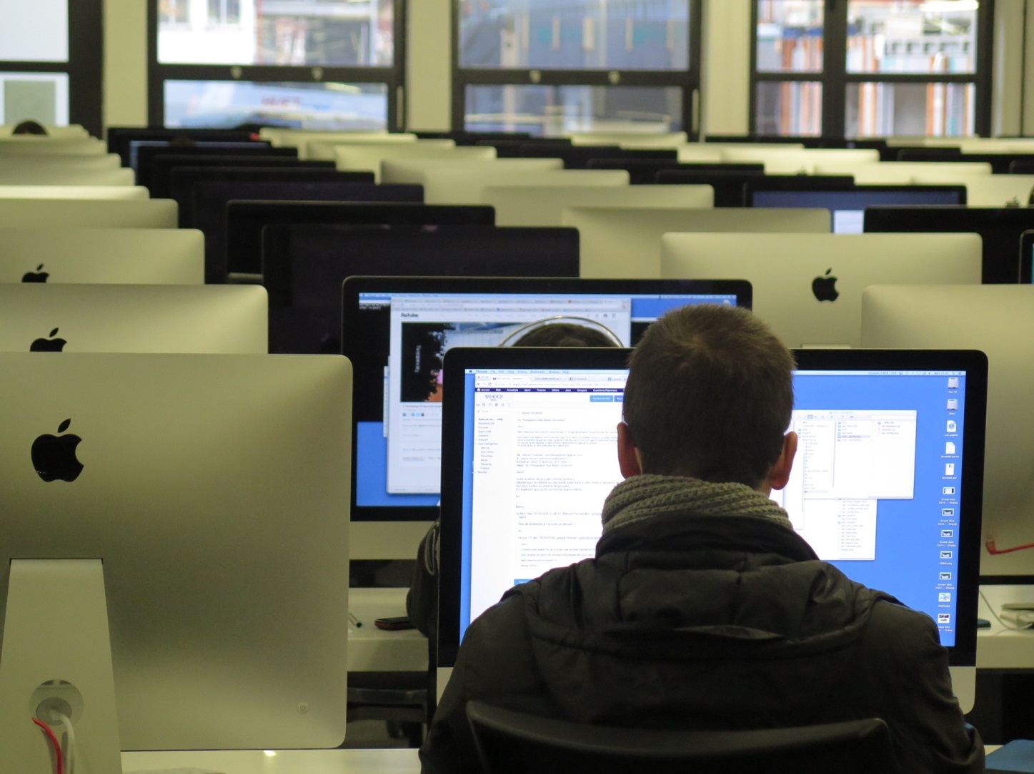

Slide 18
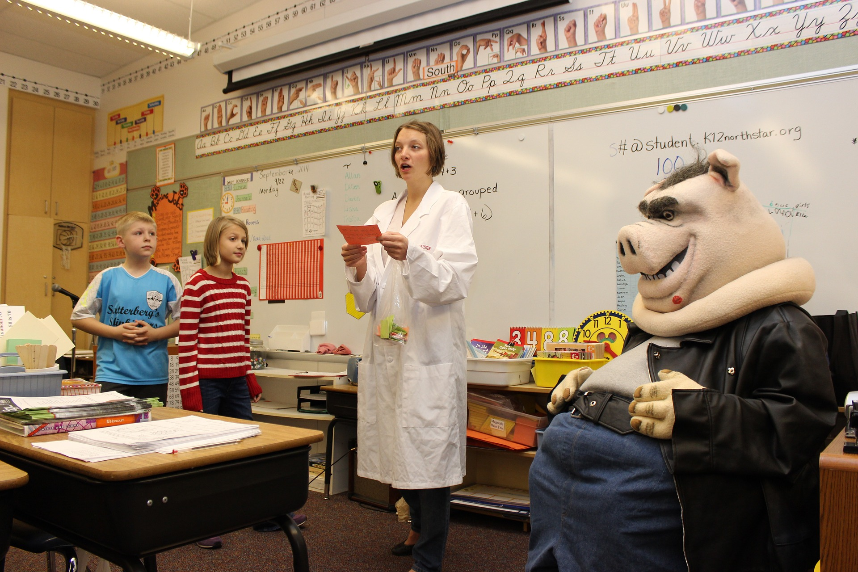

Slide 19
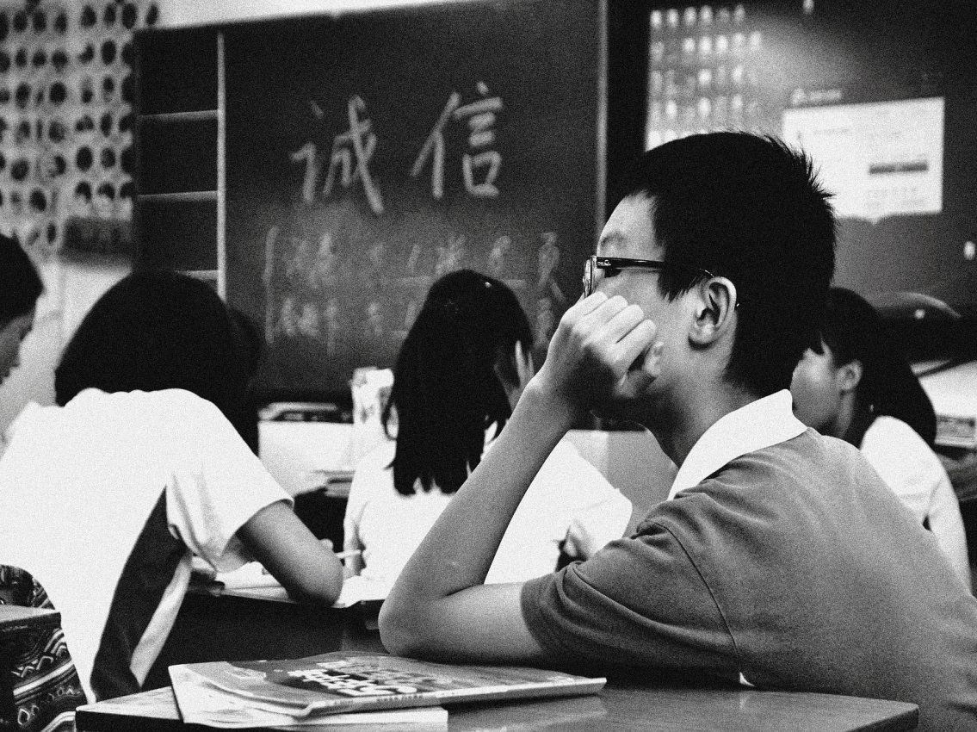
Research design – What would a spatial perspective/-s implicate for research questions, materials and methods? Pick one or several of the projects in the group and discuss it/them:
Is there a spatial perspective in the study? If yes, in what way? If no, discuss the advantages and disadvantages of adding a spatial perspective to the study…
Would it be possible to cover different spatial dimensions (like Lefebvre advocates)?
What research question/-s and what kind of data/material would you need to include/add in order to bring in
a spatial perspective to the
study?

Slide 20
References
Castells, M (1996) The information age; economy, society and culture. Malden, Mass: Blackwell
Elden, S (2004). Understanding Henri Lefebvre. Theory and the Possible. London: Continuum
Gulson, KN & Symes, C (2007) Spatial Theories of Education. Policy and Geography Matters. London: T & F Books UK, 1-16.
Harvey, David (2001) Spaces of Capital. Edinburgh: Edinburgh University Press.
Harvey, David (2006) Den globala kapitalismens rum. På väg mot en teori om ojämn geografisk utveckling. Hägersten: Tankekraft förlag.
Lefebvre, Henri (1991) The Production of Space. Oxford: Blackwell
Massey, D (2005) For Space. London: SAGE.
Rönnlund, M (2015). Schoolyard Stories. Processes of gender identity at a ’childrens’ place. Childhood, 22 (1), p 85-100.
Rönnlund, M. (2015) Skolgården som socialt rum. Nordic Studies in Education,33 (3-4).
Rönnlund, M & Tollefsen, A (2016) RUM – samhällsvetenskapliga perspektiv. Stockholm: Liber
Soja, E. W. (1989). Postmodern geographies. The reassertion of space in critical social theory. London: Verso.
Tuan, Y-F (1977) Space and Place. The Perspective of Experience. Minneapolis: University of Minnesota Press.

