Slide 1
Sexual Harassment in Higher Education: Disrupting Norms and Dissolving Disadvantage
CENTRE FOR HIGHER EDUCATION AND EQUITY RESEARCH
Professor Louise Morley, University of Sussex, UK

Slide 2
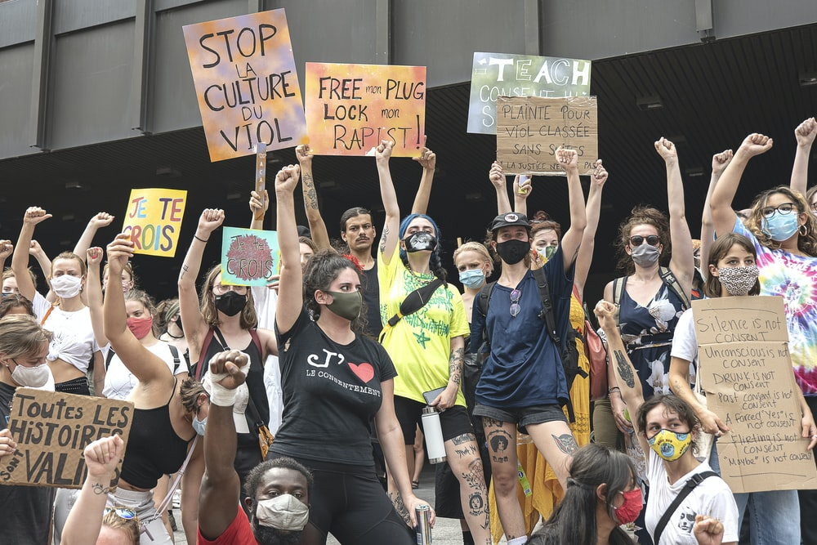
Globalised Gender-Based Violence
Gender –based violence is pervasive with 1 in 3 women worldwide subjected to physical or sexual violence (WHO, 2021).
The largest national survey on gender violence on campuses in the USA reported:
26.4% of female and 6.8% male undergraduate students have experienced sexual assault or rape.
For self-identified transgender, genderqueer and nonconforming college students, the proportion of sexually assaulted individuals was 23.1%.
Sexual violence on campus in the USA higher education is more prevalent than any other crime (Cantor et al., 2020).

Slide 3
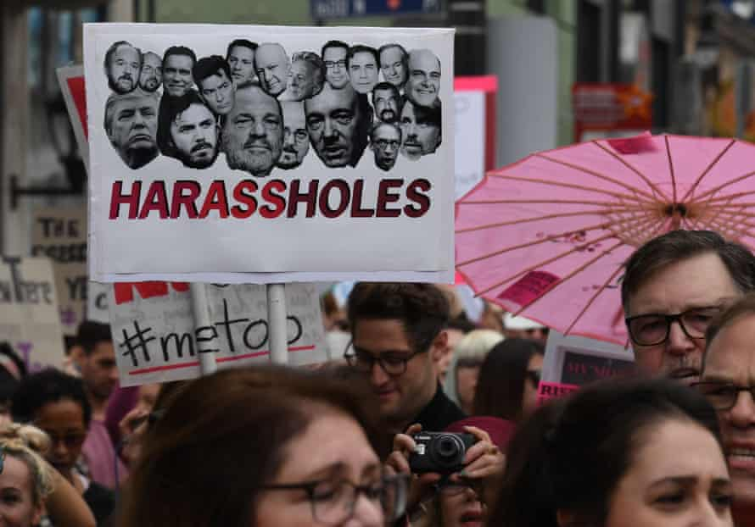
Sexual Harassment…
Involves spatial and cognitive justice.
Creates hostile/toxic learning and working environments.
Is often unreported for fear of victimisation, stigmatisation, or lack of confidence in procedures (Bull and Rye, 2018).
Constructs ‘victims’ as unreliable narrators, and denies injury.
Naturalises the hierarchical and gendered power relations within universities into a sexual contract.
Is actual and symbolic violence.
Is a hidden norm of organisational life- MeToo and Time’sUp Movements.

Slide 4
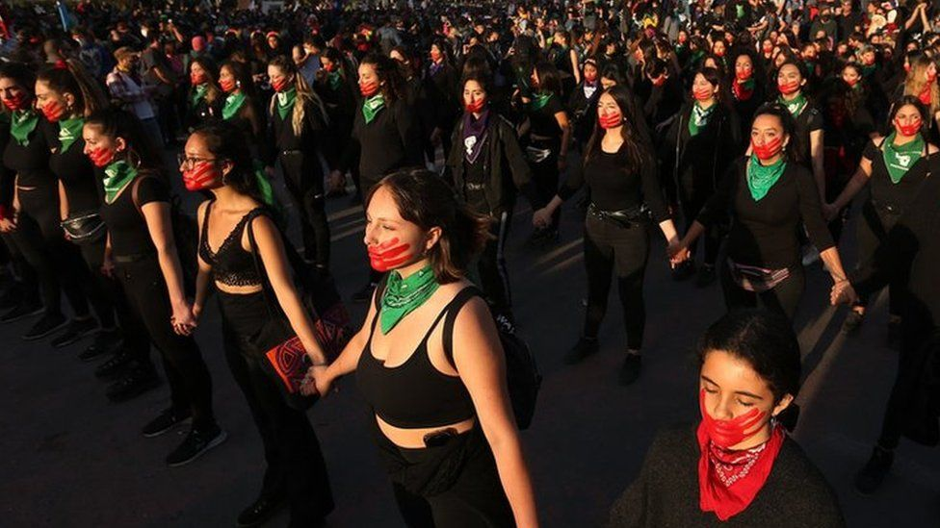
Speech Acts to Denaturalise (Heteronormative) Abuse
1970s
Catherine MacKinnon (1979) argued that sexual harassment is sex discrimination because the act reinforces the social inequality of women to men.
1980s
The Lecherous Professor (Dziech & Weiner, 1984) suggested that 20–30% of undergraduate female students were victims of some form of sexual harassment by at least one of their professors.
1990s
Boyer (1990) reported that more than 60% of the presidents surveyed at large research institutions said sexual harassment was a problem.
Paludi and Barickman (1991) suggested that women were overwhelmingly the targets of sexual harassment and nearly all harassers were heterosexual males.
Thomas and Kitzinger (1997) - heteropatriarchy- power of men as a collective.

Slide 5
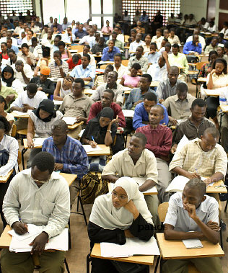
Widening Participation in Higher Education in Ghana and Tanzania
Measuring:
Social variables of gender, age, socio-economic status (SES)
In Relation to:
Educational Outcomes: access, retention and achievement.
In Relation to:
4 Programmes of Study in each university.
2 Public and 2 private universities.
Quantitative Data -100 Equity Scorecards
Qualitative Data - 200 interviews with students and 200 with staff and policymakers.
(www.sussex.ac.uk/education/cheer/wphegt)

Slide 6
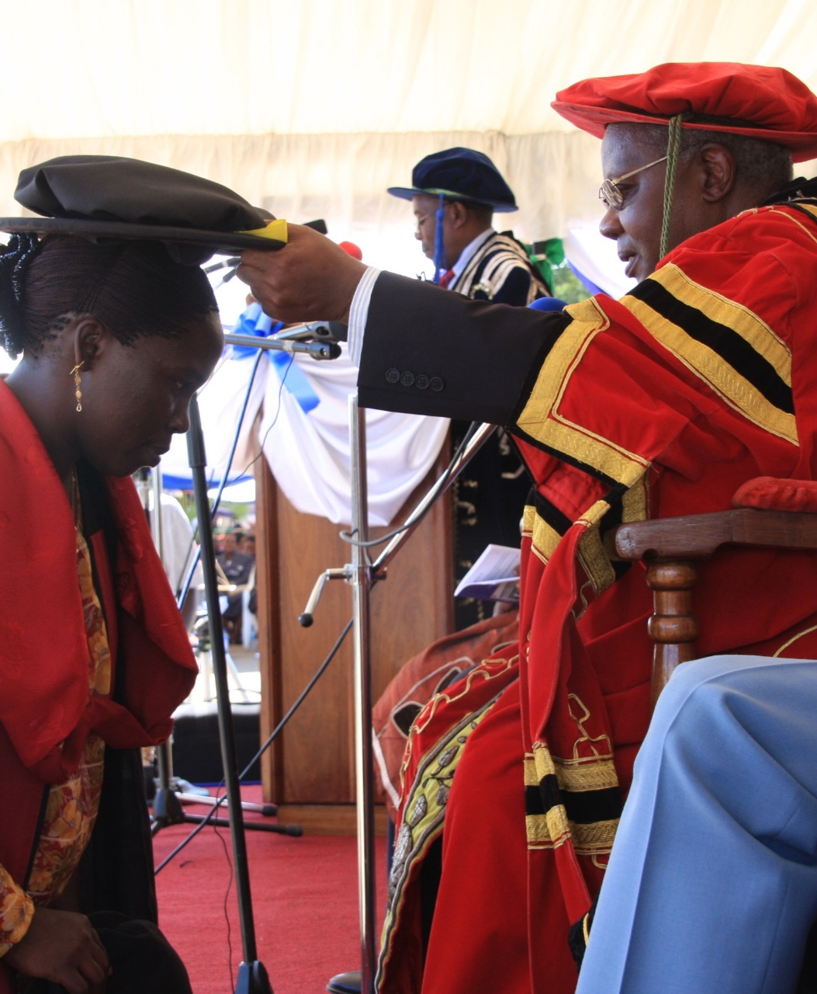
Transactional Sex, or Sexually Transmitted Grades
Quid pro quo
Sex-for-grades exchange in which some male lecturers considered that they had a droit de seigneur, or patriarchal entitlement to the sexual favours of their female students.
Agentic transaction- women being strategic/ gaining academic advantage.
Spatial Justice and Self-Minimisation
Territory marked out as male
Women reluctant to seek tutorial support from male tutors or make themselves visible in class.
Affective Ecology
Shame
Blame
Attribution/ Injury Denial/ Consent
Trust
Student Identity - Women constructed as ‘Corrupt Learners’.
(Morley, 2011)

Slide 7


Sexual harassment is a way of life at this university … and people don’t like to talk about it … the female students are very vulnerable to lecturers... and the girls think that’s a legitimate way to get marks. Boys think the girls have an advantage because they can get marks that way and the men think if the girl comes to me and she’s a grown up she’s asking for it ...(Female academic manager, public Ghanaian university).
Being a girl costs sometimes…There are some things in which people can take advantage of you because you are a girl…There are corrupt staff… Certain staffs like if you want help they say you have to do this or that, it is not your fault but he does that so that he can get you… get sex (Female student, public Tanzanian university).
Sometimes you will see a woman or a lady in a class or maybe in a group discussion…you wonder how she got admission? But when the paper comes she performs better than you. …Sometimes some women have been favoured (Male student, public university, Ghana).

Slide 8
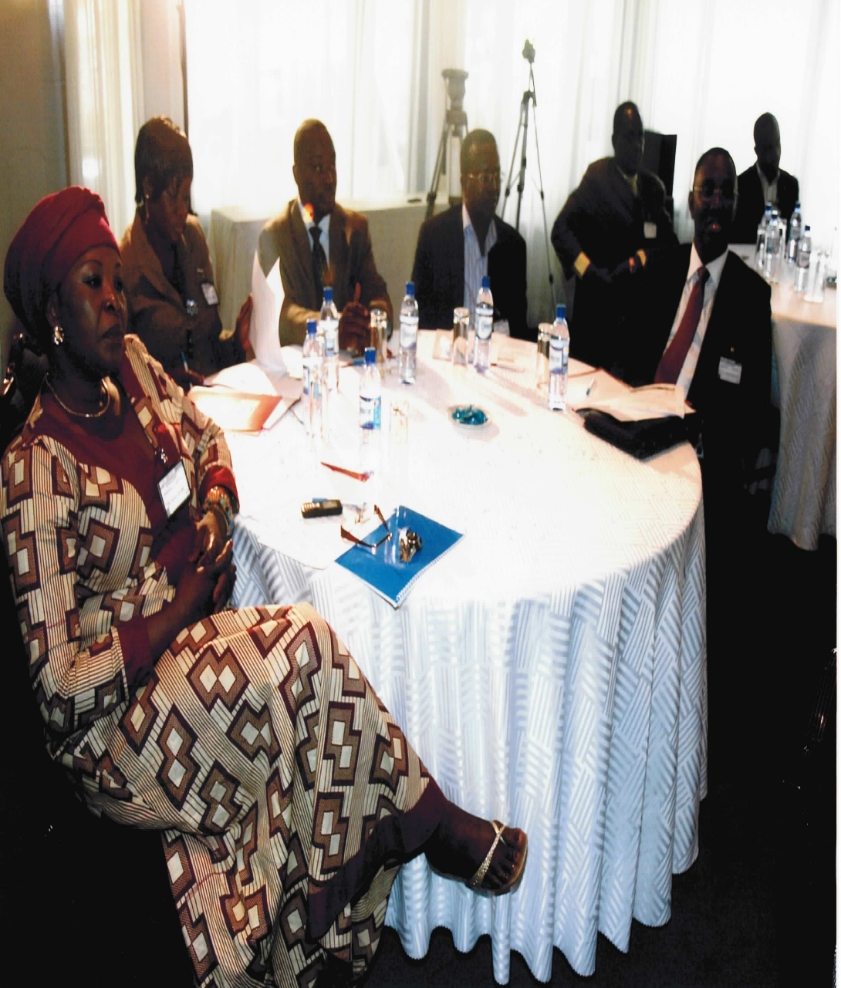
Impact: Dissemination Seminar in Ghana
Academic and Managerial Staff- Policy and Prowess
Stressed existence of policy on sexual harassment.
Some men blamed women students’ ‘indecent dressing’/ suggested that we interviewed the ‘wrong’ students.
Many women wanted to support/ raise awareness.
Students- Activism and Agency
Angry and outraged- started a zero tolerance campaign.
Wanted student union representation on disciplinary hearings.
NGOs- Partnerships
Wanted coalitions to challenge gender violence
Challenged sexist assumptions about dress etc.

Slide 9
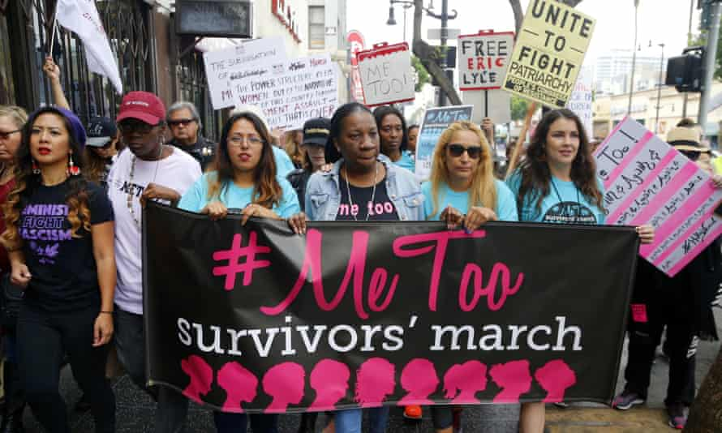
Contemporary Challenges
Individual universities might have policies, but national higher education sectors often lack policy architecture/ specific guidance on procedures to address student complaints about staff sexual misconduct.
Students are often excluded from the process purporting to resolve their complaint.
Complainants do not always have appropriate and effective support, nor are they briefed on the outcome of the investigation (breach of human rights?)
(See Bevan et al, 2020)

Slide 10
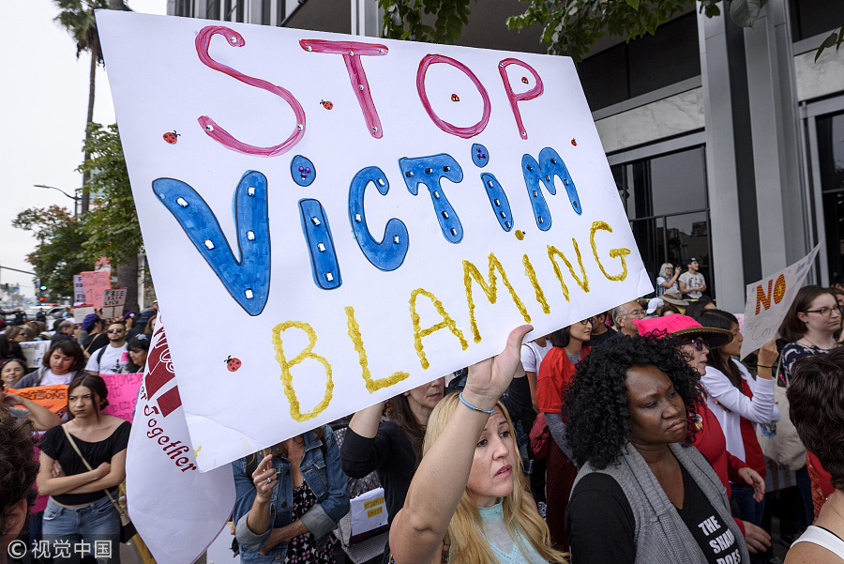
Provocations
Quality over-rides equality
Universities fail to take action against research superstars; do not want to publicise cases/ marketing.
Heteronormativity
LGBTQAI+ students/staff overlooked; more vulnerable/ visible e.g. Avital Ronell in the USA.
Leadership
What makes a difference/ creates safe spaces for disclosure and protection? (Morley & Crossouard, 2016; Morley & Lund, 2020).
Ethics
Should academic ethics follow medical ethics?
How to destabilise the social and cultural power relations that enable this form of abuse to thrive?

Slide 11
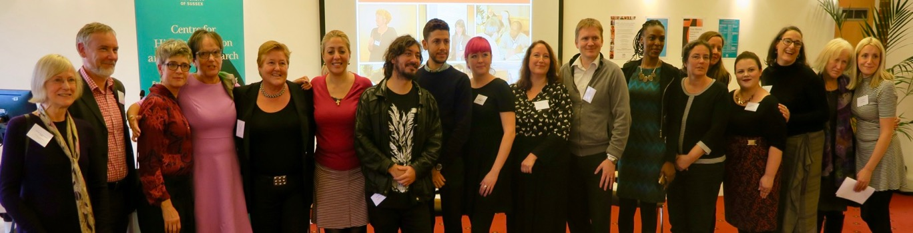
Follow Up?
Boyer, E.L. (1990). A special report. Campus life. Princeton, NJ:The Carnegie Foundation for the Advancement of Teaching.
Bull, A., & Rye, R. (2018). Silencing students: institutional responses to staff sexual misconduct in higher education. The 1752 Group. https://pure.port.ac.uk/admin/files/11631036/Silencing_Students_The_1752_Group.pdf
Cantor, D., et al.(2020). Report on the AAU Campus Climate Survey on Sexual Assault and Misconduct.
https://www.osu.edu/assets/buckeyesact/2019_campus_climate_survey.pdf.
Dziech, B., & Weiner, L. (1984). The lecherous professor: Sexual harassment on campus. Chicago, IL: University of Illinois Press.
MacKinnon, C. (1979). Sexual harassment of working women: A case of sex discrimination. New Haven, CT: Yale University Press.
Morley, L. and Crossouard, B. (2016). "Gender in the Neoliberalised Global Academy: the Affective Economy of Women and Leadership in South Asia." British Journal of Sociology of Education 37(1): 149-168.
Morley, L. (2014) Lost Leaders: Women in the Global Academy. Higher Education Research and Development 33 (1) 111–125.
Morley, L. (2013) "The Rules of the Game: Women and the Leaderist Turn in Higher Education " Gender and Education. 25(1):116-131.
Morley, L., and Lund, R. (2020). The affective economy of feminist leadership in Finnish universities: class-based knowledge for navigating neoliberalism and neuroliberalism. Discourse 42 (01). https://doi.org/10.1080/01596306.2020.1855567
Morley, L. (2011) Sex, Grades and Power in Higher Education in Ghana and Tanzania. Cambridge Journal of Education 41(1): 101-115.
Paludi, M.A., & Barickman, R. (Eds.). (1991). In their own voices. In M.A. Paludi, & R.B. Barickman, Academic and workplace sexual harassment: a resource manual. Albany, NY: State University of New York Press.
Thomas, A.M., & Kitzinger, C. (Eds.). (1997). Sexual harassment: Contemporary feminist perspectives. Buckingham: Open University Press.
WHO (2021) Violence Against Women https://www.who.int/news-room/fact-sheets/detail/violence-against-women.
CHEER Website: www.sussex.ac.uk/education/cheer
Twitter: @SussexCHEER
Facebook: www.facebook.com/groups/CHEERSussex/

