Slide 1

It is our responsibility to promote equality and ensure the provisions of the Equality Act are implemented and adhered to by our members and in the sectors where we organise. This is also written into our rules. Our rules commit us to ending all forms of discrimination, bigotry and stereotyping.
UCU believes academic freedom is bound up with other civil liberties and human rights so therefore does not give the right to discriminate.

Slide 2

UCU is committed to an intersectional approach within all its work.
The concept of intersectionality has at its core an understanding that within marginalised groups there are a number of different identities
Listening and trying to understand difference within groups, from an intersectional position, is key to building the strength of the group as a whole.

Slide 3


UCU supports trans workers' rights and, as champions of equality, we welcome the increased visibility and empowerment of transgendered and non-binary people in our society.
Trans people, including students and staff in tertiary education, face physical and verbal abuse, prejudice and discrimination, marginalisation and misrepresentation.
UCU is fully committed to providing practical support and policy guidance for reps and trans members in challenging discrimination and harassment.

Slide 4

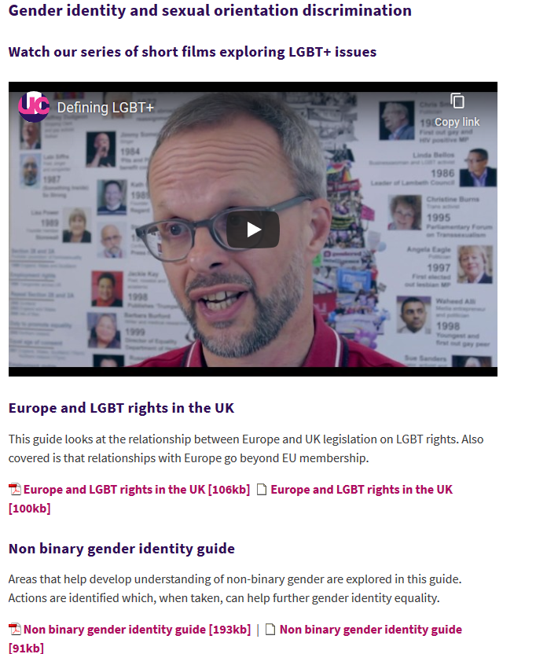
Research, Advice and Guidance

Slide 5
LGBT+ Voices, Visibility, History
Important to ensure visibility of LGBT+ people in all areas including family, social, work, history and curriculum
Keep a focus on international issues including international working

Slide 6




Slide 7
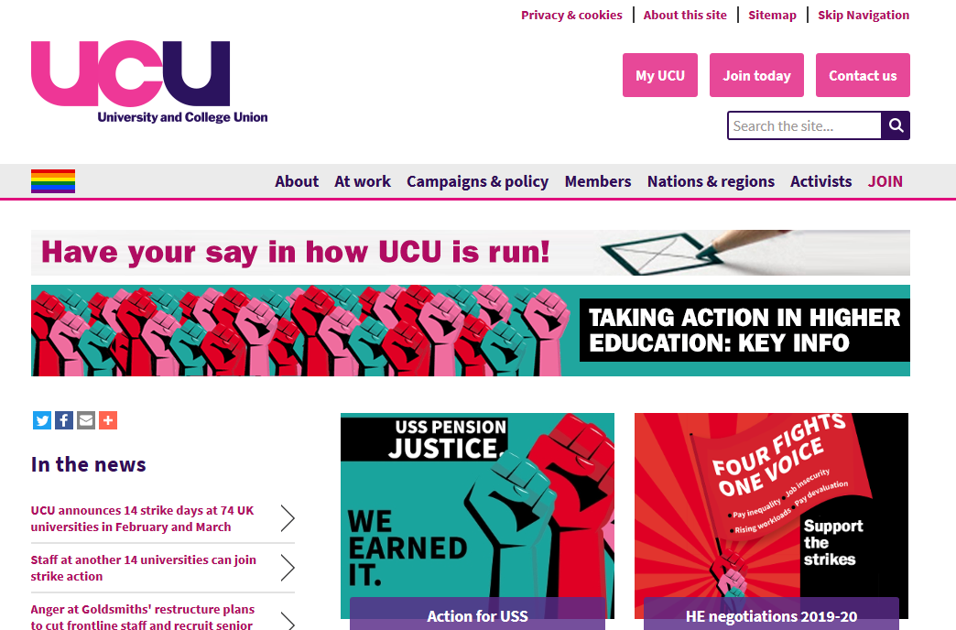

Contacts
UCU website: ucu.org.uk
Seth Atkin: satkin@ucu.org.uk

