Slide 1
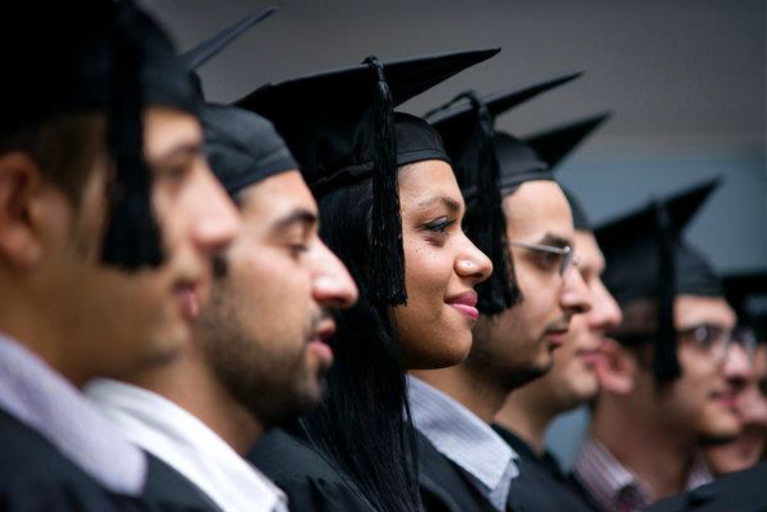
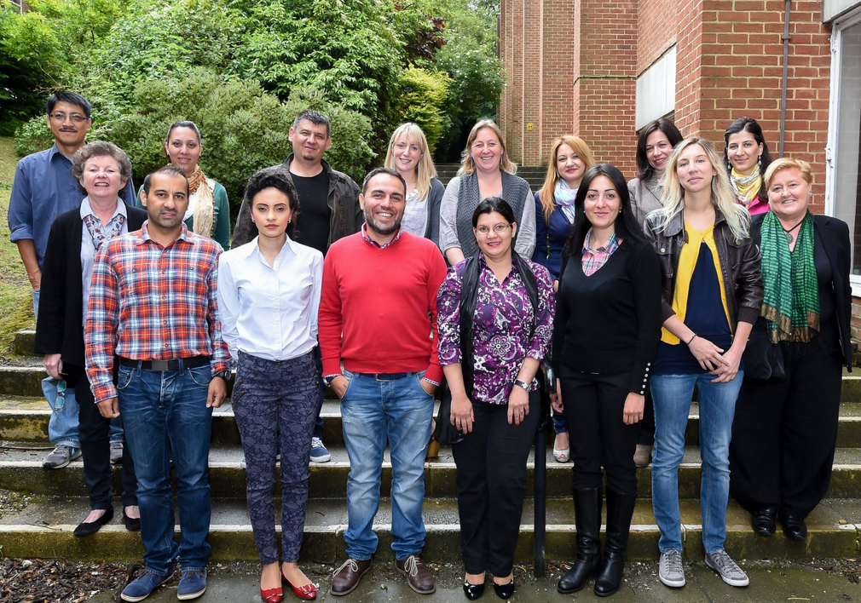
Roma students’ experiences in European Higher Education: Exploring gender, identity and marginalisation
Dr Emily Danvers, Dr Tamsin Hinton Smith, Tanja Jovanovic
CHEER (Centre for Higher Education and Equity Research)

Slide 2
Roma Exclusions
Roma as a heterogeneous minority ethnic group with considerable debate over categorisation and naming.
Roma young people are vastly underrepresented in higher education (HE) compared to their non-Roma peers. Less than 1% of Roma in Europe complete a tertiary-level qualification. (UNDP et al., 2011). In the UK this equates to around 11 times lower than the whole population (HESA, 2017)
There are complex factors structuring the under-representation of Roma students within HE including material deprivation, geographical marginalisation and racism/discrimination.
Progress on Roma integration and inclusion in the UK in particular (in response to the EU National Framework for Roma Integration) is exceptionally slow or even absent in many policy areas

Slide 3
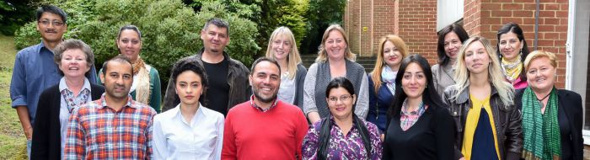
The HEIM Project
The HEIM (Higher Education Internationalisation and Mobility) project looks at equity and inclusion within internationalised HE, focusing on the Roma community in Europe.
It is a partnership between three universities (Sussex, Umeå and Seville) and the Roma Education Fund (REF), based in Hungary.
The project runs from January 2015 - December 2017 and comprises of secondments, staff exchange and collaborative inquiry. Outputs include capacity building, training materials, network building, policy and institutional guidance and working papers and academic journal articles.

Slide 4
Researching Roma Women
In March 2015, we were seconded to Budapest to write a briefing report based on policy analysis and meetings with Roma activists and NGO colleagues on the situation of Roma in UK HE.
Gender emerged as a key theme in this ethnographic scoping work - prompting further exploration.
We conducted semi-structured face-to-face interviews with 5 Roma women about their experiences of access and participation in higher education and the graduate labour market.
These women were from Albania, Macedonia, Romania and Serbia. Three were currently studying towards PhDs, and all were active internationally in Roma activism.
These interviews offered in-depth insight into the experiences of Roma women students in European Higher Education, deserving of a distinct analysis.

Slide 5
Researching Roma Women in Spain
Spain as the only country outside CEE to participate in the Decade of Roma Inclusion (2005-2015)
The largest Roma population outside CEE
Both Spain and CEE persistent characterised by persistent discrimination against Roma alongside internationally-recognised inclusion strategies
Opportunities for Roma negatively impacted in both CEE and Spain by decreasing social protection: end of state socialism in CEE, 1989 and economic recession in Spain, 2010
Internationally recognised ‘Spanish model for Roma inclusion’ from 1989 - based on a widely inclusive, universal welfare system
BUT in contrast to CEE, no Affirmative Action policies in Spanish HE targeting Roma or any other ethnic group – despite rising overall HE participation in Spain, participation remains low for disadvantaged groups, including those from migrant, working-class, and low parental education backgrounds

Slide 6
Feminist Researchers?!
Operationalising gender as an essentialising positioning – conveying participants’ own meanings, acknowledging the construction of opportunities and similarities with other marginalised groups
Intersectionality (Crenshaw, 1991; Collins, 1990; Baca Zinn and Thornton Dill, 1996) - participants lives, research process, and negotiating the complexities
Slippery spaces – shifting identities, boundary crossings between researcher and participant – individuals as ‘not only the actor, but also the author’ (MacIntyre, 1981, p. 198)
RISE and collaborative partnerships – researcher as ‘traveller’ (Kvale, 1996) or ‘feminist as tourist’ (Mohanty, 2003) and democratising the research process?
For a politics of ‘speaking nearby’ (Trin Minh ha, 1992) and feminist solidarity across unequal power relations (Mohanty, 2003)

Slide 7
1. Tensions of Identity and Belonging
Being a woman, being a Roma woman, being an educated woman, I feel like you’re not accepted anywhere. I feel about myself in [home country] when I go there I’m not accepted in my community, I’m not accepted in the non-Roma community. I feel somehow I’m in between. (Tatjana)
Feelings of ‘un-belonging’ in both their new lives of HE and professional employment, and traditional ties of marriages, family, and community - frequently expressed as engendering a sense of slipping between spaces, belonging nowhere.
Roma women’s ‘double disadvantage’ in mainstream culture and Roma communities (Kyuchukov, 2003, p.97).
Tensions of identity and belonging felt differently in relation to multiple (and often shifting) identities comprising national identity, religion, geographic location, social class and marital status, suggesting a complex set of factors constructing the educated female Roma subject.

Slide 8
2. Doors Opening and Closing
I don’t know whether University broke my marriage or opened my eyes. Men don't necessarily want a professional woman next to them, it becomes too much. I realised that I could do more than iron my husband's shirts. (Mila)
Opportunities simultaneously opened and closed - while HE presented a precarious offer of financial, intellectual and personal rewards, it also opened up new sites of exclusion and marginalisation. This reflects Brine and Waller (2004) who assert that for marginalised groups accessing HE ‘twin images of opportunity and risk shimmer’ (p. 103)
These women’s stories did not suggest a neutralised agentic chooser prevalent in dominant theorisations of international HE mobility. Instead they could be more accurately characterised as complex, multi-causal processes of becoming that enacted simultaneous pulls between past/future and between former/possible selves.

Slide 9
3. Integration and normalisation
Studying means leaving your Roma culture? No, I’ve seen that in marginalised contexts but not where I live, in my town... It doesn’t depend of the culture but on the context in which you are (Flora)
I was a normal student, as everyone else in the classroom (Antro)
My high school was an integrated school. I was the only Gitano studying there (Ets)
‘Normalised’ as opposed to ‘marginalised’ upbringings
Not socially, economically or occupationally different from the wider population
Spanish Roma students researched all lived and had been educated in areas integrated with the mainstream community, as is in line with the Spanish model of inclusion

Slide 10
4. ‘Coming out’ or ‘ethnic invisibility’
Declared as Gitano? No, I don’t know anyone. There might be others because sometimes I see people with some features… but I don’t ask them “hey, are you Gitano?” I simply don’t speak about it…. I have told my close friends I’m Roma because I don’t have any problem with saying “I’m Gitano”… because they are my friends and I never heard any derogatory comment from them regarding Roma… But, when it comes to anyone in the classroom, somebody that I just see once or twice a week, one hour, or from who I have heard negative things about Roma… I pass. (Refre, Spain)
Competing pulls of ‘coming out’ (Pantea, 2015) versus ‘ethnic invisibility’ (Abajo and Carrasco, 2004; Padilla-Carmona et al., 2016)
Existence of Affirmative Action in CEE implies a compulsion to disclose ethnicity and also an often explicit requirement to ‘give back’ in return for support received. In contrast, the presence of discrimination against Roma in Spain alongside an absence of targeted support, gives little impetus for disclosure of ethnicity.

Slide 11
5. A precarious inclusion
Someone started to say that me and my brother were Gitanos… Before that I knew that I was different but didn’t know what difference was that and then, one day, he started to release that I was Gitano… and I suppose that I started to see it as something negative, because of the things they said about me… (Antro)
My mates thought I was joking when I told them I was Gitano (Antro)
Spanish Roma invariably described inclusion as reliant on Roma origin remaining hidden from peers and teachers
‘Ethnic invisibility’ - Roma from CEE countries sometimes described experiencing prejudice because of ‘not being white.’ In contrast, Spanish Roma are often physically undifferentiable from non-Roma peers, and hence assumed not to be
A fragile, illusive basis of inclusion and belonging?
Being welcome contingent on looking and behaving as non-Roma

Slide 12
Conclusions
The need to validate the experiences that diverse students bring to HE
The opportunity to redress chasms between community of origin and being a university student and graduate that emerge from Roma students’ narratives in this research
Enabling processes of becoming that do not inherently require breaking with minority community in order to achieve belonging within the academy
Addressing the impact of cultural assimilation approaches on engendering ethnic invisibility responses by individuals is central to ensuring that Roma are not simply numerically present in HE
The need to be able to ‘come out’ without being perceived out of place in doing so
Positioning HE as an individual right and responsibility for all rather than a gift to be repaid by the marginalised.

Slide 13
References
Abajo, J. E. and Carrasco, S. (Eds) (2004) Trayectorias de éxito escolar de gitanas y gitanos en España: Encrucijadas sobre educación, género y cambio cultural (School successful trajectories of Roma girls and boys in Spain: Crossroads of Education, Gender and Cultural Change), Madrid, Instituto de la Mujer/CIDE.
Baca Zinn, M. and Thornton Dill, B. (1996). Theorizing Difference from Multiracial. Feminisms. Feminist Studies 22 (2), pp. 321-33.
Brine, J. and Waller, R. (2004) ‘Working-class Women on an Access Course: Risk, Opportunity and (Re)constructing Identities.’ in.Gender and Education, Vol.16 No.1, pp. 97-114.
Chen, N. (1992). Speaking Nearby: A Conversation with Trinh T. Minh–ha. Visual Anthropology Review 8(1), pp. 82-91.
Collins, P.H. (1990). Black Feminist Thought: Knowledge, Consciousness and the Politics of Empowerment. Boston, USA: Unwin Hyman.
Crenshaw, K. (2003). Traffic at the Crossroads: Multiple Oppressions. In Sister- hood is Forever: The Women’s Anthology for a New Millennium, edited by R. Morgan, 43–57. Washington, DC: Washington Square Press.
Department for Business Innovation and Skills (2014). Participation Rates in Higher Education 2006-2013. London: Department for Business Innovation and Skills.
HESA (2017). Higher education student enrolments and qualifications obtained at higher education providers in the United Kingdom by ethncity 2015/16. London: Higher Education Statistics Agency.
Kvale, S. (1996) An Introduction to Qualitative Research Interviewing. London: Sage.
MacIntyre, A. (1981). After virtue: A study in moral theory. London, UK: Duckworth.
Mohanty, C. (2003) Feminism without Borders: Decolonizing Theory, Practicing Solidarity. North Carolina, USA: Duke University Press.
Padilla-Carmona, M.T., González Monteagudo, J. and Soria Vílchez, A. (2016) ‘Los gitanos en la universidad española: Un estudio de caso de trayectorias de éxito’ (Roma students in Higher Education: A qualitativeresearchonsuccessfultrajectories) in Revista de Educación. (Under review)
Pantea, M.C. (2012) From ‘Making a Living’ to ‘Getting Ahead’: Roma Women's Experiences of Migration, Journal of Ethnic and Migration Studies, 38(8), 1251-1268.
United Nations Development Programme, World Bank and European Commission.The Situation of Roma in 11 EU Member States. http://issuu.com/undp_in_europe_cis/docs/_roma_at_a_glance_web/1 - download. 2011a, Accessed 03 April 2015.

