Slide 1

FACTORS INFLUENCING THE EMPLOYABILITY OF NON-TRADITIONAL UNIVERSITY STUDENTS
“Critical Perspectives on Transitions Into, Through and Beyond Higher Education”
University of Sussex, 15th October, 2018
María Tenorio-Rodríguez.
Universidad of Seville (Spain)
Email: mtenorio@us.es

Slide 2
INTRODUCTION
Graduates’ employability has become a key objective in the Bologna process.
Little has been investigated on the process of transition to the labour market of non-traditional groups (disability, mature age, ethnic minorities, low socio-economic capital, with children in their care, first-generation students, immigrants) .
The objective of this paper is to identify the factors that are influencing the employability of non-traditional students from the perspective of these students and employers.

Slide 3
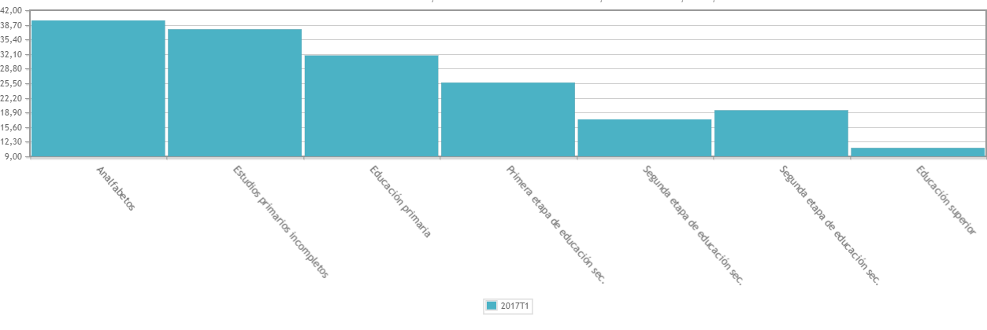
NON-TRADITIONAL LEARNERS IN UNIVERSITY AND THEIR EMPLOYABILITY
Many studies point to the process of integration into the work market being more satisfactory and successful for university graduates in comparison to the rest of the population.
Figure I. Unemployment rates in Spain according to level of training (2017).

Slide 4
NON-TRADITIONAL LEARNERS IN UNIVERSITY AND THEIR EMPLOYABILITY
However, not all graduates have similar job opportunities despite having received the same education. Some of the characteristics linked to non-traditional students could aggravate the situation of this group with respect to their employability.
Non-traditional students at Spanish universities
- 28,2 % are mature students
- 51% first generation students
- 7,2 % have dependent children
- 4,9 % come from abroad
- 13,6% low social class
- 1,3 % are disabled
(Eurostudent 2011; CERMI 2014; ECoViPEU 2011; Eurostudent 2011, MECD 2015)

Slide 5
There are many factors that influence an individual's employment prospects, such as age, sex, ethnicity or social class (Harvey, 2001).
Non-traditional students face specific difficulties in achieving effective transitions in the labour market (Brown and Hesketh, 2004).
Need more time than "traditional" students to find highly qualified jobs
More likely to find jobs below their skill level, less interesting and with lower wages (Purcell, Wilton y Elias, 2007)
RESEARCH OBJECTIVE:
Identify and deepen knowledge the factors influencing their employability.

Slide 6

METHOD
Qualitative approach
In order to analyze the perception that these subjects have of employability, identifying the factors that promote or limit it.
In-depth biographical interviews with:
7
* Ten students in their last year of degree
* Ten recent graduates
(University of Seville, belonging to all fields of knowledge and representing the different non-traditional profiles)
* Ten employers
(Representing different professional sectors and covering both SMEs and large companies)
NVIVO

Slide 7
FACTORS INFLUENCING THE EMPLOYABILITY
External Factors
Internal Factors
Changes in the labour market
Low investment in some sectors
Precarious jobs
Excessive work requirements
Lack of contacts
Training difficulties
Labor Responsibilities
Prejudice to Non-Traditionals
Family Responsibilities
Economic difficulties
Mobility difficulties
Supply-Demand mismatch

Slide 8
External Factors
Prejudice to Non-Traditionals
"It's not well seen in the company, so it's something you can't say openly that he's a gypsy, you can't say it because it's not well seen (...) It's very difficult to talk about these issues openly but it is a hidden discrimination. Yes, there is, of course. (Angel, employer)
“I know that I’m a person who’s at risk of exclusion (…) because I’m a woman, I’m over forty-five and I’m working class. Though I’m educated, the social class still counts” (Justa, student).

Slide 9
External Factors
Excessive work requirements
"That hold me back, (...) to get a number of requirements the employers ask you and I do not have them. As a language, as having worked abroad, as having done fourteen things before that job. Because I've always worked in the same thing, I haven't had fourteen jobs. (Botico, student)
"What I would say to a recent graduate to improve their employability is training, training, training. Master's, doctorate, training, training, training. Because maybe training doesn't give you the job, but it opens the doors. Training opens the doors for you and then personal value is what makes you settle into the job. (Arte, employer)

Slide 10
FACTORS INFLUENCING THE EMPLOYABILITY
External Factors
Internal Factors
Changes in the labour market
Low investment in some sectors
Precarious jobs
Excessive work requirements
Lack of contacts
Training difficulties
Labor Responsibilities
Prejudice to Non-Traditionals
Family Responsibilities
Economic difficulties
Mobility difficulties
Supply-Demand mismatch

Slide 11
Internal Factors
Mobility difficulties
"I thought it at the beginning of the degree, when I came very motivated that I wanted to go on an Erasmus. After that, I had complications learning my way around, to go with support cane from one place to another. (...) I thought: "If here in Seville it has been complicated, abroad I can't even imagine it". (Manda, student)”.
Labor and family responsibilities
"To be at the same time at the university and working in the bar, to leave the bar, to enter in classroom, to leave the classroom, to enter in the bar. It has taken to me a time that others would have used to study". (Arias, student)

Slide 12
Internal Factors
Economic difficulties
"Yes, I'm studying English on my own, an "English yourself" program, with classes that are posted on the Internet and so on. Of course, I don't have the money to pay for an academy or a private teacher and so on, I do what I can.” (Alejandro, student)
"I come from a working family, we've had a little shop. By comparison, I have a colleague who is the son of a lawyer, a family of lawyers, who knows that if he can't find a job he will be able to work in his father's office.". (Flora, graduate)
Lack of contacts

Slide 13
FACTORS INFLUENCING THE EMPLOYABILITY
External Factors
Internal Factors
Changes in the labour market
Low investment in some sectors
Precarious jobs
Excessive work requirements
Lack of contacts
Training difficulties
Labor Responsibilities
Prejudice to Non-Traditionals
Family Responsibilities
Economic difficulties
Mobility difficulties
Supply-Demand mismatch

Slide 14
It is sometimes assumed that after having begun higher education there is equality among students, irrespective of their social or family backgrounds. Yet we have found out in this study that there are other factors which are overlooked by higher education policies and institutions.
The important point to be noticed is that no attention is being paid to the specific work transition process of non-traditional graduates. They might be at risk of exclusion in the labour market but no special measures are taken to overcome it.

Slide 15
FACTORS INFLUENCING THE EMPLOYABILITY OF NON-TRADITIONAL UNIVERSITY STUDENTS
“Critical Perspectives on Transitions Into, Through and Beyond Higher Education”
University of Sussex, 15th October, 2018
María Tenorio-Rodríguez.
Universidad of Seville (Spain)
Email: mtenorio@us.es

