Slide 1
Quality, Power and Equality in Higher Education: Tensions and Convergence
CENTRE FOR HIGHER EDUCATION AND EQUITY RESEARCH
Professor Louise Morley and Paul Roberts

Slide 2

Policy Drivers
  Academic managerialism
  Political concerns with the exchange/ use value of higher education
  The need for certainty in expanding, global systems
  Consumer empowerment/choice/ entitlements
  Marketisation
  Enhancing productivity
  Allocation of funding
  Maintaining/ enhancing standards
  Recession, selectivity/ closures and austerity cultures.

Slide 3






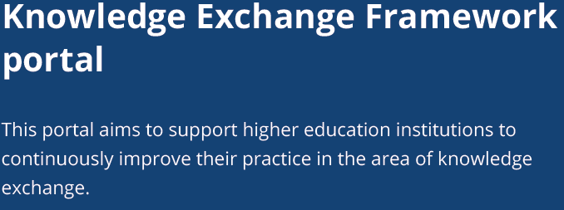
CENTRE FOR HIGHER EDUCATION AND EQUITY RESEARCH
CURRENT FORMS OF QA

Slide 4

Impact on Higher Education
Changing Priorities
Changing Social Relations
Changing Pedagogical Relations
Changing Professional Identities
League Tables
Differential Funding
Managed Productivity
Increased Workloads
The Affective Domain

Slide 5

Quality as Discourse: Creative and Restrictive Potential?
    QA reinforces power via:
    Monolithic notions of what constitutes quality
    Relationship of power between observers and observed/ one-way gaze
    Evaluative State and Audit Culture
    Domination, regulation and surveillance
    QA disrupts traditional power relations via:
    Transparency
    Accountability
    Consumer rights

Slide 6
Advantages?

Slide 7

Equity and Social Inclusion
Private matters in public domain
The ‘panoptic’ gaze of QA has brought marginalised groups into the light e.g. students with special needs.
Reconstructing students as consumers = more rights?
Greater transparency makes discriminatory/
exclusionary practices more visible.
BUT
Is Equality a performance indicator in global league tables?

Slide 8
Disadvantages?

Slide 9

Reductivism?
Quality not about high standards, but about those which are uniform, predictable, demonstrable, and verifiable.
Emphasis on outcomes, rather than on complex processes.
What counts as evidence?
Criteria for best practices = the intellectual field, or client satisfaction?

Slide 10
Summary

Slide 11
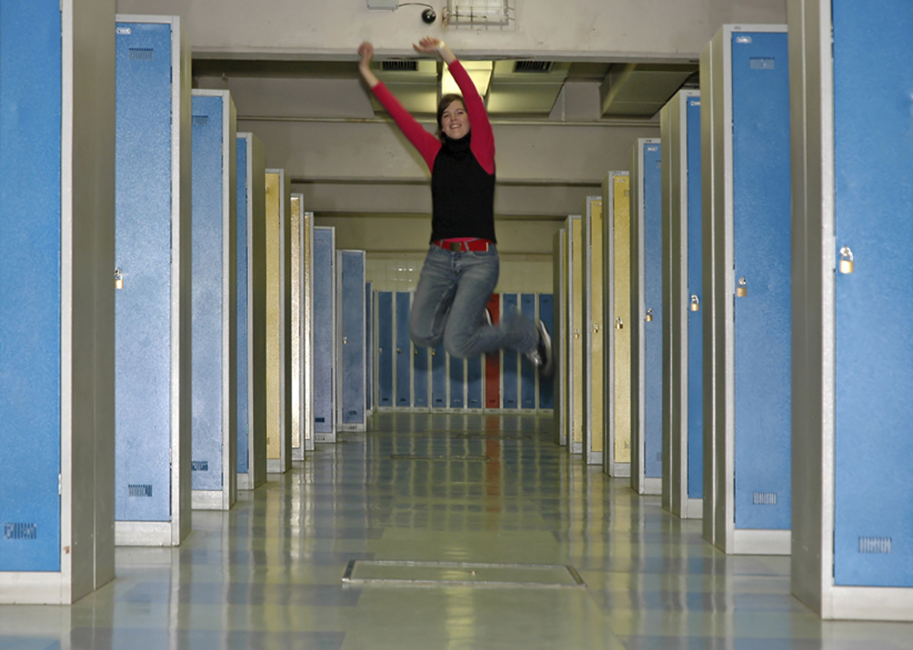
Positivity
For some, quality assurance:
has transformative potential
is democratising
challenges elitism, mystification and academic solipsism
facilitates organisational development
modernises/ revitalises archaic public services
makes the professions more responsive to clients/consumers
drives up standards
provides new paradigms for professional reflection.

Slide 12

Concerns
For others, quality assurance:
is unstable, unreliable and undesirable
suppresses critical knowledge
is irritating and time-hungry forms of new managerialist ‘noise’
contributes to a compliance culture and command economy
creates potential for misrecognition and inequalities
is about suspicion and mistrust
involves a form of symbolic violence.

Slide 13

Questions?
How is quality assured in your organisation/ professional context?
What signs of quality are being valued and performed?
What data are used/ required to evaluate quality?
What have been the losses and gains for different stakeholders?
What do you believe needs to be done differently?

Slide 14

http://www.sussex. ac.uk/education/ cheer
Centre for Higher Education and
Equity Research (CHEER)

