Slide 1
UK University Governance
Forms & New classification
Date: 27 February 2017
At: university of Sussex
Yumiko hada
Director of rijue (hiroshima university)

Slide 2
Introduction
To describe new classification of new universities after unification (former polytechnics, higher education institutions which were upgraded into universities) and old universities (formerly existing universities before 1992).
To define current UK education governance structure
To assess the decision-making mechanisms, from the initial leadership actions of chancellors and other individuals in leading positions, to the function of academic staff organizations and cooperation among academic staff in such organizations

Slide 3
1. The general trend of the decision- making mechanisms in UK universities
The composition of the decision-making organizations and intellectual organizations governance structures, branching from the board of directors and chancellor and the like
The leadership role taken by chancellors and other leaders
Institutional initiatives as a university
Education governance (focusing specifically on undergraduate education)

Slide 4
2. Analysis on the function of academic staff organizations
What form of authority and roles do academic staff organizations fulfill as management organizations of education?
In organizational education not individual level, is educational engagement achieved?
The method utilized by academic staff to coordinate the curriculum across different subjects
The condition of members (academic staff) informal involvement in decision-making mechanisms and the roles intended by organizational subdivision in universities

Slide 5
3. Method & Data
document analysis, literature survey (collection, analysis and consolidation of information sourced from print media, websites and emails), statistical analysis, and an interview
direct interviews of policy makers, researchers and related institutions

Slide 6
4. Primary sources
Government organizations’ publications, white papers, green papers, reports, laws and regulations, higher educational institutions’ publications, prospectus (university guide for their courses and graduate schools), financial reports, practical reports. Internal information which is not publicly available from higher educational institutions, such as college regulations, letters and related documents are also referenced. Information is sourced, as well, from electronic media, such as the internet.
Data not available direct from primary sources is collected from the academic literature, The Times Higher Education Supplement (THES), Guardian Education, the education journals

Slide 7
5. Research Materials
Profiles of Higher Education Institutions by Higher Education Funding Council for England (HEFCE), the university guide Good University Guide by The Times, and other major university guides such as The Virgin Alternative Guide to British Universities by Virgin Media Inc. and The Guardian University Guide by the Guardian. Economic aspects, such as tuition and governmental funding for education or research are analyzed. Reference data sources mainly from Higher Education Statistics Agency (HESA), Higher Education Funding Council for England (HEFCE), Higher Education Funding Council for Wales (HEFCW), Scottish Higher Education Funding Council (SHEFC), and Universities UK (UUK).

Slide 8
6. unification of UK higher education
“binary system” since 1965 (Speech of Education Minister Crosland) lasted for decades
1992 became an epoch-making year for the higher education sector of the UK after enactment of 1988 Education Reform Act and the 1992 Further and Higher Education Act.
New universities after unification (former polytechnics, higher education institutions which were upgraded into universities) and old universities (formerly existing universities before 1992)

Slide 9
6-1. After 1992 Unification
It increased the number of universities and college students as a result.
Full-time first degree students used to receive grants up until 1989, but schools started to collect tuition in that year.
As a result, universities became more aware of the need for efficient management and focusing on collecting funds.

Slide 10
7. new universities attempted collaborations
University Alliance: UA has 23 universities which focus on business.
Bournemouth, Bradford, Cardiff Metropolitan, De Montfort, Glamorgan, Glasgow Caledonian, Hertfordshire, Huddersfield, Kingston, Lincoln, Liverpool John Moores, Manchester Metropolitan, University of Wales, Newport, Northumbria, Nottingham Trent, Oxford Brooks, Plymouth, Portsmouth, Salford and Open University

Slide 11
8. Overview of University Reform and University Governance Reform
In March 1985, a report, the Committee of Vice-Chancellors and Principals: Report of the Steering Committee for Efficiency Studies in Universities, commonly known as the “Jarratt Report” focusing on the management of universities was published by The Committee of Vice-Chancellors and Principals (CVCP, currently organized as Universities UK (UUK)).
In 2003 Richard Lambert published Lambert Review of Business-University Collaboration (known as the “Lambert Report”)”, focusing on the university management for the first time after Jarratt Report.

Slide 12
“Lambert Report”
a) Look on the activities of universities in new business partner collaborations for research and development
b) To highlight the successes of current university research department and business partnerships as a role model
c) Assist in molding policy by giving a variety of views to encourage further debate and suggestions
（Lambert 2003: 12）

Slide 13
9. Oxbridge-Business model
Universities were put under increased pressure by the government to mimic business management styles, and it was clear that the pressure was distinctively directed to the efficient management of Oxbridge.
The reason is that only these two universities were allowed to establish their own rules and regulations under Oxford and Cambridge Act 1923 with the approval of Privy Council since they were out of the framework of CVCP
The government expected other universities could also follow the business model easily if the Oxbridge-Business model became common. The reform of Oxbridge was an essential priority for the government in order to enact their desired higher education policy.

Slide 14
１０． Seven classifications
the Russell Group
“Sutton 13” and post-92 universities
①University I : Housing a Faculty of Medicine, and with more than 3 from Humanities Literature, Social Studies, Natural Science and Medical Science.
②University II : Housing more than 3 from Humanities Literature, Social Studies, Natural Science, Medical Science, but without Faculty of Medicine
③Research University : Housing a Research Quality : RQ 2.5 or more and 30% or more of graduate students
④Pro-Research University A : RQ 2.0 and more or 2.4 and less
⑤Pro-Research University B : RQ 1.5 and more or 1.9 and less
⑥Pro-University offering Bachelor’s Degree : Offering Bachelor’s Degrees and the advanced degrees attainment rate is 50% and less, RQ 1.0 and less
⑦Educational University : RQ1.4 or less, and not applicable to Pro-University offering Bachelor’s Degree

Slide 15
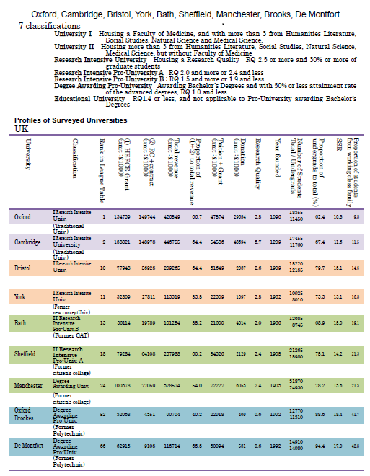

Slide 16
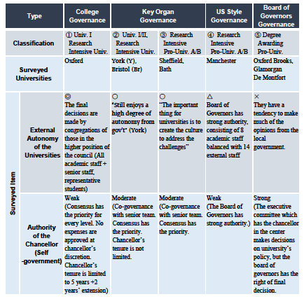

Slide 17
