Slide 1
International Mobility and Tensions
Yuki Yamaguchi (RIJUE)

Slide 2
Contents
1. Organization of the School System in Japan
2. Decline of the 18-year-old population
3. The Number of International Students and Japanese Students Abroad
4. Top Global University Project
5. University Mobility in Asia and the Pacific: UMAP
6. An example of Syllabus of Japanese Undergraduate Course in 2011
7. Standards of Undergraduate Programmes
8. The Number of Overseas Offices of National Universities
in Chugoku-shikoku Region
9. The Number of Overseas Offices of Japanese Universities

Slide 3
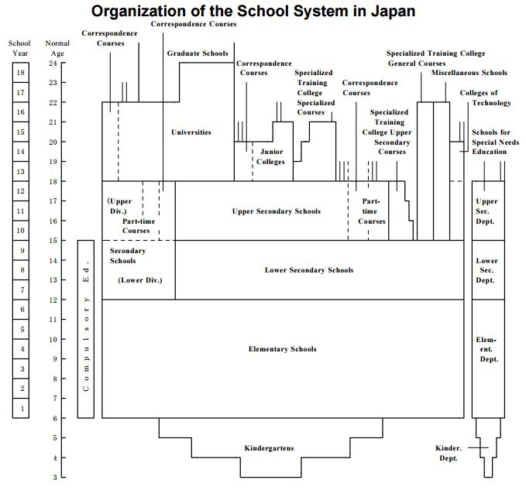
(MEXT, 2012)
1. Organization of the School System in Japan

Slide 4
1. Organization of the Higher Education System in Japan
・Japanese higher education institutions include universities, junior colleges awarding associate’s degree, colleges of technology, and specialized training colleges (specialized schools) offering specialized courses (MEXT, 2012).
・The structure helps us to examine the advancement rate of higher education.

Slide 5
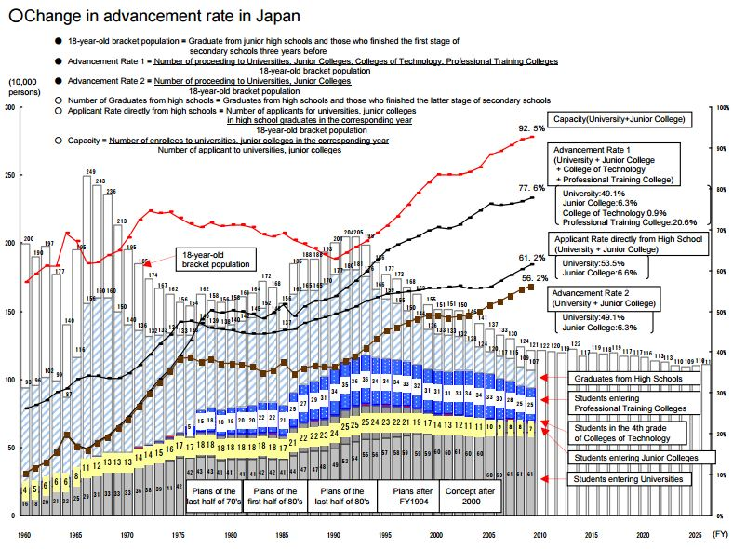
2. Decline of the 18-year-old population
Advancement Rate (University)
49.1 % in 2009,
51.5% in 2015
Advancement Rate (University, Junior College, College of Technology, Professional Training College )
77.6% in 2009,
79.8% in 2015
(MEXT , 2012, 2015b)

Slide 6
In Japan, the percentage of students in the 18-year-old population bracket enrolling in universities and junior colleges has steadily increased since the Second World War to exceed 50% as of now. If the percentages of students enrolling in colleges of technology and specialized schools are included, the total percentage exceeds 70%. Judging from this situation, it is assumed that Japan has already entered the stage of universal access to higher education (MEXT, 2012).
2. Decline of the 18-year-old population

Slide 7
152,062 (2015)
3. The Number of International Students and Japanese Students Abroad
81,219 (2014)
(JASSO, 2016a, 2016b)

Slide 8
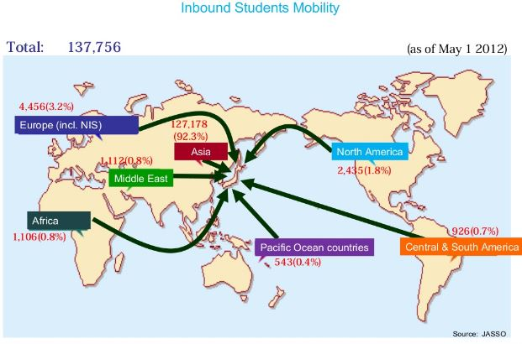
(Kato, 2013)

Slide 9
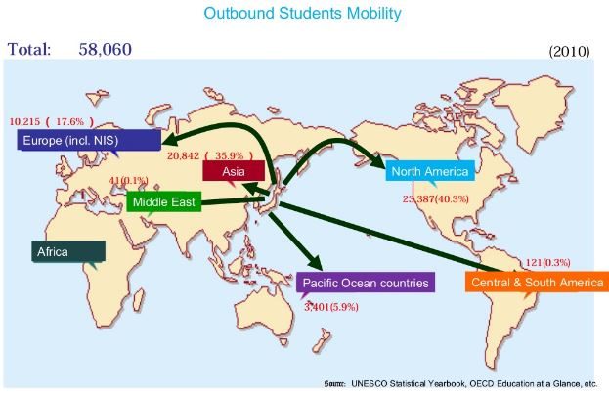
(Kato, 2013)

Slide 10
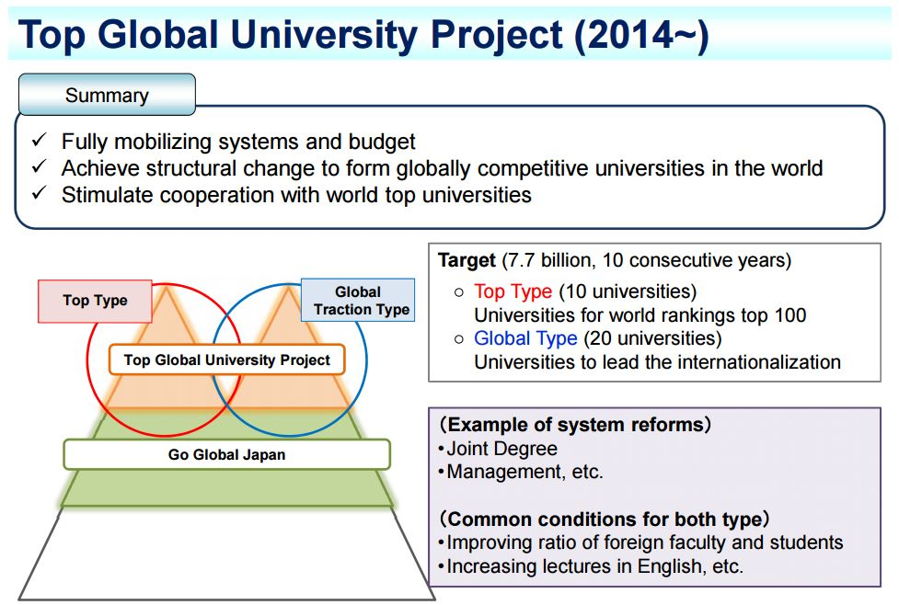
4. Top Global University Project
Source: MEXT, 2014, ‘Selection for the FY 2014 Top Global University Project’

Slide 11
With an aim to bolster the international competitiveness of Japanese higher education, this program works to thoroughly internationalize Japanese universities by
・establishing linkages between them and top-flight overseas universities
・advancing university reforms.
Features
Type A (Top Type): 13 universities
World-class universities that have the potential to be ranked among the top 100 world universities.
Type B (Global Traction Type): 24 universities
Innovative universities leading the internationalization of the Japanese society, based on continuous improvement of their current efforts.
4. Top Global University Project

Slide 12
・UMAP is the acronym for the “University Mobility in Asia and the Pacific.” Founded in 1991, it is a voluntary association of government and non-government representatives of the higher education (university) sector (UMAP).
・UMAP currently comprises 35 countries/territories with over 570 participating universities (UMAP).
5. University Mobility in Asia and the Pacific: UMAP

Slide 13
Title | Methodology of Extra Curricula Activities
 | In this course, you read academic articles about Arinori Mori in English. This course is composed of students’ presentations about assigned sections and group works. Your active participation is welcomed.
Objectives | To acquire reading skills in English To understanding about education of modern Japan.
Schedule | 1. Orientation
 | 2. Historical Background of thoughts of Arinori Mori (1)
 | 3. Historical Background of thoughts of Arinori Mori (2)
 | 4. Reading academic papers about Arinori Mori (3)
 | 5. Reading academic papers about Arinori Mori (4)
 | 6. Reading academic papers about Arinori Mori (5)
 | 7-13: Reading academic papers about Arinori Mori (6) – (12)
 | 14. Reading academic papers about Arinori Mori (13)
 | 15. Conclusion
Assessment | Participation: 80%, Presentation and Group works: 20%
6. An example of Syllabus of Japanese Undergraduate Course in 2011

Slide 14
Standards of the Ministry of Education, Culture, Sports, Science and Technology: MEXT
・2005 Medical Science
・2006 Pharmacy (2013 revised)
・2009 Veterinary Science
・2011 Management of Technology: MOT
・2016 Initial Teacher Training (Committee set up)
Standards of the Science Council of Japan
・In 2014, Science Council of Japan set up a committee and 14 section committees.
・The Committee member are professors.
・They set the standards of 25 academic fields.
・They comprise objectives, contents, teaching methods, and assessment methods.
7. Standards of Undergraduate Programmes
(SCJ, 2014)

Slide 15
8. The Number of Overseas Offices of National Universities in Chugoku-shikoku Region
Number of National Universities in Chugoku-Shikoku Region: 9
Almost all of offices located in Asia (86.7%).
Source: Mext 2015

Slide 16
9. The Number of Overseas Offices of Japanese Universities
Overseas Bases (UK): 11 (2013) ※Number of University: 782
Name of Universities | Name of Bases | Location
The University of Tokyo | The University of Tokyo London Office | London
The University of Tokyo | Clare Hall | Cambridge
Tokyo University of Foreign Studies | London Office | London
Shinshu University | - | Manchester
Kyoto University | Kyoto University's European Representative Office in London | London
Kyusyu University | London Office | London
Keio University | Keio University London Office | London
Teikyo University | Teikyo University of Japan in Durham | Durham
Kanto Gakuin University | Kanto Gakuin Centre | Oxford
Doshisha University | Doshisha London Office | London
Ritsumeikan University | Ritsumeikan UK Office | London
Source: Mext 2015

Slide 17
References
Japan Student Survices Organization: JASSO, 2016a, ‘The survey of japanese students study study abroad’ http://www.mext.go.jp/a_menu/koutou/ryugaku/__icsFiles/afieldfile/2016/11/11/1345878_1.pdf (22/2/2017).
JASSO, 2016b, ‘The Survey of International Students in 2015’ http://www.jasso.go.jp/about/statistics/intl_student_e/2015/index.html (22/2/2017).
Kato, S. 2013, ‘Higher Education in the Age of Globalization,’ (20th Tri-University Seminar and Symposium).
Ministry of Education, Culture, Sports, Science and Technology (MEXT), 2012, ‘Higher Education in Japan’, http://www.mext.go.jp/en/policy/education/highered/title03/detail03/1374111.htm (22/2/2017).
MEXT, 2014, ‘Selection for the FY 2014 Top Global University Project’ (Press Release), http://www.mext.go.jp/b_menu/houdou/26/09/__icsFiles/afieldfile/2014/10/07/1352218_02.pdf (22/2/2017).
MEXT, 2015a, ‘National Budget for FY 2015’, http://www.mext.go.jp, (22/2/2017).
MEXT, 2015b, ‘School Basic Survey’ http://www.mext.go.jp, (22/2/2017).
Science Council of Japan, 2014 , “Standards for Undergraduate Programmes,” http://www.scj.go.jp/ja/member/iinkai/daigakuhosyo/daigakuhosyo.html (22/2/2017).
Shimizu, K. 2011, ‘Current Situation and Policy Challenges in Japanese Higher Education’, http://www.kobe-u.ac.jp/documents/topics/top/2011_03_11_01-2-5.pdf (22/2/17).
UMAP, http://umap.org/, (22/2/2017).

