Slide 1
The Trouble with TEF*:
Problems and Possibilities in Enhancing the Quality of Teaching and Learning in Higher Education
Dr Simon Thompson
27th February 2017
* Teaching Excellence Framework

Slide 2

Focus
Outline key features and origins of the Teaching Excellence Framework (TEF)
Present challenging implications (including student opposition) for ensuring excellence in teaching and learning in the UK academy
Drawing upon Engestrom (2007) identify unintentional opportunities and alternatives in strengthening quality teaching

Slide 3

What is the TEF?
TEF is the Teaching Excellence Framework, introduced by the Government in 2016 ‘to recognise and reward excellent learning and teaching.’
TEF
It will be an annual exercise implemented by the Higher Education Funding Council for England (HEFCE). Participating universities make submissions that are a combination of data and narrative themes.
TEF is likely to affect both reputation and finances: TEF outcomes will inevitably be used by some prospective students deciding where and what to study; and a university’s ability to raise student fees (in line with inflation) will be directly linked to its TEF award.

Slide 4
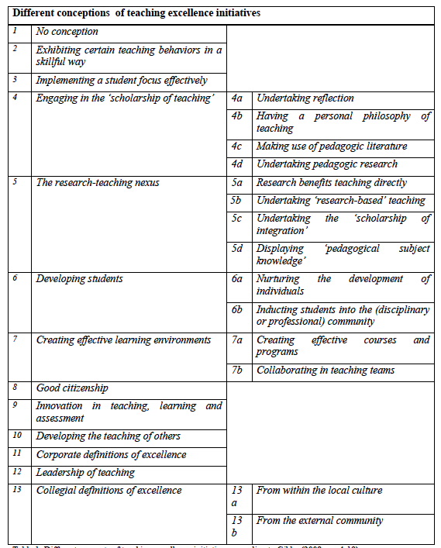
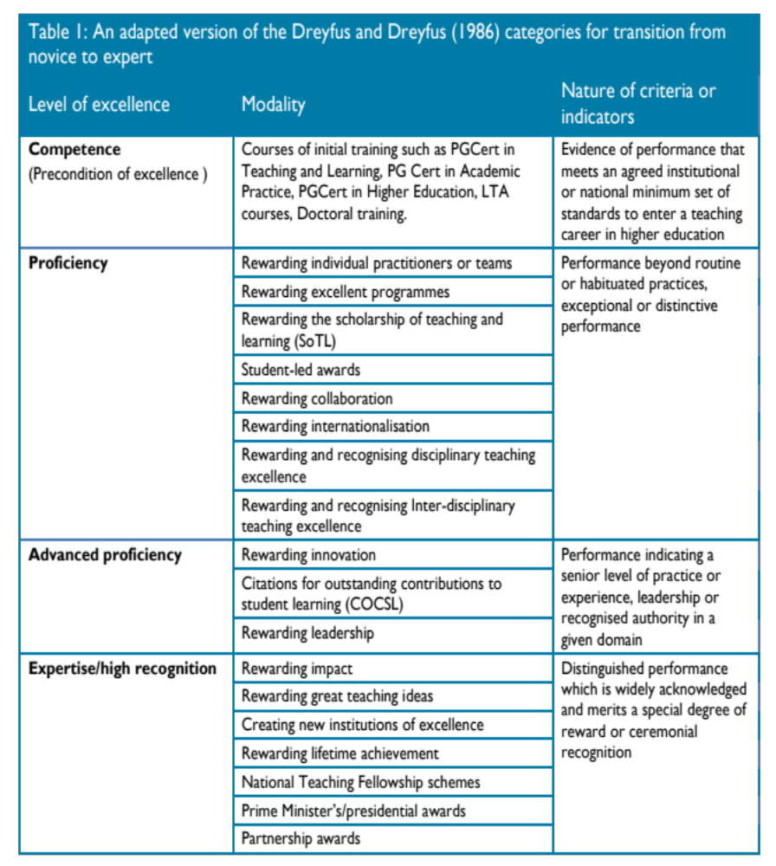
Scholarship Context of Teaching Excellence: Gibbs (2008) and Land and Gordon (2015)

Slide 5

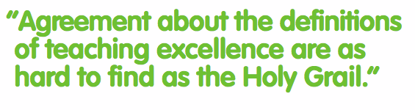
Definitions: “interminable and …insoluble debates” Deem (2015)

Slide 6

Teaching Excellence Defined:
Teaching
Quality
Learning
Environment
Student Outcomes and Learning Gain
Student Engagement
Resources
Employment and Further Study
Valuing Teaching
Scholarship, Research and Professional Practice
Employability and Transferrable Skills
Rigour and Stretch
Personalised Learning
Positive Outcomes for All
Feedback

Slide 7



Policy Context

Slide 8
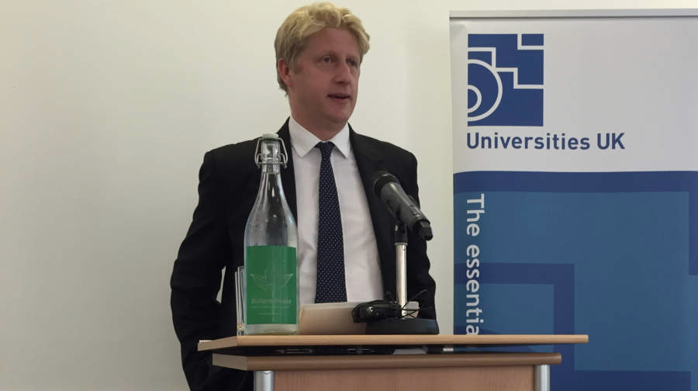
Policy Context
“This patchiness in the student experience within and between institutions cannot continue. There is extraordinary teaching that deserves greater recognition. And there is lamentable teaching that must be driven out of our system. It damages the reputation of UK higher education and I am determined to address it,”
Jo Johnson, Minister for Universities and Science at Universities UK Conference, September 2015

Slide 9
Purpose of the TEF (according to the TEF …)
Better inform students’ choices about what and where to study
Recognise and reward excellent teaching and raise esteem for teaching
Drive up standards of teaching across the sector
Improve match of graduate skills with needs of employers and the economy.

Slide 10
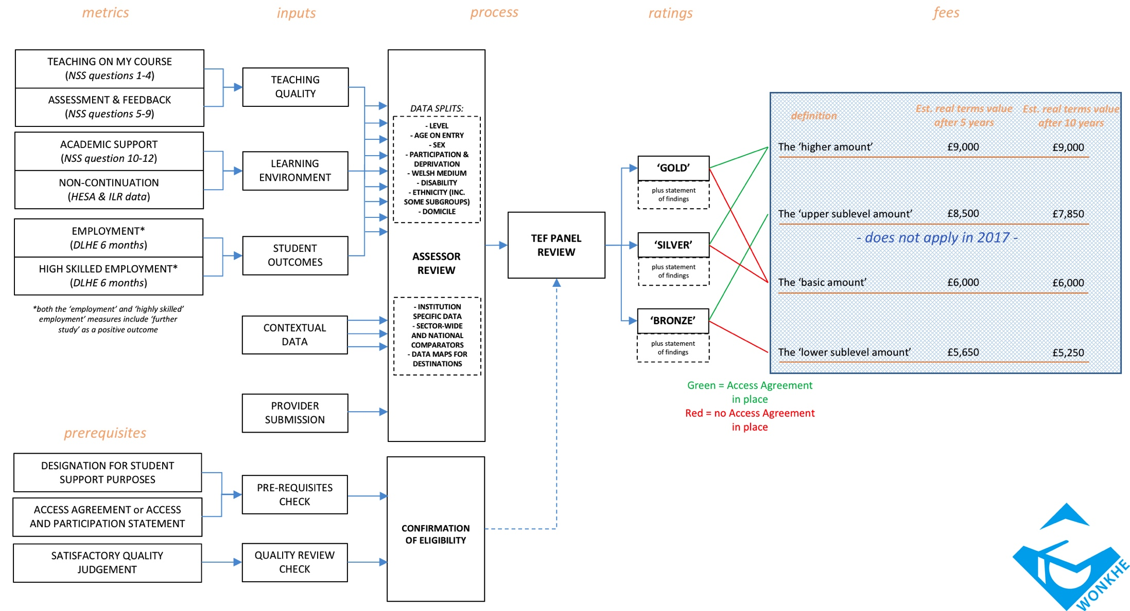




Slide 11
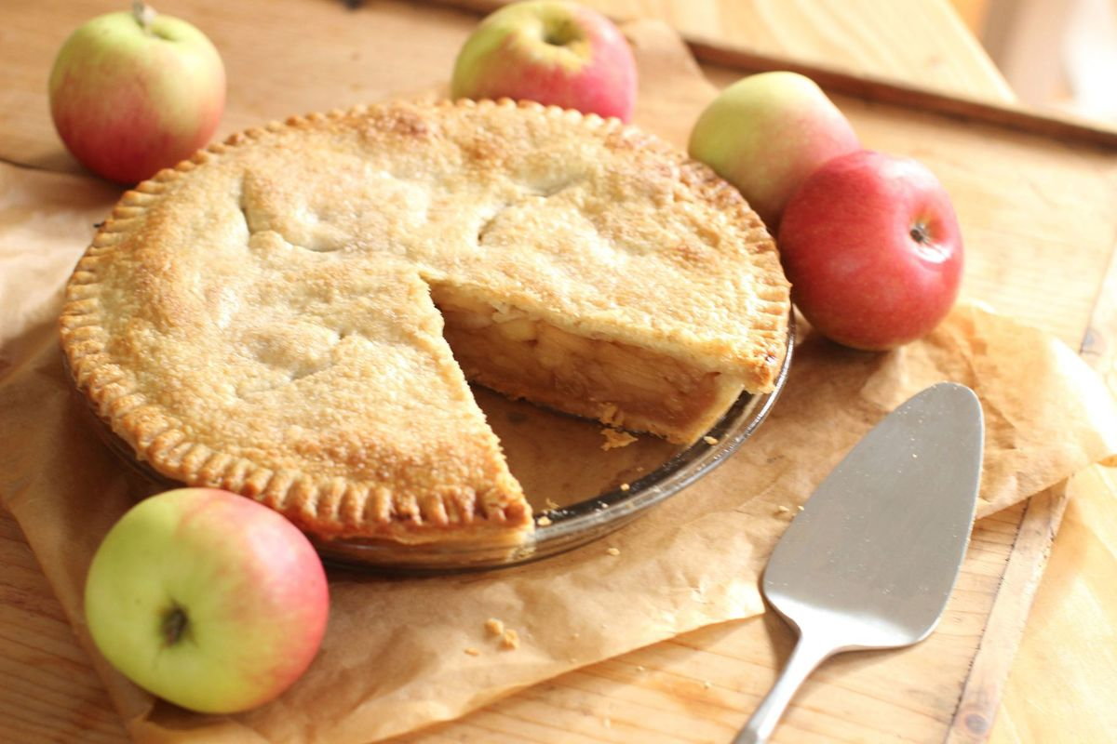
Kneale (2015): “Who can be against
excellence in teaching?”

Slide 12
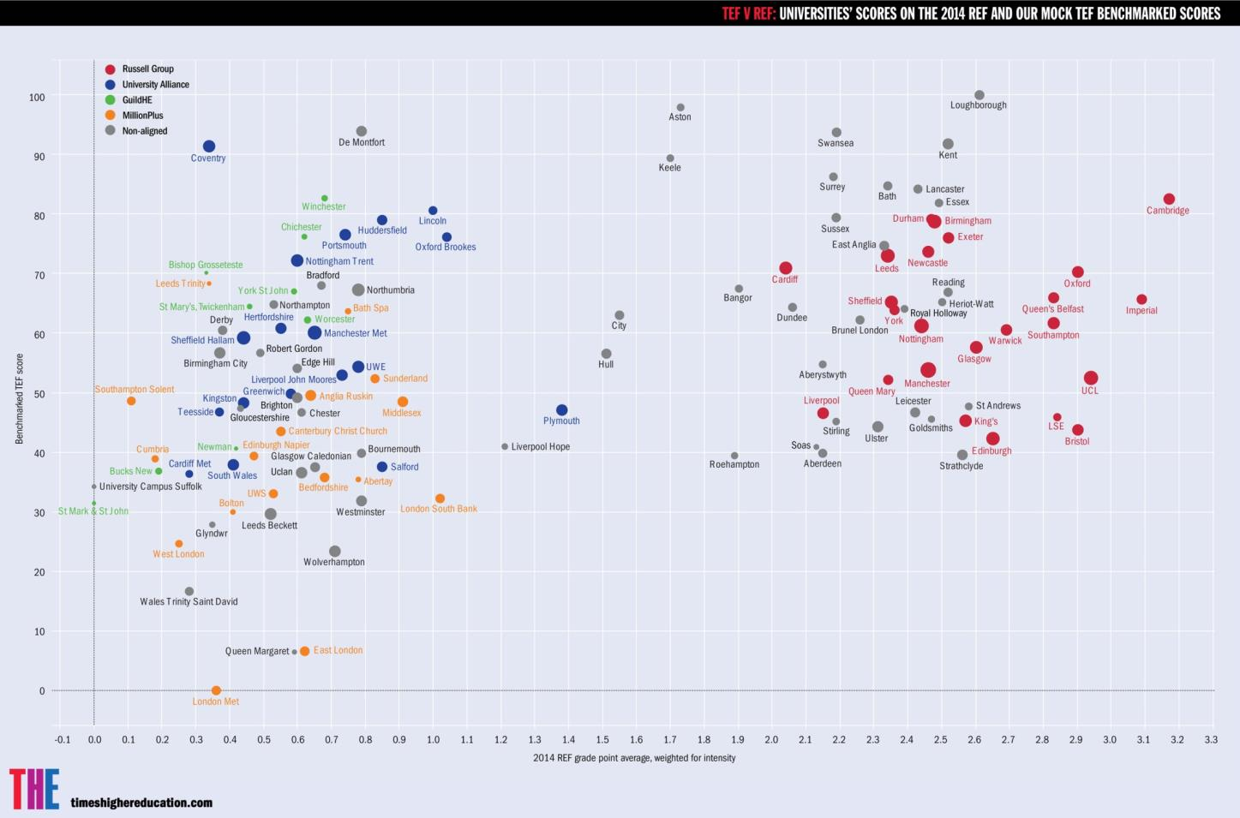
Trouble?: REF vs TEF
“Ugly Sisters of HE” Kneale (2016)

Slide 13


Trouble? Fit for purpose or discriminatory metrics?
Many academics critique the metrics privileged in TEF II. Most are arguably not about teaching at all – destinations, retention, etc. The only metric which explicitly explores teaching quality (of sorts) comes from the NSS which research has identified can betray sexist and racist bias.
Reported by Holyroyd and Saul (2016)

Slide 14

Trouble?: Lack of student interest
“Findings from BIS’s own research raise a number of doubts about this. Their applicant survey suggests that most students don’t think that there is a problem with information, with just eleven percent saying that information on quality is not transparent and six in ten saying it is. Their qualitative research findings also suggest that, while students think TEF information would be useful, it probably wouldn’t change their choice”
Darian (2016)

Slide 15


Trouble?: Teaching to the Test
Competing dynamics render the operation of an excellence scheme something akin to the playing of a game, requiring subtle moves and shrewd evaluative judgment in terms of anticipating possible effects and outcomes.
Land and Gordon (2015)

Slide 16

Trouble? – Competition over collaboration
Every other university participating in the scheme becomes a direct competitor as a result of this benchmarking element. A whole new era of internal competition is in prospect for higher education in the UK.
Dr Peter Kahn (2016)

Slide 17

Trouble?: “better life chances”
“The TEF ignores the wider public value of undergraduate education … risks eclipsing the wider social and personal purposes of higher education”.
Forstenzer (2016) – Sir Bernard Crick Centre for Public Understanding of Politics
Students continue (although evidence of decline) to apply for courses where relatively low salaries are regular – e.g. social work, education, nursing
Morrish (2016) – Academic Irregularities Blog

Slide 18

Trouble?: Student Opposition
“Trojan horse for raising fees” – Gordon Marsden, MP – Shadow Minister for Higher Education
’’The University say that they want students to complete the survey because they value students’ feedback, but really it’s because they want students’ fees’’ …
“Don’t allow your feedback to be used against you, don’t fill in the NSS. Not for a free coffee, not for a Print voucher, not even for a crack at a free iPad.”

Slide 19

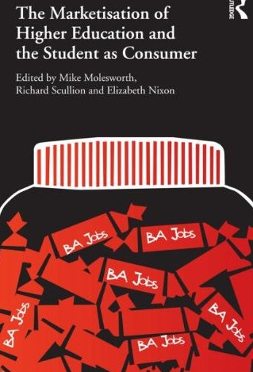
Institutional Responses - After Ellis and McNicholl (2015)
Flexibility and responsiveness privileged but tends towards short term solutions and can be characterised by race to the bottom
Managerial control enables swift dissemination of knowledge limited anticipation of innovation and contextual sensitivity. tends towards short term solutions

Slide 20





co-configuration
Theme 4: Teacher Education for School Improvement
Knotty

Slide 21
Co-Configuration – Engeström (2008)
An emerging, historically new type of work responsive to context, requires mutual exchange, continual evaluation, active involvement by traditional end users - a kind of knot-working - a joint activity that is focused on complex boundary spanning problems that emerge, expand and require multiple forms of distributed expertise
Transformative
Experiencing/relational/embodied
Horizontal – limited hierarchy
Subterranean
“most policies are ramshackle, compromise, hit-and-miss affairs, that are reworked, tinkered with, nuanced, and inflected through complex processes of influence, text production, dissemination and ultimately recreation in contexts of practice.” Ball (2006: 75)

Slide 22

Signs TEF might be:
1. Recognising and rewarding the contribution of teachers who are excellent – promotional structures and opportunities
2. Revisiting the reality of balancing tripartite demands of teaching, research and service – rethinking faculty workload models
3. Responding (genuinely) to student feedback - student voice active at Boards of Study
4. Valuing opportunities for professional development – PG Cert and MA in Inclusive HE
5. Communities of practice – Association of National Teaching Fellows
6. Reconsidering what students might want and need (Generation K or Z – “a generation very different from those that preceded them” – Hertz (2016) - students informing course and curriculum development – Role Models Project

Slide 23
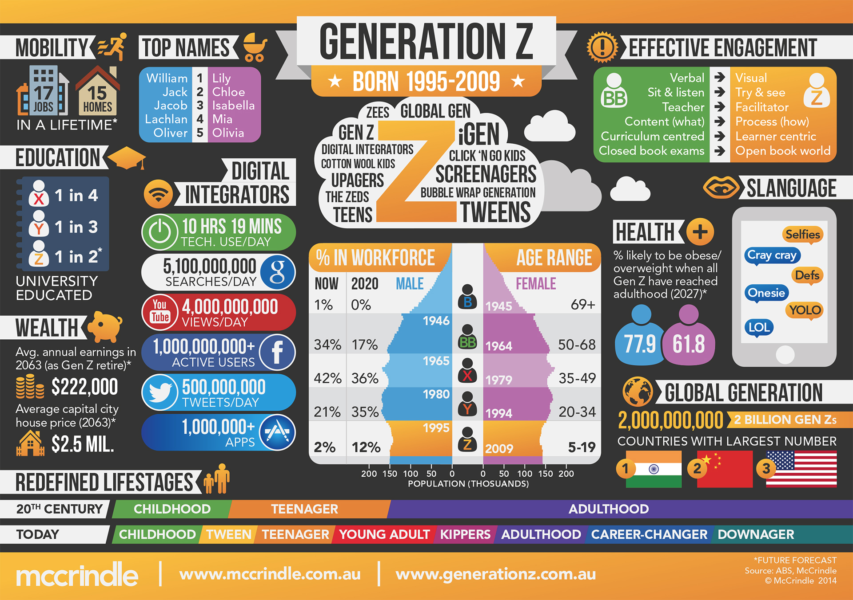

Slide 24
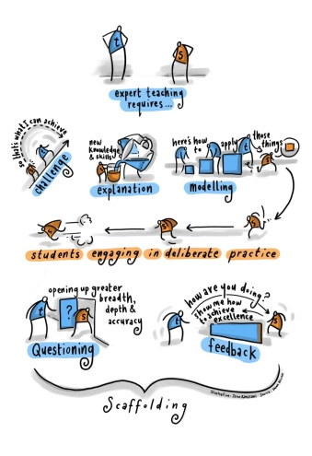
Suddenly we are “hip and cool”?
Talking about pedagogy, thinking about it critically, is not the intellectual work that most folks think is hip and cool…
bell hooks (1994: 204).

Slide 25

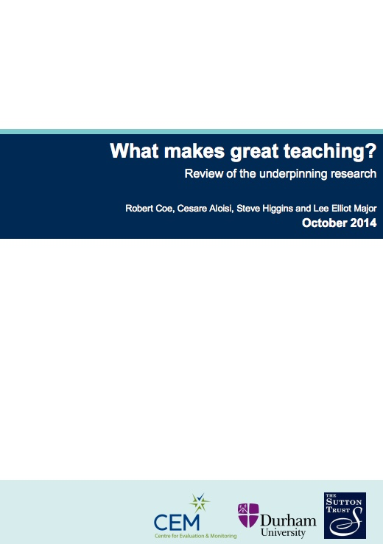
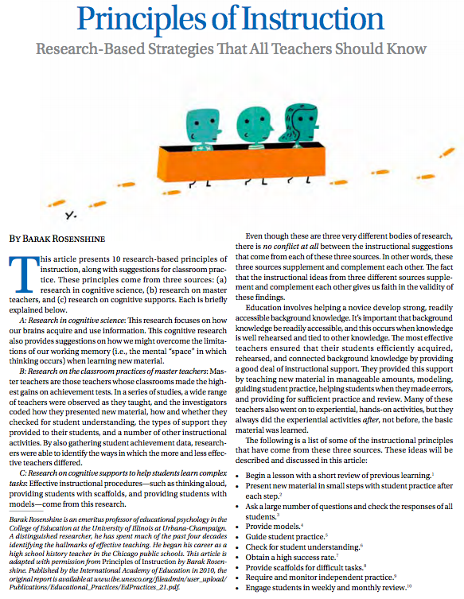
Pedagogic Research

Slide 26
References
Ball, S. J. (2006) Big Policies/Small World: An Introduction to International Perspectives in Education Policy. In Education Policy and Social Class: The Selected Works of Stephen J. Ball. London: Routledge, pp. 67–78
Darian, L (2016) – Five risks to the success of the Teaching Excellence Framework, WONKHE - http://wonkhe.com/blogs/the-five-risks-to-the-tefs-success/
Deem, R (2015) – A critical commentary on Ray Land and George Gordon ‘Teaching excellence initiatives: modalities and operational factors’, The Higher Education Academy
Engeström, Y (2008) From teams to knots: Activity-theoretical studies of collaboration and learning at work, Cambridge
University Press.
Ellis, V and J McNicholl, (2015) Transforming Teacher Education: Reconfiguring Academic Work, Bloomsbury
Gibbs, G (2008). Conceptions of teaching excellence underlying teaching award schemes, The Higher Education Academy
Havergal, C (2016) ‘Biased’ students give BME academics lower NSS scores, says study – Times Higher Education Magazine
Hertz, N (2016) Think millennials have it tough? For 'Generation K', life is even harsher - https://www.theguardian.com/world/2016/mar/19/think-millennials-have-it-tough-for-generation-k-life-is-even-harsher

Slide 27
References
Hillman, N (2016) – Teaching Excellence and the Higher Education and Research Bill, PEDRIO Conference - https://www.youtube.com/watch?v=Fq1sc0Nk4cA
hooks, b (1994) – Teaching to transgress: Education as the practice of freedom, Routledge
Kahn, P (2016) - The challenges of assessing teaching excellence: Universities will game the system - http://www.telegraph.co.uk/education/2016/12/13/challenges-assessing-teaching-excellence-universities-will-game/
Kneale, P (2016), Teaching Excellence – An Opportunity to be Grasped, PEDRIO Conference
Land, R and G. Gordon (2015) - Teaching excellence initiatives: modalities and operational factors’, The Higher Education Academy
MacNell, L et al (2015) – What’s in a Name: Exposing Gender Bias in Student Ratings of Teaching, Innovative Higher Education, 40/4, pp. 291-303.
Morrish, L (2016) – Ten Myths and A truth from the TEF: Reading the White Paper, Academic Irregularities Blog – www.academicirregularities.woodpress.com
Tatlow, P (2015) The possibilities and pitfalls of a Teaching Excellence Framework, Policy Briefing, million+
Tsui, A (2015) A critical commentary on Ray Land and George Gordon ‘Teaching excellence initiatives: modalities and operational factors’, The Higher Education Academy

