Slide 1


\
CHEER
Doctoral education – a mirror for the future of higher education?
Rosemary Deem, Vice Principal (Education) & Dean of the Doctoral School, Royal Holloway & Bedford New College, University of London UK and Chair, UK Council for Graduate Education
R.Deem@rhul.ac.uk

Slide 2
Overview
Do changes to the Doctorate mirror other changes to Higher Education? If so how & what?
Organisational changes to the university
Changes to the nature of academic work
Recent developments in and features of Doctorate programmes and participants
Criticisms of the Doctorate; a doctoral education crisis?
The Doctorate of the future?

Slide 3
The doctoral degree
The landscape for doctoral degrees continues to change worldwide (Golde 2014, Nerad and Evans 2014, Horta 2015, Blessinger and Stockley 2016, van den Hoven and Connell 2016, Blackman 2016 , League of European Research Universities 2016 )
This involves everything from funding, who applies, supervision practices & pedagogies (Lee & Danby 2012), to student identities/roles, thesis format, internships & interdisciplinarity
Traditionally the doctorate prepared for academic work; today doctorates contribute to the wider knowledge economy (Kitagawa 2016)
Doctoral education reflects many external and internal changes to HE and its fate is intimately bound up with the organisations within which it is located, as well as the changing nature of academic work as it moves from knowledge creation to performativity (Pereira 2014, 2016a, 2016b)

Slide 4
Global systems of doctoral education
The European Bologna doctoral programme: normally 3-4 years full time, includes methods training and oral thesis defence (open or closed). Doctoral 3rd cycle first introduced to Bologna process in 2003
The North American system: separate coursework component assessed by comprehensive examination and a separate thesis component, with oral defence; can take up to 7 years
The Australian system similar to the European, 3-4 years full time but no oral defence, remote examination only.
There are many variants of the European model in particular & but these three represent the most common world systems

Slide 5
What is the environment & ethos of the contemporary university?
A turbulent external environment nationally & globally (Nelson & Wei 2012,) which whether under government control or private, is becoming more marketised (Huisman et al 2012)
Becoming more business-like, questioning earlier purposes (Collini 2012, Docherty 2011, Bok 2004)
The economic dimension, not the social & cultural, drives teaching (Gumport 2000) and HE public policy on ‘employability’
Highly ‘managed’ top-down approach by manager-academics(Deem, Reed, Hillyard 2007), based on new managerial ideology

Slide 6
What is the environment & ethos of the contemporary university? (2)
A shift in governance regimes from academic self-governing collegiality to external governors as ‘non-interfering friends’ (Magalhães, Veiga and Amaral 2016) and ‘boardism’ praxis (Veiga, Magalhães & Amaral 2015)
Diversity in student composition and staff cultures and values; emphasis on global outlook
More use of digitisation and mobile technologies
Student expectations increasingly instrumental, though see Budd (2014, 2016) on UK/German undergraduates comparison

Slide 7
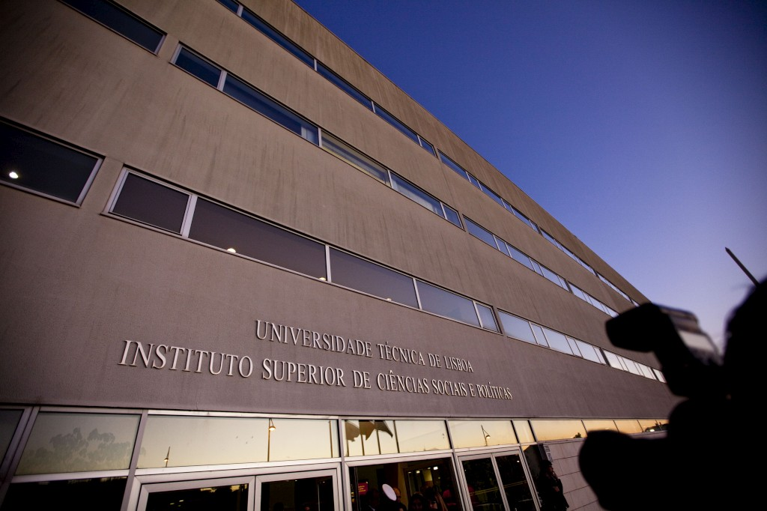
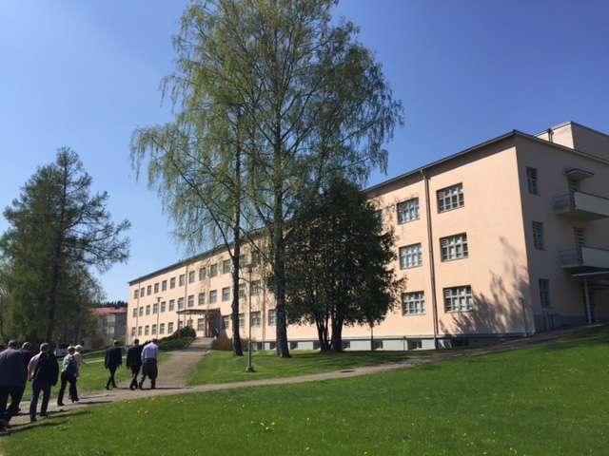
21st century universities: ISCSP, Universidade de Lisboa, Portugal and Hamk University, Finland

Slide 8
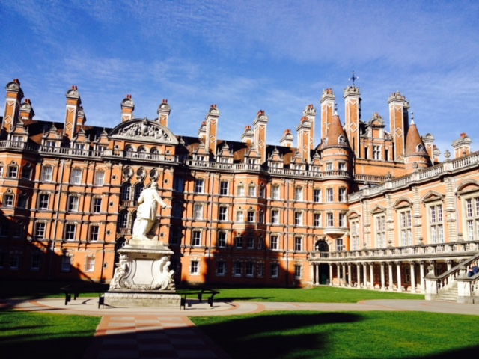
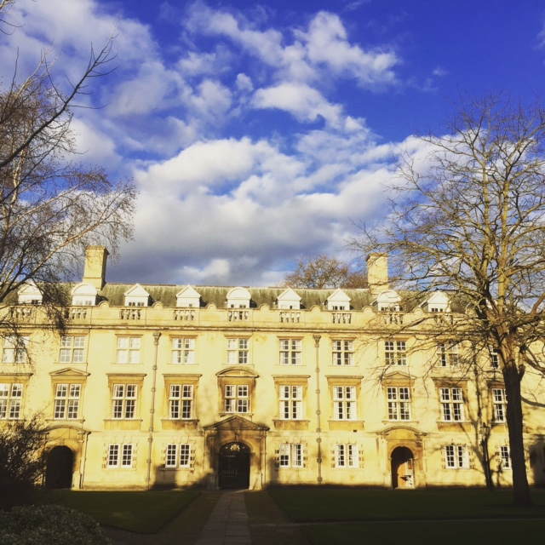
21st century universities? Royal Holloway, Egham and Christ’s College, Cambridge, UK

Slide 9
What are some of the characteristics of a 21st century university?
Polarisation around research or teaching
Massification of intake in many countries
Can be public or private or a hybrid
Markets growing in significance (Marginson 2013) but may sometimes be quasi-markets (Le Grand 1993) or ‘fixed’ (e.g UK 2016 White Paper on HE privileges private ‘challengers’ over public ‘incumbents’)

Slide 10
What are some of the characteristics of a 21st century university?
Private interests of students overtake knowledge for knowledge’s sake
Importance of new digital technologies and social media; e-learning isn’t now separated out as only for distance learners
Multi-skilled staff (Whitchurch 2012, Musselin 2009) but deskilling of academics (MacFarlane and rise in numbers and power of administrative staff (Gornitzka and Larsen 2004)
Students who act like consumers (Naidoo, Shankar & Ekant 2011); work of Competition & Markets Authority in UK a dangerous extension of this trend specifying when programmes may be changed according to consumer law

Slide 11
How do organisational changes to universities affect the doctorate?
Supervising doctoral candidates just another activity of academics; no longer ‘special’ but routine
More emphasis on submission/completion as key metrics for doctoral programmes, not the academic content or contribution to knowledge of a doctorate
Greater stress on collaboration across institutions and internationalising of the doctoral experience
Destinations of doctorate holders scrutinised more carefully
Cost and benefits of doctoral programmes held up for analysis

Slide 12
Recent changes to academic work
Casualisation: academic work increasingly precarious (Lama & Joullié 2015, Courtouis & O’Keefe 2015)
Collectivisation; more interdisciplinary & other research centres/teams, doctoral schools (Nyhagen & Baschung 2013)
Specialisation e.g teaching-only, research-only, management-only
Academic work is no longer as special as it once was (Musselin 2012)
Mobility/virtualisation: high academic turnover, academic travel, on-line but out-of-office, distance learning, MOOCS
Speed-up of academic work leads to varied responses (Ylijoki 2013)

Slide 13
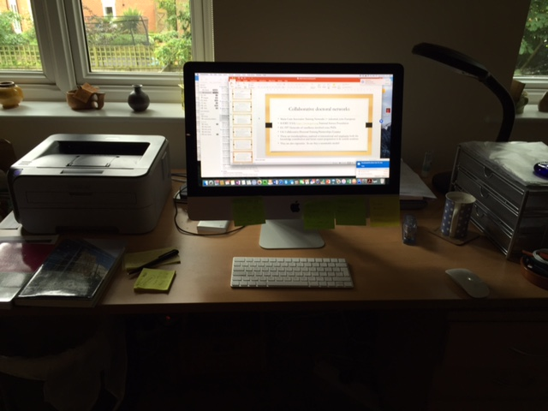
Academic work is increasingly digitised work

Slide 14
How changes to academic work affect the doctorate
Casualisation: doctoral students badly paid to teach, few permanent jobs
Collectivisation: full-time doctoral education more likely to be in collaboration with other depts or universities in same or another country;
Specialisation: doctoral education becoming a field in itself
        growth of doctoral schools/colleges
Mobility of academics and virtualisation reduce f2f contact with supervisors
Speed-up: supervisors have more doctoral students & much greater pressure for submission/completion/publications

Slide 15
Share of Doctoral students out of all HE students on Bologna programmes EHEA 2012

Slide 16
OECD statistics on doctoral students 2011 http://www.oecd-ilibrary.org/sites/sti_scoreboard-2011-en/02/01/index.html?contentType=/ns/StatisticalPublication,/ns/Chapter&itemId=/content/chapter/sti_scoreboard-2011-12-en&containerItemId=/content/serial/20725345&mimeType=text/html
‘In Switzerland and Sweden, graduation rates [reached 3.4% and 3.0%, respectively. The relative increase was largest in the Slovak Republic and Portugal.
In 2009, women received 46% of the OECD average of total doctorate degrees awarded but remain underrepresented in science and engineering, (34% of all degrees in these subjects). Exceptions are found in Iceland (64%) and Portugal (49%).
The largest share of new doctorate degrees is in Science and Engineering, -followed by the social sciences for men and by health and welfare for women.
Absolute numbers of S&E doctorates have increased significantly since 2000 but share has been declining in a majority of OECD countries.
USA is the largest single contributor of new doctorates with more than a quarter of the nearly 89 000 OECD total in 2009, -followed by Germany, the United Kingdom and France. The 20 EU countries combined account for more than half of the total number of OECD doctoral degrees in S&E’.

Slide 17
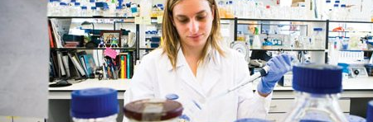
Who does the doctorate?

Slide 18
Who does the doctorate: what kinds of knowledge are privileged?
There is considerable variation by discipline; in most but not all STEM subjects, doctoral candidates are more likely to be male & full time
In humanities/social sciences more women and part-timers but ethnicity, social class, disability remain challenges in many countries (Wakeling 2013)
Haake (2011) notes that the gender balance of disciplines affects how students selected, what is done and how is valued. In some disciplines there are still essentialist views about gender & a belief that men & women contribute differently to same disciplines. Gender equality measures often seen to apply to women only.
Danovitz (2016) researched an interdisciplinary gender studies doctoral programme and noted the importance to candidates of power relationships, how to find jobs and succeed in them & bodies and ways of doing gender studies

Slide 19
Recent developments in the doctorate itself
Emphasis on the ‘training’ PhD rather than the ‘knowledge’ PhD (Winfield 1987)
Proliferation of types of doctorate: industrial (Kitagawa 2016, Casano 2016); professional (Mellors Bourne et al 2016), concurrent/prior publication (Jackson 2013)
Greater collaboration in doctoral education (Kitagawa 2014, Deem 2015, Dahlgren 2012, )
Increased focus on contribution of doctoral graduates to wide range of occupations, not just academe (CFE Research 2014; Ehrenberg & Kuh 2009)
Changing perceptions of roles of doctoral candidates (Balaban 2016, Walker et al 2008)

Slide 20
Box 1: A model of the modern doctorate (from LERU, 2016 & 2010)
Doctoral researchers are the drivers of their professional development…
While being immersed in a research rich environment…
Where boundaries to other research fields are highly permeable…
And in which connections to the external world have a global outlook …
And link to other sectors of society…
So that the skills the new doctors develop are highly valuable to the knowledge society…
LERU 2016 p. 8

Slide 21
Collaborative doctoral networks
Marie Curie Innovative Training Networks eg UNIKE
IGERT (USA) http://www.igert.org National Science Foundation
EU FP7 Networks of excellence involved PhDs
UK Collaborative Doctoral Training Partnerships/Centres
These are interdisciplinary, national or international and emphasise both the knowledge contribution and future career preparation in & outside academe
They lead to very employable globally-aware students & their supervisors also benefit from the international experience involved in partnerships and networks
They are also expensive. So are they a sustainable model?

Slide 22
Policy foci on doctoral education
Emphasis on doctoral programmes, not individual doctoral experiences
Focus on employability outside academe but not wider social/cultural roles
Contribution to economic growth and innovation emphasised
The full-time student science model is still to the forefront (Becher et al 1994)
Doctoral submissions & completion rates are key metrics but societal contribution not usually taken into account

Slide 23
EUA Doctoral Education 2016 – Taking Salzburg forward – implementation & new challenges
Institutional structures are diverse & open, need to watch for inefficiencies (32 EHEA countries have doctoral schools, 16 do not)
Create space for dialogue between researchers & doctoral candidates
Build research capacity, using strong institutional leadership
Nurture talent at all levels, focus on rigour, resilience, originality, critical thinking, independence, ability to create new knowledge
Develop ethos of research integrity, including ethics
Meet the digital challenge and foster open access research

Slide 24
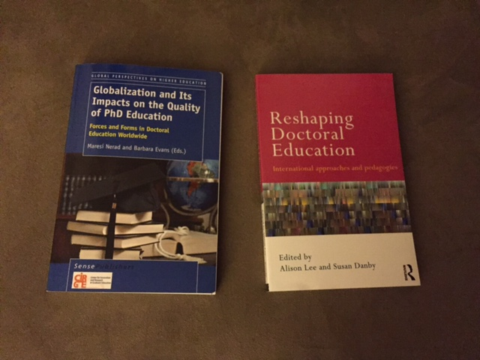
Recent texts on doctoral students

Slide 25
Criticisms of the doctorate
No longer an entirely adequate preparation for academic work (Ehrenberg 2008) and perhaps not for other kinds of work either (Mertens and Robken 2013);
A monograph-based thesis is only suited to some disciplines (Jump 2015, Jackson 2013)
An oral defence, whether open or especially if closed, may be seen as too subjective a way in which to examine
One to one supervision may be giving way to more collective forms? (Lee & Danby 2011)
The professional doctorate could wipe out the conventional doctorate? (Blackman 2016)
Doctoral structures can be small and isolated e.g tiny discipline based graduate schools (EUA 2016)

Slide 26
A doctoral crisis (Cuthbert & Molla 2015)?
Shift in policy focus from efficiency to skills of doctoral graduates
Doctorates no longer just preparation for academic work (few jobs)
Questions of what originality & contribution to knowledge mean
Proliferation of doctoral types in some countries (USA, Australia, UK)
Questioning about whether different kinds of doctorates have equivalent outcomes
Are doctorates a new form of credentialism? (Collins 1979)

Slide 27
Why do we still have the doctorate?
Academic traditions and careers?
Contribution to the knowledge economy and innovation?
Developing expertise and its application in wider society?
Laboratory based scientists need research student labour on projects?
The right to award research degrees is still a symbol of the university’s autonomy? But for how long?

Slide 28
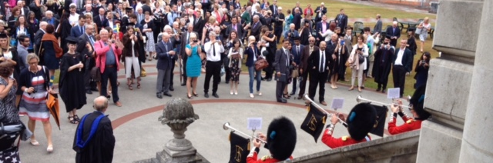
Tradition?

Slide 29
What could we change in the doctorate?
Who we recruit; greater selectivity but focused on future leaders/versatility
How we fund; fewer candidates but more generous stipends
How we train and supervise; co-supervision across disciplines/HEIs/countries
Offer more substantial international experience during the doctorate
What doctoral graduates are prepared for: broader citizenship, social, cultural and political roles as well as careers
The kind of knowledge doctoral candidates produce and for whom: emphasise co-production of knowledge (Jasanoff 2004) and significant translation of knowledge

Slide 30
Doctoral Students’ Roles
Balaban (2016) in a review article traces a shift in how student roles regarded (noting these are not from a student perspective):
Golde et al (2006) Students as stewards of their (mono) disciplines (USA Carnegie Initiative)
Walker et al (2008) Shared (supervisor/student) formation apprenticeships, emphasis on student communities & blurring of disciplinary fields (USA, Carnegie research project)
Nerad et al (2014) Students as future leaders in many fields, exploration of excellence, global collaborations/pedagogies, transferable skills, progression of the doctoral identity & engagement with the knowledge economy as well as trend to greater agency
Balaban (2016) observes that these categories overlap

Slide 31
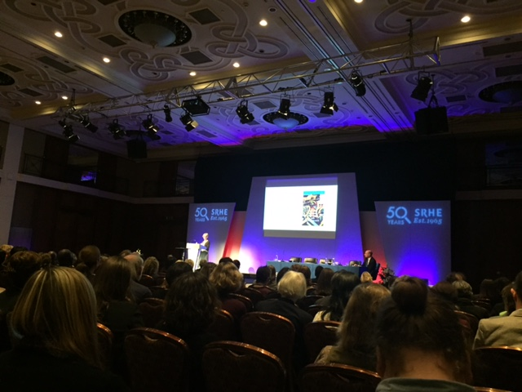
Are Doctoral candidates’ roles changing?

Slide 32
Changing Student Roles
Many authors see students as ill-prepared for life after the doctorate
USA studies suggest that over time, students’ career preferences may shift from academic towards private, sector or other non-academic jobs (Sauerman & Roach 2012), though supervisors may continue to expect them to go into academic jobs (Monka, Footeb & Schlemper 2012).
In the UK many still want to be academics despite poor prospects for this (Boulos 2016, Jons & Deakin 2014)
In Germany more PhDs look to jobs outside academe, possibly because doctoral schools push them to finish their PhDs fast and as postdocs they have to work out quickly where they want to go (Fitzenberger and Schulze 2014)
Finally, it might be worth remembering that professional & industrial doctorate students often already have a professional job or are placed on a fast-track route to a non-academic career.

Slide 33
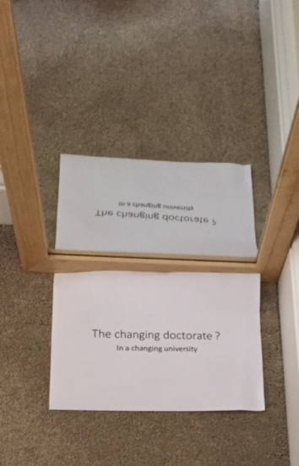
The doctorate as a mirror for the changing university?
Where are we going?

Slide 34
How might the 21st century university change in future?
Greater variety of organisational forms (multi-nationals, transnational campuses, on-line only, disassembled with degree validation separated from recruitment & teaching, co-operatives, elite campuses ( e.g Harvard, Oxford)
Higher focus on undergraduate & vocational programmes with fast ‘efficient’ delivery
Few permanent staff or spaces; casualised labour plus robot tutors in rented rooms?
Technology-driven not technology-informed; the digitisation of everything (Selwyn& Facer 2014), learner analytics replace personal tutors, research done by artificial intelligence
Flipped lectures the norm; production of materials & teaching separated
Research & research-informed teaching at elite institutions only

Slide 35
Can the doctorate be ‘unbundled’?
Already possible to separate out initial methods/researcher development training of doctorates, on line or face- to-face
Fieldwork, archival work, laboratory work could also be ’outsourced’
Supervision a mix of external organisation personnel and casualised contracted academic supervisors, or instead use on-line monitoring/learner analytics
Just need a validating institution to award the degree; maybe in future this will come in a kit, activated with a credit card

Slide 36
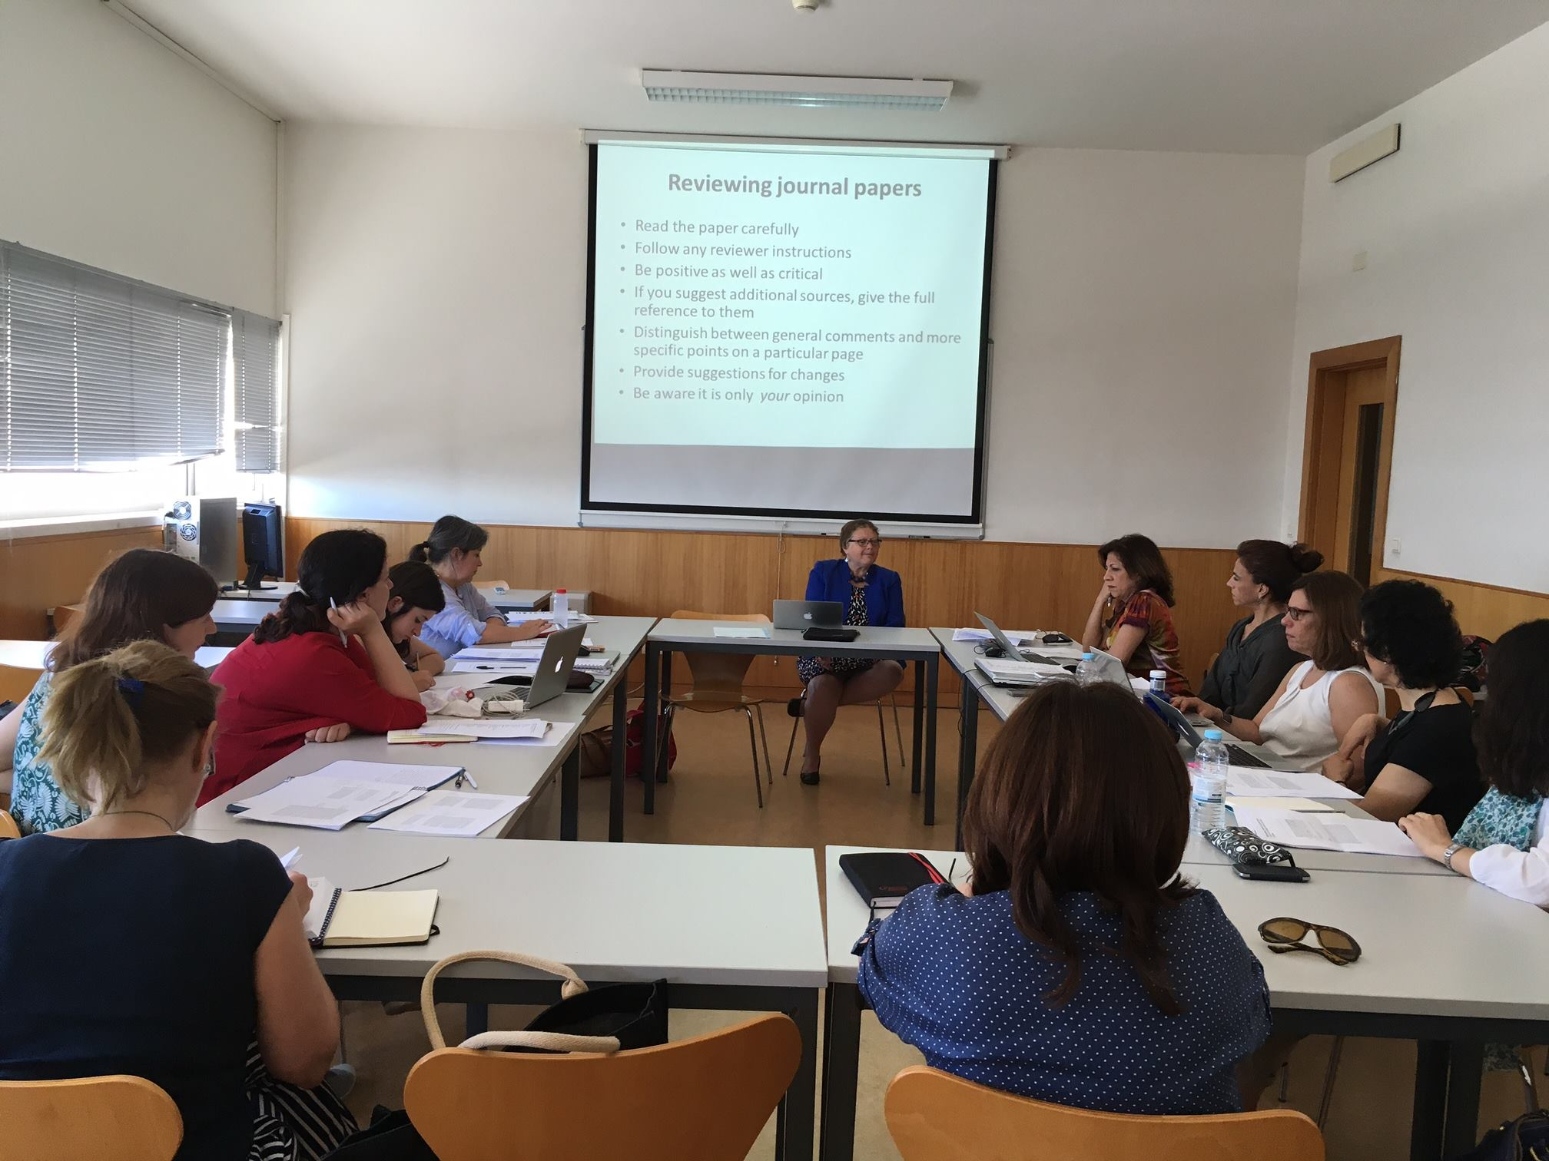
Researcher development can be outsourced

Slide 37
Summary
Examined how organisational changes to the university & changes to the nature of academic work, have themselves had some effects on doctoral degrees and vice versa
Also looked at recent developments in and features of doctoral programmes and participants, including proliferation of types of doctorates, collaborative programmes and changing roles of doctoral students
Finally I looked at criticisms of the doctorate and the notion of a doctoral education crisis

Slide 38
Doctorates and university futures; a two way mirror?
As universities continue to change, so will doctoral education
If there are fewer research intensive universities, there may be more selective admission to full time doctorates
New private for profit providers may not see doctorates as a priority but may be interested in ‘unbundling’; may need PhDs for some of their teaching
Knowledge co-production & collaborative schemes will grow as consistent with open access principles but tested by inter institutional competition
We could consider establishing cooperatives running PhD programmes

Slide 39
The Changing Doctorate: what next?
If it survives, candidates do need to be prepared for a world beyond academe but also for the broader social and cultural purposes of doctoral study
The concept of originality in a thesis will be further challenged
Doctoral candidates will also need preparation for a world of digitisation, precarity, translational knowledge (for wider society not just careers) and transferable skills
Co-production and collaborative theses may become the norm
Equally we could be heading for doctorates written by artificial intelligence?
Notes:
Bibliography
Balaban, C. (2016). "From steward to leader: a decade of shifting roles for the PhD student." Learning and Teaching: The International Journal of Higher Education in the Social Sciences 9(1): 90-100.
Becher, T., M. Henkel and M. Kogan (1994). Graduate Education in Britain. London, Jessica Kingsley.
Beck, U. (1992). Risk Society: Towards a New Modernity. London, Sage.
Blackman, T. (2016 ). Professional doctorates and the 21st century university; address to the 2016 International Conference on Professional Doctorates. International Conference on Professional Doctorates, the Titanic, Belfast, 15th March
Blessinger, P. and D. Stockley, Eds. (2016). Emerging Directions in Doctoral Education (nnovations in Higher EducationTeaching and Learning vol 6). Bingley, UK, Emerald.
Bok, D. (2004). Universities in the Marketplace: The Commercialization of Higher Education. Princeton, NJ, Princeton University Press.
Boulos, A. (2016). "The labour market relevance of PhDs: an issue for academic research and policy-makers." Studies in Higher Education: 901-913.
Budd, R. (2014 ). Students as Neo-Institutional Actors: A Comparative Study of German and English Graduates’ Understandings, Experiences and Negotiations of Higher Education. PhD unpublished thesis, University of Bristol
Budd, R. (2016). "Undergraduate orientations towards higher education in Germany and England: problematizing the notion of ‘student as customer’." Studies in Higher Education.
Casano, L. (2016). "When research moves up regulation: a trailblazing experience of Industrial PhD in Italy." International Journal of Technology and Globalisation.
CFE Research (2014). The Impact of Doctoral Careers. Swindon, UK, Research Councils UK.
Collini, S. (2012). What are universities for? . London, Penguin.
Collins, R. (1979). The Credential Society New York Academic Press
Courtois, A. and T. O'Keefe (2015). "Precarity in the ivory cage: Neoliberalism and casualisation of work in the Irish higher education sector." Journal for Critical Education Policy Studies 13(1): 43-56.
Cuthbert, D. and T. Molla (2014). "PhD crisis discourse: a critical approach to the framing of the problem and some Australian ‘solutions’." Higher Education 69: 33-53.
Dahlgren, M. A., G. Grosjean, A. Lee and S. Nystrom (2012). The Graduate School in the Sky: emerging pedagogies for an international network for doctoral education and research Reshaping Doctoral Education: international approaches and pedagogies. A. Lee and S. Danby. London and New York Routledge 173-186.
Danowitz, M. A. (2016). "Power, jobs and bodies: the experiences of becoming a gender scholar in doctoral education." Studies in Higher Education 41(5): 847-858,.
Deem, R., S. Barnes and G. Clarke (2015). Social science doctoral training policies and institutional responses: three narrative perspectives on recent developments in and consequences of the uk transition to collaborative doctoral training. Universities in Transition: Shifting institutional and organisational boundaries. E. Reale and E. Primeri. Rotterdam, Sense Publishers.
Deem, R., S. Hillyard and M. Reed (2007). Knowledge, Higher Education and the New Managerialism: The Changing Management of UK Universities. Oxford, Oxford University Press.
Docherty, T. (2011). For the University: Democracy and the Future of the Institution London, Bloomsbury Academic.
Ehrenberg, R. G. and C. Kuh, Eds. (2009). Doctoral Education and the Faculty of the Future. Ithaca USA & London, Cornell University Press.
European University Association Council for Doctoral Education (2016 ). Taking Salzburg forward – implementation & new challenges. Brussels European University Association Council for Doctoral Education, http://www.eua.be/Libraries/publications-homepage-list/Doctoral-Education_Taking-Salzburg-Forward.pdf?sfvrsn=18
Fitzenberger, B. and U. Schulze (2013). "Up or Out: Research Incentives and Career Prospects of Postdocs in Germany." German Economic Review 15(2): 287–328
Golde, C. M. (2014). "The Formation of Scholars: insights of the Carnegie Initiative on the Doctorate " Geojournal 80: 209-213.
Gornitzka, A. and I. M. Larsen (2004). "Towards professionalisation? Restructuring of administrative work force in universities." Higher Education 47: 455–471.
Gumport, P. (2000). "Academic Restructuring: organizational change and institutional imperatives." Higher Education 39(1): 67-91.
Gumport, P. (2000). "Academic Restructuring: organizational change and institutional imperatives." Higher Education 39(1): 67-91.
Haake, U. (2011). "Contradictory values in doctoral education: a study
Horta, H. (2015). Young doctorates in a fast-changing higher education system: the case of Portugal. Young Faculty in the Twenty-First Century: International Perspectives. M. Yudkevich, P. G. Altbach and L. E. Rumbley. New York, Albany 201-226.
Huisman, J., C. Adelman, C. C. Hsieh, F. Shams and S. Wilkins (2012 ). Chapter 5: Europe's Bologna Process and Its Impact on Global Higher Education. . Ed . Thousand Oaks, California. The Sage Handbook of International Higher Education. D. K. H. D. K. Deardorff, H. de Wit, H. J. D. Adams and T. Adams. Thousand Oaks, California., Sage
Huisman, J., H. De Boer and P. C. B. Bótas (2012). "Where Do We Go from Here? The Future of English Higher Education ".Higher Education Quarterly 66(4): 341-362.
Jackson, D. (2013). "Completing a PhD by publication: a review of Australian policy and implications for practice." Higher Education Research & Development 32(3): 355-368.
Jasanoff, S. (2004 ). The Co-Production of Science and the Social Order. New York, Routledge. New York Routledge
Jöns, H. and H. Deakin (2014). Mapping the population, careers, mobilities and impacts of advanced degree graduates in the social sciences and humanities (POCARIM): Geographies of Transnational Career (Im)mobility of European PhD Graduates in the Social Sciences and Humanities: . Loughborough, http://www.salford.ac.uk/__data/assets/pdf_file/0010/532639/PR11-immobility-mobility-formatted-HJ-HD.pdf, Loughborough University.
Jump, P. (2015). PhD: is the doctoral thesis obsolete? Should the foundations of a 21st-century academic career still be built on the traditional model? Times Higher, 15th May London Times Higher.
Kitagawa, F. (2016). "Crossing boundaries between science and innovation: Career mobility and impacts of graduates of the UK Industrial Doctoral Centers (IDCs)." International Journal of Technology and Globalisation.
Lama, T. and J. E. Joullié (2015). "Casualization of academics in the Australian higher education: is teaching quality at risk?" Research in Higher Education Journal 28.
Le Grand, J. and W. Bartlett, Eds. (1993). Quasi-markets and social policy. London, Macmillan.
League of European Research Universities (2016 ). "Maintaining a quality culture in doctoral education at research-intensive universities." LERU, Brussels
Lee, A. and S. Danby (2012). Reshaping Doctoral Education: International approaches and pedagogies London and New York, Routledge.
Magalhães, A., A. Veiga and A. Amaral (2016). " The changing role of external stakeholders: from imaginary friends to effective actors or non-interfering friends." Studies in Higher Education.
Marginson, S. (2013 ). "The impossibility of capitalist markets in higher education'." Journal of Education Policy 28(3): 353-370.
Mellors-Bourne, R., C. Robinson and J. Metcalfe (2016). Provision of Professional Doctorates in English Higher Education Institutions. Bristol, HEFCE & Careers Research and Advisory Centre.
Monka, J. J., K. E. Footeb and M. B. Schlemper (2012). "Graduate Education in U.S. Geography: Students’ Career Aspirations and Faculty Perspectives." Annals of the Association of American Geographers 102(6): 1432-1449.
Musselin, C. (2009). Towards A Sociology Of Academic Work, Springer.
Musselin, C. (2012). "Redefinition of the relationships between academics and their university." Higher Education 65: 25–37.
Naidoo, R., S. A and V. Ekant (2011). "The Consumerist Turn in Higher Education: Policy Aspirations and Outcomes." Journal of Marketing Management. 27(11-12): 1142-1162.
Nelson, A. and I. Wei, Eds. (2012). The Global University. New York, Palgrave Macmillan.
Nerad, M. and B. Evans, Eds. (2014). Globalization and Its Impacts on the Quality of PhD Education: Forces and Forms in Doctoral Education Worldwide. Rotterdam Sense Publishers
Nyhagen, G. M. and L. Baschung (2013). "New organisational structures and the transformation of academic work." Higher Education 66: 409–423
of gender composition in disciplines in Swedish academia." Higher Education 62: 13–127.
Pereira, M. d. M. (2014). "The Importance of Being “Modern” and Foreign: Feminist Scholarship and the Epistemic Status of Nations." Signs 39(3): 627-657.
Pereira, M. d. M. (2016a). "Struggling within and beyond the Performative University: Articulating activism and work in an “academia without walls”." Women's Studies International Forum 54(January/February): 100-110.
Pereira, M. d. M. (2016b ). Power, Knowledge and Feminist Scholarship: an Ethnography of Academia. London Routledge
Selwyn, N. and K. Facer (2014). "The sociology of education and digital technology: Past, present and future 10.1080/03054985.2014.933005." Oxford Review of Education 40(4): 482-496.
van den Hoven, E. and J. Connell (2016). Joint Doctoral Supervision across Countries: Changes, Challenges and Considerations, in Patrick Blessinger , Denise Stockley (ed.) Emerald Group Publishing Limited, pp.259 - 280. Emerging Directions in Doctoral Education (Innovations in Higher EducationTeaching and Learning, Volume 6. P. Blessinger and D. Stockley. Bingley, UK Emerald Group 259-280.
Veiga, A., A. Magalhães and A. Amaral (2015). From Collegial Governance to Boardism: Reconfiguring Governance in Higher Education. The Palgrave International Handbook of Higher Education Policy and Governance,. J. Huisman, H. De Boer, D. Dill and M. Souto-Otero. London Palgrave Macmillan: 398-416.
=Wakeling, P. and G. Hampden-Thompson. (2013 ). "Transition to higher degrees across the UK: An analysis of national, institutional and individual differences. York: Higher Education Academy." Retrieved August 2013, from http://www.heacademy.ac.uk/assets/documents/research/Transition_to_higher_degree_across_the_UK.pdf.
Walker, G. E., C. M. Golde, L. Jones, A. C. Bueschel and P. Hutchings, Eds. (2008). The Formation of Scholars: Rethinking Doctoral Education for the Twenty-first Century, San Francisco: The Carnegie Foundation for the Advancement of Teaching; Wiley Imprint.
Whitchurch, C. (2012 ). Reconstructing Identities in Higher Education: The Rise of Third Space Professionals. New York Routledge.
Winfield, G. (1987). The Social Science Ph.D: the Economic and Social Research Council enquiry on submission rates. Swindon, Economic and Social Research Council.
Ylijoki, O.-H. (2011). "Boundary-work between work and life in the high-speed university." Studies in Higher Education 38(2): 242-255.

