Slide 1

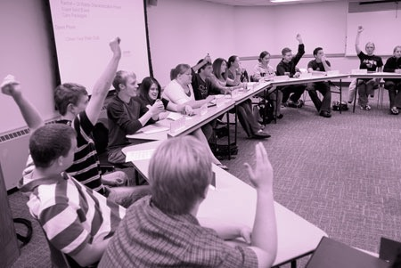
Critical Thinking and the Student Voice: Speaking up and Speaking Back
Current Challenges/Desired Futures for Higher Education in Japan and the UK:
Dr Emily Danvers
CHEER (Centre for Higher Education and Equity Research)
e.danvers@sussex.ac.uk

Slide 2
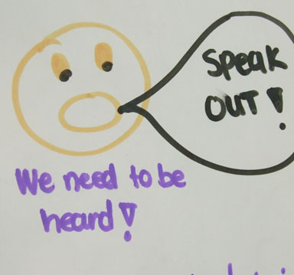
Speaking up and speaking back
‘The concept of the student voice can be passive and disempowered, governed and operated by the institution rather than by students themselves’ (Kay et al., 2010, p, 1)
‘Students believe that their identity as consumer (or as a producer, evaluator, partner or critical citizen) provides them with a recognised, valued, and powerful voice. Yet forms of engagement are filtered through discourses of who gets to speak in and about higher education’. (Danvers and Gagnon, 2014, p. 15)

Slide 3
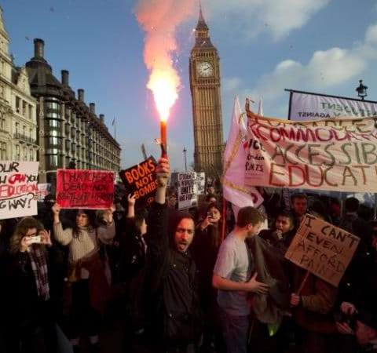
Speaking up (but not speaking back to?)
‘[This is the] paradox of autonomy, whereby the subject developed through university education and who is capable of making decisions so as to be self-governing also has the ability to imagine a different future or set of possibilities and learns the skills to disrupt the dominant order…to use their critical thinking skills to challenge, rather than reproduce their communities’
(Staeheli et al., 2013, p. 92)

Slide 4
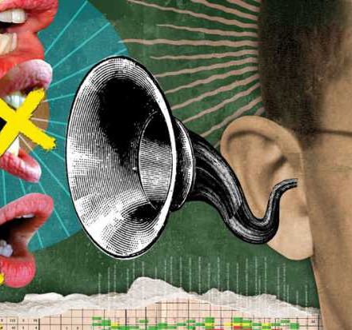
Speaking up (and being heard)
‘Some voices are totally unheard; others are not heard in the places where they may inform universities practices. Others are misunderstood or misinterpreted. And just because a sound is being made does not mean it is of value to the hearer whether the hearer seeks the student voice for viewpoint, marketing, enhancing the quality of teaching and learning or listening to the student voice because it is the right thing to do according to procedures’.
(Canning, 2017)

Slide 5

Embodying the critically ‘engaged’ student
Critical ‘beings’ (Barnett, 1997) predominantly conceptualised as unspecified bodies in policy, pedagogical practice and in ‘rationalist’ theorisations of critical thinking (e.g. Fisher, 2001; Halpern, 2003; Bailin and Siegel, 2003; Paul and Elder, 2006).
Critical thinking as a negotiated processes that are embodied, affective and contextual (Danvers, 2017; Fenwick and Edwards, 2013; Thayer-Bacon, 2000).

Slide 6
Conclusions
Critical thinking, student voice and student engagement as inter-related ‘buzzwords’ that require contextualisation as to who is their ‘desirable’ subject and what behaviours/practices they might exclude.
Re-thinking ‘speaking up and speaking out’ raises pertinent questions about higher education’s ‘values’ and function - and how to respond to the numerous (often conflicting) ways students are constructed (as consumers, as thinkers, as partners).
Key challenges for UK higher education are to find inclusive ways for students to be critical both in and of their experience in higher education.
However this becomes particularly tricky in a context where critical thinking is narrowly understood as a pedagogic measurement…

Slide 7
References
Bailin, S. and Siegel, H. (2003) Critical Thinking. In N. Blake, P. Smeyers, R. Smith and P. Standish (eds.) The Blackwell Guide to the Philosophy of Education. Oxford: Blackwell, pp. 181-193.
Barad, K. (2007) Meeting the Universe Halfway: Quantum Physics and the Entanglement of Matter and Meaning. Durham, NC: Duke University Press.
Barnett, R. (1997) Higher Education: A Critical Business. Buckingham: SRHE.
Canning, J. (2017). Conceptualising student voice in UK higher education: four theoretical lenses. Teaching in Higher Education.
Danvers, E. (2017). Re-thinking Critically: Undergraduate Students and Critical Thinking in Higher Education. Thesis: University of Sussex.
Danvers, E. C., and Gagnon, J. (2014). "Is ‘student engagement’ just a mirage? The case for student activism." Student Engagement and Experience Journal, 3(2), 1-16.
Department for Business Innovation and Skills (BIS) (2016). Success as a Knowledge Economy: Teaching Excellence, Social Mobility and Student Choice. London: BIS.
Fisher, A. (2001) Critical Thinking: An Introduction. Cambridge: Cambridge University Press.
Fenwick, T. and Edwards, R. (2013) Networks of Knowledge, Matters of Learning and Criticality in Higher Education. Higher Education, 67, pp. 35-50.
Gourlay, L. (2015). ‘Student Engagement’ and The Tyranny of Participation.Teaching in Higher Education 20 (4): 402–411.
Halpern, D.F. (2003) Though and Language: An Introduction to Critical Thinking. Mahwah, NJ: Lawrence Erlbaum.
Kay, J., Dunne, E. & Hutchinson, (2010). Rethinking the values of higher education – students as change agents. QAA: Gloucester.
Paul, R. & Elder, L. (2006) The Miniature Guide to Critical Thinking: Concepts and Tools. Tomales, CA: Foundation for Critical Thinking.
Staeheli, L. A., Attoh, K., and Mitchell, D. (2013). "Contested Engagements: Youth and the Politics of Citizenship." Space and Polity, 17(1), 88-105.
Thayer-Bacon, B. (2000) Transforming Critical Thinking: Thinking Constructively. New York, NY: Teacher's College Press.

