Slide 1

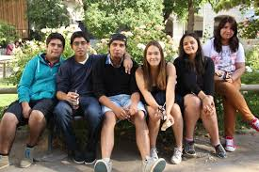
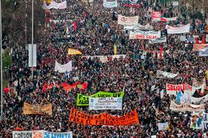
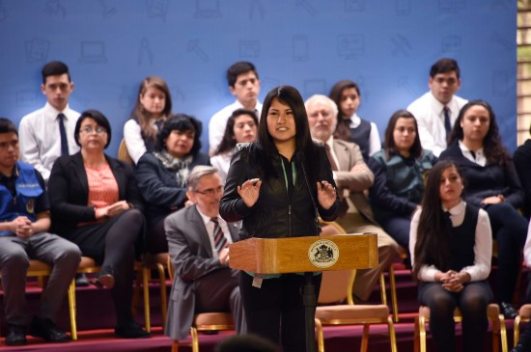
Diversity, Democratisation and Difference: Theories and Methodologies
Desirable Subjectivities in Chilean Widening Participation Policy in Higher Education
www.sussex.ac.uk/education/cheer

Slide 2
UNESCO Induction Access Programmes
Aim of the programmes:
  to restore the right to higher education to students from vulnerable sectors, guaranteeing places in higher education to students who meet the requirements of the programme (MINEDUC, 2016)
  Legitimacy: Re-engaging with meritocracy ≠ inequality
How?
  Selecting the best students from low socioeconomic school backgrounds, according to their academic performance
      Pre-entry interventions: Maths, Language, and Personal Management
% of Students Inscribed for taking the National Entrance Test and got selected by Universities according to students' schools type. Admission Process, 2013
79% of students perceive HE as unfair in terms of access
Notes:
I will start giving some background about Chilean Higher Education.
Chilean HE has a history of market-driven policies since the 1980s triggering the competition for students among universities, so producing a market. These policies are based (even nowadays) on loans and vouchers to students, on a deregulation of tuition fees, and on a strong privatisation as a mean of profit and widening the participation of students. We have just 8 state universities among 59. Among the consequences of these arrangement we can mentioned that:
(adjusted for income) Chile has the most expensive Higher Education among OECD countries. To study a bachelor degree cost in average £4000 per year, and we need to take into account that in Chile more than 50% of households live with less than £250 x month.
It has multiple inequalities affecting underprivileged students. These students have 5 times as low a chance to enter the university than the affluent students; among the total who enter HE just 60% continue their studies after 4 years in contrast to the 80% of affluent students; they are highly underrepresented in the prestigious universities because of their cost, and because of the university entrance test which discriminates by class and educational backgrounds. Usually they don’t get the minimum scores to enter universities.
Universities expend more money in advertisement to attract students than in education turning from a space of learning to a space of profit where powerful people are involved even the Justice Minister.

Slide 3

Understanding WP policy as discourse and subjects as desirable
Policy as discourse:
  Epistemological and ontological assumptions, and related social knowledges, which configure unexamined forms or regimes of truth from which policies and subjects are formed and practiced- (see, Bacchi and Goodwin, 2016).
  How a policy or subject is shaped by a discourse or multiple discourses?
Desirable subjectivities
Desirable | Undesirable
Wanted Valued Attractive’ Appealing’ Useful’ Necessary Advantageous Profitable Recommendable Preferable Sensible | Disposable Rejected Abject Unfavourable Foolish Out of reasonability (insane) Imprudent

Slide 4
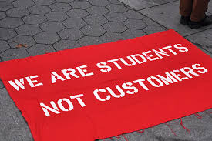
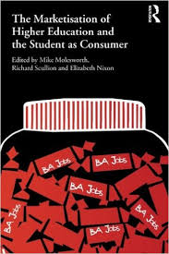
The Neoliberal Formation of Chilean Higher Education
Neoliberalism as the discursive context where widening participation policies s unfold.
Mode of governmentality under the form of the market (competition, individual responsibilisation, consumption, privatisation, mandatory values)
‘When politics are used to allocate resources, the resources all end up being allocated to politics’ (P.J.O Rourke).
‘Who is society? There is no such thing! There are individual men and women and there are families and no government can do anything except through people and people look to themselves first’ (Margaret Thatcher).
Neoliberalism is embedded in a particular sociocultural and political landscape.
Notes:
I will start giving some background about Chilean Higher Education.
Chilean HE has a history of market-driven policies since the 1980s triggering the competition for students among universities, so producing a market. These policies are based (even nowadays) on loans and vouchers to students, on a deregulation of tuition fees, and on a strong privatisation as a mean of profit and widening the participation of students. We have just 8 state universities among 59. Among the consequences of these arrangement we can mentioned that:
(adjusted for income) Chile has the most expensive Higher Education among OECD countries. To study a bachelor degree cost in average £4000 per year, and we need to take into account that in Chile more than 50% of households live with less than £250 x month.
It has multiple inequalities affecting underprivileged students. These students have 5 times as low a chance to enter the university than the affluent students; among the total who enter HE just 60% continue their studies after 4 years in contrast to the 80% of affluent students; they are highly underrepresented in the prestigious universities because of their cost, and because of the university entrance test which discriminates by class and educational backgrounds. Usually they don’t get the minimum scores to enter universities.
Universities expend more money in advertisement to attract students than in education turning from a space of learning to a space of profit where powerful people are involved even the Justice Minister.

Slide 5

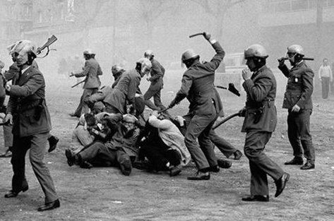
THE NEOLIBERAL FORMATION OF CHILEAN HIGHER EDUCATION
1973s. From popular democracy to an authoritarian neoliberalism.
  A violent break from and shutting down of the becoming of the working class as “the people” (Selina Todd, 2015).
Based on class policing/disciplining, depolitisation and commodification.
In higher education.
  Depolitisation under the national security doctrine: when the “people” and politics are the thread.
  ‘….Nor can it [university autonomy] signifies protection for political activity within the university confines, above all in the form of oral or written propaganda, relative to issues that are commonly understood as part of political debate and commitment’ (General Gustavo Leigh; member of Military Junta)
The neoliberal economists known as “Chicago boys”

Slide 6
THE NEOLIBERAL FORMATION OF CHILEAN HIGHER EDUCATION
Competition: as governing rationality
  Competition for students by fees and advertisement
  Competition for research funding
  Economy of prestige based on class position of students.
  During the 1990s and 2000s. Furthering competition: reshaping “solidarity” through human capital, competitiveness, Knowledge based economy
‘...making possible the necessary competition is mandatory for advancing intellectual activity and, in turn, should ensure the solidarity, coordination and programmatic oversight necessary to develop higher education that will enable Chile to occupy a leading position in the Latin American region. (Concertación de Partidos por la Democracia, 1989:23)’
‘... it is important to achieve high level outcomes in an educational system as it is transformed, partaking of the revolution of knowledge and information and of the growing process of globalization. Such trends mean for the country and for its universities new requirements in terms of knowledge creation capabilities, of the training of highly qualified human resources and of technology transfer’ (Ministry of Education, 1997:7)

Slide 7
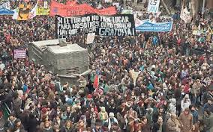
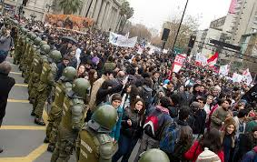
THE NEOLIBERAL FORMATION OF CHILEAN HIGHER EDUCATION
Privatisation
  Foundation of private universities
  Blurring the distinction between private and public
  “Civilisation is the progress toward a society of privacy. The savage’s whole existence is public rule by the laws of this tribe. Civilisation is the process of setting man free from men” (Ayn Rand, The Virtue of Selfishness, 1964).
“The ungovernable others”
Notes:
In Japan, we can see the epistemological neoliberal trend. Public is the ungovernable “other”. In order to govern “the public” they construct the “ungovernable” through the eyes of competition. Then, the wilful subject became the ineffective, the inefficient, unuseful.

Slide 8
THE NEOLIBERAL FORMATION OF CHILEAN HIGHER EDUCATION
The silent arrival of the entrepreneurial student subject by widening participation policy
  Multiplication of student funding through loans and scholarships" based on academic merit.
  Financialisation and Corporatisation of WP policy, by the massive introduction of the state-subsidized credit where the state gives the money back to banks, and students became indebted. £360,000 billion pounds between 2006 and 2014 for the banks
  WP focused on dropout and repetition issues by promoting strategic, rational decisions regarding what and where to study, and promoting “emotional skills”
Number of Students with the State Sponsored Credit, 2006-2014

Slide 9
What is the desirable subject the affirmative action policy construct within this discursive context?
Depolitisation and fear of the “public working class other”.
“When my students (those under the programme) engage in political assembly and activities, sometimes I go to see what is going on in these spaces, I identify them, I ask them, what they are doing there, I ask them, if I can participate and stay in their meetings” (Policy maker and university professor)
From my field notes in a meeting with monitors and practitioners:
“monitors were discussing about how to avoid and persuade students participating in the programmes not to get involve in political activities. They were worried because these “students” are easily “absorbed” by political organisations, and that can be a distraction from their duties as students.
Induction Access Programmes and the new working class students.
Based on two documents, interviews, and field notes.
  “More Induction Access Programmes in Chile: The discourse of students at Universidad Católica Silva Henríquez (2013)
  The Rationales for the “Support and Effective Access into Higher Education Programme” (Ministry of Education, 2015)

Slide 10
The rejection of the working class (the othering of working class subject).
"Be a professional". This constitutes a positive identity…education in the university, acquires a relevant assessment and opposes "being a worker" as this situation is associated with people who are outside the university or do not study in it (More Induction Access Programmes in Chile, 2013)
Being self-responsible ‘as something that should drive people to focus more on themselves and lead to the internalisation of the idea that societal problems and socio-economic realities are, in fact, their individual responsibility’ (Kurki & Brunila, 2014).

Slide 11
The competitive, profitable subject (the blending of security national doctrine with entrepreneurialism)
'These young people are represented and presented as a different type of student. A student who is distinguished from the rest because his merits and gifts are not associated with the social class from which they come. They are the results of their effort, sacrifice, planning and clear goals ... [beyond academic achievement] as a good predictor of academic success, are people who have managed to be the best from their own means, in contexts of high vulnerability’ (More Induction Access Programmes in Chile, 2013, p. 276).
The aspirational subject.
This [the programme] will increase equity, diversity and quality in higher education, as well as generate new aspirations in secondary education (MINEDUC, 2015)
‘The expectation of students' access to the university generates a strong change of attitude, management and commitment of the teachers in their work and in their relationship with the students, transmitting them that they can go far. The expectation, have given meaning to teaching and learning’ (MINEDUC, 2015)

Slide 12
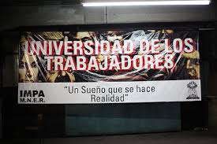
The strategic protection of the upper classes
Daniel we need to talk…We cannot speak and revival a language of class struggle. If we do that the government will burn us! (Policy network leader B)
….We must be smarts. When we present a policy we do it without pointing enemies. We never say that we are stolen quotas (places) to children from private elite schools…to fight against the most powerful people in the country is very hard. That’s why we haven’t used the other discourse (the discourse of class) because we knew we would lose…Therefore we should go from another perspective, from the perspective of the inclusion and quality. Those arguments are not so disputable. (Policy network leader A)
“Workers University: A dream comes true”

