Slide 1


Slide 2


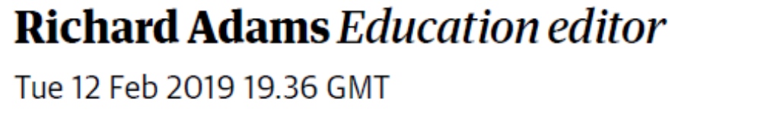

Slide 3

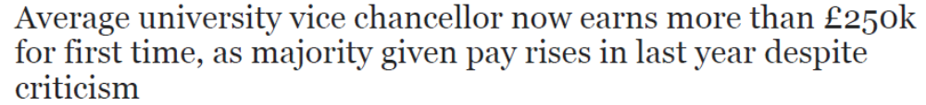


Slide 4




Slide 5




Slide 6




Slide 7
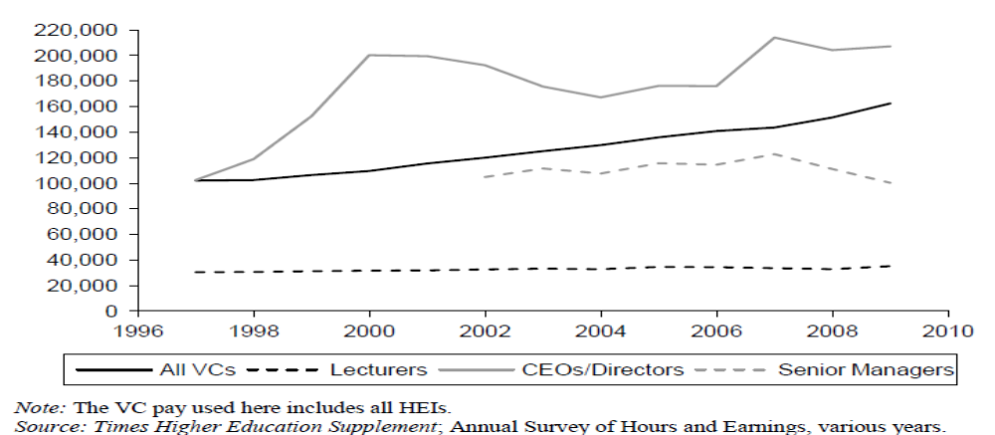
Average annual real pay at 1998 prices: all VCs, CEOs/directors, senior executives and university lecturers
(Bachan and Reilly 2015 p53)

Slide 8
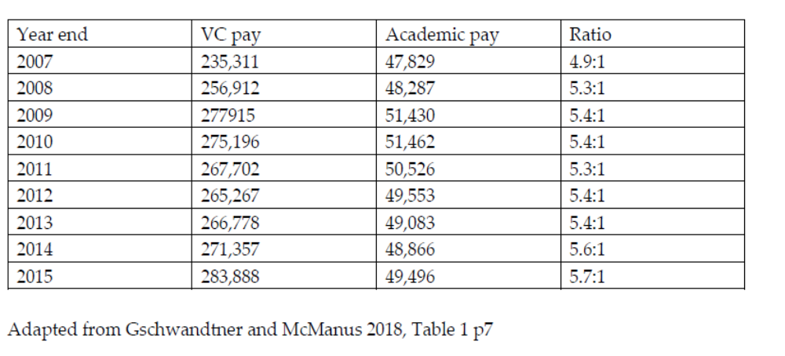
Average UK VCs’ and academics’ pay, adjusted to 2017 prices.

Slide 9
Average annual UK VC remuneration stood at £289,756 by 2016-17, an increase of 3.2% on the previous year.
Between 2011-12 and 2016-17 it rose by 3.1% a year – during which time a 1% public sector pay rise cap applied to other university staff.
Averages can be misleading because of the marked variation in size and nature of UK universities.
In 2016-17 the average remuneration of VCs of the elite Russell Group universities was £355,670
There is clear evidence of a rapid escalation in UK VCs’ pay since compulsory reporting began in 1995.

Slide 10

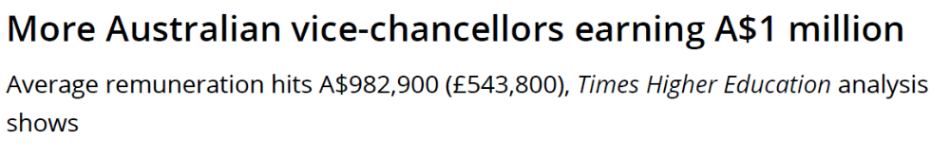
”The average remuneration package for bosses of Australia’s 37 public universities reached A$982,900 [£543,800] last year, with 16 leaders pocketing more than A$1 million each – up from 13 in 2017 and 11 in 2016.”

Slide 11
Rapid and relatively recent increases in VCs’ remuneration
Have little connection between pay and performance (Bachan & Reilly, 2015).
Tournament theory plays a part
Formulaic pay-setting mechanisms such as benchmarking also play a part.
…but there’s not much by way or rigorous explanation as to why these increases are occurring.

Slide 12

Remuneration
= the money and non-monetary perquisites (“perks”) an individual receives because of their personal relationship with an organisation.
Four types:
Salaries/wages
Stipends
Profits
Rent

Slide 13


Slide 14
Contemporary stewardship theory posits that individual behaviour can be
ordered such that pro-organisational, collectivistic behaviours have higher utility than individualistic, self- serving behaviours…even where the interests of the steward and the principal are not aligned, the steward places higher value on co-operation than defection
(Davis, Schoorman & Donaldson, 1997, p. 24).

Slide 15
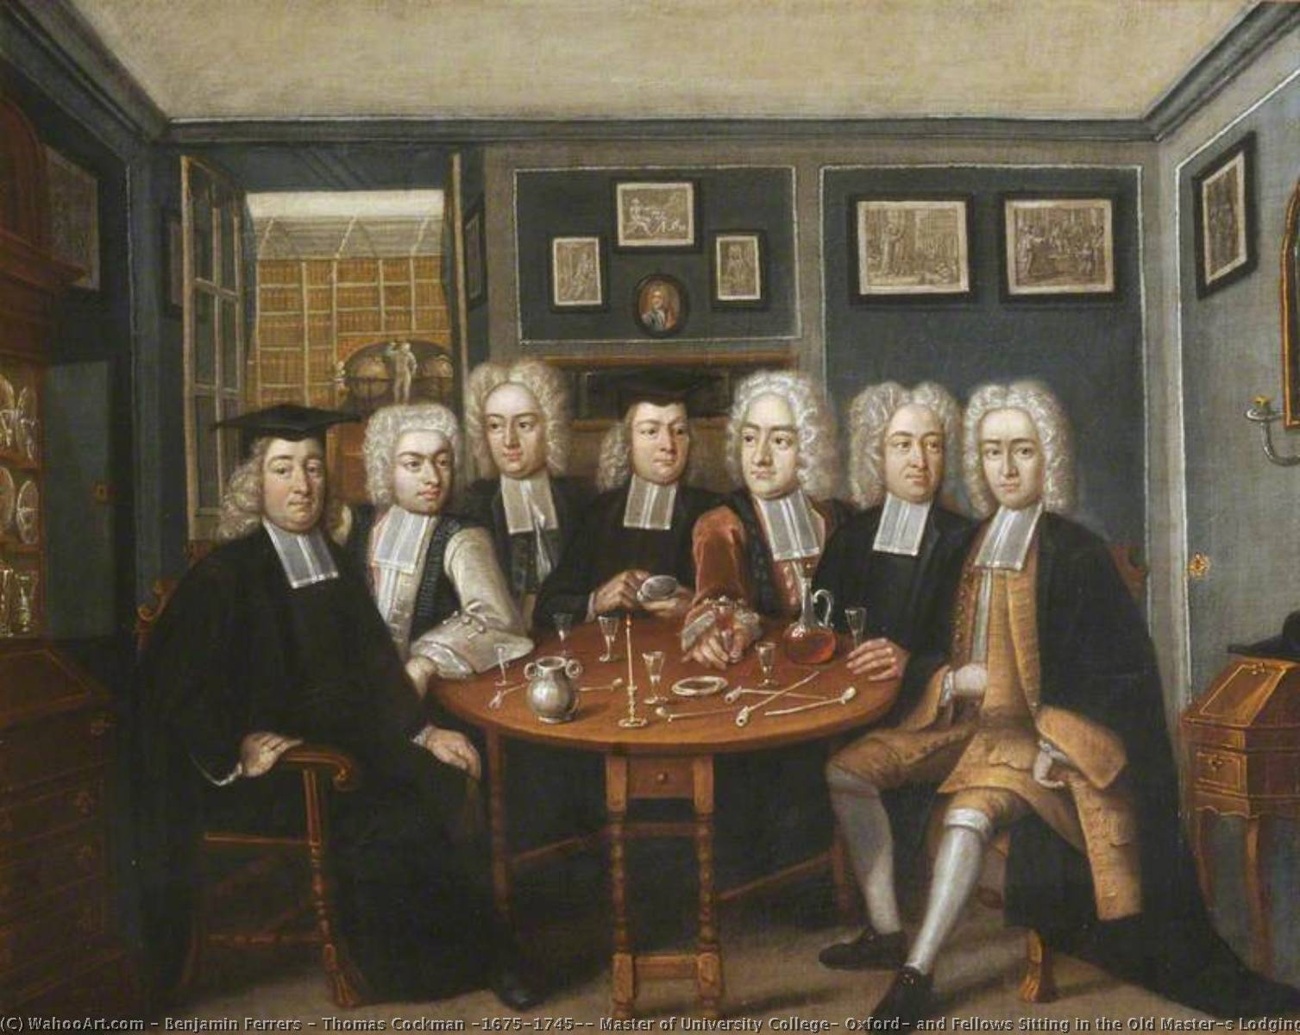

Slide 16
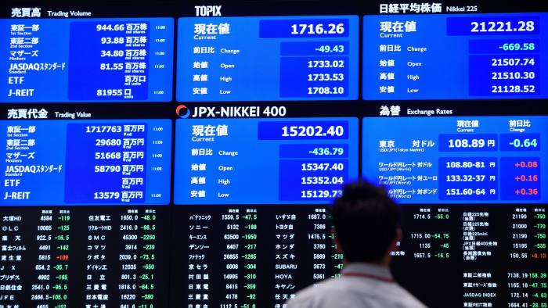

Slide 17
Agency theory
owners = principals and managers = their agents. Both seek to maximise their own (implicitly) financial position at the expense of the other.
Jensen and Meckling (1976): this conflict can be mitigated in two ways.
Principals may institute costly governance systems that delimit, control and monitor the actions of agents.
Principals use remuneration to align agents’ interests to their own - managers will always seek to maximise shareholder wealth if they share in it – e.g. profit-related bonuses. Remuneration is the most cost-effective way to protect shareholders’ interests as it frees managers to behave entrepreneurially whilst minimising surveillance costs

Slide 18


Slide 19
Stewardship v Agency (1)
Motivation: agency favours measurable, extrinsic motivations such as remuneration. Stewardship focuses on less measurable intrinsic factors such as personal growth, achievement and affiliation.
Identification: for a steward, the organisation becomes an extension of their identity and ‘psychological structure’, leading to a greater sense of personal responsibility. For an agent, the attachment is strictly financial and self-serving.
Power: Stewardship is personal, expert and referent with influence coming through knowledge and expertise or through personal relationships with others. Agency is coercive, structural power.

Slide 20
Stewardship v Agency (2)
Trust Stewardship marked by high commitment and trust. Agency seeks to minimise risk through control systems that cast individuals as economically self-interested actors.
Culture: Stewardship tends to be collectivist, agency is individualistic
Power-distance Stewardship is marked by lower power-distance relationships than agency, with flatter, less hierarchical organisations
(Davis, Schoorman and Donaldson 1997)

Slide 21
Universities and agency theory?
Strictly non-applicable: Public universities in the UK and Australia are autonomous, self-governing, not-for-profit entities. They have no shareholders with personal financial interests to act as principals.
However, we argue that notions of agency theory have been discursively deployed within transformed university governance frameworks as a way of enabling VC remuneration increases.

Slide 22

Australia has 38 comprehensive publicly funded universities
Self-governing, self-owning charities.
Since 1950s, funding has been from the federal government.
A ‘reduction of direct control of the internal business of higher education institutions’ signalling a ‘Thatcher-like commodification of the tertiary education system’ .

Slide 23
VCs were to be chief executive officers of universities more ‘business-like’ and entrepreneurial
The balance of internal power reverted sharply to university councils, away from academic senates
Councils became much smaller and more focused on strategic and financial matters
Openly corporatist, to deliver greater accountability to government’
Senior external business people appointed to councils, concomitant reduction in staff and student members

Slide 24
Universities and salary setting
1974 to 1990s, academic staff salaries were centrally determined. Was replaced by decentralised local enterprise bargaining – salaries determined by each university. = greater managerial control
1976 -86 pay award body recommended VC salaries. Deviations penalised
From late 1980s, VC pay set entirely within each university
VCs sit on own remuneration committees in many instances

Slide 25
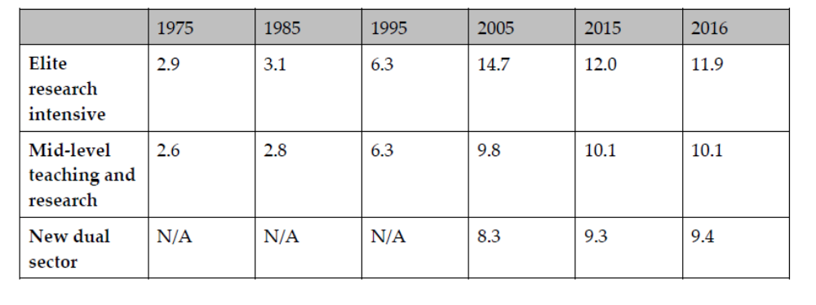
Comparison of selected Australian vice-chancellors’ and lecturers’ salaries 1975-2016

Slide 26

Origins as autonomous, self-governing communities of scholars endowed financially by the state, church or wealthy
Apart from a small number of more recent commercial for-profit institutions, they remain private, charitable and self-governing.
Until 1990s, marked by cultures of trust and a significant absence of managerial control mechanisms or formal exogenous accountability; academics were the primary decision makers in collegial governance systems and VCs were primus inter pares

Slide 27
From the 19th century to 1980s, state increasingly funded universities. Government took care not to exercise a strong governance role. Ended with Thatcher
Committee of Vice-Chancellors and Principals - Jarratt Report 1985
Crucial to this was ‘recognising the Vice-Chancellor not only as academic leader but also as chief executive of the university’ (CVCP, 1985, para 5.5 d).
Universities have prioritised corporate efficiency and profitability, shifting the balance of power further to senior, non-academic managers.

Slide 28
In 2018 95% of VCs were either members of the remuneration committee that set their own salaries or allowed to attend meetings. This continues.
Voluntary code agreed by the Committee of University Chairs [of councils] in 2018 stated that it was inappropriate for VCs to be members of their remuneration committees but that they could attend – provided they were not present when their own salary was being discussed.
By 2019 some 81% of UK universities still allowed their VC to attend remuneration committee meetings and nine still allowed the VC to vote (down from 66 the previous year).

Slide 29
Pay comparisons
Mean academic earnings in in the year to April 2017 = £49,100.
This gives a salary ratio of 5.9:1, or 7.2:1 in the Russell Group universities
VCs in the UK enjoy significant salaries
These have been increasing at a faster rate than academic salaries.
This period coincides with the rapid marketisation and commercialisation of UK higher education.

Slide 30

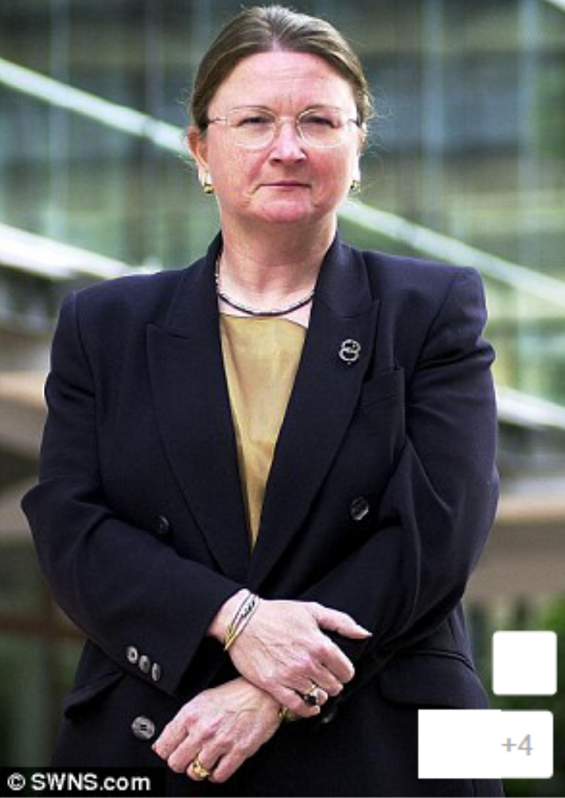


Slide 31
Taking the…rent?
Rent-seeking behaviour is where actors extract a greater share of remuneration than is economically justified in terms of work undertaken or risks taken; a consequence of having unchecked power
Rent-taking is intrinsic to agency governance
Governance mechanisms such as remuneration committees give false impression
Breakdown in collegiality may encourage rent-seeking
Salary transitions to rent and vice chancellors become rentiers

Slide 32
What is to be done?
In Australia, no moves to curb VC remuneration, despite public outcries.
In the UK, CUC Code weak and still allows VCs to participate in salary-setting. Unlikely the OfS will do very much.
Exhortations have fallen on deaf ears
Leaves only central control as the means to curb pay – either by fixed ratios or a national salary body, such as exists for MPs or senior judges.
Needs political will…

Slide 33


