Slide 1

Affects, the Permanent Audition, the Academy:
Notes on The Contemporary Psychic Life of Feminism
Professor Valerie Hey
http://www.sussex.ac.uk/education/cheer

Slide 2
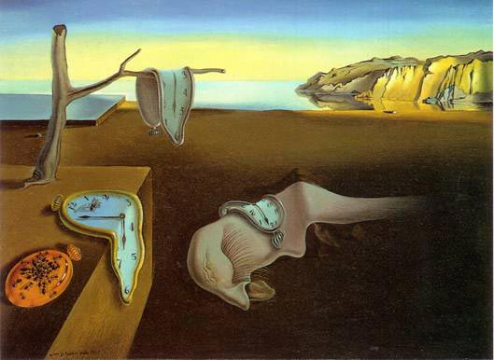
The Temporal Curve of the ‘Autobiography of the Question’
Prologue
Speaking Up – ambiguity of privilege – precaristocracy? (Will Self)
Exit, Voice, Loyalty (Hirschman)
Modernism – Postmodernism – Affluence – Austerity
Notes:
Subtext and text
Argument is that feminism is a palpable politics – its form can not be entirely predicted in advance – need some historical memory but not to tie feminism down as much as set it free to disagree with it.

Slide 3
Themes and Issues
To acknowledge the role of emotions in feminist politics, theories and subjectivities
To situate and describe intellectual trends & resources comprising ‘the affective turn’
To explore the Academy as affect-creating and distributing
To invite comments on some implications for feminist agency

Slide 4
A Brief History of :
Emotion or Affects?
Wetherell’s account includes the way emotion is understood in psychology as a grammar for describing singular bodily states (fear, shame, pride, etc.) as well as the affective covering a
‘wilder more encompassing project highlighting difference, process and force’ (2012, 2).

Slide 5
A `Brief History of :
Emotion or Affects?
But Probyn cuts it the other way
‘A basic distinction is that emotion refers to cultural and social expression, whereas affects are of a biological and physiological nature’ (Probyn 2005: 11).
Bourdieusian work Reay, Skeggs,McNay

Slide 6
‘Emotion as a way of apprehending the world’ (Ahmed, 2004)
‘Emotions do things, and they align individuals with communities or bodily space with social space through the very intensity of their attachments. Rather than seeing emotions as psychological dispositions, we need to consider how they work, in concrete and particular ways, to mediate the relationship between the psychic and the social, and between the individual and the collective. (Ahmed 2004a, 119)
Notes:
Which emotions ‘stick’ to which bodies –
Race as a sticky subject
Feminist killjoys

Slide 7
Affects Put to work :
(1) Berlant’s Cruel Optimism and Depressive Realism
‘To phrase ‘the object of desire’ as a cluster of promises is to allow us to encounter what is incoherent or enigmatic in our attachments, not as confirmation of our irrationality but as explanation for our sense of our endurance in the object, all attachments are optimistic‘
‘There is no collective life without norms, the question isn’t how to become post-normative as such but how to respond to the urgency to engender other kinds of anchors or magnets for new social relations and modes of life’
(Intellectual interest in affects/emotion/subjectivity/power
Notes:
Being alongside the world – sticking with difficulty.

Slide 8
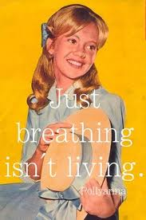
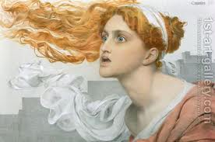
Argument : Tracing the Affective Landscapes of Altered Feminist Rationalities
1960s liberal humanism – renaissance or ‘the glad game’
1980s- present neo-liberal realism
Feminist Futures ? :
‘We inherit the future, not just the past’ (Barad, 2010: 257).

Slide 9
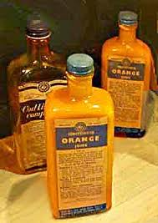
Act 1 Pollyanna Rationality
Optimism, Investment and Growth = Welfare State – class collectivism
Modest Redistribution, Renewal & Prosperity
The Law of Unintended Consequence –HE access – the production of new subjects
Notes:
Commemorating the Robbins Report http://www.sussex.ac.uk/education/cheer/events
Thus thinking the present about the past – often cited as loss
gap populated by desire -
Expression of Welfare State/Democratic Impulse & Impetus
Overcoming of 5 evils including Ignorance
In Robbins report crucial Role of (LSE) public intellectuals – for the solidary supportive state e.g. Titmus – his work on “The Gift”
Evidenced-based policy – para-utopian
The positive spirit of the age
Affirmed the virtues of a liberal education
Context of reform e.g. secondary education
Egalitarian – inclusive – women, working class & ?
Is it possible to read it defractively as Barad urges -

Slide 10
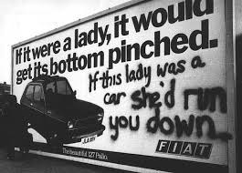
Act 1 Access to HE –Expressing Modern Welfare Feminism?
New Social Movements including Feminism
Politicising Gender
Cultural and Material Change
Feminist Access to Universities & Professions
Male knowledge –decentred but Male Reason still rules
Notes:
Important to historicise political and to see the ‘political’ in how knowledge discourses arise, are challenged and undone.
crude to periodise ‘feminism’ as if it were a singular thing rather than a movement and then fissured into many discourses and practices but can see the fracturing of modern feminism coincident on the eruption of ‘difference’ & dissolution and fragmentation of women's liberation movement
The contestation from black women; working class women, lesbian politics and disabled women – what was called Third World Feminism – challenged First world, affluent, white global north accounts – so gender was seen as intersected by class, ethnicity, sexuality, geographies of affluence etc
The rise of neo-liberalism – post-welfare politics – the domination and success of individualism and the promise of Capital – in UK Third Way - The American Empire – shopping and consumption, mobility and opportunity – Bridget Jones – job education but still no-man ! Chick lit – aspiration and women having it all – Sex in the City – sexualised hyperfemininity – site of women’s presence but not her equality? See Angela McRobbie – on The Aftermath -

Slide 11

Act 2 Cassandra Rationality
Inside The Neo-Liberal Academy
'My point is not that everything is bad, but that everything is dangerous, which is not exactly the same as bad. If everything is dangerous, then we always have something to do. So my position leads not to apathy but to hyper - and pessimistic – activism. I think that the ethico-political choice we have to make every day is to determine which is the main danger.’

Slide 12
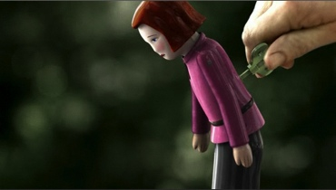
Cassandra (Clockwork) Feminist
The Triumph of Performativity ?
Immaterial Labour – Dreaming in Code for Capital? (Lucas, 2010, NLR)
Academic Feminism – Productivity without Purpose?
Competition's Affects – The Fatigue of Being Oneself
Notes:
Woe Woe and Thrice Woe – pessimism, passionate commitments
Excessive production – driven maniacs (Skeggs, 2008)
reproduction not resistance or both but then how?
Mastery and subjectivation (Butler)
Deep ambiguities of presence – ‘Conceptual war of attrition’
Witness and reminder –rewriting going on

Slide 13
Act 2 Knowledge about/from the inside
The Death of Critique - Bronwyn Davies
Killing Thinking – Mary Evans
Neo-liberal Cruelties – Rosalind Gill
Micro-politics & Disqualified Discourses – Louise Morley
The Norm of Carelessness – Kathleen Lynch
Why Bother? (Louise Morley)
Affective Asymmetries (Valerie Hey)
Notes:
Re-considering what it is possible to resist, to do, to act as a feminist academic – last inspiration is a Deleuzian inspired artist – talks about precarity
- What can a white feminist professor know of precarity – position of non-identification with the dispossessed – but one of dialogue

Slide 14
Raced, Classed and Gendered Academic Labour Market
‘Why is My Professor White’ campaign
ECU reports by Hey et al (2011); Bhopal (2014)
The Experiences of Black and Minority Ethnic Academics:
Casualised working conditions; insecurity of employment; Warwick unit for teaching-only contracts, performance management with income generation targets, suicide, stress …
Notes:
IMPACT ON CULTURES SECTORS AND SELVES

Slide 15
Affects Put to Work:
(2) Disgust as Generative
  To be in agreement with’ – ‘to look, to not turn away’ – ‘to resist, to resist the facts’
  ‘Obscene Gifts’ – public potlatch art of Thomas Hirschhorn
  Inspired by the compulsion to ‘Reveal…) the ‘Real’(Zizek, 1997) = Capitalism
  Against ‘decaf resistance’ (Contu, 2008)

Slide 16
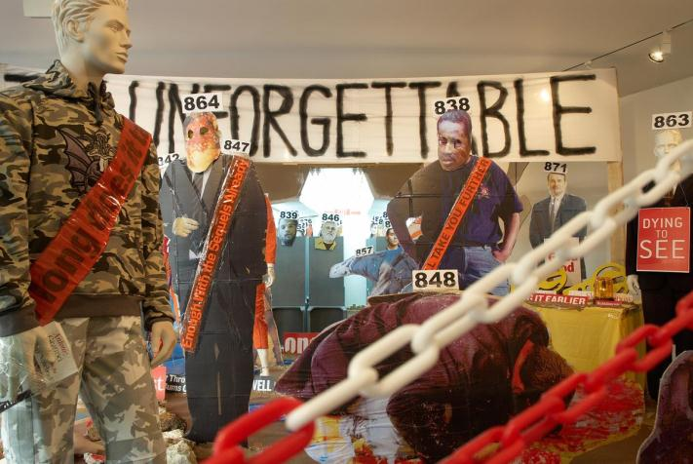
Ambivalent Disgust
Notes:
Images of atrocities that I'd rather never have let into my mind are collaged into its scornful cardboard architecture (for God's sake don't take children). As you edge into the glass-fronted showroom of the gallery where Hirschhorn is showing until April 7, you are pushed back against the wall by a structure that turns in on itself in an epic Dada pantomime of cut-out figures, news headlines, satire and pathos: I've been unimpressed by Hirschhorn before but this is a coruscating masterpiece.
Based on the phenomenon of "flat daddies" - cardboard substitutes for US soldiers in Iraq to reassure their children - it extrapolates from this kitsch by-product of war into what I can only describe as a great vomit of loathing for contemporary western society.

Slide 17
Public Collective Resistance ?
But where do we produce our publics and our ‘obscene gifts ?’
Given ‘private’ institutionalised academic production.
Hyper productivity – REF productivity functions as alienated – - form of a commodity fetish not least in the teleology of ‘impact’or subversion or complicity?
Notes:
Alternative Modalities of Resistance in the Contemporary Workplace, Peter Fleming and Graham Sewell, Sociology Volume 36 n Number 4 November 2002 .
The piece argues that looking for major spectacular resistance (strikes, sit-ins) is passe; that footdragging, flannelling, pretending ignorance, skrimshanking and false compliance etc. are the typical forms of resistance in teamwork managed workplaces and the like. They called it Sveikism, after the Good Soldier Sveijk
- Of course someone else in the team may pick up the slack – ive argued this before in terms of emotional labouring in higher education -

Slide 18

Alternative Resistance Modalities?
Sveikism, Foot-dragging, flannelling, pretending ignorance, scrimshanking and false compliance‘ characterise the team-managed workplace
(Fleming and Sewell, 2002).
Notes:
Alternative Modalities of Resistance in the Contemporary Workplace, Peter Fleming and Graham Sewell, Sociology Volume 36 n Number 4 November 2002 .
The piece argues that looking for major spectacular resistance (strikes, sit-ins) is passe; that footdragging, flannelling, pretending ignorance, skrimshanking and false compliance etc are the typical forms of resistance in teamwork managed workplaces and the like. They called it Sveikism, after the Good Soldier Sveijk
- Of course someone else in the team may pick up the slack – ive argued this before in terms of emotional labouring in higher education -

Slide 19
What’s to be done?
Does our immaterial labour matter?
Living in the time of the never arrived–suspending now for the next (Emily Henderson).
How to deal with this in terms of ethics of care for our self and our students?
Privilege and the seduction of ‘success’?

Slide 20
`Unloved University? Toxic Correlations/ Access and Social Identities
4% of UK poorer young people enter higher education
(David et al, 2009; Hills Report, 2009).
5% of this group enter UK’s top 7 universities (HESA, 2010).
Universities = hereditary domain of financially advantaged (Gopal, 2010).
Opportunity hording by privileged social groups? (Morley, 2012)

Slide 21
The Affective Economy of the Academy
The calculus of rational actor theory
The dominance given to naïve realist views aligned with neo-liberal realism (Wendy Brown)
The toxic politics of narcissistic individualism BUT
The truth of human and system vulnerability & interdependency
Not entirely captured by the system
Rebellions of and through our precarious bodies

Slide 22
No Answers ?: Feminism, Fashion and Difference
Has feminist theory moved from the realm of the necessity of resistance into reproduction?
Are there any political consequences for feminism of material generational differences among ‘vintage’ feminists and younger feminists?
What new imaginaries can assist us in thinking outside the ‘master’discourses and the ‘discourse of the master’and the logic of ‘mother knows best’!?

Slide 23
Hey, V. (1997a) ‘Northern accent and southern comfort; subjectivity and social class’, in: P. Mahony & C. Zmroczek (Eds) Class matters ‘working-class’ women’s perspectives on social class, London: Taylor & Francis, pp. 143-154
Hey, V. (1997b) The Company She Keeps: an ethnography of girls’ friendship, Buckingham,
Open University Press
Hey, V. (2003) ‘‘Joining the club?’; academia and working-class femininities’, Gender and Education, vol. 15, no. 2, pp. 319–335.
Hey, V. (2004) ‘Perverse pleasures; identity work and the paradoxes of greedy institutions’, Journal of International Women’s Studies, vol. 5, no. 3, pp. 33–43. Available online at: http://www.bridgew.edu/soas/jiws/May04/Hey.pdf/.
Hey, V. (2006a) ‘‘Getting Over It’; Reflections on the melancholia of reclassified identities’ Gender and Education, vol. 18, no. 3 pp. 295–308

Slide 24
Hey, V. (2006b) 'The politics of performative resignification: translating Judith Butler's theoretical discourse and its potential for a sociology of education', British Journal of Sociology of Education, vol. 27, no. 4,pp. 439 – 457
Hey, V. (2008): ‘The strange case of Nietzsche's tears: the power geometries of passionate attachments in education’, British Journal of Sociology of Education, vol. 29, no. 5, pp. 571-7 [,
Hey, V. and Leathwood, C. (2009). ‘Passionate attachments: Higher education, policy, knowledge, emotion and social justice’. Higher Education Policy Vol. 22, no. 1, pp. 101-18.
Hey, V. (2011) ‘Affective asymmetries: academics, austerity and the mis/recognition of emotion’, Contemporary Social Science, vol. 6, no. 2, pp. 207-222

Slide 25
Hey, V. (2011) ‘Notes Towards Decoding the Affective Economy of Austerity in Higher Education’ Keynote presentation at the 4th Annual Conference Psychosocial Studies Network, University of Brighton 11th June
Hey, V. (2011) ‘Affective asymmetries: academics, austerity and the mis/recognition of emotion’, Contemporary Social Science, vol. 6, no. 2, pp. 207-222

Slide 26
Hey, V. (2013): Privilege, Agency and Affect in the Academy: Who Do You Think You Are? In (eds) Claire Maxwell & Peter Aggleton, Privilege, Agency and Affect: Understanding the Production and Effects of Action London, Palgrave
Hey, V. and George, R. (2013): Dissident Daughters? The Psychic Life of Class Inheritance Special Issue, Young Women in Movement: Vulnerabilities, Needs and Norms Pedagogy, Culture and Society 21(1), 95-110
Hey, V., Dunne, M., Aynsley, S., Kimura, M., Bennion, A., Brennan, J. with Patel, J. (2011):
The Experience of Black and Minority Ethnic Staff in Higher Education in England. London, Equality Challenge Unit.

