Slide 1





The role of transitions in the mental health and wellbeing of PGR students
Dr Rachel Moss, Dr Jane Creaton and Professor Karen Heard-Lauréote

Slide 2
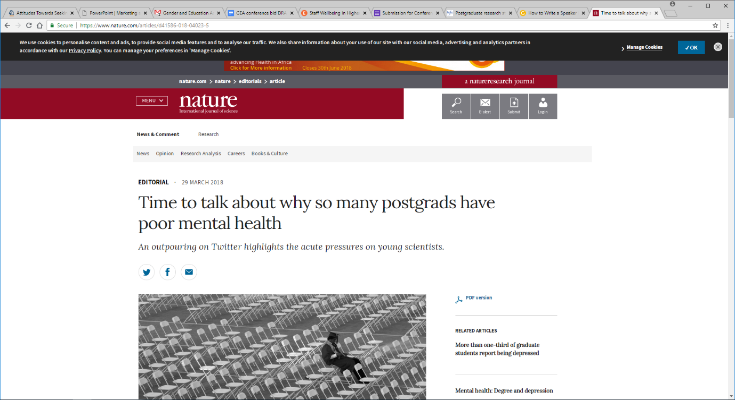
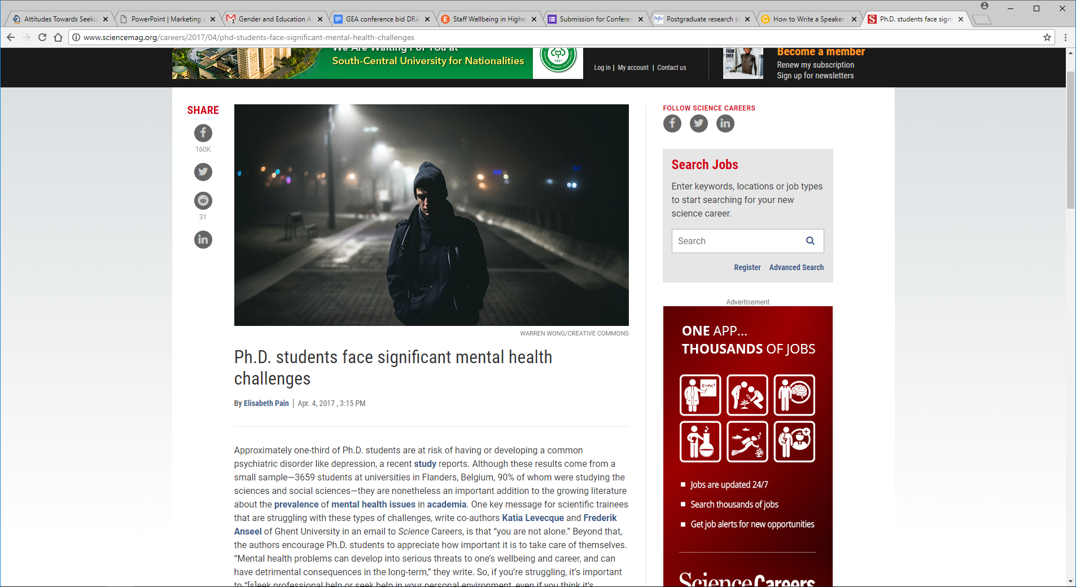
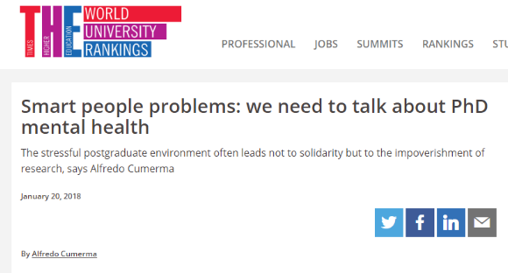

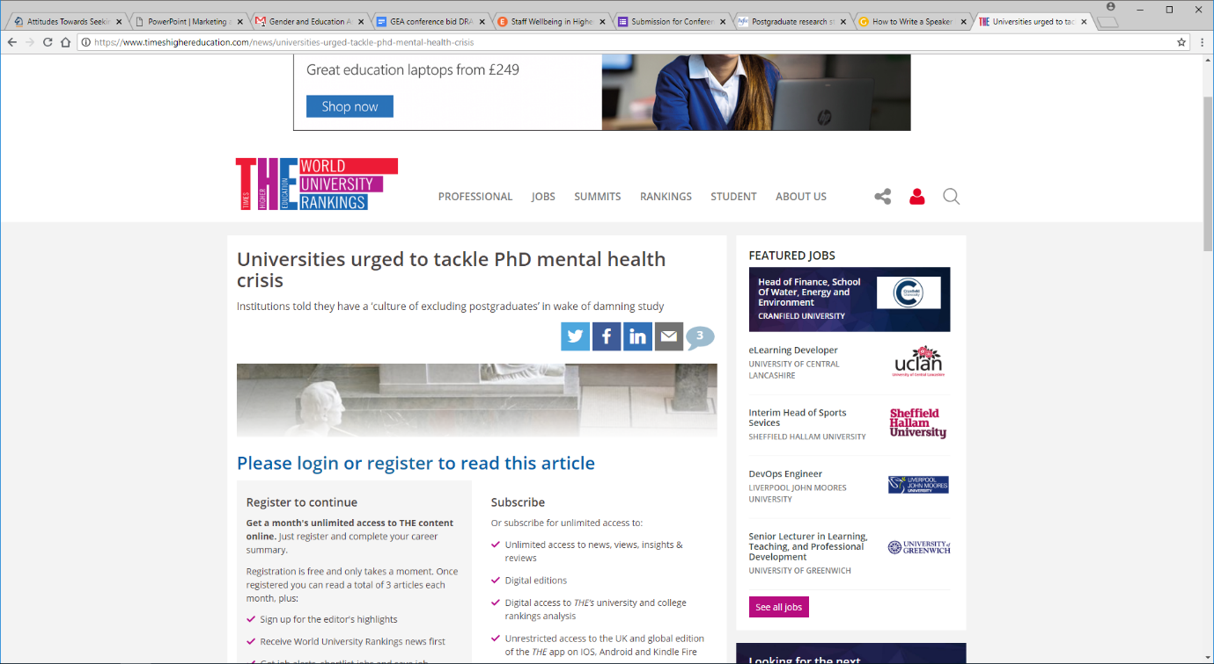
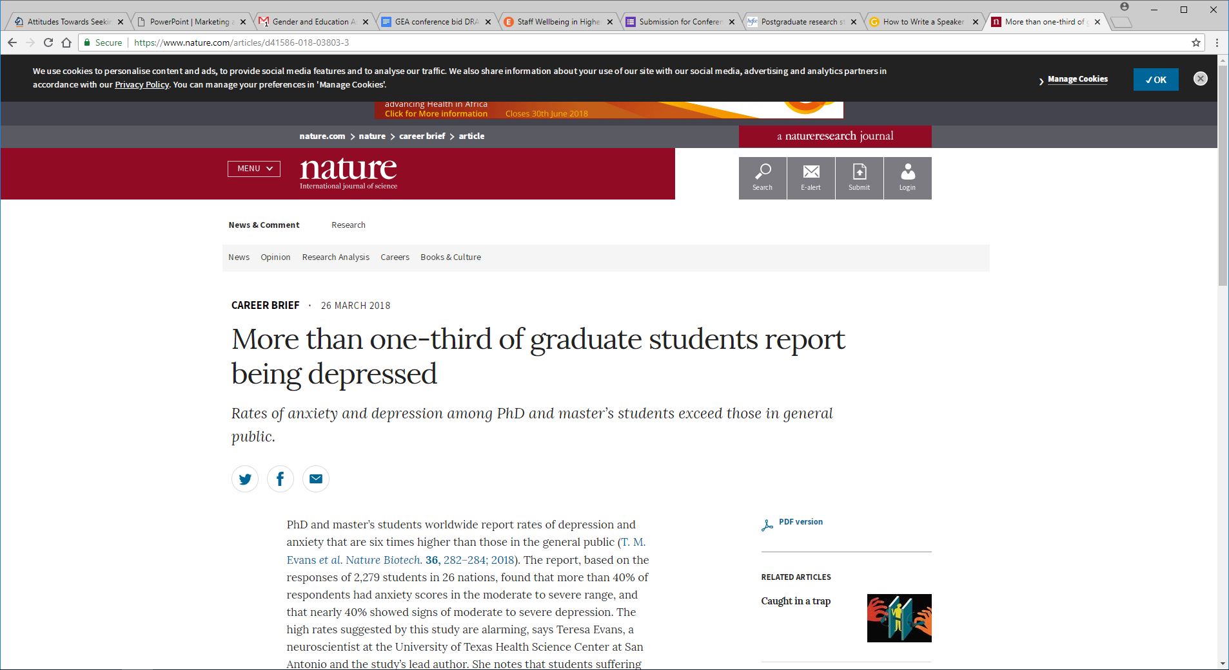
PGR mental health and wellbeing
Notes:
There are concerns about the mental health and wellbeing of PGR students, as highlighted by a number of academic press articles in the past couple of years.
Clearly further support is needed – it should not be a given that PhD students experience mental health problems. It should not be expected or part of the doctoral process.

Slide 3
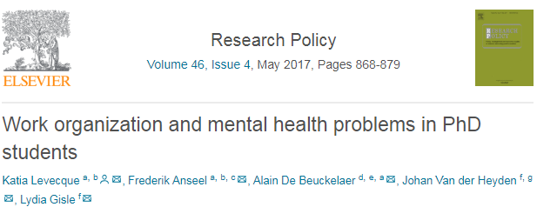
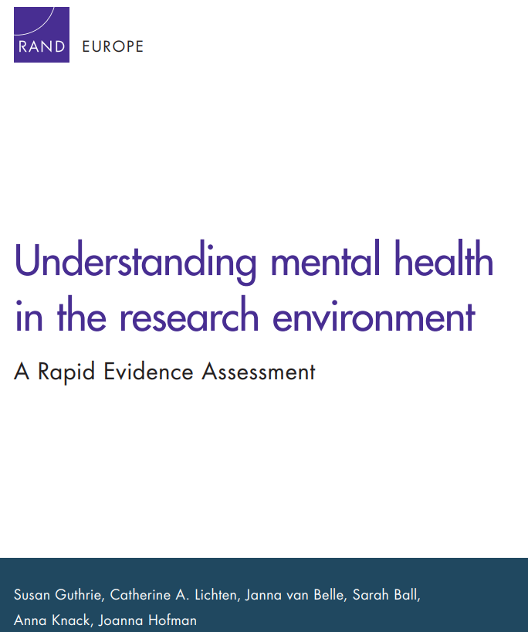
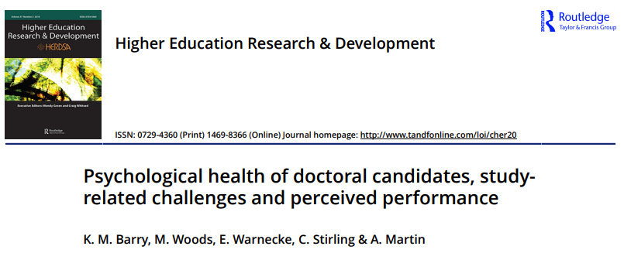
PGR mental health and wellbeing
Notes:
Reports within the academic press are responding to growing international research evidence on the state of PGR student mental health and wellbeing.
Levecque et al (Belgium): One in two PhD students experiences psychological distress; one in three is at risk of a common psychiatric disorder; The prevalence of mental health problems is higher in PhD students than in the highly educated general population, highly educated employees and higher education students.
Barry et al (Australia): participants reported higher levels of depression, anxiety and stress than age-matched general population.
Guthrie et al. (International – literature review): based on self-reported evidence, University staff and PGR students are at greater risk, compared to other working populations, of having or developing a mental health problem. Large proportions (> 40%) of PGR students report symptoms of depression, emotion, or stress-related problems, or high levels of stress.

Slide 4


PGR Transitions: An pedagogical perspective
Notes:
What could be the risk factors which underpin the poor state of PGR student mental health and wellbeing? The role of transitions should be considered from both pedagogical and psychological perspectives
The importance of transitions in the context of PGRs tended to be overlooked both in the pedagogical literature and in institutional policies and practices (assumption that PGRs are HE experts who already know the “rules of the game”
Yet transitions into, through and beyond the doctorate equally significant – students engaging with new practices, policies, procedures, cultures which are often different from UG and PGT – in particular, the move to self-directed study and the managing of unstructured time.
3 particular issues (1) The rules of the game are even less explicit than at UG (entire books devoted to trying to explicate the tacit knowledge embedded in academic culture) (2) Supervisors are assumed to be primary means of supporting PGR in transitions through – but lack either the capacity, the training of the time (3) there is a lack of a formal curriculum or structured learning, teaching and assessment opportunities in which to embed support for transitions.

Slide 5
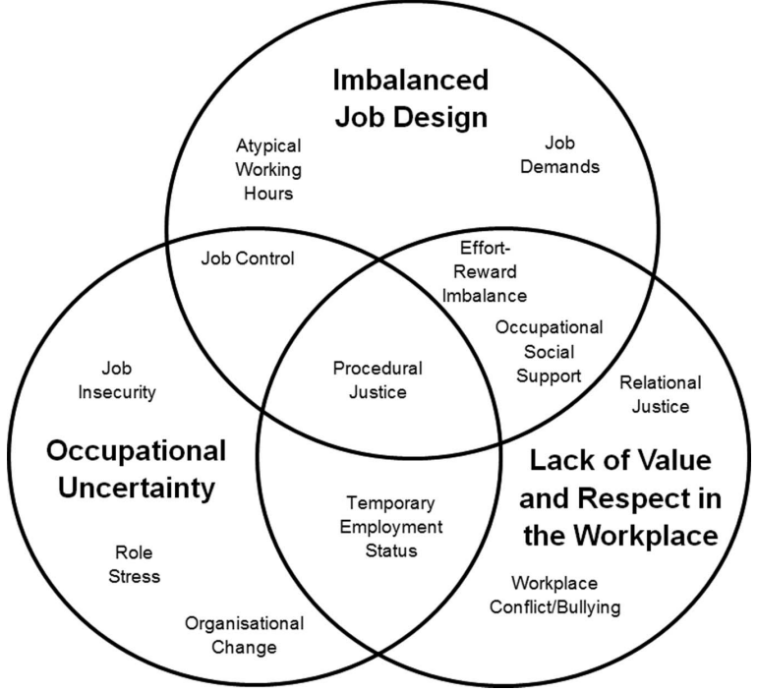
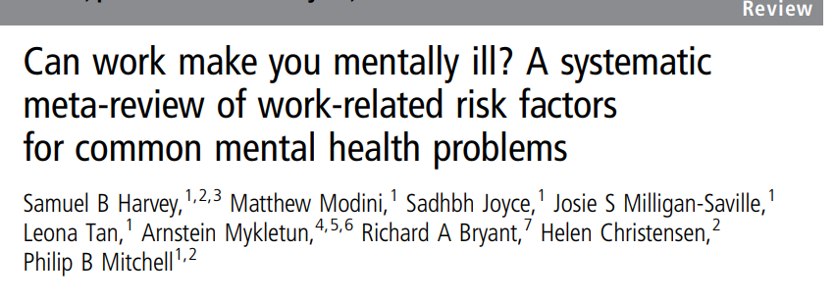
PGR transitions: a psychological perspective
Harvey et al. (2017), Occupational & Environmental Medicine
Notes:
The personal demands and environmental situation that doctoral students are presented with consists of an intense period of personal and professional development – this could be placing doctoral students at risk of developing mental health problems.
Students may already be placed under great strain because of the personal and professional development required (the course is already demanding). Their work environment also contains stressors reported to be associated with increased rates of common mental health problems:
In a systematic meta-review review (seven moderate or high quality reviews), Harvey et al. (2017) noted that there were 12 work-related risk factors associated with increased rates of common mental health problems
High job demand, low job control, low workplace social support, effort-reward imbalance, low organisational procedural justice, low organisational relational justice, organisational change, job insecurity, temporary employment status, atypical working hours, workplace conflict/bullying and role stress.
This work is also reflected in PhD students - Levecque et al. (2017) highlighted that work-family conflict was the most important predictor of psychological distress and risk of a common psychiatric disorder. Job demands, family-work conflict, job control and inspirational leadership style were also predictive. A closed decision making culture had a significant impact on the risk of psychiatric disorders (development of).
Elements of workplace-characteristics associated with stress also present in the PhD environment have been associated with higher instances of depressive symptoms

Slide 6

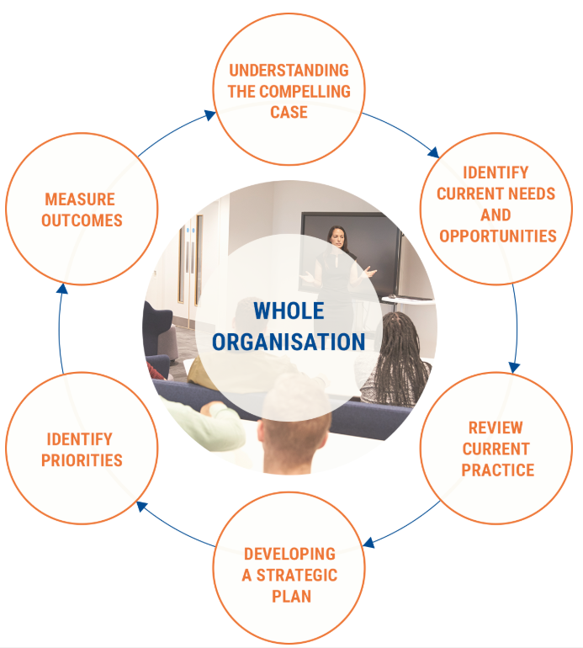
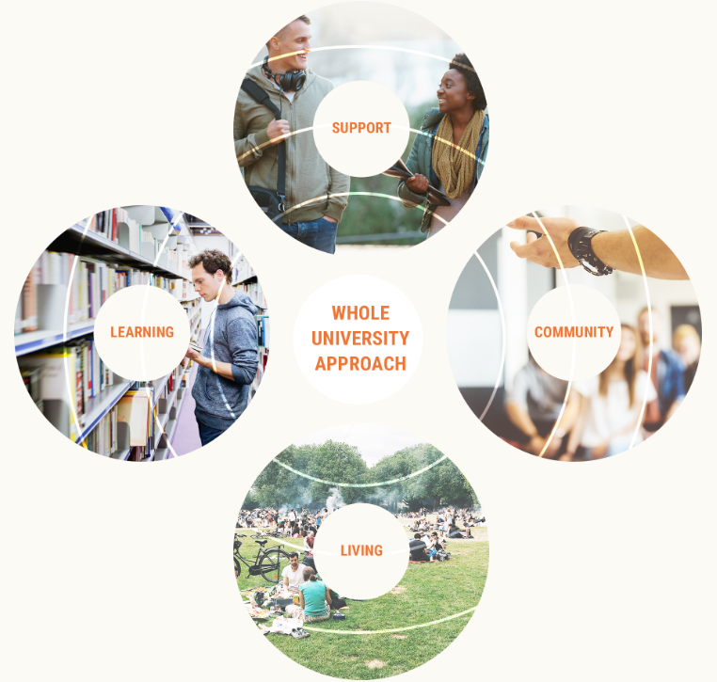
Mental Health in HE #stepchange
Notes:
Response nationally to wider issue of MH come from Universities UK Mental Health In Higher Education Working Group.
Report in September 2017:
Universities should adopt mental health as a strategic priority, implementing a whole university approach, with students and staff involved at all stages of the journey.
The whole university approach includes four facets – community (students/staff at all stages involved); learning (adjusting curricula and teaching practices); social (social/physical/digital media environments to support/improve healthy cultures); support (review of range of support services and whether these are appropriate to the needs of the students).
Requires a joined up approach to transform cultures and embed mental health initiatives beyond student services – encouraging positive mental health practice is of relevance to everyone.

Slide 7
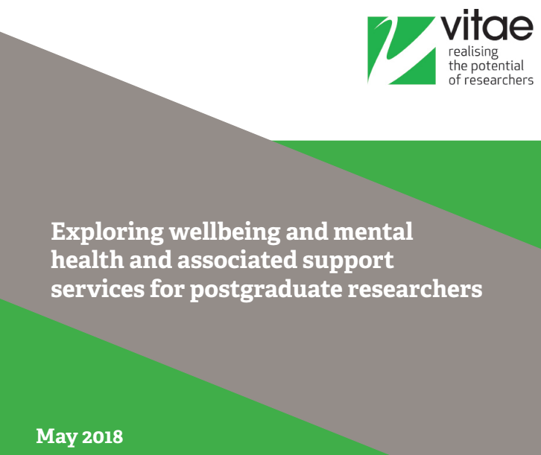
Notes:
Vitae assessed the wellbeing and mental health of postgraduate researchers, and the policies and provision relating to these issues through interviews with staff and postgraduate researcher focus groups at ten UK HEIs. Identified a number of issues that could affect their wellbeing and mental health (e.g., supervisory relationship, financial concerns), and varying levels of provision and support at HEIs for postgraduate researchers. Made recommendations for institutions and for UKRI and other stakeholders (e.g., “supervisors and postgraduate tutors, should be trained, supported and recognised for their role in the identification and early intervention in wellbeing and mental health issues of their PGRs”).

Slide 8
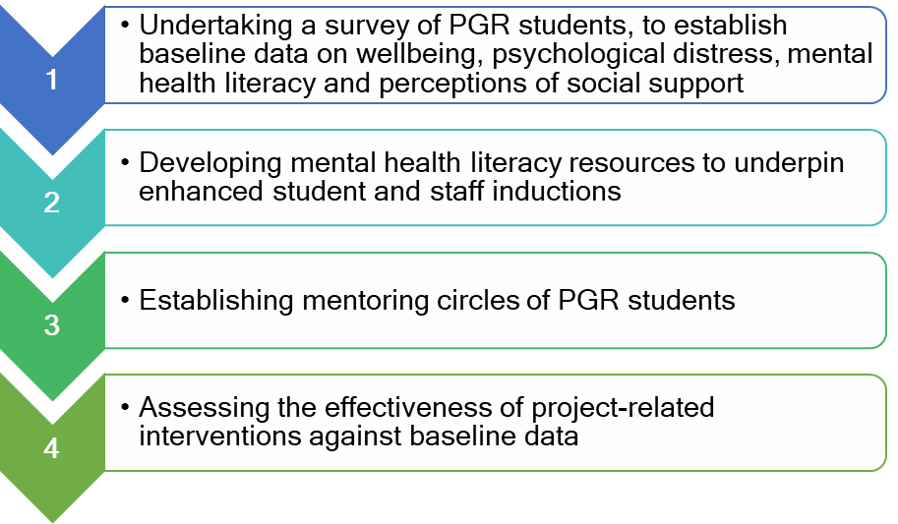
PGR Wellbeing project: Objectives
Notes:
The Office for Students funded PGR Wellbeing project aims to improve PGR student wellbeing by increasing mental health literacy and social support by:
Undertaking a survey – questionnaire data and demographic characteristics
Academic information will also be obtained, so that we can investigate the role of transitions (e.g., year of study)
Developing mental health literacy resources
Establishing mentoring circles of students an experienced academic
Assessing the effectiveness of project-related interventions against baseline data
The approach aligns with the Universities UK #stepchange framework (Universities UK, 2016), as well as recommendations from Vitae to support the mental health and wellbeing of PGR students (Vitae, 2018).

Slide 9
PGR Wellbeing project: Interventions
Enhanced supervisor training
Targeted online resources
Mentoring circles
Notes:
Evidence suggests there is a clear need to improve the mental health and wellbeing of PGR students – in which case, what can be done to improve it?
Mental health literacy consists of three components: knowledge of mental health issues, attitudes toward mental health issues and care, and ability to seek care. Previous research on mental health literacy indicates that increased knowledge about mental disorders and positive attitudes towards care can assist in prevention, recognition and management of mental illness. In the HE context, improved mental health literacy may enhance the willingness of students to seek help (Gorczynski et al, 2017).
Increasing MH literacy can also increase likelihood of staff responding appropriately to students with mental health problems (Gulliver, 2017).
Online resources will support enhanced student induction and PGR specific resources will be co-produced by PGR students, ready for an official launch of October 2019. Student inductions will include signposting to existing resources within the 2018/19 academic year.
These could be tailored to focus on particular ‘critical’ periods for PhD students which could be stressful (e.g., before/after the viva).

Slide 10
PGR Wellbeing project: Interventions
Enhanced supervisor training
Mentoring circles
Targeted online resources
Notes:
Discussion of mental health problems and where to access existing resources (e.g., key transition periods) will be embedded into enhanced supervisor training at UoP – one date in November and another in February.

Slide 11
PGR Wellbeing project: Interventions
Enhanced supervisor training
Targeted online resources
Mentoring circles
Notes:
There is compelling evidence that social support (perceived support available during time of need – emotional and practical) can reduce the risk of mental health disorders and enhance recovery if they do develop (Leach, 2014). Mentoring circles can enhance social support through an innovative, group mentoring model which increases social interactions, a sense of belonging and resilience (Darwin & Palmer, 2009).
Few studies have examined methods of supporting the mental health and wellbeing of PGR students, particularly in relation to doctoral transitions.
Social support can be improved through group mentoring circles (Darwin & Palmer, 2009)
Mentoring circles will include PhD students and one academic mentor from outside of their supervisory team. The format of the circles is in development.
The circles could be used to support doctoral students during transitions.

Slide 12
PGR Wellbeing project: Evaluation and outcomes
Analysis of quantitative and qualitative data
PGR-specific and tailored mental health resources will be embedded into all PGR and staff inductions/training at UoP/LBU
Project-specific learning will be shared across the sector. We will provide guidelines for adjusting the framework to fit the local context and level.
Notes:
We will measure the success of the project via qualitative and quantitative data analysis.
Sector outcomes will outline how universities could support doctoral students during transitions and over the course of their studies, with resources/toolkits available sector wide.

Slide 13
Issues and Questions
What changes are needed to how the doctorate is structured and supervised?
Can mentoring circles also provide the opportunities for building academic communities/increasing scholarly interactions?
How has changing context of HE (marketisation, metrics etc) impacted on PGR transitions/mental health and wellbeing?
What is the impact on supporting PGR transitions on existing academic workloads, culture and communities?

Slide 14




Thank you
E: pgrwellbeing@port.ac.uk
@PgrWellbeing
Notes:
Thank you for your attention, and we welcome any questions/feedback!

