Slide 1
Entangling Gender and Neoliberalism in the
Global Academy
CENTRE FOR HIGHER EDUCATION AND EQUITY RESEARCH
Professor Louise Morley

Slide 2
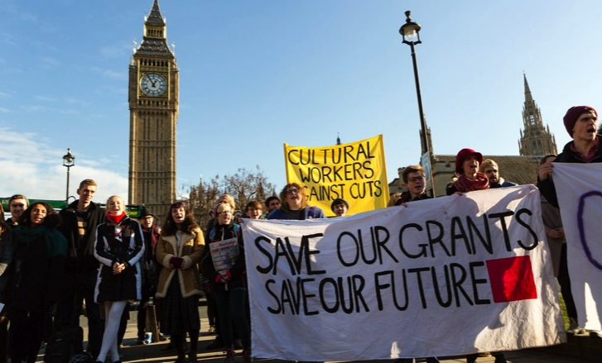
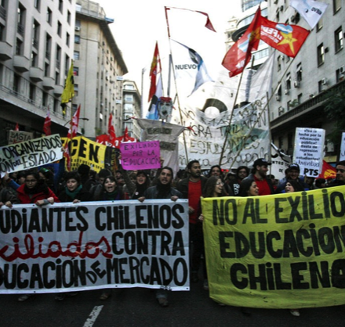
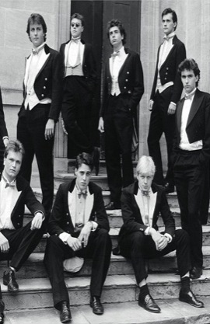
The Political Economy of Neoliberalism: Whose Imaginary?
Privatisation
Deregulation
Financialisation
Globalisation
Uberisation

Slide 3
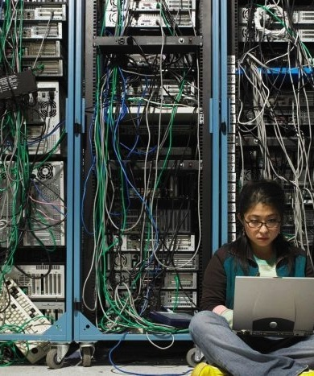
Entangling and Installing Neoliberalism in Higher Education
MATERIAL
Funding: linked to policy narratives/priorities
Audit: condensed quality indicators
Employment Regimes: Performance pay/ tenure/ promotion = epistemic hierarchies
DISCURSIVE
Truth-telling: peer review/ impact/ appraisal/ search agencies/ esteem/ reputation
Closure of the political universe/ TINA Effect
Performative Repetition
Reputation and Impression Management
AFFECTIVE
Guilt / pride / shame / fear/ desire
Success / failure narratives
Competition erodes solidarity?

Slide 4

Cognitive Capitalism
Market Dominance
Market principles frame every sphere and activity (Brown, 2015:67)
Accounts and Accountability
Higher education placed within a system of accounts (McGettigan 2013).
Investment and Enterprise
Academic identity = entrepreneurs
Shifting Values
Higher Education =
Product/service with commercial, market, and financial benefits.

Slide 5

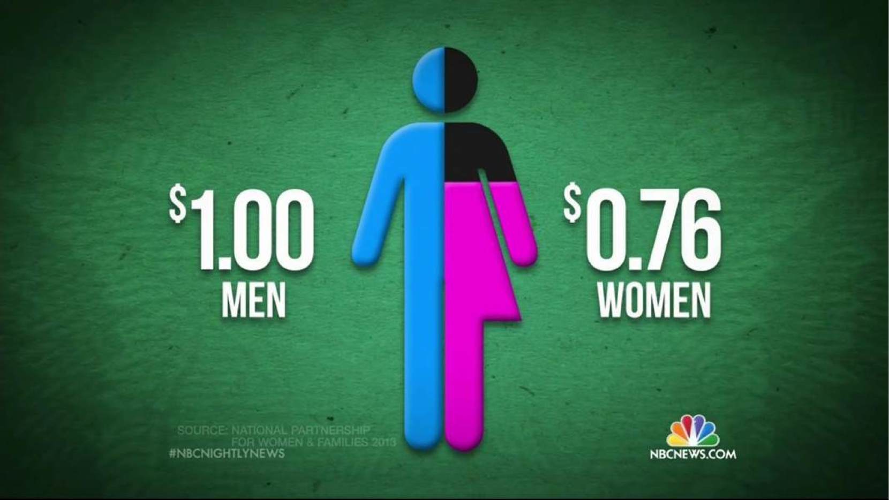

Measurement and Metrification: Ideology Posing as a Technology?
Desire for Global Spaces of Equivalence
Competitive measuring = essence of the global prestige economy
Academic labour, activity and productivity = made intelligible via dominant metrics and norms.
What is not measured?

Slide 6

(Lack of) Resistance?
Neoliberalization is generally more termitelike than lionlike (Brown 2015: 35/36)
Capillary Power
Fatalistic Resignation
Cognitive Triage/ Accelerated Academy
Audit Society/ Prestige Economy
Monetarising desires
Sacrifice/Austerity
Money and Minds (Ball 2015)
Illusio = investing in the game
(Bourdieu 1977; Colley 2013)

Slide 7

Marina Warner‘s high-profile resignation from the University of Essex:
“ …. where enforcers rush to carry out the latest orders from their chiefs in an ecstasy of obedience to ideological principles which they do not seem to have examined, let alone discussed with the people they order to follow them, whom they cashier when they won’t knuckle under.”
(Brown 2014 np)
Exit, Loyalty, Voice: Quit Lit

Slide 8

Gender and Neoliberalism:
A Complex Assemblage?
Neoliberalism is not ...
Essentially male.
Neoliberal Feminism
Women = ideal neoliberal subjects (aspirational and capacious).
(McRobbie 2009)
Gender Equality = cognitive and behavioural restructuring.
(Sandberg 2013)
Recognition of economic achievement rather than resource redistribution.
(Fraser 2013)
The new feminist = responsible for her professional success, wellbeing and work/life balance.
(Rottenberg 2014)

Slide 9

Womenomics
Has Neoliberalism Colonised/Provided a New Variant of Feminism/ Feminist Subjectivity?
Commodification of Social Struggles?
Driver for gender equality = economic, not social.
Women = New Market.
The ills of the global economy/organisations can be fixed by the incorporation of women.
Unit of analysis = individual, not collective, social structures.

Slide 10

New Epoch for Feminism:
Right Wing Cultural Capital?
Right-wing Women Self-Identifying
as Feminists
Theresa May
Marine Le Pen
Ivanka Trump
Mantras
Work/Family Balance
Lean In
Having It All
Empowerment/Confidence-Building
Women’s Rights Justify Xenophobic Politics
Gender Equality = Smart Economics/ Business Case/ Wasted Talent.

Slide 11
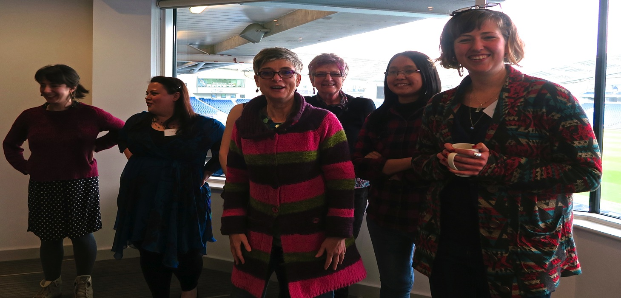
Researching Gender in the Neoliberal University

Slide 12

Disattractions of Leadership:
What and How Are We Asking Women to Lead?
Neoliberalism
Being ‘other’ in male-dominated cultures
Misogyny
Gendered authority
Disrupting the symbolic order
Financialisation
Unliveable lives
Pre-determined scripts
Women lack capital (economic, political, social, symbolic) to redefine the requirements of the field
(Morley 2012, 2013, 2014:
Morley & Crossouard 2016 a, b, c)

Slide 13

Women’s Credibility Deficit
in the Global Research Economy
Women = unintelligible as knowledge creators.
Lack of sponsorship / investment / transparency.
Gendered divisions of labour (Morley 2015)
Women less likely to be:
Journal editors/cited in top-rated journals (Tight 2008)
Principal investigators (EC 2011)
Awarded large grants (Husu 2014)
Awarded research prizes (Nikiforova 2011)
Conference keynote speakers
(Schroeder et al. 2013)
= Epistemic Injustice.

Slide 14

Intersecting Internationalisation and Equity
Higher Education Internationalisation presented as:
Ideologically neutral
Disembodied
Knowledge-driven, rational policy intervention.
But
Who is the ideal international subject e.g. young, male, able-bodied and white?
Empowerment of some, Inaudibility of others.
Gender and spatiality /mobility.
Whose knowledge is included and circulated in the global knowledge economy?
(Morley et al 2018)

Slide 15
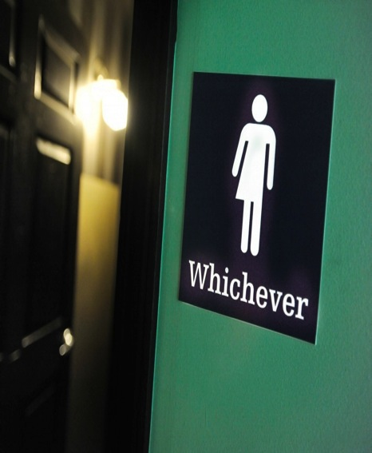
Gender:
More than a Demographic Variable
Gender as a Noun
Quantitative Change
Gender as a Verb
Gendered Power Relations:
Symbolically/ Materially
Construct/Regulate
Everyday Experiences.
Gender = formed/ re-formed in:
Organisational Cultures
Academic Disciplines
Social Relations
Postgenderism / Post Binary / Gender Fluidity
Eliminating / moving beyond gendered identities / roles / signifiers.

Slide 16

Neoliberalism is…
Normative order of reason
Fluid, capricious, stealthy
Market fundamentalism
Harnessing desires/ aspirations to the needs of the economy
Absorbed into professional identities
A policy and affective installation
Disarticulating structural inequalities
Promoting competitive individualism
Beneficial for those who comply with the performance indicators.
Valuing and rewarding the areas and activities in which elite groups have traditionally succeeded.
Neoliberalism is not…
An external, material entity
A seamless monolithic apparatus
Easily identified and resisted
Non-human
Essentially male
Just about injury or subjectification
Binary opposite of an absent, pure ‘other’/ golden age?

Slide 17

Making Alternativity Imaginable:
How Can We ….
Trouble neoliberal realism
Challenge / expose increasing socio-economic inequalities / exclusions
Re-invigorate knowledge production as a creative site of transformation
Identify new discursive formations / lexicons for viewing social and organisational worlds
Imagine and research the future of higher education that we want to see.

Slide 18

Follow Up?
Morley, L. (2015): Troubling Intra-actions: Gender, Neo-liberalism and Research in the Global Academy.
Journal of Education Policy 31(1): 28-45.
Morley, L. (2018): Gender in the Neoliberal Research Economy: An Enervating and Exclusionary Entanglement? In, Kahlert, H. (ed) Gender Studies and the New Academic Governance. Global Challenges, Glocal Dynamics, and Local Impacts. Wiesbaden: Springer VS.
CHEER: www.sussex.ac.uk/education/cheer

