Slide 1
The Future of Higher Education in Japan and the UK
CENTRE FOR HIGHER EDUCATION AND EQUITY RESEARCH
Professor Louise Morley

Slide 2

Contestations and Challenges
Purposes of Higher Education?
Whose Imaginary?
Who are legitimate providers/ leaders/participants/ knowledge creators?
Measurement and Metrification in the Global Prestige Economy
The Knowledge Economy: Democratisation, Distributive Justice or Domination?

Slide 3

Purposes of Higher Education?
Who/ What concepts/ values/ aspirations inform HE policy discourses?
Social: Critical Citizenship/ Inclusion/ Democratisation/ Distributive Justice
Economic: Human Capital/ Labour Market/ Wealth Creation/Global Competition.
Public or Private Good?
Construction of an ‘ideal’ university?

Slide 4
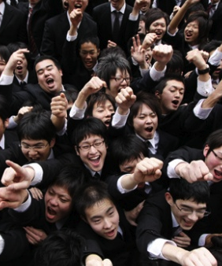
Consuming Higher Education
From
Planned scarcity
To
Demand-led and claimed form of citizenship
Over-supply (in Japan)
The citizen now constructed as:
an economic maximiser
governed by self-interests
individual investor rather than a member of a collective.
Higher Education constructed as private and public good.
Almost a civic duty to aspire to HE (Biesta, 2006).

Slide 5

Whose Imaginary: Political Economy of Neoliberalism?
Privatisation
Deregulation
Financialisation
Globalisation
Uberisation

Slide 6
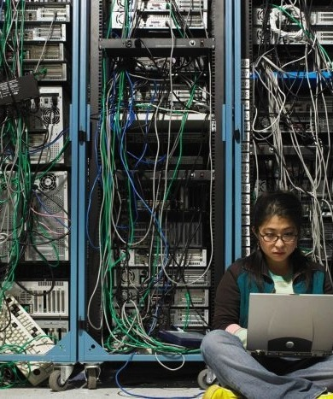
Entangling Neoliberalism and Higher Education
Narratives of state failure
Generalisation of economic form to social fields
Human Beings = Human Capital
Rankings/ ratings systems determine value
Ratings govern pedagogy/ research
Live and Let Die
Education = Attracting Investors
Values reinforced via Funding Regimes
Beneficence of state patronage only for those sharing/ performing the values of the new times
Privatised higher education = anti-critical spaces of learning
Erasure of intelligible, legitimate alternatives to economic rationality.

Slide 7

Cognitive Capitalism
Market Dominance
Market principles frame every sphere and activity (Brown, 2015:67).
Accounts and Accountability
Higher education placed within a system of accounts (McGettigan 2013).
Investment and Enterprise
Citizens = entrepreneurs
Shifting Values
Higher Education =
Product/service with commercial, market, and financial benefits.

Slide 8

Installing Neoliberalism
Material
Funding/ Employment regimes
Promotion/ Tenure/ Precarity
Financial Rewards/ Grants
Accelerated Academy/Hyper Productivity
Discursive
There is No Alternative
Affective
Governance by fear/ desire
Fear, shame, anxiety, competitiveness, pride
Circulation of affect produces self-governing subjects and actors
Occupational Stress.

Slide 9
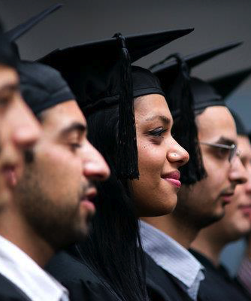
Whose Knowledge Economy: Cognitive/ Epistemic Injustice?
Who is credentialised to produce knowledge?
(Fricker, 2007)
Unequal geographies of knowledge?
Has knowledge:
Been colonised by the ‘cultural circuits’ of capitalism?
(Mills and Ratcliffe, 2012)
Become overtly aligned with the values of neoliberal and austerity policy cultures?
(Morley 2015)
Of/from some social groups been misrecognised/absent
(De Souza Santos, 2001; Walby, 2011)

Slide 10

Measurement and Metrification: Ideology Posing as a Technology?
Desire for Global Spaces of Equivalence (Shahjahana & Morgan 2016)
Geopolitics of Knowledge privileges universal, delocalised knowledge systems (Mignolo 2003)
Competitive measuring = essence of the global prestige economy
Academic labour, activity and productivity = made intelligible via dominant metrics and norms.
Metrics
Impose the ‘law of value’
Can be reductive and simplistic
Imply norms
What is/not measured?

Slide 11
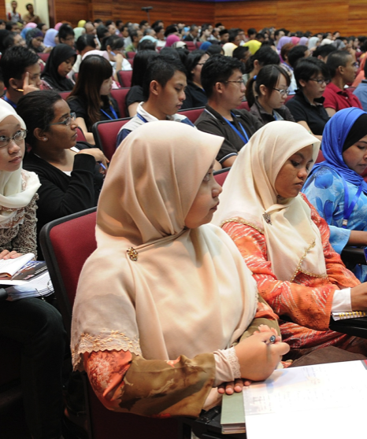
Desiring Higher Education
Aligning personal aspirations with the needs of economy (Morley et al. 2010; Walkerdine, 2003).
Growing Global Gross Tertiary Enrolment Ratio
1992 – 14%
- 32% / 54 countries 50+%
- 50%
Why?
Rise of the Middle Classes
Women’s Empowerment
Labour Market Demands
Meta-cognitive skills
Technology and Digital Economy
Social and geographical mobility
Insurance against pubic/ private poverty
Urbanisation/ Changing Spatialities
De-territorialization of Universities
Liquification of HE
Victory for Equity and Inclusion or Cruel Optimism?
(Berlant 2011)

Slide 12
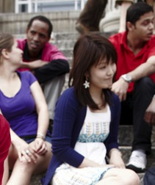
Democratisation/Participation in Higher Education
IS NOT
Access to knowledge/ knowledge production systems and organisations monopolised/ dominated by the elite.
Decontextualised/ Colonised knowledge.
Commodifying knowledge/ exchange value.
Overlapping social with epistemological hierarchies.
COULD INVOLVE
Discovering new conceptual grammars to include social identities and cognitive/ epistemic inclusion.
Contributing to wealth/ opportunity distribution as well as to wealth creation.

Slide 13
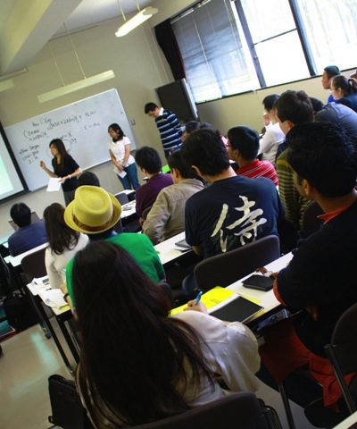
Exchanging Knowledge: Common Challenges in Japan and the UK
Prestige Economy Constructing Rationalities
Japan: 5 universities in Top 100 (QS)
UK: 18
Research Concentration/ University Stratification
Japan: 15 universities receive 50% governmental research grants
UK: 24 receive 75% research funding
Male Dominance
Japan: 2.3% of university leaders are women; lowest female academic staff participation rates in the OECD.
UK: 22% Vice-Chancellors are women; majority of fixed term contracts are held by women
Privatisation
Japan: two thirds places provided by private sector
UK: Higher Education Research Act 2017 (‘alternative’, ‘challenger’, ‘private’, ‘independent’ and ‘non-traditional’ providers).

Slide 14

Internationalisation: Mobility of People and Knowledge
Multiple Ideologies
Idealism
Instrumentalism
Educationalism (Stier 2004)
Linked to
Economic growth
Sustainability (Bone 2008)
Promotes
Employability/ intercultural competencies
Innovation
Marketability
Transnational coalitions and networks
Influence/ Soft Power (De Wit et al 2015)
Disrupts
Borders/ Boundaries
Intellectual Parochialism
Traditional Geographies of Knowledge

Slide 15

Are international opportunities dominated by the elite?
Survey of 1,300+ institutions worldwide identified that internationalisation primarily benefits wealthier students (IAU, 2014).
Who is the ideal mobile academic subject e.g. young, male, able-bodied and white?
Voluntary/ Coercive Migration?
Geopolitics/Visa and Immigration restrictions.
Hidden Narratives?
(Morley et al, 2017)
Equity Considerations: Who Has the Right to Mobility?

Slide 16
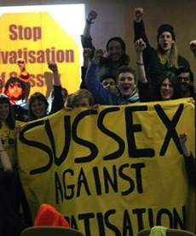
UK’s Current Complexities
Brexit: Shifting Mobilities/ Alliances
Toxic Correlation between Social Class and HE Participation
Financing: Tuition Fees/ Student Debt
Epistemic and Social Exclusions
Elitist Research Economy
Audit Culture/ Accountability/ Performance Management- research, teaching
Precarious/ Uberised Employment Regimes
Higher Education Reform introducing new providers

Slide 17
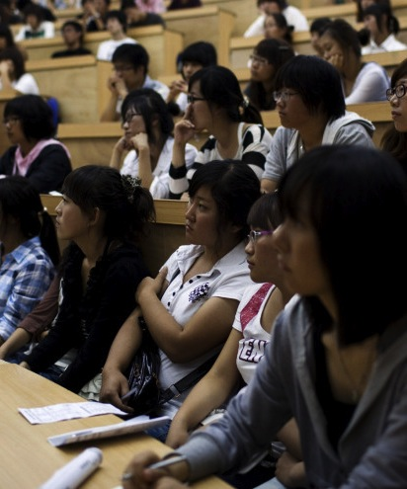
Characterising Japan
Finance
Japan’s national universities - 20% HE students but 80% national higher education budget.
Stratification
Correlation between students’ social class background and choice of university (Kariya, 2009).
Higher Education Pedagogies
The word ‘to learn’(manabu) in Japanese has the same stem as maneru meaning ‘to imitate’ and therefore a very different origin from the English word ‘educator’ (from the Latin, educare, meaning ‘one who draws out’).
(Goodman, 2007: 74).
Robotics?
High Participation Rates/ Over-supply/ Shifting Demographics

Slide 18

Current Contradictory Assemblage?
Hypermodernisation
Knowledge Capitalism
Digital Economy
Shifting Spatialities/ Liquified Borders (for some)
New Constituencies
Archaism
Maldistributions of Opportunity Structures
Male Dominance
Socio-economic advantage maps on to elite provision.
The University of the Future in Japan and the UK must not be the University of the Past.

Slide 19

Crisis Discourse
The future of HE is often theorised using disaster and crisis metaphors to justify reform:
Ruins (Readings 1996)
Tsunamis (Popenici 2014)
Avalanches (Barber et al, 2013)
Quality Concerns in HE linked to:
Massification of HE e.g. dilution, contamination, pollution of elite space.
State monopolies e.g. in the UK policy documents, competition is invoked to drive up quality.
My point is not that everything is bad, but that everything is dangerous, which is not exactly the same as bad. If everything is dangerous, then we always have something to do. So my position leads not to apathy but to hyper - and pessimistic – activism. I think that the ethico-political choice we have to make every day is to determine which is the main danger. (Foucault 1983: 231/2)
How can we celebrate the gains and successes of the global higher education sector while being aware of future dangers?
What new vocabularies can be marshalled to consider the morphology of the university of the future?
,

Slide 20
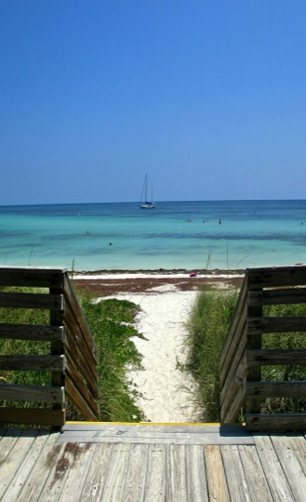
Trouble neoliberal realism
Resist co-option by narrow policy agendas
Challenge/ expose increasing socio-economic inequalities/ exclusions
Recover critical knowledge and be a think tank and policy driver.
Re-invigorate knowledge production as a creative site of transformation/ possibility
Identify new optics/ discursive formations for viewing the social world
Imagine and research the future that we want to see.
Making Alternativity Imaginable:
How Can We ….

Slide 21

www.sussex.ac.uk/education/cheer
Centre for Higher Education and Equity Research (CHEER)

