Slide 1
Thinking Differently about the Roma in Higher Education:
Beyond Sex, Slums and Special Schools, and Towards Epistemic Inclusion!
CENTRE FOR HIGHER EDUCATION AND EQUITY RESEARCH
Professor Louise Morley

Slide 2
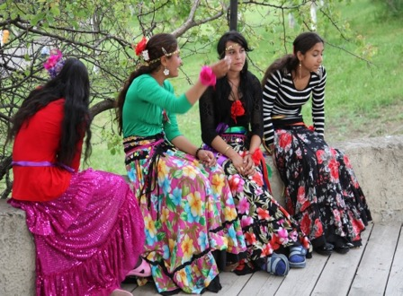
Defying the Default Deficit Construction
How to speak/write about/research the Roma without:
Degenerating into racially objectifying discourses, hyperbole/ sensationalism about:
  Material
  Economic
  Social
  Affective disadvantage and deprivation?
How to challenge the relentless production and reproduction of marginality and fragility
How to undo:
Romaphobia (McGarry, 2017)
Anti-Gypsyism (Izsák, 2015)

Slide 3
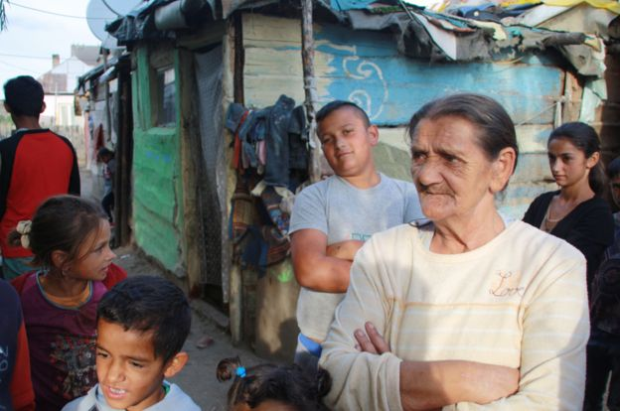
Problematic Precarity
Dominant Narratives =
Spatial Segregation
Symbolic and Actual Ghettoisation
The racialisation of poverty and
social exclusion.
Roma =
Discursively constructed within assigned categories.
Permanently accused of an assemblage of wrongdoing.
The endless repetitions are predictable and tiresome.
Overlook differences within communities.

Slide 4
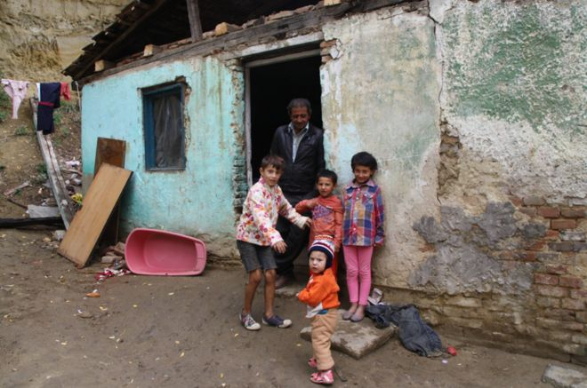
Racialised Poverty Porn!
Crude Representations / Multifarious Insinuations and Imagery of
Roma Alterity =
Strategy to divide and rule communities within the political economy of neoliberalism?
Poverty understood as individual or collective, rather than systemic, failure?
The ‘unchosen cohabitation’
(Butler, 2012:145) raises questions about plurality, heterogeneity, and equal rights to inhabit the earth.

Slide 5
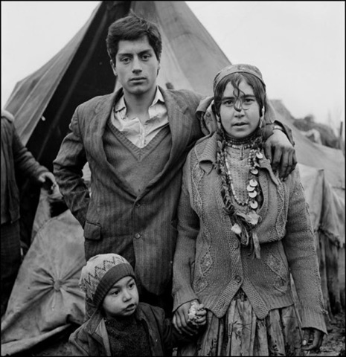
Stranger Danger:
Despised, Fetishised, Exoticized, Eroticised ‘Other’?
Combination of cohabitation proximity and distance =
Complex affective entanglement of discomfort, degradation, dehumanisation, disparagement.
‘Us’ and ‘them’ racialised discourses
(Tremlett, 2009, 2013, 2014; Yuval-Davis et al. 2017)
Various moments of geographical proximity – what we might call ’up againstness’ – the result of populations living in conditions of unwilled adjacency…
(Butler, 2012: 134).

Slide 6
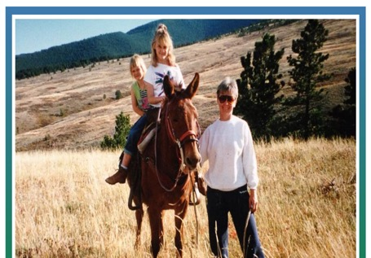
Global Roma:
Activism, Advocacy, Resistance, Influence
Approximately 20 million worldwide
More than half of the 10-12 million European Roma live in EU countries, comprising Europe’s largest ethnic minority.
Over a million live in the United States (Brooks, 2012)
Roma live in the Americas:
in Argentina, Brazil, Canada, Chile, Colombia, Ecuador and Peru
(Human Rights Council, 2016)
100,000 live in Australia
(Sayer, 2017)
Roma live in West and South Asia and North Africa

Slide 7
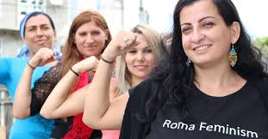
Roma Women:
Feminists, not Femme Fatales!
At a 1999 Open Society Institute forum, founder George Soros asked Romani feminist Nicoleta Bitu, ‘Why Roma women?’
The Roma Women’s Initiative (RWI) was founded. Roma feminism now flourishing
Politics of recognition/ ensuring that Roma women are included in international feminist movements.
Confronting the manifestations of patriarchy that exist in Roma communities.
Covert’s (2015) thesis on Romani women in USA education found that the majority of the stories of discrimination in education came from higher education.
At an Open Society Institute forum in 1999, founder George Soros asked Romani feminist Nicoleta Bitu, ‘Why Roma women?’
The Roma Women’s Initiative (RWI) was initiated. Roma feminism is now flourishing of discrimination in education came from higher education.

Slide 8
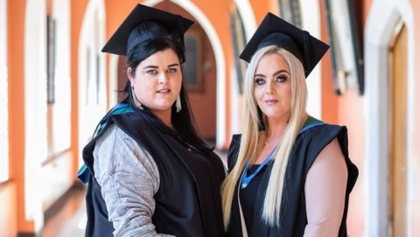
Thinking Differently
How to challenge:
Binary Thinking
The Semiotics of Abjection?
Can we refresh:
Narratives?
Images and accounts of/from/about/for
the Roma?
Can a new ethics and a new
aesthetics be forged?
What part can higher education play
in this process?

Slide 9
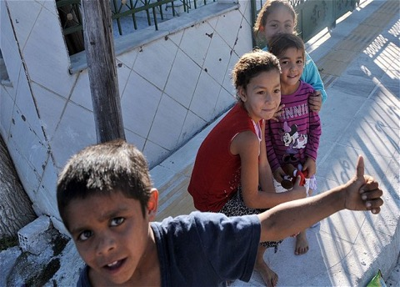
Educating the Roma:
Re-casting Identities and Life Chances?
Policy focus on schools
Completion
2015: Only 1 in 10 Roma had completed secondary school in the 12 countries in the Roma Decade policy initiative
(Jovanovic, 2015).
Segregation
of Roma in special schools, or in separate classes
(Rostas, 2012).
Explanatory variables include:
Racism, discrimination and bullying
(Bhopal, 2011)
Roma as transgressives or ‘cultural deviants’ refusing to comply and conform to state legislation for school attendance.
Roma as an uneducated underclass, providing cheap and disposable labour?
(Vincze, 2015).

Slide 10
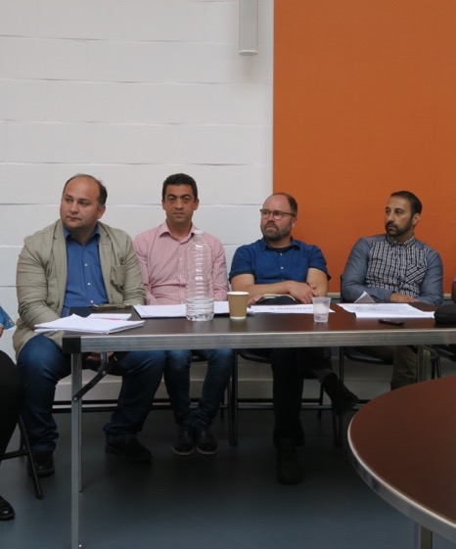
Higher Education Internationalisation
and Mobility (HEIM) Project
Three European universities (Seville, Sussex and Umea) and the Roma Education Fund
Focused on the Roma community at staff and student levels in higher education.
Explored social mobility and inclusion, and in relation to opportunities for internationalisation.
Examined how principles of equity and inclusion can be applied to internationalisation strategies.
European Union Horizon 2020 Framework Programme for Research and Innovation for funding the HEIM project
(Grant number: H2020-RISE-2014-643739),

Slide 11
What Value Did HEIM Add?
Policy Learning/ Knowledge Exchange across diverse constituencies:
Academic/NGOs/Policymakers
Central & Eastern Europe/Western/Northern Europe
Experienced and Early Stage Researchers
Coordinating/Creating Knowledge on Roma in Higher Education.
Via 6 Work Packages
See www.sussex.ac.uk/education/cheer/
researchprojects/rise

Slide 12
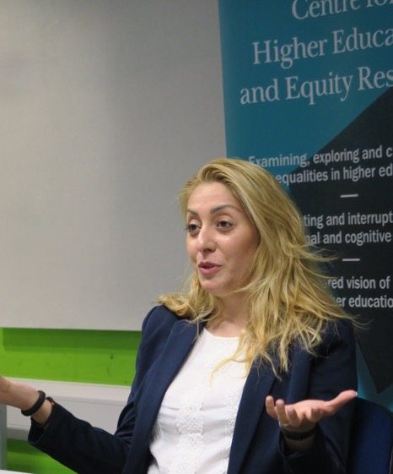
Key Findings
1% of Roma (10,000) enter higher education in Europe.
Disaggregated data on the Roma and Education unevenly collected across Europe.
Roma in policy and research = in relation to compulsory education.
Limited research/ policy attention to
higher education.
National strategies for widening participation in higher education often exclude specific consideration of Roma communities.
Roma academics – impact of international mobility on identities, networks and epistemic inclusion.
Affirmative Action – scholarships, quotas,
pre-sessional programmes – successful and problematic.

Slide 13
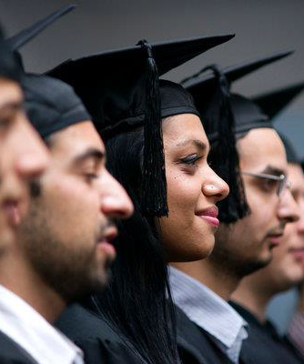
Researching Roma in Higher Education
Small-scale, single location, grey literature/doctoral/Masters’ theses,
or organisational research
Brüggemann (2014) Roma students in Spain
Garaz (2014) Students on the Roma Education Fund’s scholarship programme in Central and Eastern Europe.
Gkofa (2016) Roma students in Greece.
Jovanovic (2018) Roma students’ experiences
in Serbia.
Kende (2007) Success stories of Hungarian Roma university students.
Pantea (2014, 2015) Affirmative action programmes and Roma women’s access in Romania.
Torotcoi (2013) Widening participation initiatives for Roma students in Romania.

Slide 14
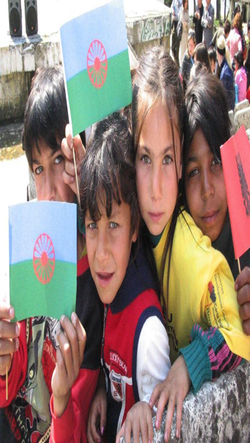
Policy Performatives
Framework
The EU Framework
Council of Europe Strasbourg Declaration on Roma (CoE, 2010)
Decade for Roma Inclusion (2005-15)
Questions
How are Roma constructed and imagined in policy discourse?
Combination of human rights and human capital?
World Bank frame Roma inclusion as
‘smart economics’ (World Bank, 2010)
Measuring Roma against an idealised white and middle-class European citizenship?
On whose terms are the Roma being integrated?
Policy compliance: performative/uneven,
depending on political will at national and regional levels.

Slide 15
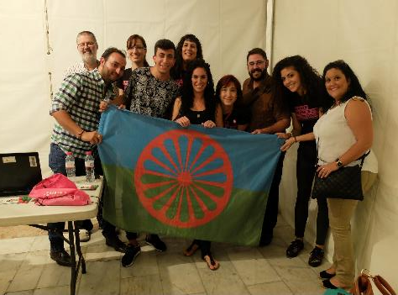
Higher Education:
Interrupting the Inferiorisation of Roma?
Counting more Roma in as knowledge producers/ consumers.
Enabling the development of a professional class.
Epistemic inclusion/ construction of knowledge itself about the Roma.
Pathway out of Poverty?
BUT
Burden of being so few/ first-generation scholars.
Obligation for Multiplier Effect.
Belonging and social class identification
Distance from culture and community in order to credentialise themselves as knowers (Pantea, 2015; Walkerdine, 2011)

Slide 16
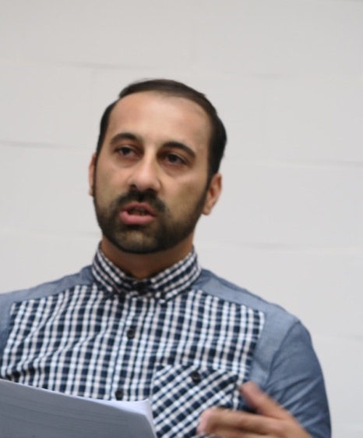
What HEIM Did
Examined access to higher education in Spain,
Sweden and the UK
Analysed European, national, organisational policy frameworks/solutions that regulate the access of
Roma young people to education
Trained doctoral researchers and professionals
working with Roma communities in CEE in research methodologies for equity, diversity and social inclusion
Produced the film Gypsy, Roma and Traveller (GRT) Communities in Higher Education
Interviewed Roma academics and doctoral researchers about their experiences of higher education internationalisation
Developed a social media network to support Roma researchers and students in higher education
Provided a training module on ‘Internationalisation’
Published, disseminated, networked and promoted impact from the research findings.

Slide 17
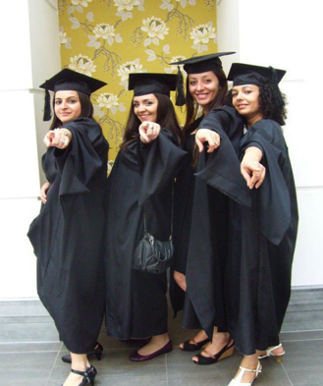
Recasting Identities,
Re-Imagining Futures
Re-cast Roma as knowledge producers, rather than objects of inquiry.
Move from evangelical zeal and philanthropy to a radical agenda for social and epistemic inclusion
(Morley et al., 2018).
Forge a new ethics and aesthetics.
Create new narratives, images and accounts that promise different futures.
Entanglement of Roma and higher education is not just about access but also about knowledge itself.

Slide 18
HEIM Publications
Alexiadou, N. (2017): 'Equality and education policy in the European Union - An example from the case of Roma'.
In: Gale, T. & Gulson, K. (Eds) Policy and Inequality in Education. Book series Education Policy and Social Inequality. Singapore: Springer.
Alexiadou, N. & Norberg, A. (2017): 'Sweden’s Double Decade for Roma Inclusion in the European Policy Context:
A case of policy learning'. European Education. 49(1): pp 36-55.
Garaz, Stela, and Torotcoi, Simona (2017): Access to Higher Education and the Reproduction of Social Inequalities:
The Case of Roma University Students in Eastern and South-Eastern Europe. European Education. 49 (1):10-35.
Hinton-Smith, T. & Danvers, E. (2017): 'Identity and Belonging: Researching Roma Women in Higher Education.’
In Morley, L. (Ed.) Europa World of Learning Special Edition on Gender and Access to and Participation in Higher Education. Routledge: London.
Hinton-Smith, T, Danvers, E. & Jovanovic, T. (2017): 'Roma women’s higher education participation:
Whose responsibility?', Gender and Education. DOI: 10.1080/09540253.2016.1274386.
Hinton-Smith, T. & Danvers, E. (2017): 'Identity and Belonging: Researching Roma Women in Higher Education.’
In Morley, L. (Ed.) Europa World of Learning Special Edition on Gender and Access to and Participation in Higher Education. Routledge: London.
Morley, L., Alexiadou, N. Garaz, S. González-Monteagudo, J. Taba, M. (2018): 'Internationalisation and Migrant Academics: The Hidden Narratives of Mobility'. Higher Education. [http://dx.doi.org/10.1007/s10734-017-0224-z]
Padilla-Carmona, M.T., González Monteagudo, J. and Soria Vilchez, A. (2017): ‘Los gitanos en la universidad española:
Un estudio de caso de trayectorias de éxito (Roma Students in Higher Education: A Qualitative Research on Successful Trajectories).’ Revista de Educación. (No.377, July-September, 2017).
Media
Times Higher Education: 'Roma: The UK's forgotten higher education minority' (29 May 2016)
Times Higher Education: 'Higher education must not exclude Roma communities' (19 May 2016)
Inside Higher Ed: 'Europe's Forgotten Minority' (3 June 2016)

Slide 19

CHEER Website: www.sussex.ac.uk/education/cheer
Twitter:
@SussexCHEER
Facebook: www.facebook.com/groups/CHEERSussex/
Higher Education Internationalisation and Mobility (HEIM) project www.sussex.ac.uk/education/cheer/ researchprojects/rise
Centre for Higher Education and
Equity Research (CHEER)

