Slide 1
Troubling Intra-actions: Gender, Neoliberalism and Research in the Global
Academy
CENTRE FOR HIGHER EDUCATION AND EQUITY RESEARCH
Professor Louise Morley

Slide 2

Provocations: Knowledge Reduced to Income-Generation?
Alignment of research with the political economy of neoliberalism
=
Financialisation / marketisation / recalculation of research value(s)
+
Ongoing misrecognition of women as research leaders
=
Gendered and exclusionary research economy
Epistemic Injustice?

Slide 3

Material
Funding: linked to policy narratives/ research concentration agenda.
Audit: Academic identities constructed/ calculated via metrics/ quantification.
Employment Regimes: Performance pay/
tenure/ promotion = epistemic hierarchies.
Discursive
Truth-telling – peer review/ impact/ appraisal/ search agencies/ esteem/ reputation.
Closing of the political universe/ TINA Effect
Performative Repetition.
Affective
Guilt / pride / shame / fear/ desire.
Success / failure narratives.
Competition erodes solidarity?
Entangling Research and Neoliberalism: Cognitive Capitalism

Slide 4
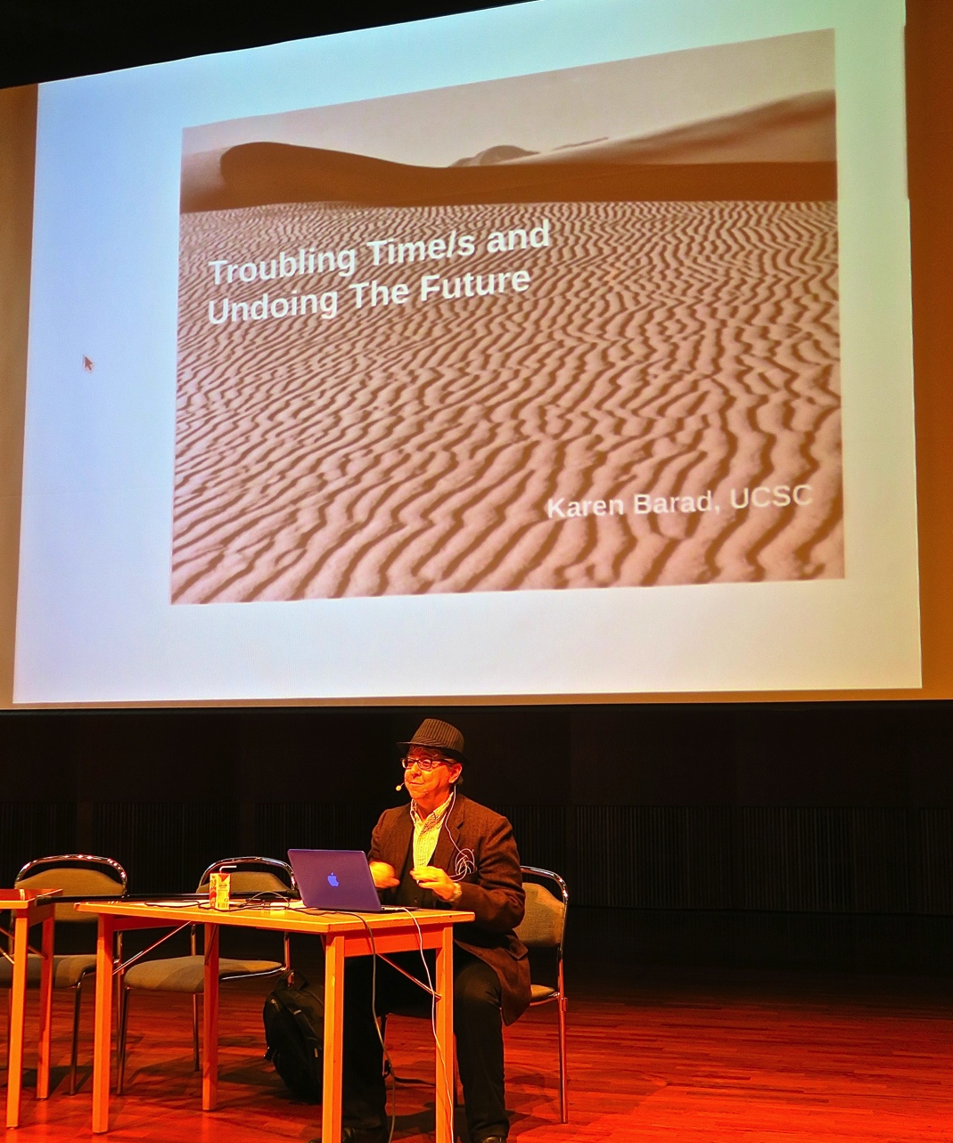
Karen Barad
The optic or apparatus for observation can determine what is seen
Barad (2007) asks:
What is it that people don’t see?
Why don’t they see it?
What do current
Optics
Practices
Specifications
Reveal and obscure?
How does neoliberal apparatus
‘intra-act’ with women’s intellectual capital?

Slide 5

Women’s Credibility Deficit
Women less likely to be:
Journal editors/cited in top-rated
journals (Tight 2008)
Principal investigators (EC 2011)
On research boards
Awarded large grants (Husu 2014)
Awarded research prizes
(Nikiforova 2011)
Conference keynote speakers
(Schroeder et al. 2013)
Women likely to be:
Cast as unreliable knowers
(Code 1991)

Slide 6

Absent Talent: Women in Research and Academic Leadership
British Council Seminars:
Hong Kong / Tokyo / Dubai
Total of 72 participants from South and East Asia, the Middle East, North Africa, Australasia and Europe
20 surveys, 3 discussion groups, 3 panels and 13 presentations

Slide 7

Women Narrating
Precarity
Unbelonging
Exclusion
Lack of authority
Affective economy
Gendered career pathways
Gendered networks
Lack of sponsorship / investment/ transparency
Good academic = the effective market competitor/actor
(Morley 2015).

Slide 8

Do Women Matter
in the Research Economy?
Research Authority Does not Stick to Women
It is the mindset of the organisation that senior positions should only be held by male colleagues and the perception that conducting research is a ‘masculine’ job which can be carried out better by male researchers
(Malaysian woman academic)
Exclusionary Practices
Quite often editing roles aren’t advertised, you are tapped on the shoulder ... there are many other things: the narrative, the discourse, that impede women
(British woman academic)
Domestic Labour
Women are found in low professional titles, low-level management and administrative positions, most of them are responsible for student affairs
(Chinese woman academic)
Gendered Networks and Lack Sponsorship from Neoliberal Winners
It also requires the capacity to play politics, be aligned with the right people, get publications in the right journals and win research grants
(Australian woman academic)

Slide 9

Neoliberalism is…
Normative order of reason
Fluid, capricious, stealthy
Market fundamentalism
Harnessing desires/ aspirations to the needs of the economy
Absorbed into professional identities
A policy and affective installation
Disarticulating structural inequalities
Promoting competitive individualism
Beneficial for those who comply with the performance indicators.
Reinforcing epistemic hierarchies by valuing and rewarding the areas and activities in which elite groups have traditionally succeeded.
Neoliberalism is not…
An external, material entity
A seamless monolithic apparatus
Easily identified and resisted
Non-human
Essentially male (Rottenberg 2014)
Just about injury or subjectification
Binary opposite of an absent, pure ‘other’/ golden age?

Slide 10
What is the Future of Counter-Hegemonic Knowledge?

Slide 11

Follow Up?
Morley, L. (2015). Troubling Intra-actions: Gender, Neo-liberalism and Research in the Global Academy. Journal of Education Policy 31(1): 28-45.
Morley, L. (In press, 2017) Gender in the Neoliberal Research Economy: An Enervating and Exclusionary Entanglement? In, Kahlert, H. (ed) Gender Studies and Gender Research in Times of the New Governance of Science. Dordrecht: Springer Publications.
www.sussex.ac.uk/education/cheer

