Slide 1
The Affective Economy of Internationalisation: Migrant
Academics in and out of Japanese Higher Education
CENTRE FOR HIGHER EDUCATION AND EQUITY RESEARCH
Professor Louise Morley, Dr Daniel Leyton and Professor Yumiko Hada

Slide 2
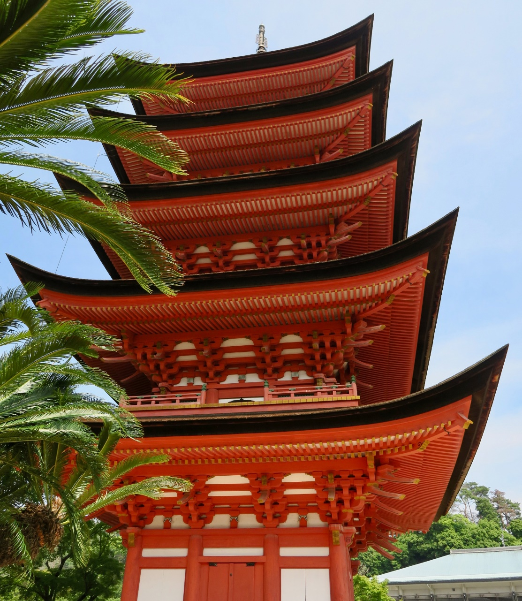
Higher Education Internationalisation: A Complex Coagulation of Opportunities and Constraints?
A rational, objective, coherent and meritocratic process
Discursively associated with freedom and fluidity; extension of markets/ mobility
New Geographies/ Gestalt of Knowledge
Ideologically neutral
Part of the ‘choice architecture’ for academics and doctoral researchers
An unquestionable good in an imagined gender-neutral, meritocratic and benign knowledge economy
Problem-free dislocation/ relocation
But:
Container for multiple aspirations, anxieties, and affordances
Deep and Surface Internationalisation
The trespassing/crossing of borders can promote the reorientation of identities, belonging and social networks
Affective labour/ frictions in mobility discounted from policyscapes.

Slide 3
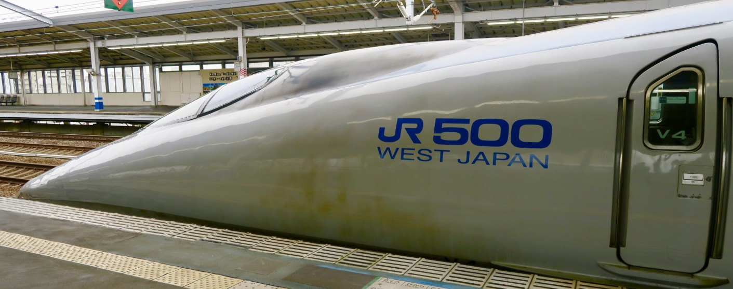
Cosmopolitanism
Intercultural Competencies/ Capacities
Internationalising one’s career = a range
Connection
Internationalisation deficit = shame,
Adaptability, Resilience and Reach
intellectual and spatial parochialism
of affects, desires and dispositions

Slide 4
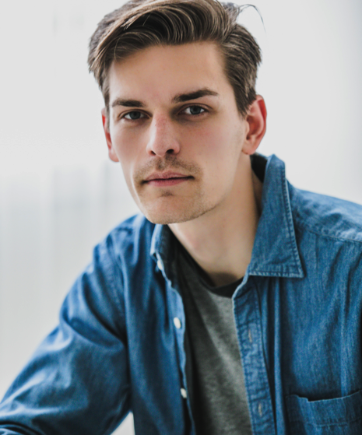
Designer Immigrants: The Ideal Migrant Academic Identity
Global
Cosmopolitan
Entrepreneurial citizen
with the capacity to:
Create
Transfer
Exchange knowledge
across
National
Linguistic and
Cultural boundaries.
N.B. 1.9% of Japan’s population=foreign residents.
OECD average = 13%. (OECD, 2019)

Slide 5
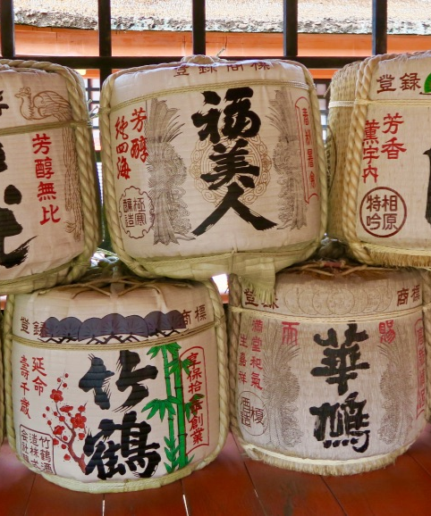
Higher Education, Knowledge Exchange and Policy Learning in the Asian Century: A UK/Japanese Partnership
Interview data gathered (2017+2018) in 15 private, 5 national and 8 public universities in Japan with 34 migrant academics (10 women and 24 men).
Short, medium and long-stay migrant academics.
25 were incoming from Australia, China, France, Germany, India, Nigeria, the Philippines, South Korea, the UK, and the USA, and 9 were Japanese who had worked in Canada, Germany, the UK, The USA.
See http://www.sussex.ac.uk/education/cheer/researchprojects/japan

Slide 6
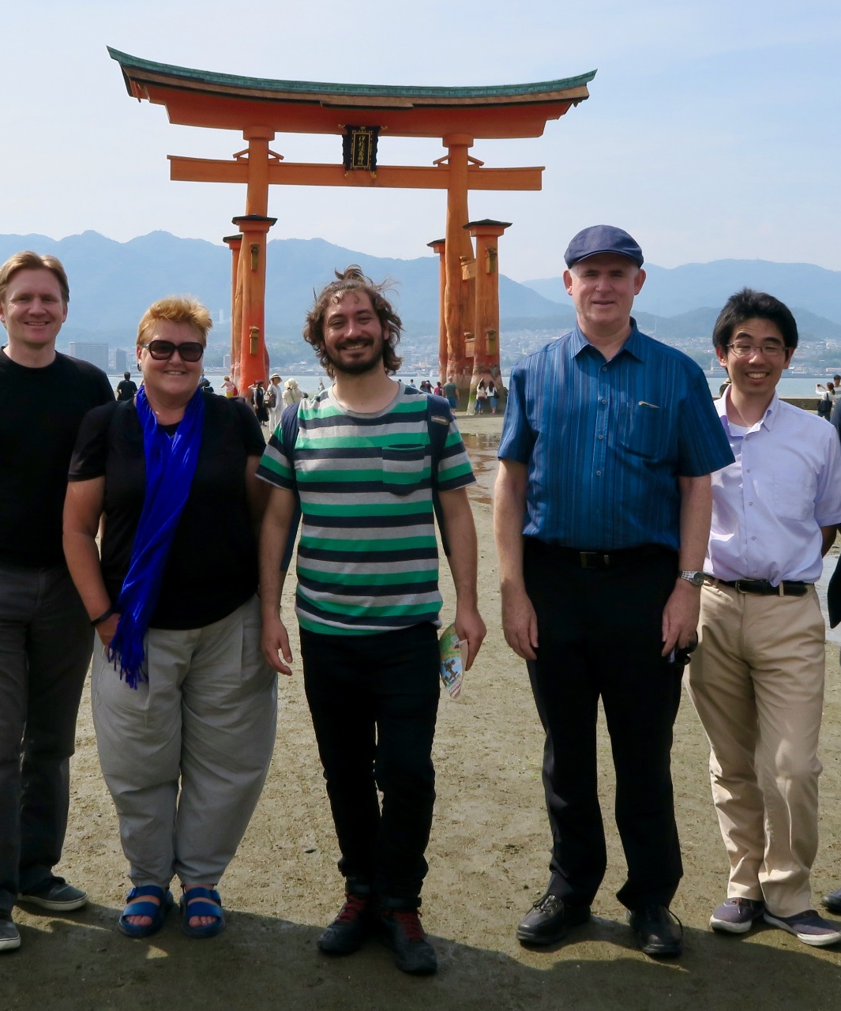
Questioning Kokusaika
What drives the internationalisation policy agenda in Japan & how was it being implemented?
Personal, professional and academic experiences as migrant academics?
What are the sites of affective intensity, attunement and dissonance?
How do participants navigate, inhabit and embody difference?

Slide 7
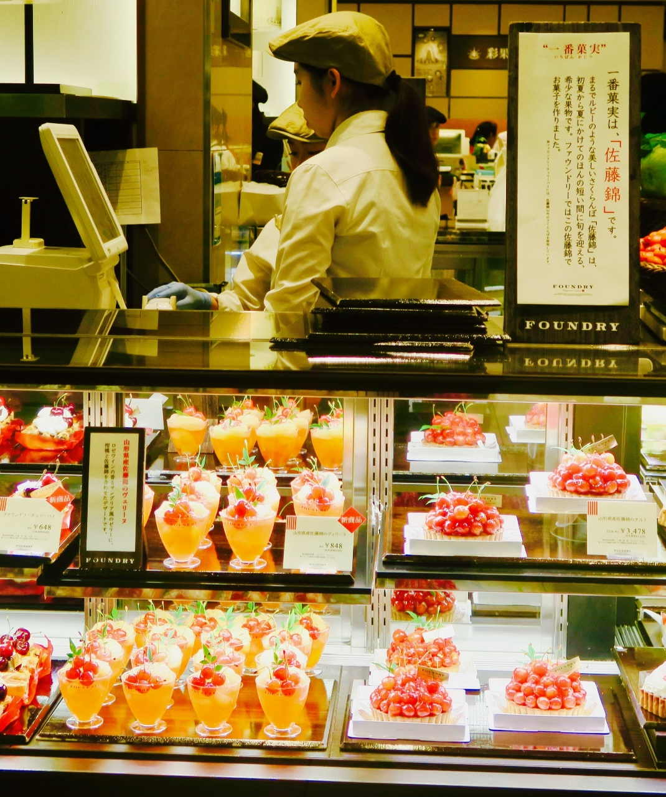
Motivations for Migration
Narratives from the Global North privileged sense of strategy, rational calculation, purposefulness and choice e.g. JET Programmes
Japan = hypermodern, safe, oriental ‘other’
Disciplinary differences e.g. STEM
Employability/ Professional Development
Narratives from the Global South = EFL, lower value of non-Anglophone qualifications (Gerhards et al. 2018).
Actually, I applied in the United States. But I got a PhD degree in my country so it's really hard to move. (A Korean female lecturer)

Slide 8

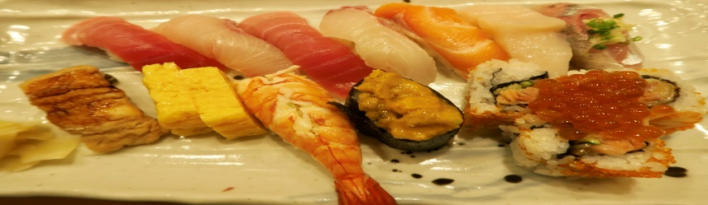
Japanophilia
Safety
That’s what I like about Japan. There’s a challenge but it’s a comfortable challenge, I guess. … Japan’s a very safe country…The people being so friendly and I think they enjoy explaining and teaching Japanese culture and language to me. (Male US Lecturer)
Academic Freedom
No appraisal, nothing. Everything, you do your best…And basically we are very free. This is I think what I feel being in Japan: I feel I am very free, I’m free to do a lot of things. (Female Chinese Associate Professor)
Japanese Culture
We were doing Aikido which is one of the martial arts, so that's why we were interested in Japan. (Female German Lecturer)
Financial Support
I think the support was quite generous like the moving expense to Japan. And then it provided the start-up fund to set up the equipment … The financial support seems quite generous to me, I think.
(Taiwanese female lecturer)

Slide 9

Affective intensity
Navigating Gender Regimes
Linguistic Imperialism
Orientalism/ Being ‘Other’
Contractual Precarity

Slide 10
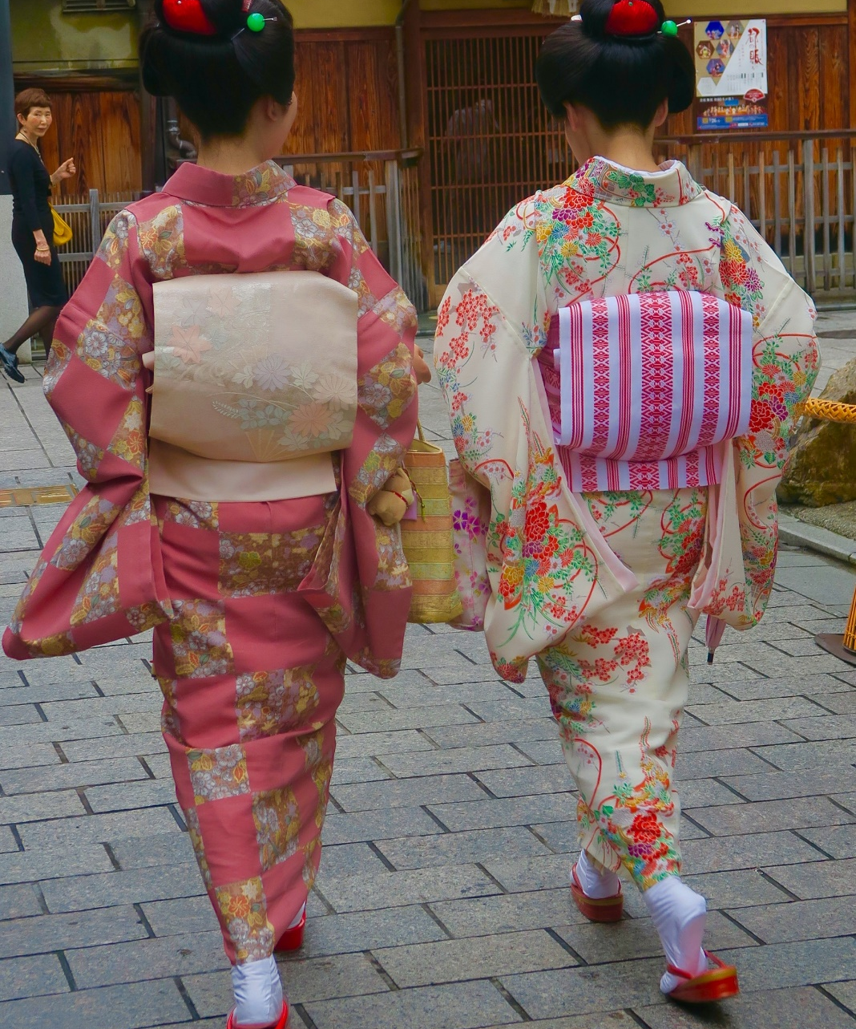
Doing Gender Internationally: the Embeddedness of the Patriarchal Premium
Four times as many male as female internationalised faculty in Japan (Huang 2017).
Gender =
Noun and verb
Relational processes/ social differentiation, as well as demographics.
Internationalisation materialises and challenges traditional gender practices and performances.
Research Findings:
Gendered premium for white, heterosexual, Anglophone men.
Japan’s traditional gender regimes as a motivator for Japanese women to migrate, and as a challenge for incoming migrant academics. (Oishi 2012, 2013)

Slide 11
Bento Boxes, Male Dominance, Trailing Spouses
What the Men Say
My wife is an engineer, IT engineer... She resigned purely because she got married to me … So, she gave up everything and then she did come here... She has two master's degrees. (Indian male Science Associate Professor)
She’s {his wife} somewhat limited, too, in the number of hours she can work, because of my insurance…Maybe it affects our taxes. … I know that she’s not doing workwise what she wants to do… even though she doesn’t express it, I do think it affects her, I think she would like to work and have more of a career, and she’s not having that right now (US male Humanities Professor).
What the Women Say
People assume, still, that you can drop everything and come to the school for a conference or work in the bazaar or do things like that. … I’ve found it very hard to be a good teacher and a good administrator and a good researcher and a good mother… So, the sacrifice has been for research. (US female Social Science Associate Professor)
(See Allison, 1991)
I think Japanese academia, as you probably have noticed, is very male. (My) University has about 10% female faculty…
(Chinese female Social Science Associate Professor)

Slide 12
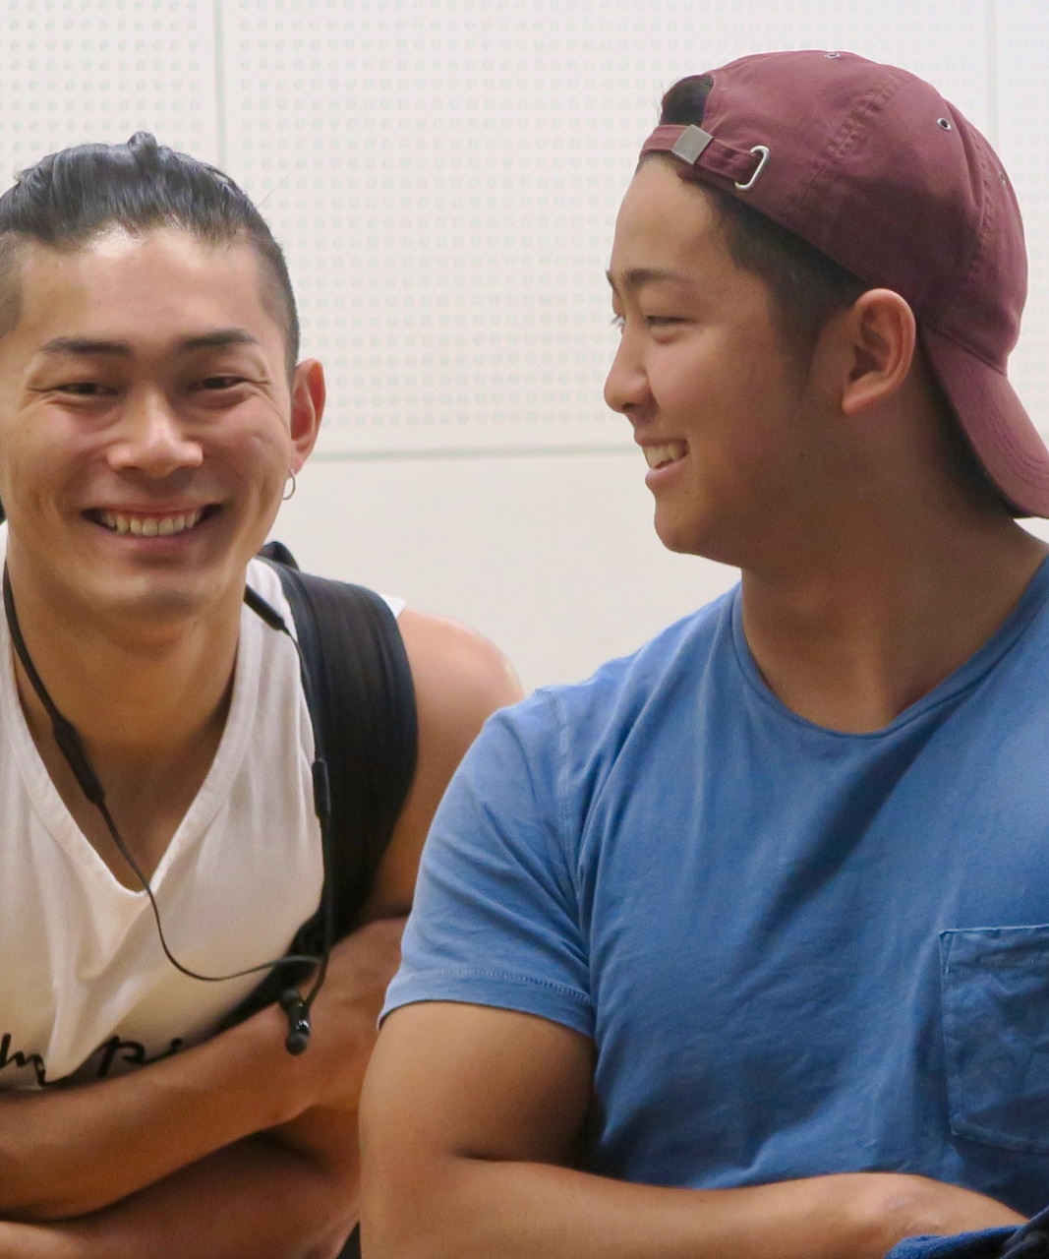
Learning the Lingo: Lines of Opposition, Resistance and Engagement
Japan’s Challenges
Low TOEFL Score
Perfectionist/ modest dispositions
Interpreting internationalisation as the English Language.
Migrant Academics’ Challenges:
Lacking language = non-attunement to the environment/ exclusion from decision-making.
Valued for their English language, rather than disciplinary expertise (EMI).
Reported marginalisation from research opportunities, epistemic inclusion, daily operations.
Investment- Language premium for those learning Japanese. Uneven support. Whose responsibility?

Slide 13
Migrant Academics Not Speaking Japanese
Still many official things are just in Japanese. So, there is some portal system on the website for the faculty members, but only in Japanese. So, for me it is really hard to search some information. (South Korean female lecturer)
As an academic if you want to get funding for your research and you don’t have the Japanese language as your first language and you’ve not managed to speak in Japanese it would be difficult to understand how the things work or to reach to informal networks, right? (US male professor)
Japanese Not Speaking English
In Japan I believe people here, since they were little, are trained to do things perfectly.…I talk to teachers or people or students, and they say, ‘oh, I don’t really speak English’, and I said ‘you are speaking English. Why can’t you?’
And later on, I found out that what they really meant is that ‘I don’t speak perfect English’. (Philippino male lecturer)
But still because of the pressure from the senior executives or the government…for improving
their university ranking. That is very important. In order to improve the ranking…you need to produce papers. In English, not in Japanese. (Japanese male director)

Slide 14
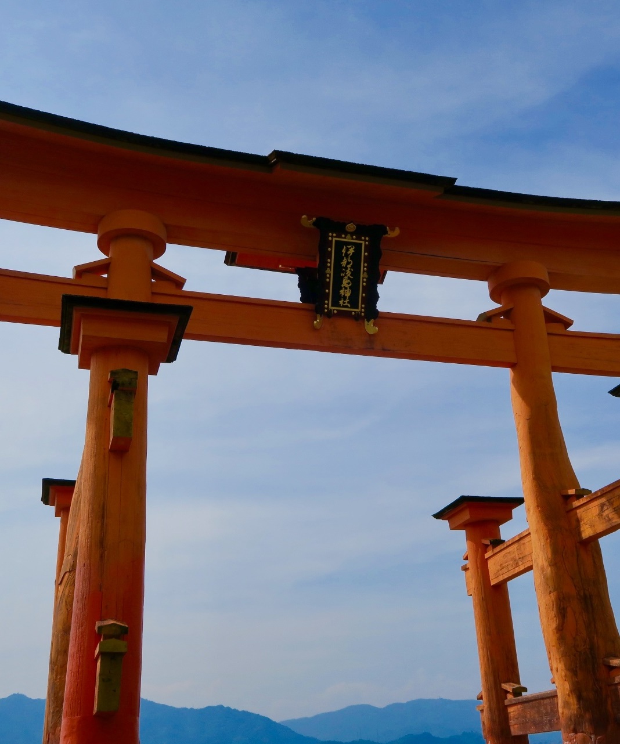
Migrants Academics
Temporary visitors
Often teachers, not researchers/ epistemic exclusion
On short-term contracts
Precarious, contingent or flexible workers.
On the periphery
Affective Load
Liminality/ hybridity (where is home?)
Being between two identity worlds
Uncertainty
Hidden Injuries: Precarity, Peripheralisation, Friction and Fragilities

Slide 15
I was on a committee for a tenure position and this really well-qualified Englishman or American applied and I said, ‘well why is this person’s CV being eliminated?’ And somebody took me aside and said, ‘don’t you know? Now that we have these five-year positions, those are for foreigners and the tenure positions are for Japanese’. (US female associate professor)
I'm dealing with maybe less favourable contract renewal conditions… I don’t know if it's a Japanese thing or it's my situation... Like for example, you don’t know when you're renewed or not. (Korean/US female English teacher)
So, in our university we still have non-Japanese contracts. I mean, our contracts are especially for us. We have a different regime, different system… non-Japanese people, we only get five years contract…only Japanese persons get non-limited contracts. (French male lecturer)
I think my first was a five -year contract, and then a three- year contract. And then they ran out of contracts. And you know, that's how it works in Japan, if they run out of contracts, then they say goodbye, right?… (US male associate professor)
And the basic principle that the foreigner is temporary, and the Japanese academic is permanent is just as strong now as it was in the eighties. (UK male Professor)

Slide 16
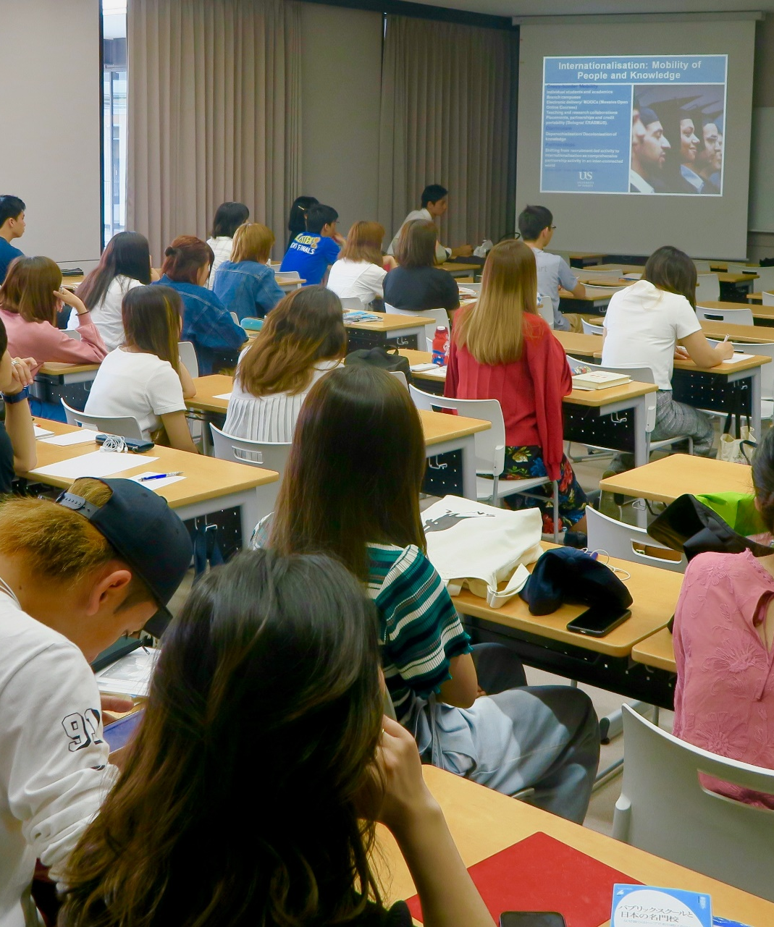
Being ’Other’/ Exilic Thinking
Migrant Academics reported:
Kindness/ Informal Support and Friendship
Lack of formal mentorship/ induction/ buddying
Need for networks
Uneven social and practical support
Exclusion from decision-making fora
Tension when promoting interactive pedagogies
Hierarchical social/ professional relations.
SeeTraining Module (https://www.sussex.ac.uk/webteam/gateway/file.php?name=trainingmodulejapanese-29may2019.pdf&site=41)

Slide 17
So, in the beginning the students would behave according to very different norms than they do in European countries…Like for example, in Germany, we would be told to express our own opinion, I know this is a stereotype, but it really exists. Whereas here students are not taught to express their own opinion (German female lecturer).
I want my students to actually behave differently from typical Japanese, I mean. So, I want
them to speak out, shout, not that situation where they always stay and listen to me all the time (Nigerian male lecturer).
Many Asian people, Asian academics, if they do not agree about some kind of issue they do not disagree about this issue. Because they respect the seniority, like that way. But, I think academics from Western countries, they really find it hard to accept this situation…(South Korean female lecturer)
I arrived there, and I was an associate professor, which meant I was involved in meetings and so on. And I really didn't know how a Japanese university worked in terms of the culture, and the bureaucracy, and the… What each committee did… There was zero orientation (UK male professor).

Slide 18
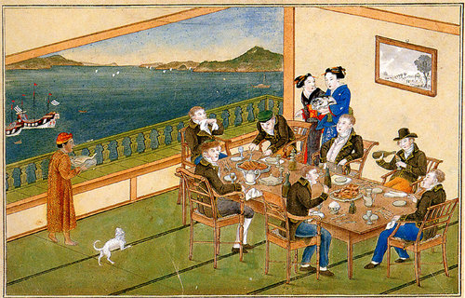
Quarantining and Isolation
They tend to Dejima the foreigners and put them on a little island and I find it very counter-productive because if they want to internationalise they should be embedding us within the rest of the faculty instead of collecting us all in one place …I have heard of situations where larger universities …create a new faculty and they'll put most of their foreigners there and then, especially at private universities where they're more nimble, things don't work out so well, university runs into financial troubles, well, we can cut a whole faculty now. We don't fire person by person and we can't be charged with discrimination, but we can cut a whole faculty and then it's just no, no we're not firing each individual foreigner, we're firing a whole faculty because it's the one that's not helping us out. (Male US lecturer)
N.B. Dejima was a small artificial island built in the bay of Nagasaki in 1634 by local merchants, notable for being the single place of direct trade and exchange between Japan and the outside world.

Slide 19
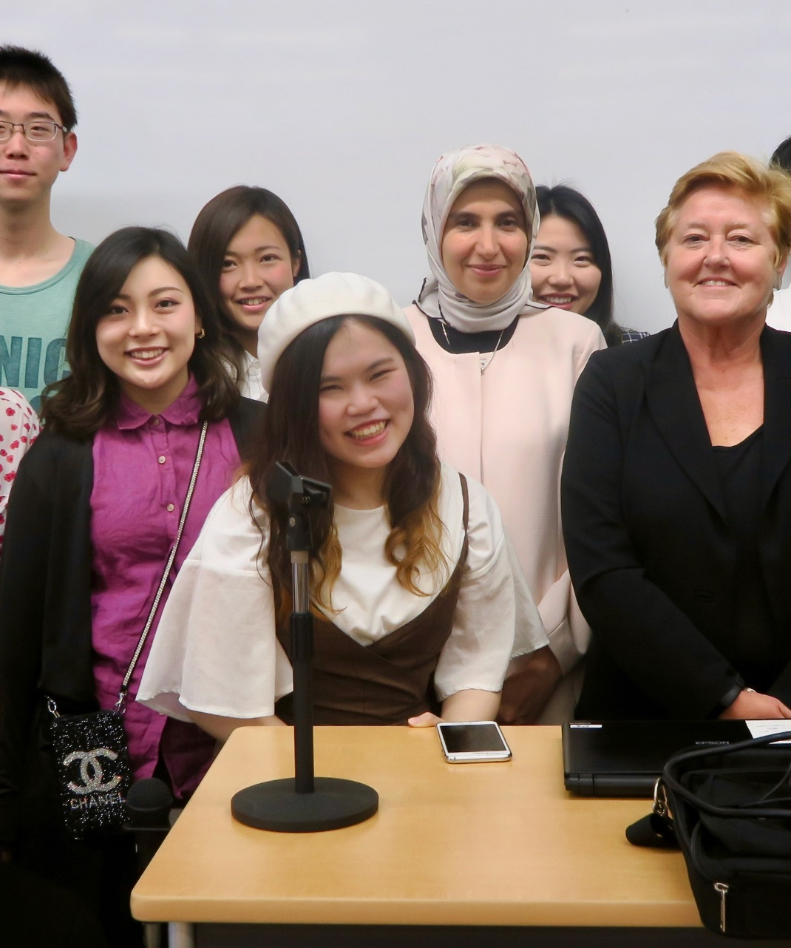
Reflections?
Who is the ideal migrant academic?
Is this racialised, gendered, regionalised?
The ‘otherness’/ externality of migrant academics offers new insights to some of the orthodoxies of academic life/ knowledge creation.
What opportunity is there for input?
Are migrant academics (disposable) knowledge workers, brokers or knowledge producers?
What arrangements/ good practices need to be i. maintained, and ii. put in place to support migrant academics?

Slide 20
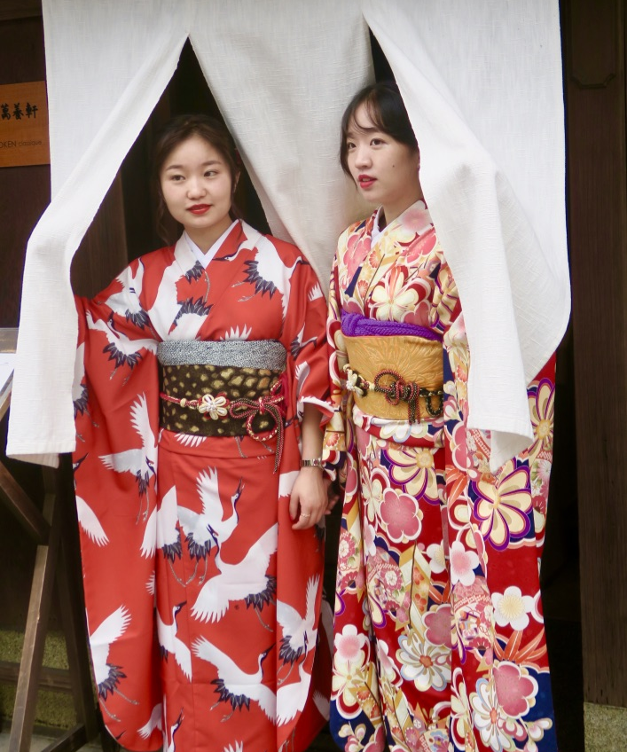
What Do We Wish to Keep?
Investment in Internationalisation/ HE?
Academic Freedom?
Opportunities for Knowledge Exchange?
Sense of Safety, Civility, and Well-being?
Other Suggestions?

Slide 21
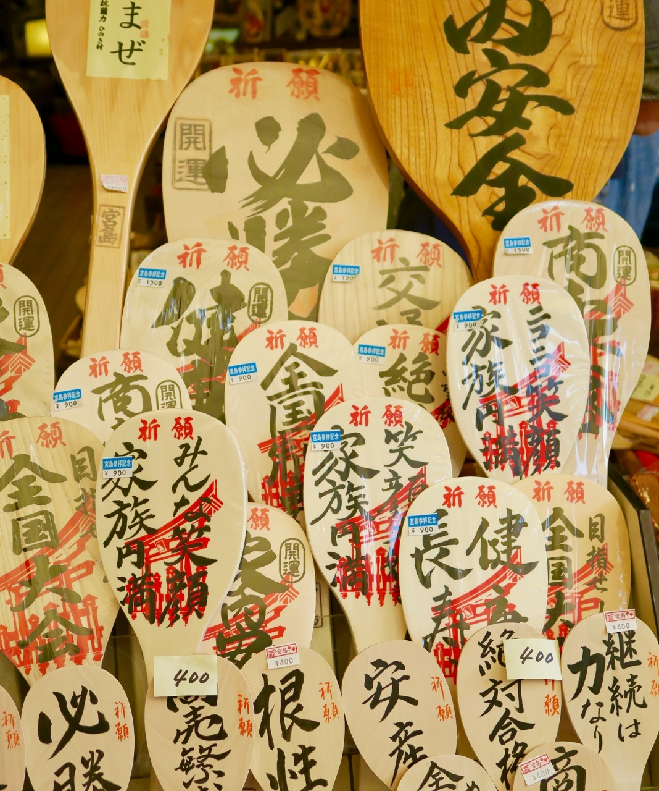
What Needs to Change?
Gender Regimes - under-representation, cultural expectations of women
Language – epistemic and professional inclusion
Precarity – contracts, uncertainty
Being ‘Other’ – induction, support, social integration, pedagogies.
What specific actions, by whom, how, when?

Slide 22
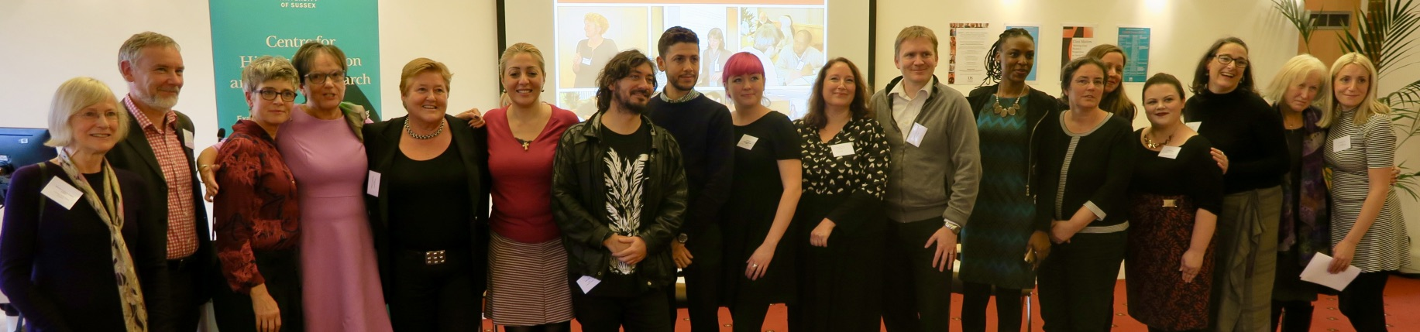
Follow Up?
Higher Education, Knowledge Exchange and Policy Learning in the Asian Century: A UK/Japanese Partnership (http://www.sussex.ac.uk/education/cheer/researchprojects/japan)
Morley, L., Alexiadou, N. Garaz, S. González-Monteagudo, J. Taba, M. (2018) Internationalisation and Migrant Academics: The Hidden Narratives of Mobility. Higher Education. 76 (3): 537–554.
Morley, L., Leyton, D., Hada, Y. (2019) The Affective Economy of Internationalisation: Migrant Academics in and out of Japanese Higher Education. Policy Reviews in Higher Education. 3:1, 51-74, DOI: 10.1080/23322969.2018.1564353.
Morley, L. et al. (2020) The Affective Assemblage of Internationalisation in Japanese Higher Education. Higher Education.
CHEER Website: www.sussex.ac.uk/education/cheer
Twitter: @SussexCHEER
Facebook: www.facebook.com/groups/CHEERSussex/

