Slide 1
Mental Health: Affect and the individual
CENTRE FOR HIGHER EDUCATION AND EQUITY RESEARCH
Paul Roberts, EdD Candidate

Slide 2
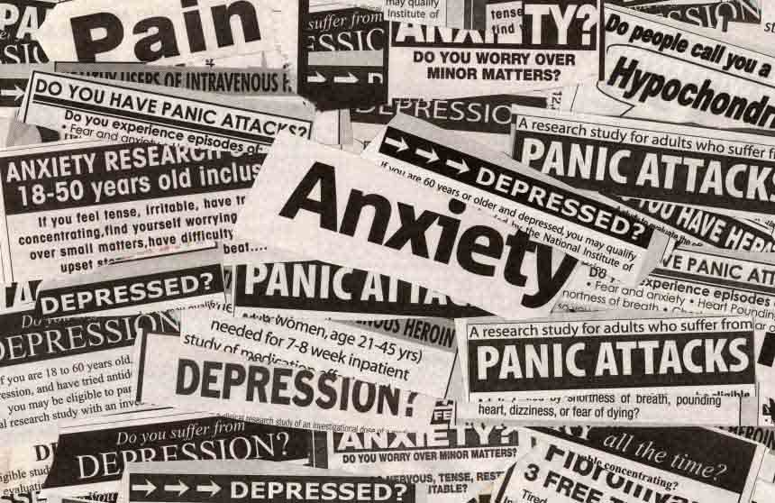
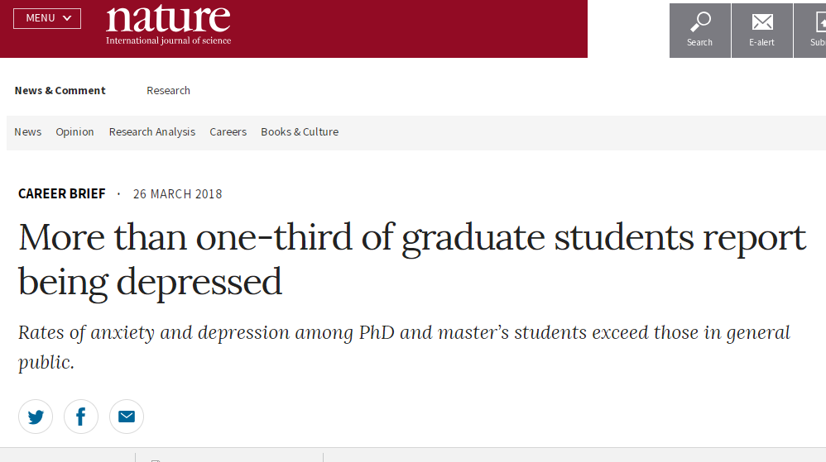
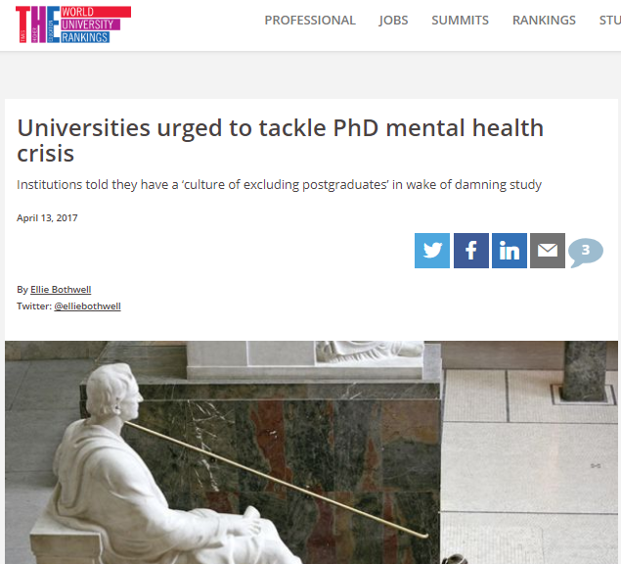
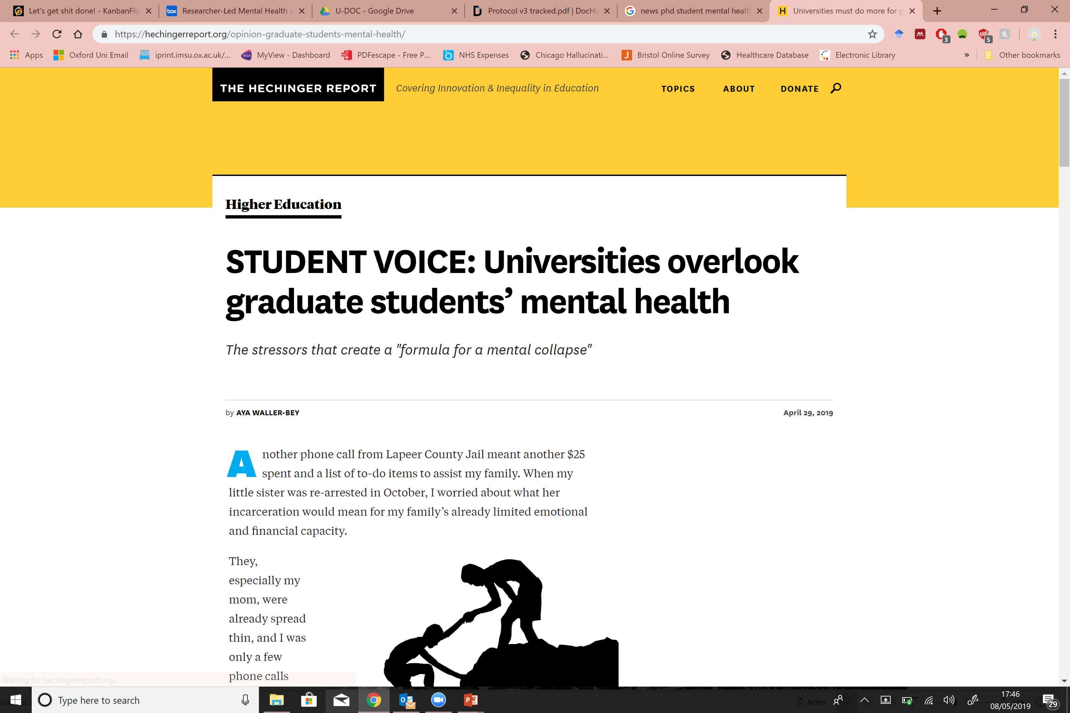
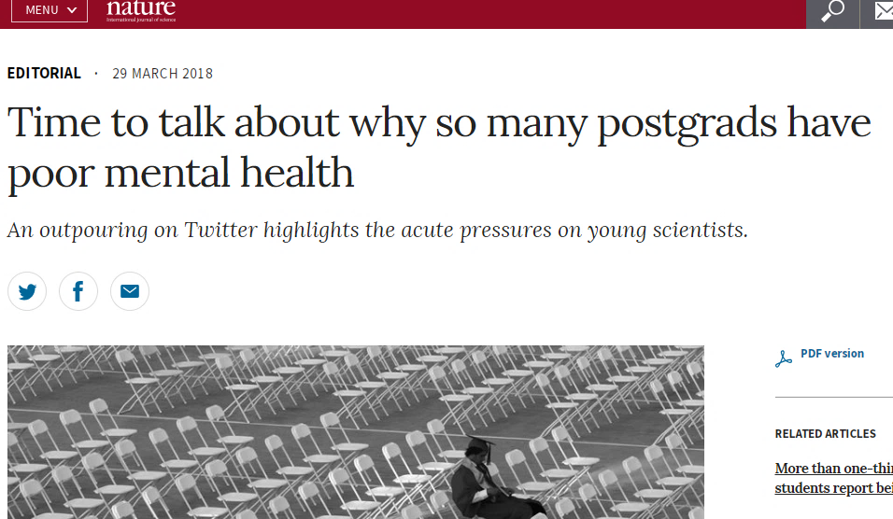
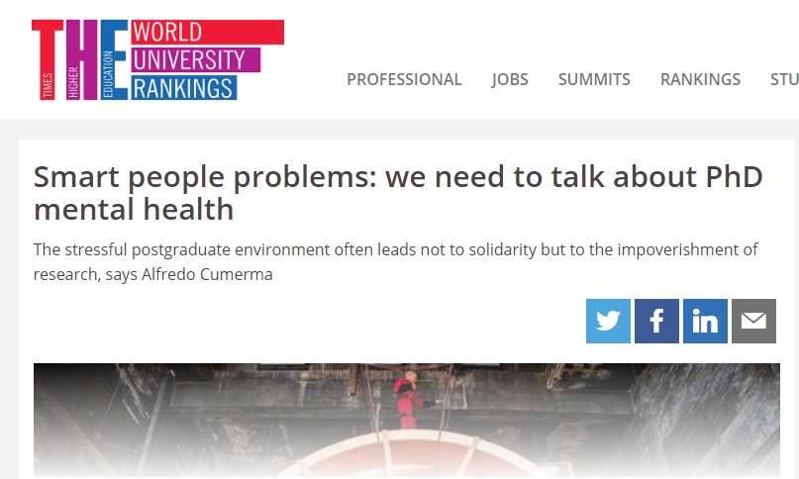
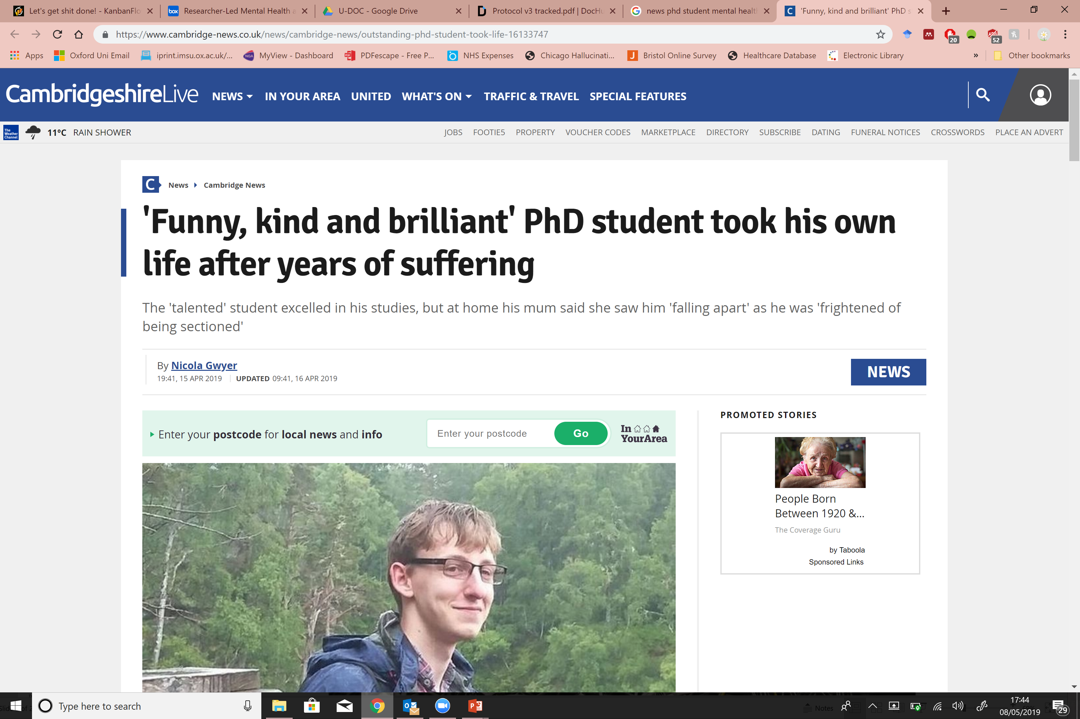
Notes:
Mental health has become a dominant discourse in UK Higher Education and Society. The Economic and Social Research Council’s 2019 Delivery Plan cited the need for Mental Health Research in relation to: Productivity, Prosperity and Growth; Living with Technology; Changing Populations; and in relation to positioning the UK in a Changing World. If as Mozzarella (2009) argues that society is inscribed on our nervous system and in our flesh before it appears in our consciousness. What is the affect that this pervasive discourse is creating?
Capillary Power – everywhere and nowhere

Slide 3
PGR Mental Health Research
Systematic Review
No observed association between stress and achievement
PhD students report significantly greater levels of stress compared to population norms
Stress is inversely associated with social support (less support <~> more stress)

Slide 4

Another Crisis Narrative?
Doctoral Education – Completions late 1990s
Ruins (Readings 1996)
Tsunamis (Popenici 2014)
Avalanches (Barber et al, 2013).
Crisis narrative (Baron, 2017)
Notes:
The great wave off Kanagawa – Hokusai’s most famous print and the first of 36 Views of Mount Fuji
Picture of PGR Catalyst call – OfS/Research England – University of Sussex
Are we responding to ‘student consumers’ (Naidoo, Shankar & Ekant 2011)?
Is this transference within Higher Education?
Is this a broader societal challenge? Social media spread?

Slide 5

Affective Economy
‘Sacrificial ethos’ silences stories of stress and insecurity (Gill 2010)
Guilt, pride, shame, fear
Imperial College Suicide (Morley 2015)
Culture of governance by fear (Braidotti 2012)
Truth-telling: peer review, appraisal, impact case studies, auditors, search agents (Ball 2014)
Notes:
“pain and suffering have become normalised in the life of academics”, whilst another questioned, “So does that mean if I stay academia I’m basically signing up to a life of poor mental health? I really feel that and that’s terrifying, and not―even just saying that makes me really anxious”.
The UK’s Economic and Social Research Council’s Delivery Plan (2019) cited the need for Mental Health Research in relation to: Productivity, Prosperity and Growth; Living with Technology; Changing Populations; and in relation to positioning the UK in a Changing World.

Slide 6

Reflections
Individual needs fixing - a discourse in which individual agency is privileged
Privatised
It must be measured set in a system of accounts (McGettigan 2013).
Illusio = investing in the game involves performativities (Bourdieu 1977; Colley 2013). Universities are keen to be seeing to do something about it.

Slide 7

Lack of Resistence…
Govermentality - regulate ourselves; TINA effect (Marcuse 1964)
Illusio = investing in the game involves performativities (Bourdieu 1977; Colley 2013)
Values reinforced via Social Media
views and likes
Value reinforced by £, March 2018 £1.5M allocated to 17 projects
Accelerated Academy – time pressures reduce deliberation about circumstances/priorities
5th - 6th November 2020
Brighton, UK.
www.ukcge.ac.uk/events/icmhw2-156.aspx
Notes:
Last year’s next steps…were to write a journal article (completed 2 on the topic), attend the World Education Research Conference in Tokyo August 2019 (symposium proposal accepted but travel grant rejected).

Slide 8

CHEER Website: www.sussex.ac.uk/education/cheer
Twitter:
@SussexCHEER
Facebook: www.facebook.com/groups/CHEERSussex/
Centre for Higher Education and
Equity Research (CHEER)

