Slide 1

Buy British, Be Global: marketing mobility and global identity at British international branch campuses
Lee Rensimer
19 July 2017
Disrupting Internationalisation Discourses Seminar @CHEER, University of Sussex

Slide 2
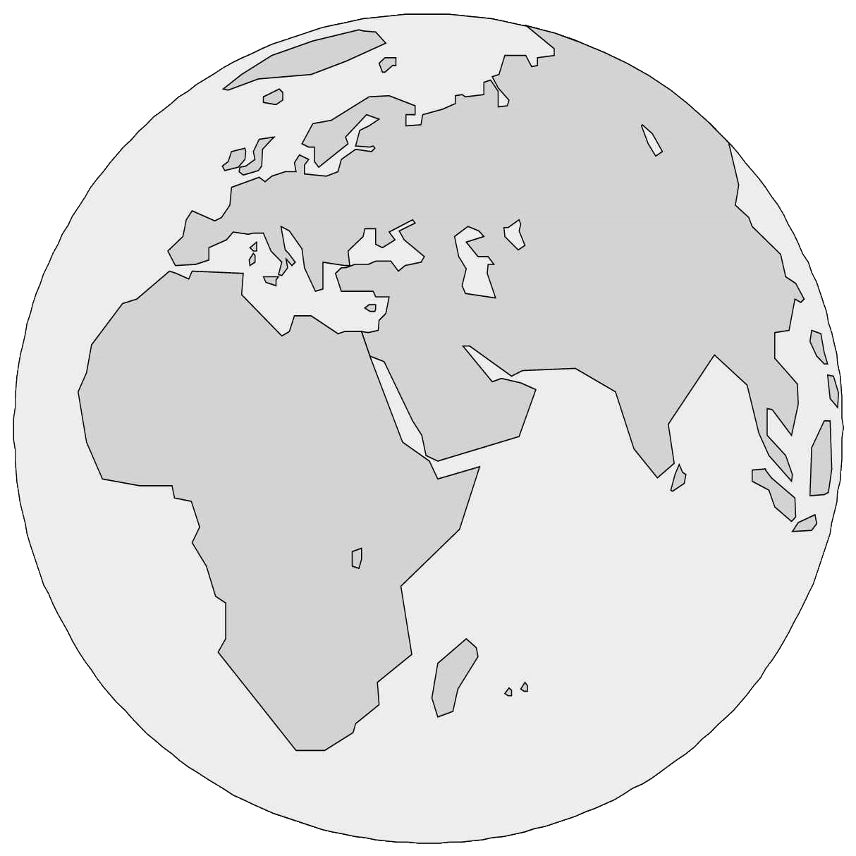





University establishes international branch campus
Branch campus is marketed and branded to appeal to new audience/market
Student interprets, imagines Britain and British universities

Slide 3


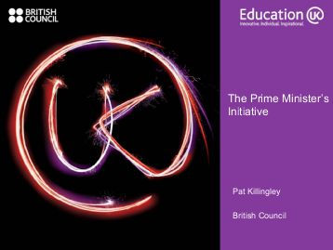

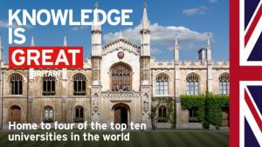

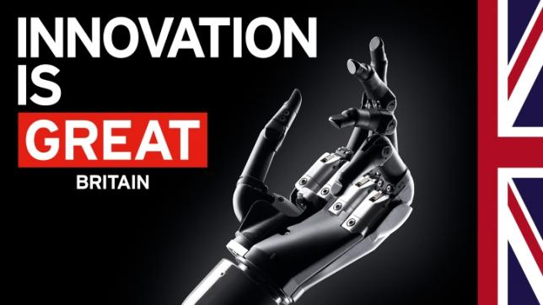
British educational export industry
worth approx. £18 billion to UK economy (DoBIS 2013)
UK education “is a high-growth industry” (Universities UK 2015)

Slide 4
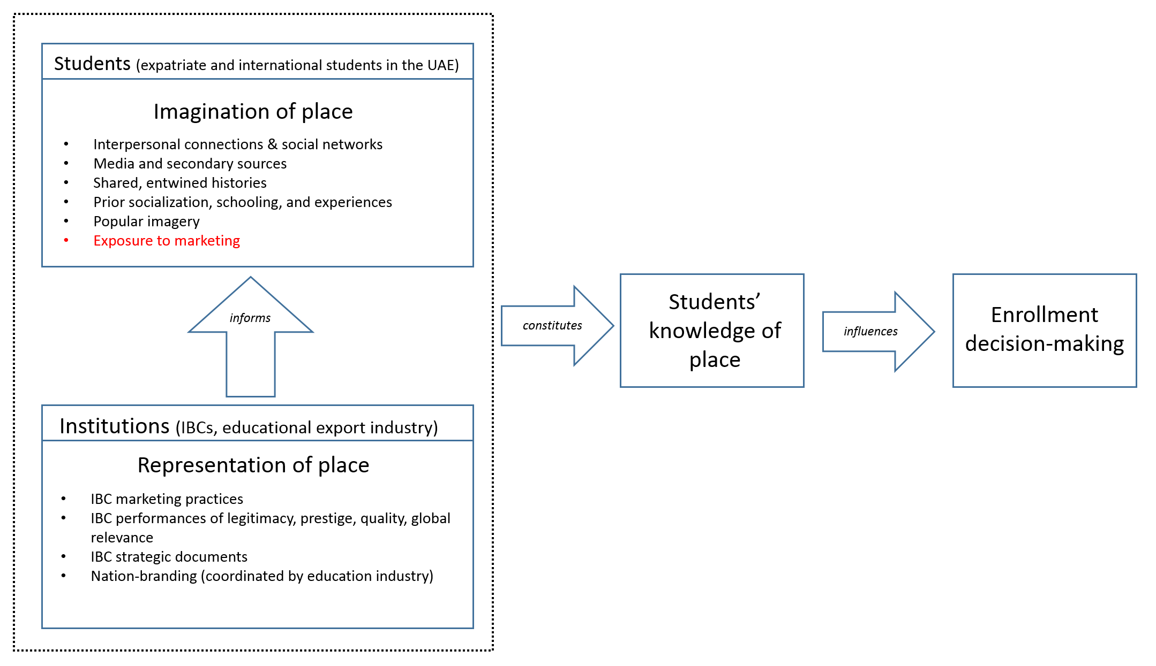
Research frame
Question 2: How do students make sense of and respond to these representations?
How do these representations inform their imaginations of and identification with the UK?
Question 1: Which discourses of the UK and its universities are articulated in the marketing practices and imagery of British IBCs in the UAE?

Slide 5
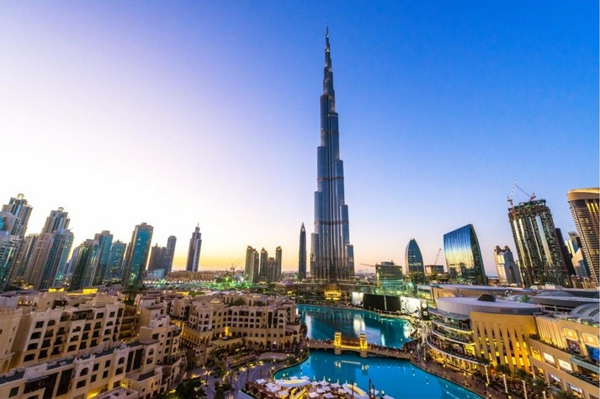
United Arab Emirates (UAE) as research site
Highly commercialised education sector
Educational “free zones” – policy spaces for creating educational markets and attracting capital investment
90% expatriate population, receive social services exclusively through private provision and market “choice”.
“Education hub”: 32+ International branch campuses; 10 of which are British.

Slide 6
Critical approaches to International Branch Campuses (IBCs)
(1) IBCs as policies
  A policy ethnography / policy sociology approach
  examines spaces between policy text and enactment
  examines how campuses are “lived” or co-constructed
  structures the research design vertically from home campus (text) to students (policy subject or actor)
(2) IBCs as signs
  Semiological analysis of campuses as ensembles of discourses and values coded in (re)presentations

Slide 7

Theoretical contributions
Imagination
  Agent-centric: Imagination as a social practice (Appadurai, Anderson)
  Discourse-centric: Imaginative geographies (Said, Foucault)
Desire (Deleuze & Guattari, Sidhu)

Slide 8
British institutions with physical presence in the UAE
Institution | Emirate | Location / Zone | Established | Students (2015-16)
Heriot-Watt University | Dubai | Dubai International Academic City | 2005 | 4300
Middlesex University | Dubai | Dubai Knowledge Village | 2005 | 3300
University of Manchester | Dubai | Dubai Knowledge Village | 2006 | 860
University of Bolton | Ras Al Khaimah | RAK Academic Free Zone | 2008 | 600
Coventry University and Emirates Aviation College | Dubai | Dubai International Academic City |  | 220
City University London, Cass Business School | Dubai | Dubai International Financial Centre | 2007 | 190
University of Bradford | Dubai | Dubai Knowledge Village | 1998/2009 | 174
University of Strathclyde | Dubai & Abu Dhabi | Within HCT (Dubai & Abu Dhabi) | 1995/2005 | 120
London Business School | Dubai | Dubai International Financial Centre | 2006 | 120
University of Exeter | Dubai | Dubai Knowledge Village | 1999 | 69

Slide 9
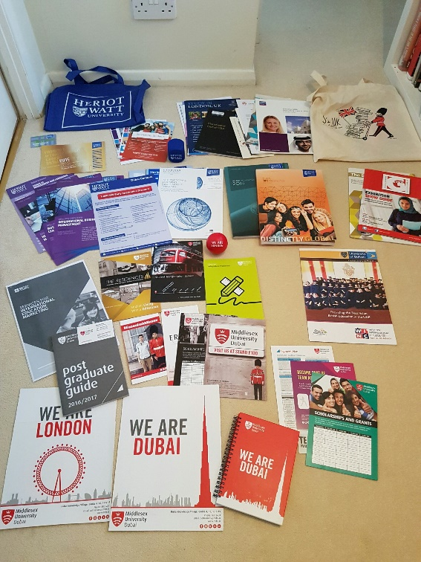
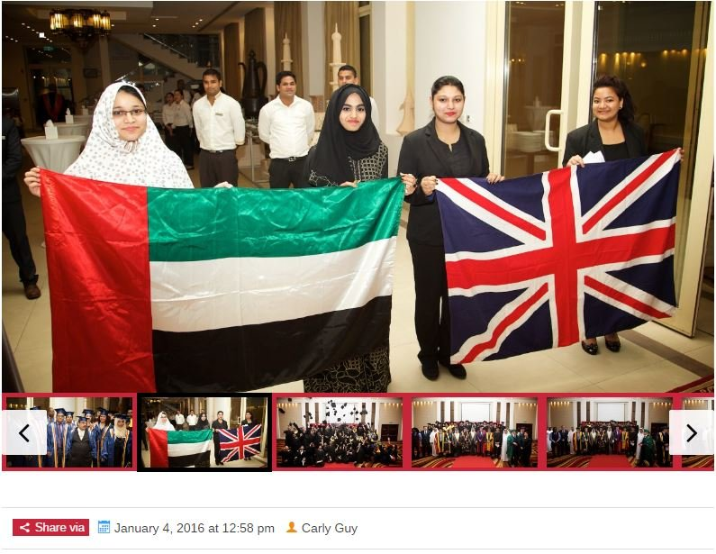

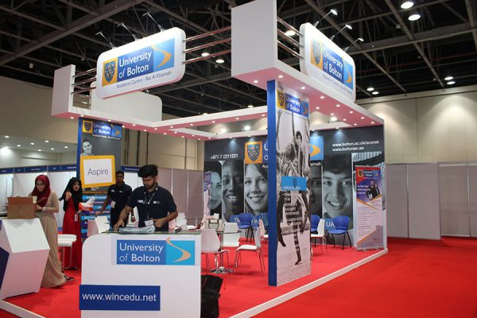
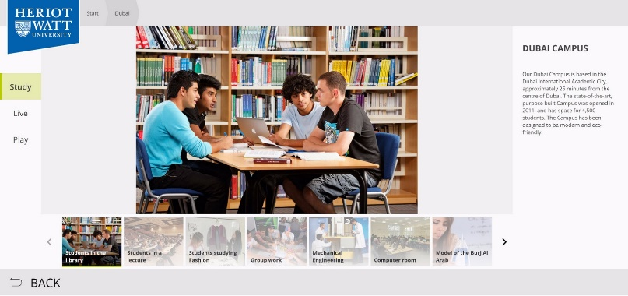
Methodology for Q1: Representation
Visual/textual analysis: websites (text and imagery), social media (Facebook and Instagram), prospectuses, flyers, billboards, campus architecture and interior motifs
Semi-structured interviews with marketing staff, recruiters, and senior management
Observations of campus spaces, educational expos and marketing events

Slide 10
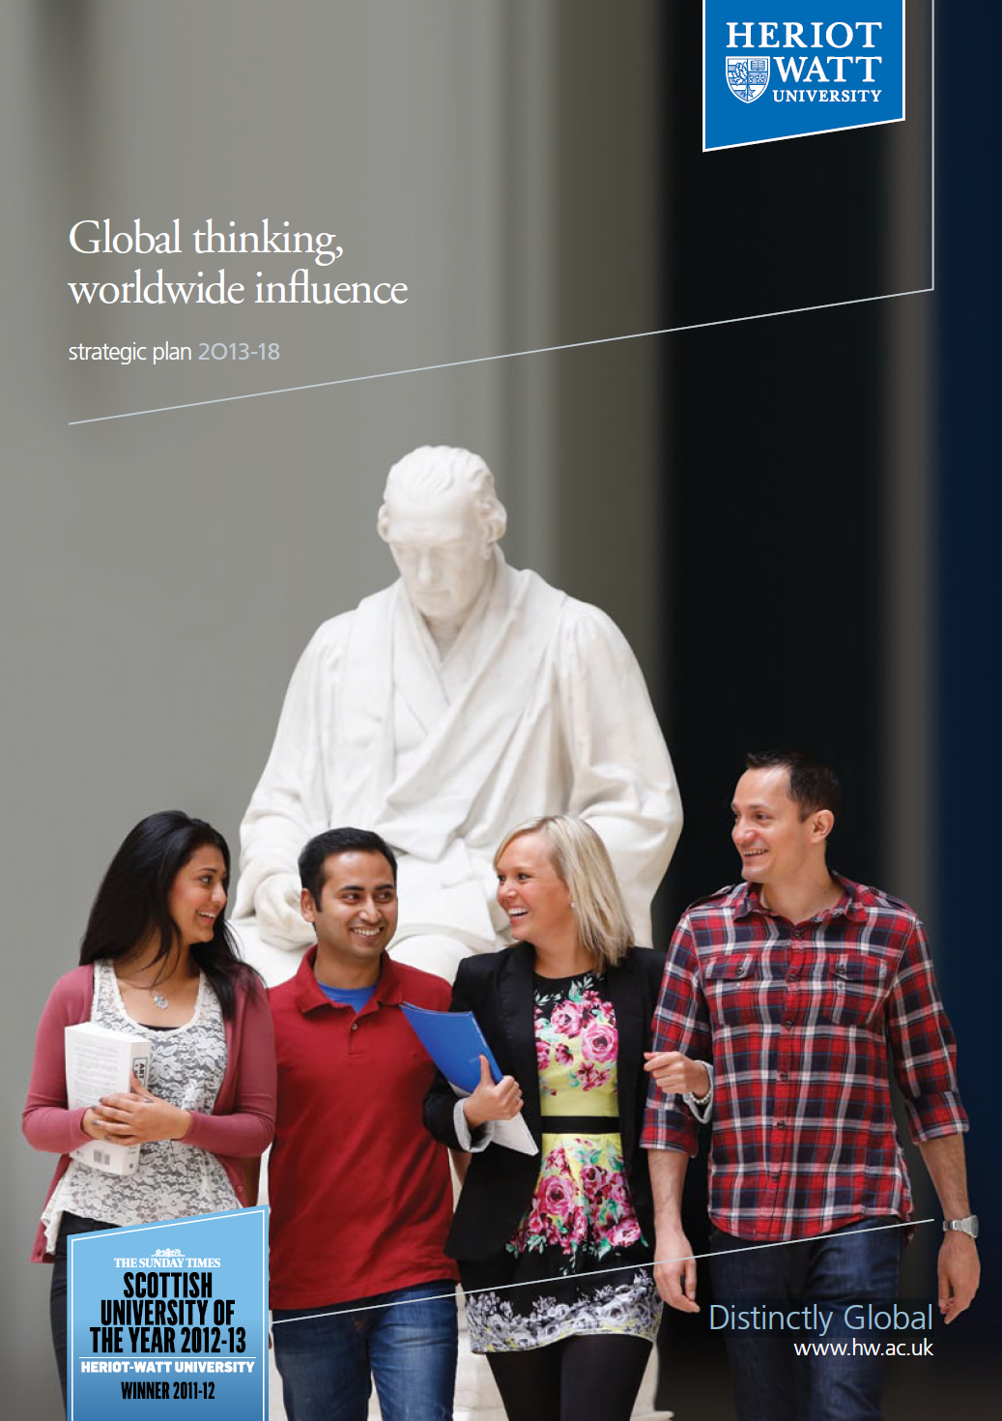
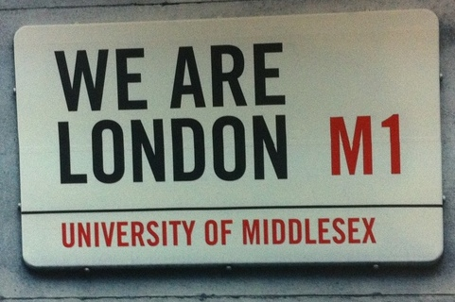
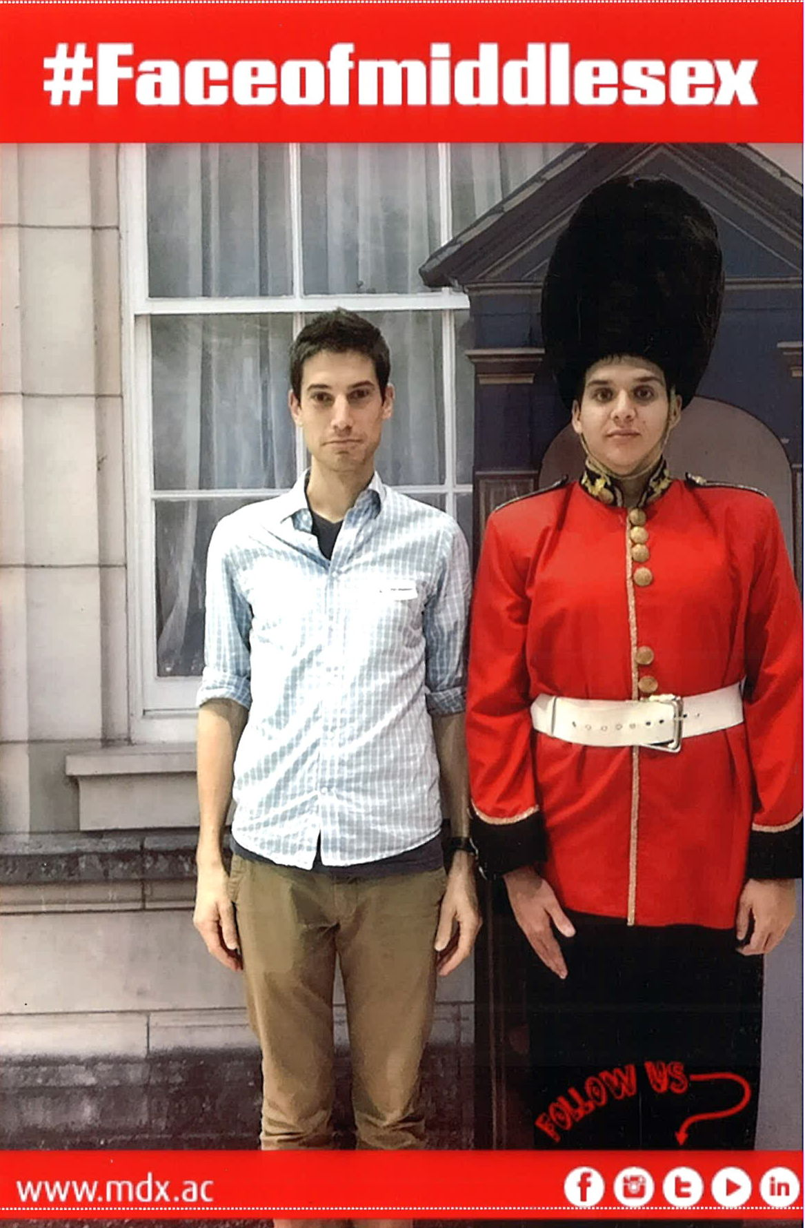
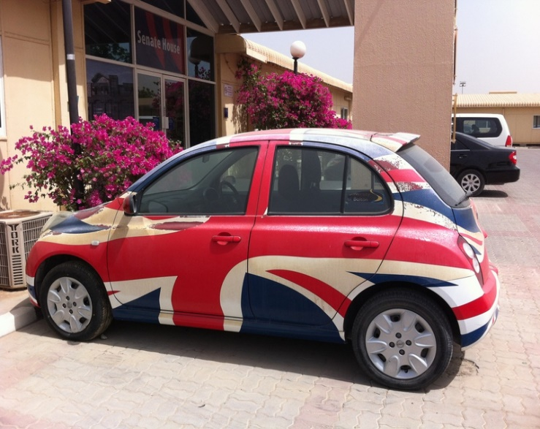

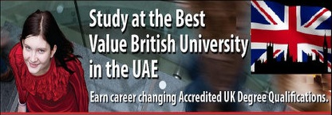

Slide 11
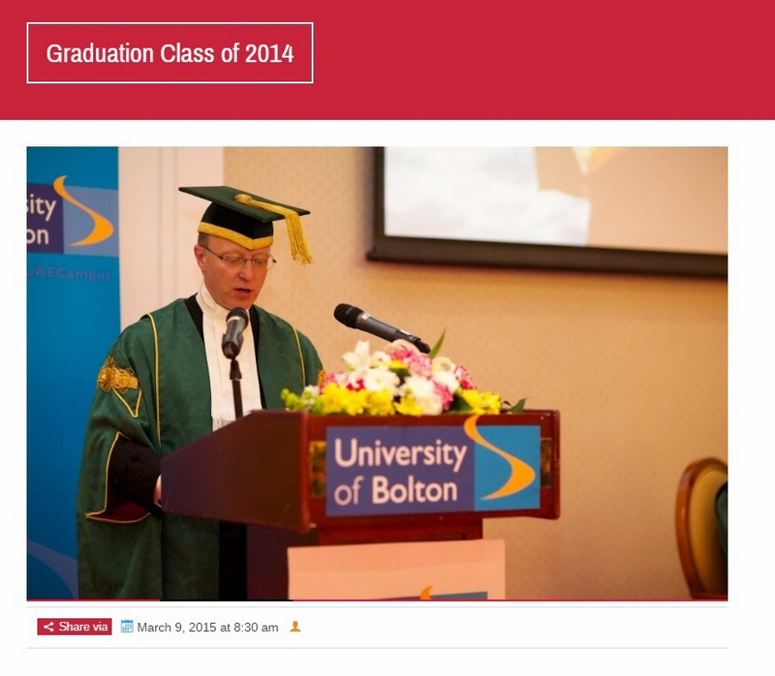
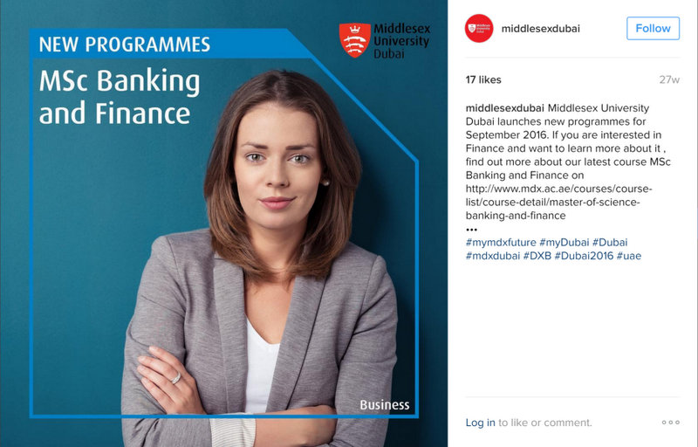

Early findings
“We don’t have such multicultural… We do actually, but we don’t have so many white people, that’s for sure [they laugh]. But we do have Indians and Pakistanis!”
“I definitely thought it was going to be way more international. I’m pretty sure that if you visited, you saw a good percentage of the students there are Indian and Nigerian… So I was expecting it to be a bit more like people from everywhere.”

Slide 12

Methodology for Q2: Imagination
Interviews with 51 undergraduate students of varying nationalities, gender, degree course and year
  Choice-making process
  How university looks and feels British or global to them
  Future plans

Slide 13
British = Global
I: You said earlier that there is a British culture on campus. Can you tell me more about that? What’s British exactly?
S: I think it depends on the University… how they are doing the things usually … we are doing a lot of activities. In last semester we did a food festival, and different food was there. The Pakistani food was there, different Emirati food was there, different other food was there. And afterwards they chose the best food stall, and ours was the best stall.

Slide 14
British = Global
I: I was going to ask you then about the British character of the institution..
S: [She jumps in] Definitely British. It’s definitely British.
I: It feels British?
S: Yeah. It’s not pretending to be British, it’s not failing to be British, it’s definitely a British university.
I: How so?
S: Umm… I think because the faculty are so well-traveled. Just speak to any given faculty, they’ve traveled around the world, they’ve lived everywhere, they’ve studied in the UK, they’ve worked in the UK, there is that connection with UK. Very few of them haven’t actually been to the UK. So they all understand the British education system.. umm.. And they’re all very, very academic. And very experienced, very sorta global and worldly. None of them come giving their nationality.. It’s all about the British education system. And I think that’s a culture that you just automatically adopt the moment you kinda walk on to the Dubai campus. It just feels like that.

Slide 15
Reproducing truths
S1: If I had a Middlesex degree, then they’d recognize it more than they would a degree, for instance, from Manipal University or American University of Dubai, because these are all – I mean, at least AUD is a local university. So Middlesex would be perhaps more recognized out there.
I: So it gives you kind of a global access?
S1: Yes. That’s also part of the reason why. Everyone was like, Manipal, you’re kind of just restricted to here; but then Middlesex, you’d have more opportunities elsewhere as well. That’s how, at least, people think out here, and that’s what I’ve heard when I speak to people.
I: Okay. So how do you know that?
S1: That’s how people think out here. Because my parents, their friends and, again, their kids who are also going to university; and that’s kind of their opinion as well, that globally Middlesex University would give you more access. So, again, it’s just that the degree … allows you to get more access to different places.
S2: It’s not really Middlesex, but the fact that Middlesex is technically a British university. And it’s the fact that because you have a British degree, it takes you more places. There are people who say that IIT in India is really, really good, but if you go to, like, Princeton – I mean, the education, the quality you would get would probably will be around the same level; but then if you go to Princeton, it’ll get you farther than it would if you went to IIT.
S1: It’s more about the name.
S2: Yeah, it’s more about the name and the reputation.

Slide 16
Materiality of globality: Mobility
“I think a UK degree does have currency in many parts of the world. It will enable students to maybe get a better job and leverage their careers and so on. So there is value in having a UK degree.” (Partnership coordinator)
“It gives you wings.” (IBC teaching staff)
“By getting the qualification from a local institution, it doesn’t have that international mobility, that currency, that you can go work at in other countries. So we saw that as a prime mover for us, simply because we said well there’s a massive population of ex-pats, a lot of them are from the South Asian continent, some European, and they actually value British education. And they want a qualification that will hold currency, [and] they are willing to pay for it.” (University Provost in UK)

Slide 17
Limitations to Mobility
Biopolitics of migratory regimes: Dunya, Iranian student at Heriot-Watt Dubai
Embodiments: Maya, Zambian student at Middlesex-Dubai
Rensimer, L. (2016), “International Higher Education for Whom? Expatriate Students, Choice-making and International (Im)mobility in the Northern United Arab Emirates”, FIRE: Forum for International Research in Education,Vol. 3, Iss. 2, pp. 79-96.

