Slide 1

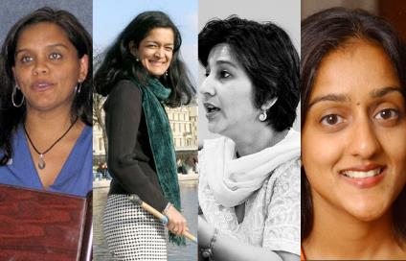
Lost Leaders:
Women in the Global Academy
Diversity, Democratisation and Difference: Theories and Methodologies
Professor Louise Morley
Centre for Higher Education
& Equity Research (CHEER)
University of Sussex, UK
www.sussex.ac.uk/education/cheer

Slide 2
Women Vice-Chancellors: Leading or Being Led?
NOR | UK | MEX | HONG KONG | JAPAN | US
31.8% | 17% | 8%? | 0% | 2.3% | 26%

Slide 3
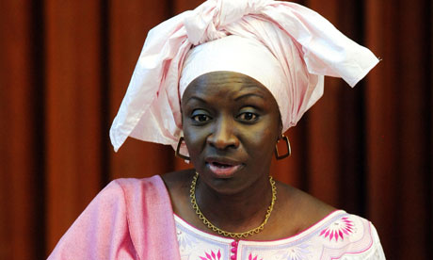
Making Women Intelligible as Leaders?
What is it that people don’t see?
Why don’t they see it?
What do current practices reveal and obscure?
Women leaders = contextual discontinuity/ interruptive in their shock quality.
Aminata Touré, Prime Minister of Senegal, 2012

Slide 4
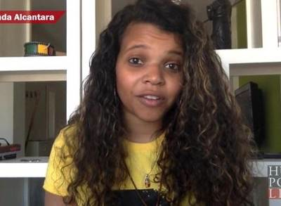
Leadership Potential
Observable
Separate
Static structure?
OR
Contingent
Contextual
Co-produced?

Slide 5
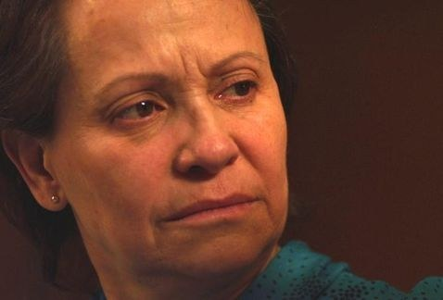
A Two-Way Gaze?
How are women being seen e.g. as deficit men?
How are women viewing leadership e.g. unliveable lives?
What narratives circulate about:
women’s capabilities?
leadership?

Slide 6
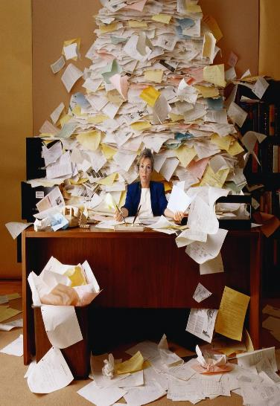
Where are the Women?
Adjunct/assistant roles
(Bagilhole and White, 2011; Davis, 1996).
‘Glass cliffs’ (Ryan & Haslam, 2005)
‘Velvet ghettos’
(Guillaume & Pochic, 2009)
quality assurance
community engagement
human resource management

Slide 7
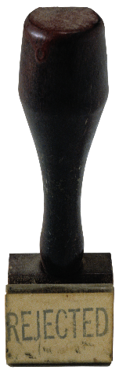
Gendered Pathways: Research/ Prestige Economy
Women less likely to be:
Journal editors/cited in top-rated journals (Tight, 2008).
Principal investigators (EC, 2011)
On research boards
Awarded large grants (Husu, 2014)
Awarded research prizes (Nikiforova, 2011)
Be conference keynote speakers (Schroeder et al., 2013 )
Women likely to be:
Cast as unreliable knowers (Longino, 2010).
Tasked with inward-facing responsibilities.
Research resources/opportunities:
Competitively structured
Replicate/reproduce gender hierarchies.

Slide 8
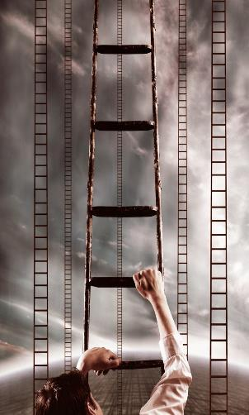
Consequences of Absence of Leadership Diversity?
Employment/ Opportunity Structures
Democratic Deficit
Distributive injustice/ Structural Prejudice.
Depressed career opportunities.
Misrecognition of leadership potential/ wasted talent.
Service Delivery
Knowledge Distortions, Cognitive/ Epistemic injustice (Fricker, 2007)
Reproduction of Institutional Norms and Practices.
Margins/ Mainstream hegemonies, with women, minority staff seen as Organisational ‘Other’.

Slide 9
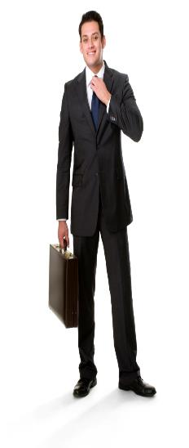
Provocations?
Gender escapes the policy logic of the turbulent global academy?
Women’s capital devalued/ misrecognised in the knowledge economy?
Cultural scripts for leaders coalesce/collide with normative gender performances?
Decision-making and informal practices lack transparency/ accountability/ reproduce privilege?

Slide 10
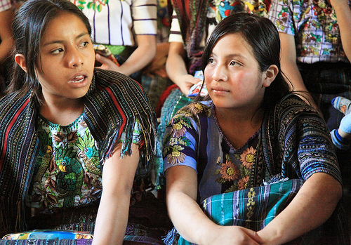
Diversity = Representational Space?
Norm-saturated (essentialised) policy narratives
Add under-represented groups
into current systems
=
distributive justice/ smart economics
organisational and epistemic transformation.
Gender = demographic variable.
Diversity = business case?
Sociology of absences?

Slide 11

Evidence
South Asia
Literature/ Policy Review
Interviews- 19 women and 11 men
Afghanistan, Bangladesh, India, Nepal, Pakistan and Sri Lanka.
Malaysia
36 Questionnaires/ 1 Focus Group
East Asia and MENA
20 Questionnaires/ 3 Discussion Groups Australia, China, Egypt, Hong Kong, Indonesia, Japan, Jordan, Kuwait, Malaysia, Morocco, Pakistan, Palestine, the Philippines, Singapore, Thailand and Turkey (Morley, 2014).
What makes leadership attractive/unattractive to women?
What enables/ supports women to enter leadership positions?
Personal experiences of being enabled/ impeded from entering leadership?

Slide 12
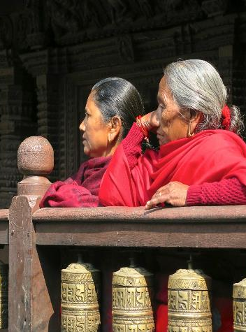
Narrating Difference
Recruitment and Selection
(Political/lacking transparency)
Passionate attachment
(Disciplines/ research)
Authority
(Does not ‘stick’ to women)
Gendered Divisions of Labour
(Women = domestic domain)
Exclusionary Networks
(Male Domination/ sexual propriety)
Hostile cultures
(Toxic/ stressful)

Slide 13
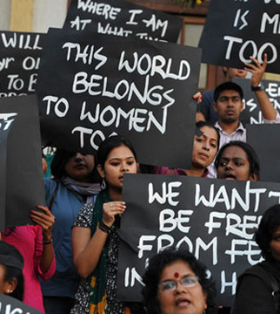
What Attracts Women to Senior Leadership?
Power
Influence
Values
Rewards
Recognition

Slide 14
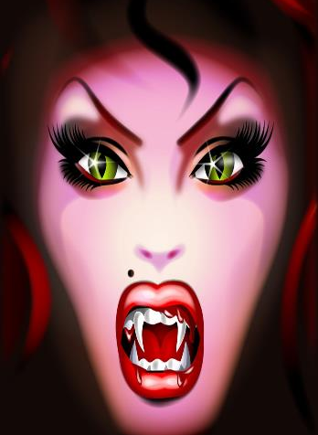
Why is Senior Leadership Unattractive to Women?
Neo-liberalism
Being ‘Other’ in male-dominated cultures (Burkinshaw 2015)
The signifier ‘woman’ reduces the authority of the signifier ‘leader’.
Disrupting the symbolic order
Corruption/ Financialisation
Pre-determined Scripts
Do women lack capital (economic, political, social and symbolic) to redefine the requirements of the field?

Slide 15
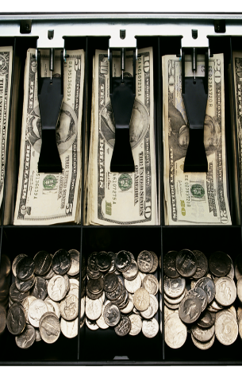
Leadership = Installation of the Neo-liberal Gaze?
Knowledge = the New Capital/ Global Commodity
Financialisation/ Market Values
Audit/ Performance Management
Prestige Economy/ League Tables
Instrumentalisation/ Mobilisation/Utility of Research e.g. Impact, Rates of Return

Slide 16

The Affective Economy of Identity Work
Working with resistance, recalcitrance, truculence, ugly feelings.
Colonising colleagues’ subjectivities towards the goals of managerially inspired discourses.
Managing self-doubt, conflict, anxiety, disappointment & occupational stress.
=
Restricting not
Building capacity and creativity.

Slide 17
Rejection, Refusal and Reluctance
Reluctance (Gendered Cultures)
The mentality of your male colleagues. That’s a deterrent like I said he’ll call you pushy, he’ll call you vicious you know and all that because a woman at the leadership or a woman boss is not readily acceptable.
(Female Pro Vice- Chancellor, Bangladesh)
The men they also do not like the female to be a leader, that I have also faced the problem…They want to see the male as the leader, not the female.
(Female Dean, Nepal)
Rejection (Misrecognition)
UK- women 2.5 times likely to be unsuccessful in applications for senior posts (Manfredi et al, 2014)
Refusal (Attachment to Discipline)
I find it difficult to control people…I know this so every time I am offered this position I say no…You are not trained to do that kind of thing, you know - we have only been trained in working in our discipline
(Female Professor, Sri Lanka).

Slide 18
Barriers Enablers
The Power of the Socio-Cultural/ Gender Appropriate
Social Class and Caste
Lack of Investment in Women
Organisational Cultures
Perceptions of Leadership
Recruitment and Selection
Family
Gender and Authority
Corruption
Policies
(affirmative action, gender mainstreaming, work/life balance)
Women-only Provision
(leadership development/ universities)
Mentoring
Professional Development
Family
Evidence
(Research/ Gender-Disaggregated Statistics)
Internationalisation

Slide 19
Women Reflexively Scanning
Women Are Not/ Rarely
Identified, supported, encouraged and developed for leadership.
Achieving the most senior leadership positions in prestigious, national co-educational universities.
Personally/ collectively desiring senior leadership.
Attracted to labour intensity of competitive, audit cultures in the managerialised global academy.
Women Are
Constrained by socio-cultural messages
Entering middle management.
Often located on career pathways that do not lead to senior positions.
Burdened with affective load:
being ‘other’ in masculinist cultures
navigating between professional and domestic responsibilities.
Often perceiving leadership as loss.
Demanding change.

Slide 20
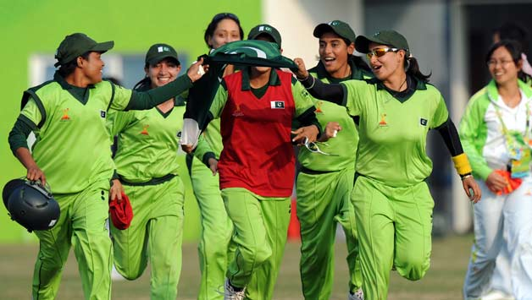
Moving On: What are We Asking Women to Lead?
Women are
Rejected
Refusing/ Self Excluding
Reluctant
Change
Not counting more women into existing structures/ scripts/systems/ gendered cultures.
Can Leadership:
narratives
technologies
practices
Be more than discursive performances/repetitions of:
values
regulative norms
of the neo-liberal global academy?
Need for
Re-visioning of Leadership
Generative, generous and gender-free.

Slide 21
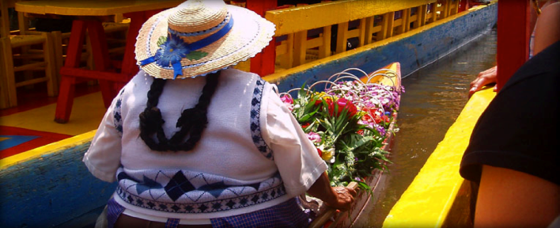
Follow Up?
Morley, L., & Crossouard, B. (2015) Gender in the Neoliberalised Global Academy: The Affective Economy of Women and Leadership in South Asia. British Journal of Sociology of Education. 10.1080/01425692.2015.1100529
Morley, L. & Crossouard, B. (2015) Women in Higher Education Leadership in South Asia: Rejection, Refusal, Reluctance, Revisioning. Pakistan: British Council.
https://www.sussex.ac.uk/webteam/gateway/file.php?name=women-in-higher-education-leadership-in-south-asia---full-report.pdf&site=41
Morley, L. et al. (in press, 2015) Managing Modern Malaysia: Women in Higher Education Leadership. In, Eggins, H. (Ed) The Changing Role of Women in Higher Education: Academic and Leadership Challenges. Dordrecht: Springer Publications.
Morley, L. (I2014) Lost Leaders: Women in the Global Academy. Higher Education Research and Development 33 (1) 111–125.
Morley, L. (2013) "The Rules of the Game: Women and the Leaderist Turn in Higher Education " Gender and Education. 25(1):116-131.
Morley, L. (2013) Women and Higher Education Leadership: Absences and Aspirations. Stimulus Paper for the Leadership Foundation for Higher Education.
Morley, L. (2013) International Trends in Women’s Leadership in Higher Education In, T. Gore, and Stiasny, M (eds) Going Global. London, Emerald Press.

