Slide 1
Internationalisation of Doctoral Education in Japan: Implications for Researcher Development
CENTRE FOR HIGHER EDUCATION AND EQUITY RESEARCH
Mariam Attia, Lecturer In Education
Paul Roberts, EdD Candidate

Slide 2
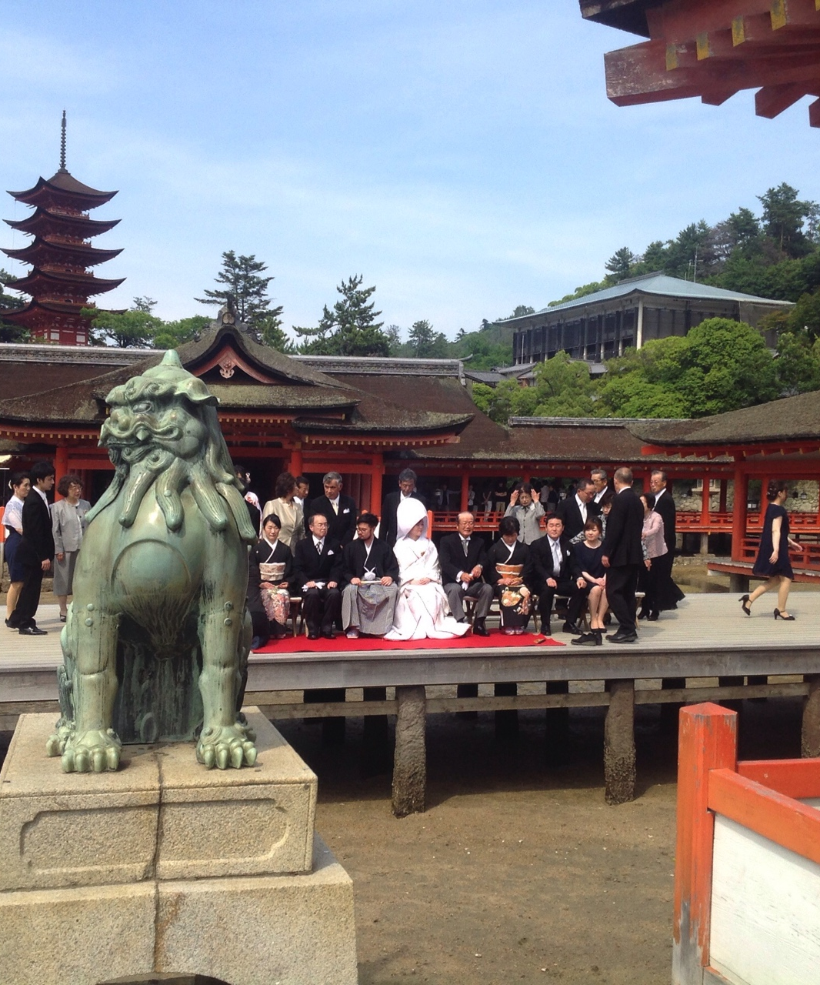
Higher Education, Knowledge Exchange and Policy Learning in the Asian Century: A UK/Japanese Partnership
Interview data gathered in 2 private and 6 national universities in Japan with 13 doctoral researchers (5 women and 8 men).
All participants met UN definition of migrants – persons who have lived outside their country of birth for 12 months or more (Castles & Miller, 2009).
The doctoral researchers came from Bangladesh, China, Ghana, Nepal (2), Philippines, South Korea, Syria, Taiwan, USA (2) and Vietnam.
Disciplinary mix included: 5 Scientists; 6 Social Scientists; 2 Arts & Humanities researchers.
Notes:
All interviews were conducted in English.
The sample was selected through personal and professional networking paying attention to gender, ethnicity, countries of origin and type of institution.
Castles, S., & Miller, M. J. (2009). The age of migration. International population movements in the modern world (4th ed.). New York: Palgrave Macmillan.

Slide 3


Policy aims…
Knowledge for the knowledge economy
Drive to attract human capital – 4th Science and Technology Basic Plan, 2011-15
Japan Doctoral Human Resource Profiling survey (JD-Pro)
Japan needs more gurobaru jinzai (global talent)
Implications for higher education
Higher education positioned as a service industry for the labour market
Challenge to incorporate (policy compliance)
Competition
Notes:
With the advent of the aging society with fewer children, the importance of doctoral HRs is increasing in Japan owing to their capabilities in innovating with high added value. However, the career path of young researchers is unclear, and there remain various issues including (1) expansion of career path to private companies, etc., (2) transition from postdoctoral fellows to stable positions, (3) delayed independence for young researchers, (4) lack of supervisory HRs, and (5) lack of female researchers in the fields of science and technology.
REF: http://www.nistep.go.jp/wp/wp-content/uploads/Outline_JDPRO1.pdf
Shibayama, S., & Kobayashi, Y. (2017). Impact of PhD Supervising Setting: A Comprehensive Analysis based on "Japan Doctoral Human Resource Profiling, JD-Pro". (Discussion Paper; No. 150). Tokyo: National Institute of Science and Technology Policy.
Work undertaken at Lund University highlighted the important role of the supervisor – “Our regression analyses [of Japan Doctoral Human Resource Profiling, a national survey of a cohort of 5000 PhD graduates from Japanese Universities] controlling for several variables indicate the following results: (1) PhD students who received frequent instruction by their official supervisors are likely to successfully earn degrees and engage in jobs related to their dissertation subjects; (2) frequent supervision by internal faculty members is associated with high performance both in academia (based on publications) and in industry (based on wage rates); (3) frequent supervision by external faculty members is associated with successful degree attainment and academic career choice”

Slide 4

Current metrics…
Performance
Japan is one of the most attractive destinations to foreign students compared to other OECD and partner countries with available data (8/46).
18% of all doctoral researchers in Japan are international students. This compares to Australia 34%, USA 40%, UK 43% (Education at a Glance 2018, OECD)
Data does not distinguish between postgraduate taught and postgraduate research.
Notes:
18% of all doctoral researcher in Japan are international students
OECD (2018), Education at a Glance 2018: OECD Indicators, OECD Publishing, Paris, https://doi.org/10.1787/eag-2018-en.

Slide 5
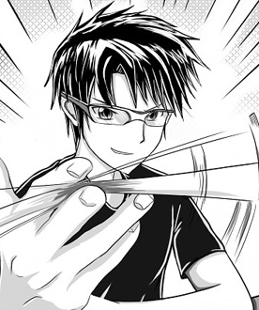
Motivations for Study in Japan
Cultural exports ‘So I liked Nintendo games as a child, like Legend of the Mystical Ninja’ ; ‘Japanese pop culture animation’
Facilities (Science students) ‘many sophisticated instruments for my research’
‘A strong research culture’
Access to scholarship funding
Professional or economic opportunities
Personal relationships

Slide 6
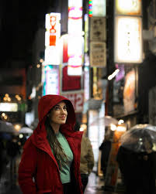
Appreciation
Polite
Safe
Clean
Kind
Professional
Hardworking
Keep promises
Trains run on time
Notes:
‘It’s nice here. It’s safe, it’s clean.‘
‘I can go anytime from the lab at night. 11 o’clock, 12 o’clock, no problem. But in my country, it’s… At night maybe, some robbery or something.’

Slide 7
Select Findings
Qualitative data was rich, allowing us to build detailed pictures about the lived experiences of international doctoral researchers in Japan.
We present some select findings from the research and highlight some of the potential impacts they have for policy and practice.
We will focus on four areas:
  Supervisors
  Scholarships
  Language
  Psycho-social support

Slide 8
Supervisors
“They say that the relationship between you and your supervisor is critical because if your supervisor doesn’t really care about your research, it’s going to be a more difficult time as a graduate student. Yes, I’m lucky enough to have a very supportive supervisor as well as other teachers who are supportive.”
“I’ve had lots of support from my advisor. My advisor is fantastic.”
“After six months my professor said my research is more important, so I should stop the Japanese classes and concentrate on my research.”
“So much depends on the teacher. That time I had a very depressed life and my… Another sensei, now my current sensei, he’s very different.”
“My supervisor – my supervisor is to be very huge advantage that I can get here.”

Slide 9

Psycho-social
Loneliness – “You’re by yourself here. You know, you have to… I can only imagine what it’s like for people who just come here straight away and have nobody. I’ve been here for almost eight years and have a small support system. And even that sometimes is not enough.”
Alienation – ‘we can feel we are from outside, we are outsider and maybe they did not accept us’; ‘even though I’ve spent here for six years, I don’t think I have a Japanese friend, one, single friend.’; Nobody talks to you first.’; ‘They are very polite and always give you very nice words but sometimes I think it is different from what they think.’; ‘many, many international students are suffering from cultural differences”.
Mixed support – ‘There’s a whole section dedicated to international students. Any kind of help you need, you just come to international student section and they just help you out.’

Slide 10
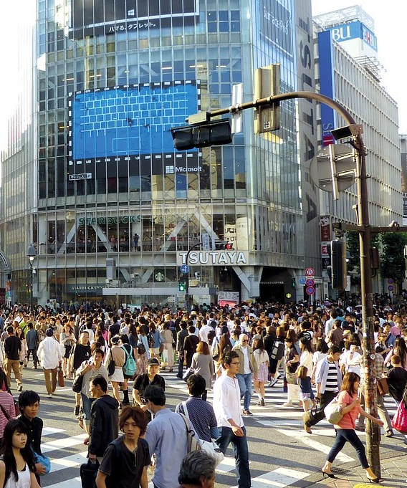
Language
“the language is really very important”
“If you don’t know the language, it’s very difficult to live everyday life.”
“Some of them …are too embarrassed to speak in English. They know how to read and how to write…they just don’t have the skill of talking.”

Slide 11
Funding
“Money issues are always on my mind, because you know, if you don’t have money then you have to drop out of school and just work.”
“The finance situation was missing. Financial situation they didn’t tell properly.”
“Money, money’s an issue. The scholarship only lasts to my third year and this is my third year.”
“I think PhD candidates all should have at least some small scholarship, all of them deserve that. A PhD is not easy to do, especially here where they expect you to do it in three years.”

Slide 12
Recommendations for Policy and Practice

Slide 13

Policy recommendations: Supervision
Propose a programme to enhance the capacity and number of doctoral supervisors in Japan supervising international doctoral researchers
Provide formal training for new and existing supervisors on some of the challenges of international doctoral supervision, using a cascade or ‘train the trainer’ approach
The training could embed both policy objectives (e.g. gurobaru jinzai) as well as unpacking the ‘affect’ associated with being a doctoral researcher
Problematising academic freedom – the freedom of each professor to supervise in their own way. Understanding the apprentice/master model
Notes:
Work undertaken at Lund University highlighted the important role of the supervisor – “Our regression analyses [of Japan Doctoral Human Resource Profiling, a national survey of a cohort of 5000 PhD graduates from Japanese Universities] controlling for several variables indicate the following results: (1) PhD students who received frequent instruction by their official supervisors are likely to successfully earn degrees and engage in jobs related to their dissertation subjects; (2) frequent supervision by internal faculty members is associated with high performance both in academia (based on publications) and in industry (based on wage rates); (3) frequent supervision by external faculty members is associated with successful degree attainment and academic career choice”
Shibayama, S., & Kobayashi, Y. (2017). Impact of PhD Supervising Setting: A Comprehensive Analysis based on "Japan Doctoral Human Resource Profiling, JD-Pro". (Discussion Paper; No. 150). Tokyo: National Institute of Science and Technology Policy.
An example of how such a cascading programme could work was based on three levels, as follows:
Key Trainers: an initial tranche of nine Key Trainers. They would develop a three-day course which they would offer six times, on each occasion to 25 senior members of academic staff who already have experience of successfully supervising at least 5 doctoral students, and who will become 150 Master Trainers. These 25 senior members of academic staff should be from a range of disciplines, both science, social science and arts, be located across the regions of Japan and have a gender balance.
Master Trainers: will be required, in gender mixed teams of three, to offer the same training courses seven times to groups of around 24 participants. The participants will comprise 2 senior members of academic staff from each of the HEIs in Japan which offer doctoral programmes. Eventually, some 350 members of academic staff will have been trained this way to become Cluster Trainers.
Cluster Trainers: these are the people who will ultimately bear responsibility, within their own HEIs, to organise and provide training to colleague supervisors in whatever way best suits the needs of their colleagues (e.g. whether as three day courses, or one day a week, or two hours after work once a week).

Slide 14
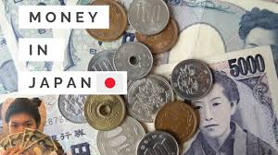


Policy recommendations: Scholarships
How do these relate to policy?
What are the aims of these scholarships? Are these known by the recipients or their supervisors?
Is there a correlation between the doctoral scholarships and Japan’s internationalisation strategy? Global talent or a service for peace?
Does communication to both students and supervisors on the purpose of scholarship need to be clearer?
Notes:
Only one considering possibly working for a US firm based in Japan.
Others – PhD requirement of role back in home country.
Conception of scholarships as a service, supporting the generation of knowledge and peace.

Slide 15

Practice recommendations: Language
Whose responsibility is it?
What should be translated and where is the balance?
The challenge beyond the campus?
Improving pre-arrival – ‘international student readiness’
Notes:
Only one considering possibly working for a US firm based in Japan.
Others – PhD requirement of role back in home country.

Slide 16

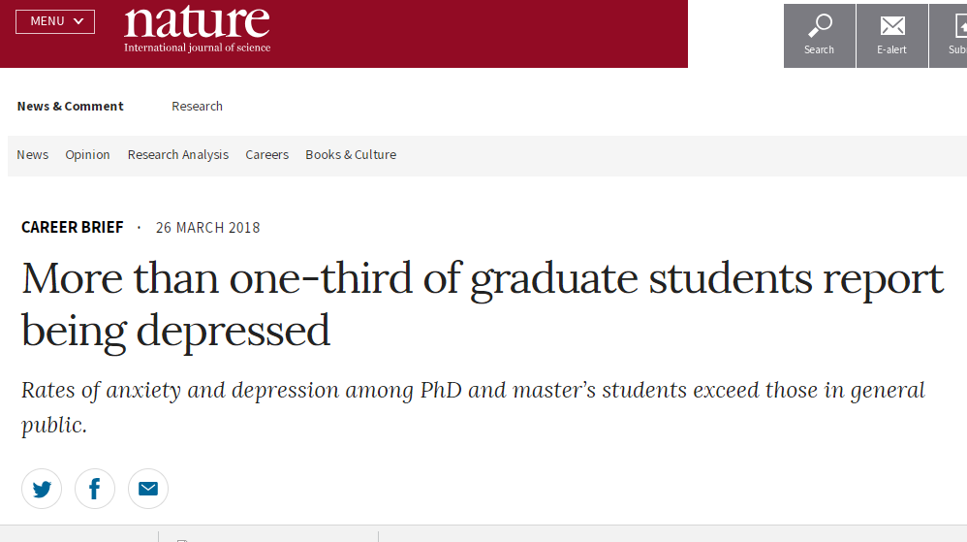
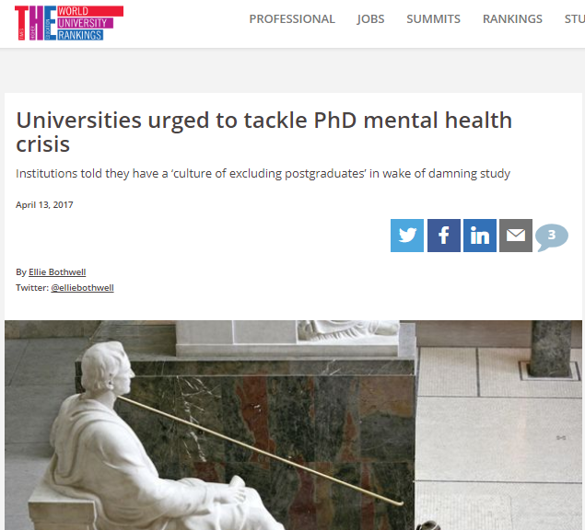
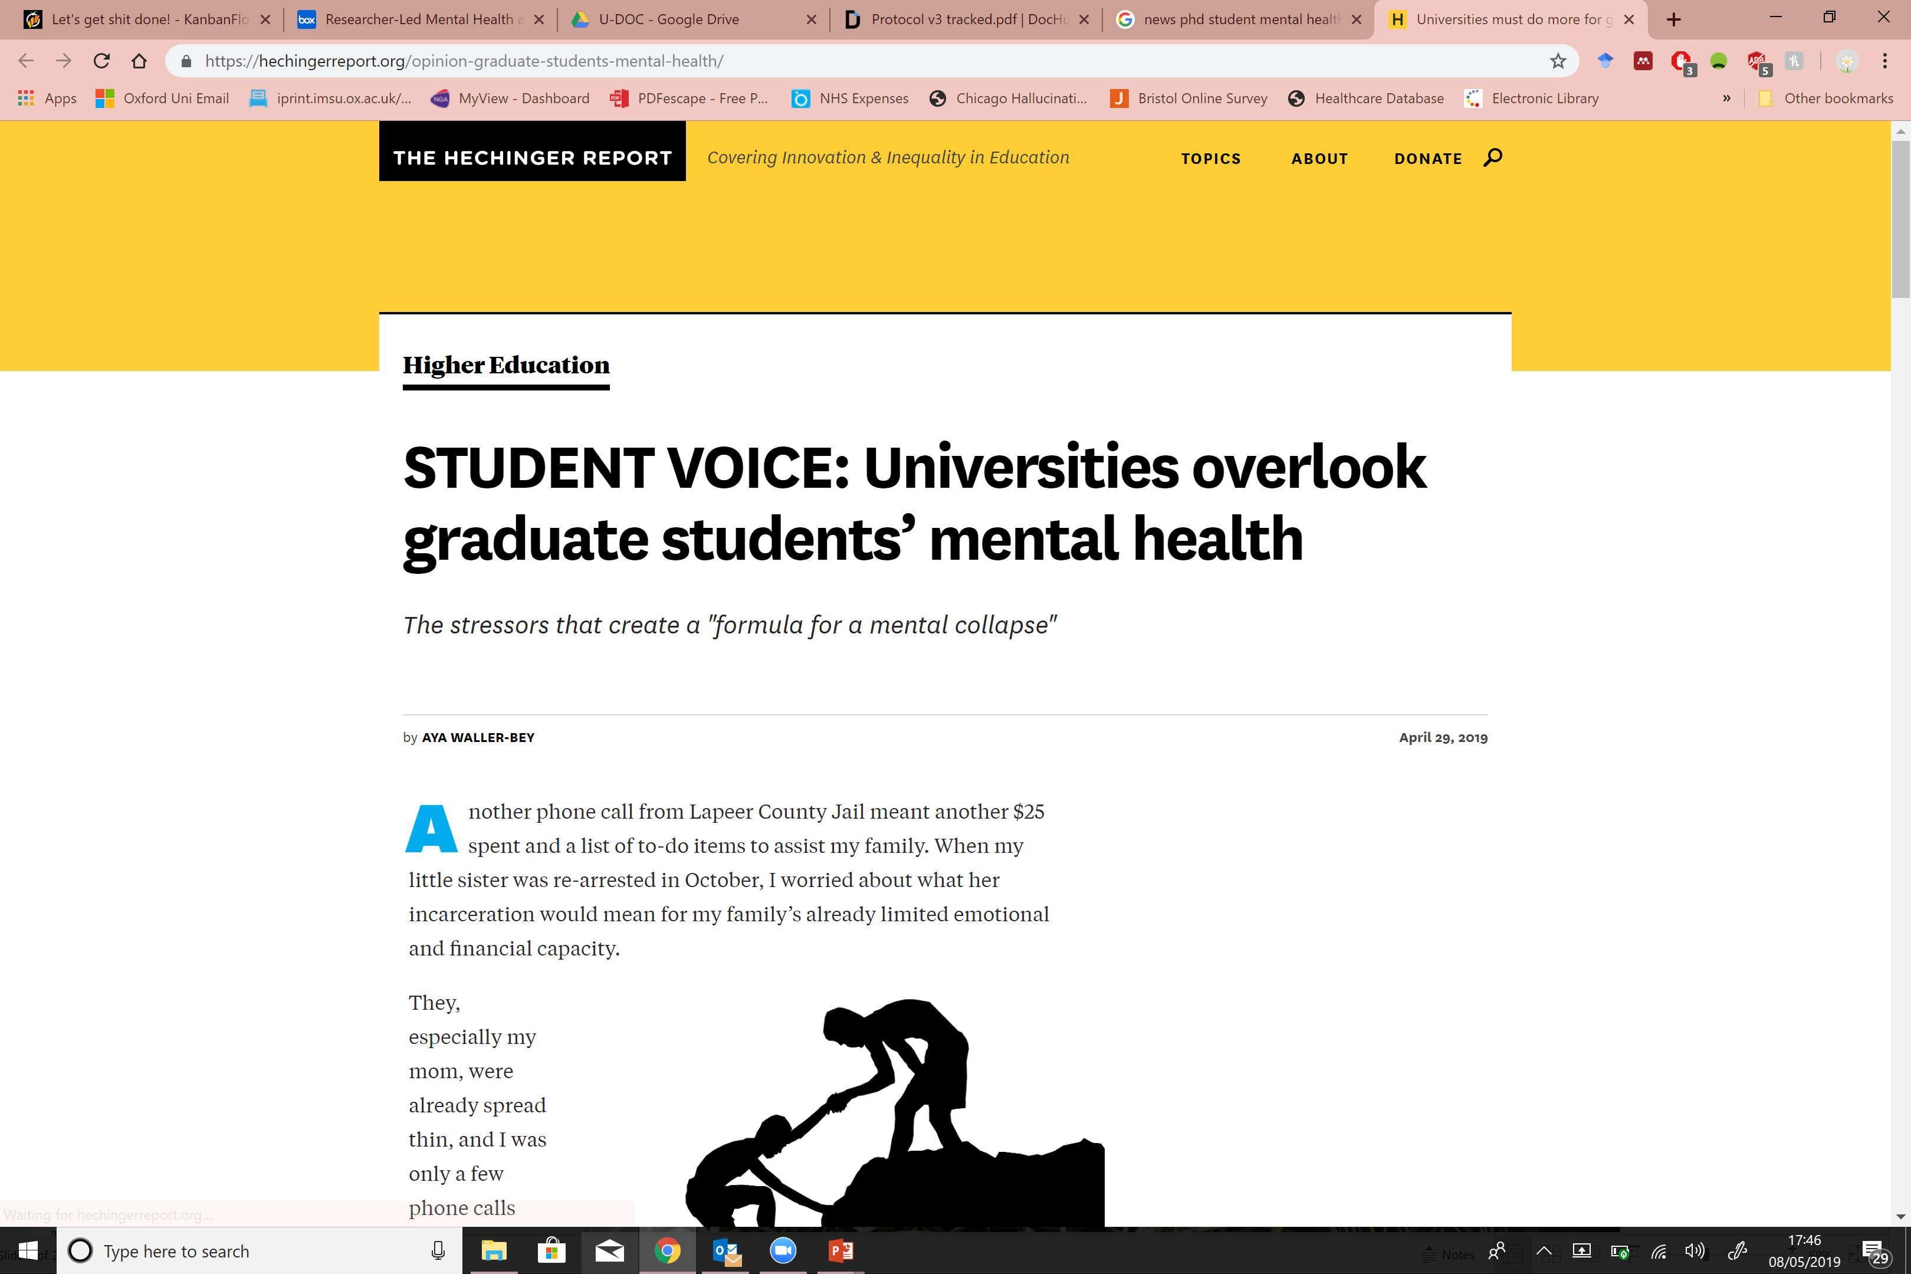
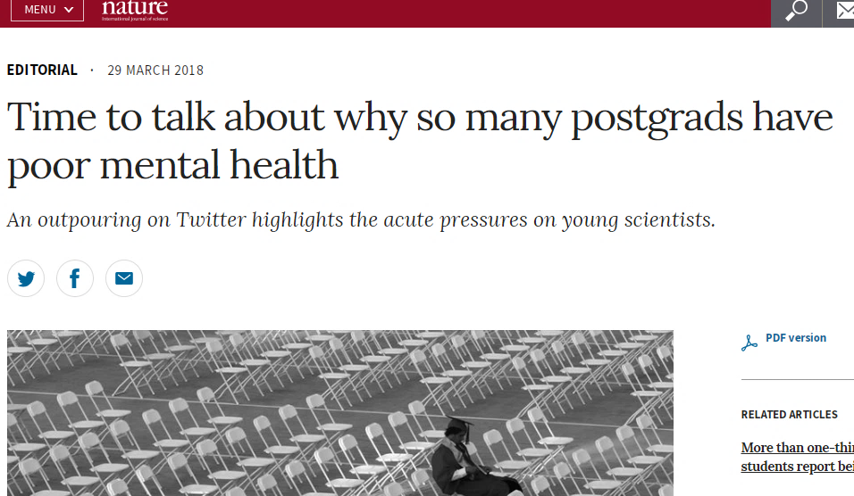
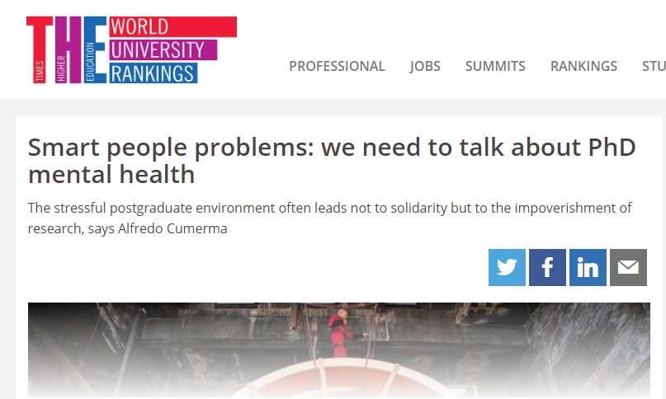
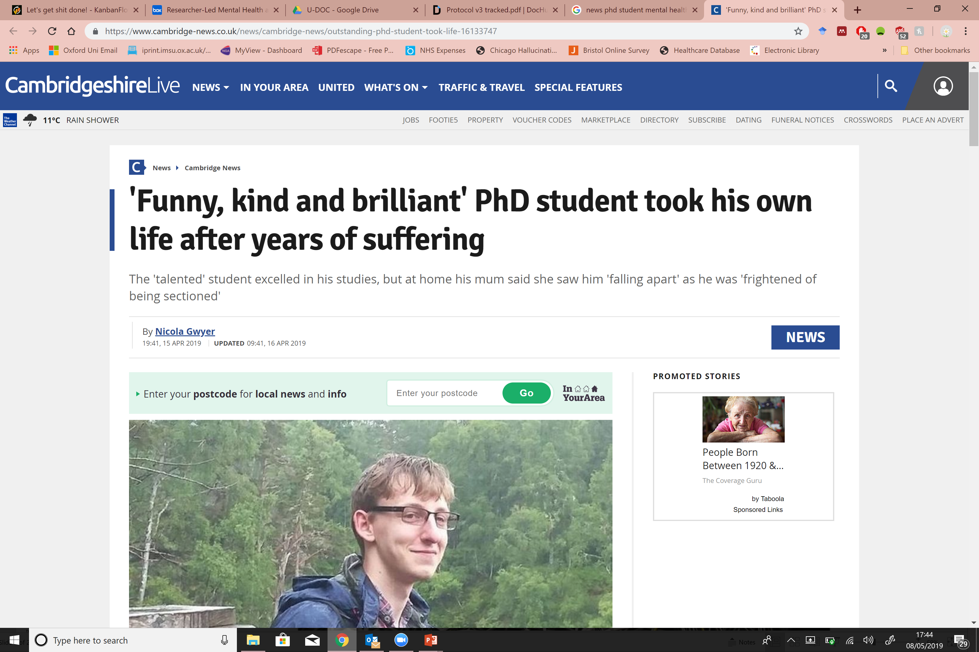
Notes:
Psycho-social picture in the UK

Slide 17

Practice recommendations: Socio-Psychology Support
The challenge of a tacit culture
Are counselling services needed for international students?
Does more recognition need to be given to the personal circumstances of international students (e.g. family)?
Holistic support?

Slide 18

CHEER Website: www.sussex.ac.uk/education/cheer
Twitter:
@SussexCHEER
Facebook: www.facebook.com/groups/CHEERSussex/
Follow Up?
Higher Education, Knowledge Exchange and Policy Learning in the Asian Century
A UK/Japanese Partnership
(http://www.sussex.ac.uk/education/cheer/researchprojects/japan)
Centre for Higher Education and
Equity Research (CHEER)

