Slide 1

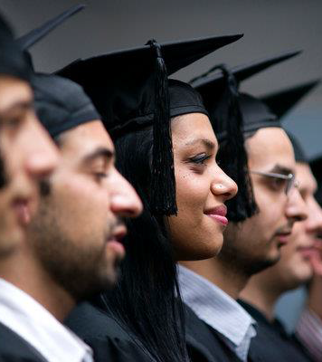
Internationalisation in Higher Education:
Theorising Equity and Exclusions
Diversity, Democratisation and Difference: Theories and Methodologies
Professor Louise Morley
Professor John Pryor
Centre for Higher
Education and Equity
Research (CHEER)
University of Sussex, UK
www.sussex.ac.uk/education/cheer

Slide 2
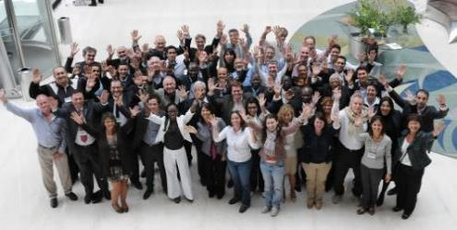
Desirable Capital for Institutions and Individuals
What are the dominant discourses that are informing visions of the future of higher education in relation to internationalisation?
How does internationalisation interact with current and emerging structures of inequality?

Slide 3

Conceptualising Internationalisation:
A Polyvalent Discourse
Multiple Ideologies (Stier 2004)
Idealism
Instrumentalism
Educationalism
Linked to
Economic growth
Prosperity
Sustainability (Bone, 2008)
Promotes (De Wit et al, 2015)
Employability/ intercultural competencies
Innovation
Marketability
Transnational coalitions and networks
Influence/ Soft Power
Disrupts
Borders
Boundaries
Intellectual Parochialism/ Traditional Geographies of Knowledge

Slide 4
Designer Immigrants
(Hawthorne 2012)
Today’s Europe is built on the four freedoms of goods, services, capital and people. The knowledge society of tomorrow needs the freedom, the freedom of movement of knowledge
(The EU Commissioner, Janez Potocˇnik in Global Higher Education, 2008: 1).
The romance of movement and mobility ought to be the first clue that this is something we ought to be particularly curious about.
(Robertson, 2010: 646)

Slide 5
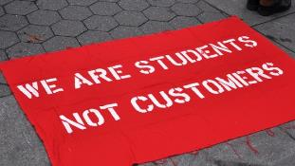
Provocations
Internationalisation Presented as:
Ideologically neutral
Coherent
Disembodied
Knowledge-driven, rational (post-human) policy intervention.
Consonant with Neoliberalism:
Knowledge - internationalisation and commodification (Ball, 2012)
International = wider market
Increased competition - winners and losers where ‘questions of social justice have mutated into economic facts’ (Oksala, 2014:128)
Educational Benefits Mask:
Commercial opportunities
Financial, ethical and social implications
Affective and Embodied Implications
Mobility:
Facilitates Internationalisation
Empowerment of some
Inaudibility of others (Sheller & Urry, 2006).

Slide 6
Materialities of Internationalisation
Migrant Academics
Precarity
Hidden injuries e.g. short-term contracts or second-class citizenship (Hoffman et al, 2014).
Dis-location and Displacement, Otherness (Kim, 2010).
Stranger Danger (Ahmed, 2000).
Talent, Knowledge under-utilised / unrecognised (ECU, 2013).
More likely to be those without care responsibilities (Lynch, 2009).
International Students
Survey of 1,300+ institutions
biggest institutional risk = it primarily benefits wealthier students
significant societal risk = growing commercialisation of higher education (IAU, 2014).
Network analysis - flows of international students become more unequal and centralised (Shields, 2013).

Slide 7
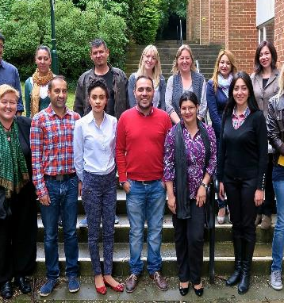
HEIM Project
(Higher Education, Internationalisation and Mobility: Inclusion, Equalities and Innovations)
CHEER, University of Sussex/Horizon 2020 Marie Sklodowska-Curie Actions
Partners
Universidad de Sevilla, Spain
Umeå University, Sweden
Roma Education Fund, Hungary
6 Work Packages:
Internationalisation with Equity and Diversity
Training Module on Reflexive Internationalisation
Network of Roma Early Stage Researchers
Supporting Roma Students in Higher Education
Researching Marginalised Minorities in Higher Education institutions: Policies and Practice
Research Methodologies Training for Equality and Diversity
www.sussex.ac.uk/education/cheer/heim

Slide 8


Affective Economy of Internationalisation
Loss of Community
No one in the university cares about you in here, you’re just, you’re a foreign student…Everybody’s going home after and you’re going home, and you’re alone at home. (Female Roma PhD international student)
Exoticisation
There is this kind of stereotype, that Roma are so exotic and they have all this sex and they are travelling everywhere… I think the travelling is because they just don't want to connect with the others… they don't want to connect with others because they don't want to face problems. They don't want to face knowing that they are different to the others. And that's why they don't want to connect with the majority (Male PhD international student)
International Exclusions
We have a friend, and she said how can this stupid gypsy guy … work in academia…I think that he is making sex for the positions! …
(Male PhD international student)

Slide 9
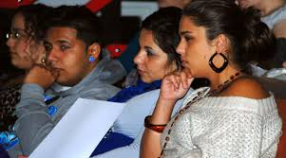
Affective Economy of Internationalisation
Stress
I’m presenting in English, in a conference …and there are 100s in the audience and I’m speaking not in my native language but in English... It was really stressful (Female International Policymaker).
New Freedoms
Until university, I had many girlfriends, and the first expression that I had relations with guys, I had to find at university (Male PhD international student)
Being ‘Othered’/ Disqualified as a Knower
I had a professor and she was never patient to teach me English. So she was working just with my colleagues when it came my turn read or listen, or say something in English, she will say ‘next, next’ (Female Roma PhD international student)

Slide 10
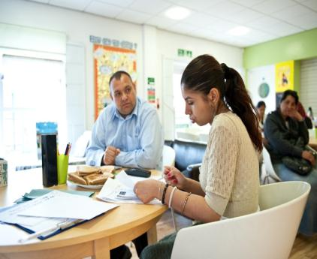
Summary: Internationalisation…
Form of academic capital in the knowledge economy
Discursive and material performances
Promotes fluidity/ mobility of people, objects, information and ideas
Involves Nomadic place-making
Upholds social closure/ hierarchies
Conversely/ contradictorily- Provides openings for excluded groups
Mobilities involve fragile, aged, gendered, racialized bodies (Büscher & Urry 2009).
Presented as a rational (post-human) policy process
Assemblage of Entanglements/ Co-productions
Intensely embodied and affective process.

Slide 11
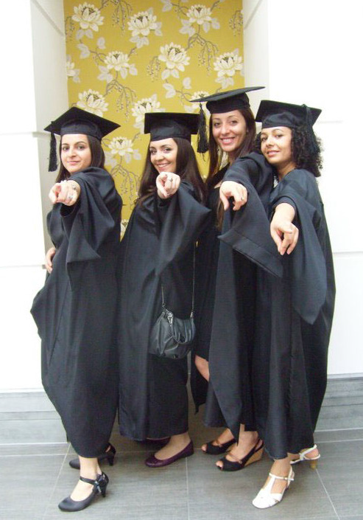
Follow Up
www.sussex.ac.uk/education/cheer/heim

