Slide 1
Hidden narratives of international doctoral students in Japan: How are Japanese government’s internationalisation policy initiatives being experienced at the micro level?
CENTRE FOR HIGHER EDUCATION AND EQUITY RESEARCH
Paul Roberts, EdD Candidate

Slide 2
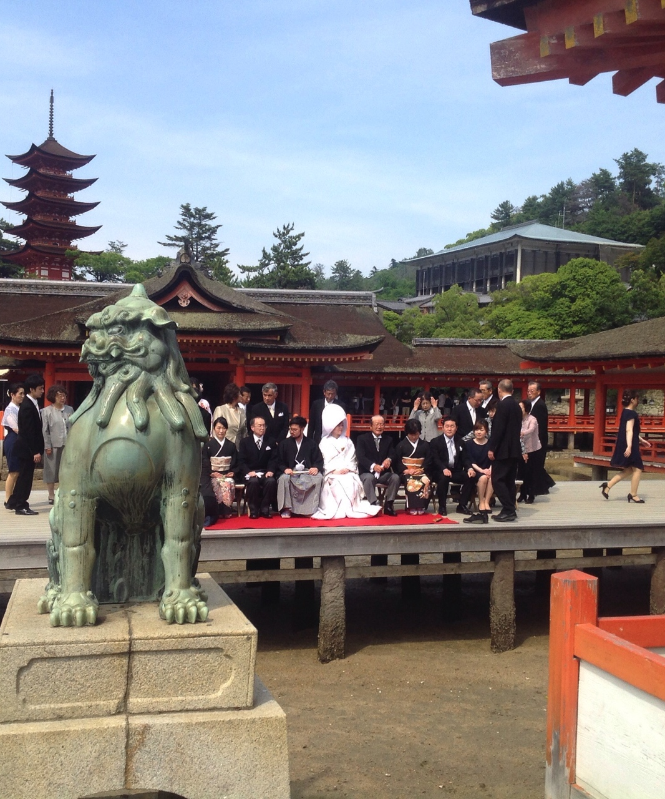
Higher Education, Knowledge Exchange and Policy Learning in the Asian Century: A UK/Japanese Partnership
Interview data gathered in 2 private and 6 national universities in Japan with 13 doctoral researchers (5 women and 8 men).
All participants met UN definition of migrants – persons who have lived outside their country of birth for 12 months or more (Castles & Miller, 2009).
The doctoral researchers came from Bangladesh, China, Ghana, Nepal (2), Philippines, South Korea, Syria, Taiwan, USA (2) and Vietnam.
Disciplinary mix included: 5 Scientists; 6 Social Scientists; 2 Arts & Humanities researchers.
Notes:
All interviews were conducted in English.
The sample was selected through personal and professional networking paying attention to gender, ethnicity, countries of origin and type of institution.
Castles, S., & Miller, M. J. (2009). The age of migration. International population movements in the modern world (4th ed.). New York: Palgrave Macmillan.

Slide 3
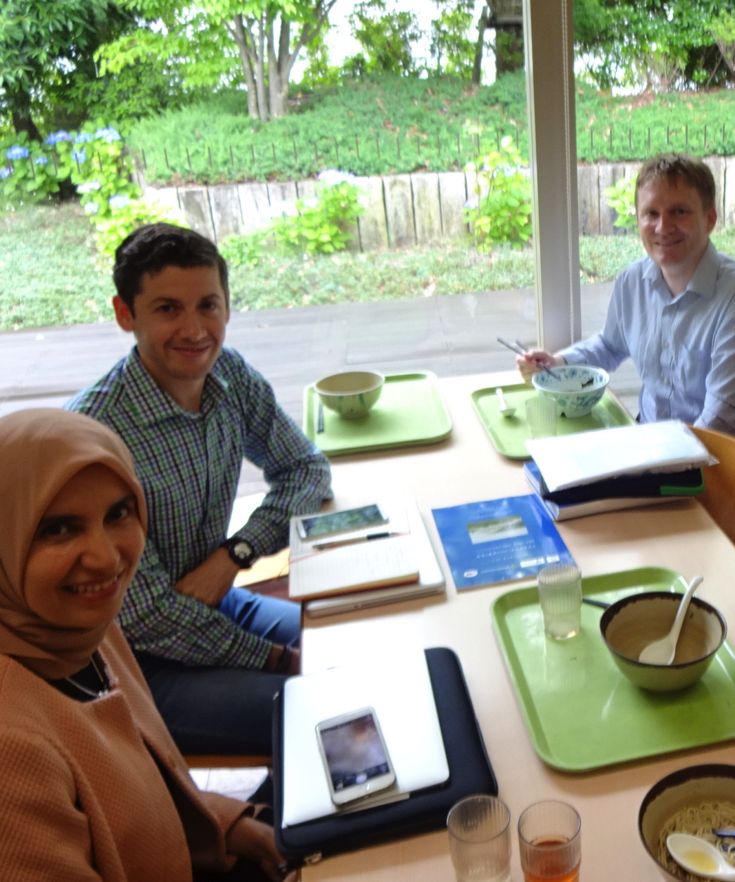
The questions and the construction?
Motivations and drivers for studying a doctorate in Japan; experiences to date; identity and mobility; and support and preparation.
Who is the Ideal International Doctoral Scholar for Japan?
‘Be(com)ing a reflexive researcher’ (Attia & Edge, 2017)….’the ways in which one may affect and be affected’ (Cole & Masny, 2012)
Meaning is fluid, rejection ‘absolute truth’.
Notes:
Cole, D. R., & Masny, D. (2012). Education and the politics of becoming. Discourse: Studies in the
Cultural Politics of Education, 33(1), 1–3.
Attia, M. & Edge, J. (2017) Be(com)ing a reflexive researcher: a
developmental approach to research methodology, Open Review of Educational Research, 4:1,
33-45, DOI: 10.1080/23265507.2017.1300068

Slide 4


Policy aims…
Knowledge for the knowledge economy
Drive to attract human capital – 4th Science and Technology Basic Plan, 2011-15
Japan Doctoral Human Resource Profiling survey (JD-Pro)
Japan needs more gurobaru jinzai (global talent)
Implications for higher education
Higher education positioned as a service industry for the labour market
Challenge to incorporate (policy compliance)
Competition

Slide 5
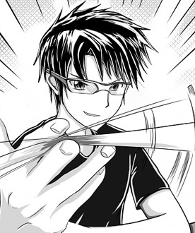
Motivations for Migration
Cultural exports ‘So I liked Nintendo games as a child, like Legend of the Mystical Ninja’ ; ‘Japanese pop culture animation’
Facilities (Science students) ‘many sophisticated instruments for my research’
‘A strong research culture’
Access to scholarship funding
Professional or economic opportunities
Personal relationships

Slide 6
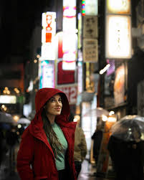
Experiences
Polite, generously polite
Safe
Professional
Hardworking
Keep promises
Trains on time
Notes:
‘It’s nice here. It’s safe, it’s clean.‘
‘I can go anytime from the lab at night. 11 o’clock, 12 o’clock, no problem. But in my country, it’s… At night maybe, some robbery or something.’

Slide 7

Experiences
Role of Sensei – ‘we cannot go over the line you have to follow the target’; ‘After six months my professor said my research is more important, so I should stop the Japanese classes and concentrate on my research. ‘
Hegemony of English - ‘So, in my research no need for Japanese and for communication with Professor, no need for Japanese…I did not learn Japanese.’; ‘With my Professor I only speak with English’; ‘Little Bubble cultures’.
Acceptable inclusion - without significant disruption (Otta, 2018). Role of international centres – holistic support (e.g. ‘doctor visit’, general bureaucracy).
Notes:
‘So much depends on the teacher. That time I had a very depressed life‘; ‘they are the boss and we are the employee’
Lack of confidentiality - I talk to her some private problems but I was very disappointed that many people knew my problems. I felt very, very disappointed. That’s why I don’t want to say anything to them, I don’t trust them.
Science PhDs and the challenge of becoming an independent researcher.
‘they follow the book that they just follow a process they have learned and they just do as hard as they can of work. But they do not have this kind of creativity in research.’
Negative perception of being able to develop international capital by doing a PhD in Japan.
‘In my lab also, all the students are also foreigners, so we basically speak English, so not learning the Japanese wasn’t much of a problem.‘
‘I am here in an international dorm in the university and I have like all the friends here in my floor we all speak English’
‘Any kind of help you need, you just come to international student section and they just help you out.‘
‘So, you are assigned a tutor for six months to help you with everything, your medicals, your documents, your travel.’ (tutors – sometimes later stage international PhD students).

Slide 8
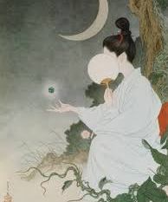
Experiences
Place – international cities offering ex-pat networks helping with cultural norms.
Alienation – ‘we can feel we are from outside, we are outsider and maybe they did not accept us’; ‘it’s just an air of passive aggressive nature towards you’; ‘even though I’ve spent here for six years, I don’t think I have a Japanese friend, one, single friend.’; Nobody talks to you first.’
Reticence – ‘some of them …are too embarrassed to speak in English. They know how to read and how to write…they just don’t have the skill of talking.’
Notes:
many, many international students are suffering from cultural differences
If you don’t know the language, it’s very difficult to live everyday life.
‘When I was in another lab I stayed there for two and a half years, but no students talked. Just greetings. If we saw… Just konichiwa, hello, then finished. We never talked.’
‘living here is very quiet, lonely, people are very closed’
‘Some people I know they speak English well. Even some professors can speak English very well but they don’t speak English to students and I think that is unfair’
‘They are very polite and always give you very nice words but sometimes I think it is different from what they think.’

Slide 9
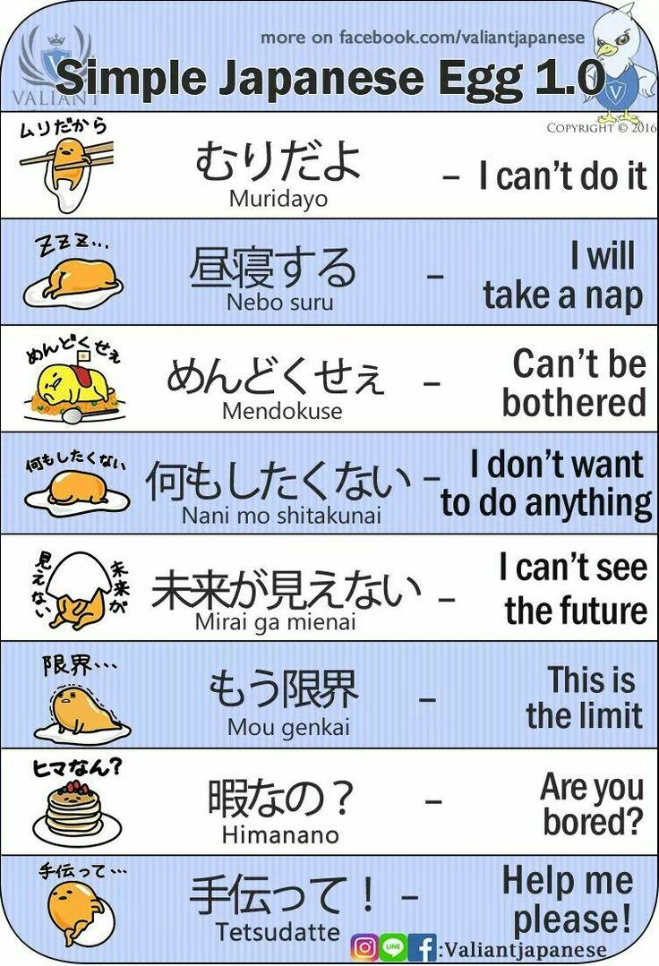
Thriving
Learn Japanese – ‘two years’; ‘the language is really very important’
Adapting and new perspectives - ‘Adaptable, number one. Just someone who is flexible with their identity, and flexible with their living arrangements.’; ‘you need to find a way to adapt’; ‘it opens up so many different perspectives’
Supervisory relationship – ‘my supervisor is to be very huge advantage that I can get here‘
Notes:
‘they follow the book that they just follow a process they have learned and they just do as hard as they can of work. But they do not have this kind of creativity in research.’

Slide 10
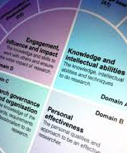
Support and Training
Language - ‘The university here actually offers for the international students and researchers free language courses’
Financial – scholarships and conferences.
Social – ‘So, because of social media, or Facebook, you can easily socialise and also go places. But it doesn’t require a lot of Japanese, because the teacher responsible also speaks very good English’
Notes:
UK industry of Researcher Development
However, the language offer was ‘only about how to express yourself, how to express your needs and how to do basic conversations’ → not academic language.

Slide 11
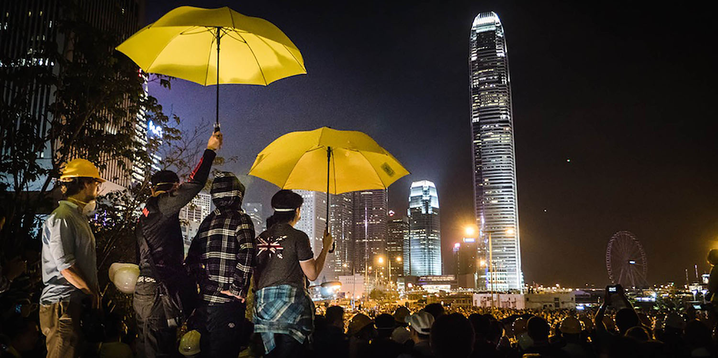
Becoming gurobaru jinzai
Language barrier – leaving highly-skilled doctoral students often only able to gain employment as unskilled workers (Osaki, 2017)
Questioned whether institutions were fully committed to supporting the policy aim of retaining doctoral students in the Japanese economy?
Those planning to stay, were seeking to stay in academia.
“I want to try English-speaking country. I have more fun.’
Notes:
Only one considering possibly working for a US firm based in Japan.
Others – PhD requirement of role back in home country.

Slide 12

Doctoral mobility & gender
Representation – Impact on myself as a researcher.
Harrassment – ’my university had to do something for me because I have enough evidence, you know, he send messages to me, phone call, he came to my hotel and there are many, many things. They said you have enough evidence to report him and we can help you to get scholarship back but they didn’t do anything. They promised but they didn’t do.’
Friendships - ’She is married to an international man, so she understands the pain’
Following – ’My number one consideration was my boyfriend’; ’I came to Japan, because he chose Japan as his destination.’

Slide 13
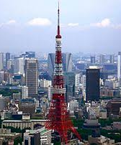
Next steps…
To write a Journal Paper by 31 December.
WERA Focal Meeting 5-8th August 2019 at the University of Tokyo Japan.
Complete Higher Education, Knowledge Exchange and Policy Learning in the Asian Century: A UK / Japanese Partnership
http://www.sussex.ac.uk/education/cheer/researchprojects/japan

Slide 14

CHEER Website: www.sussex.ac.uk/education/cheer
Twitter:
@SussexCHEER
Facebook: www.facebook.com/groups/CHEERSussex/
Follow Up?
Higher Education, Knowledge Exchange and Policy Learning in the Asian Century
A UK/Japanese Partnership
(http://www.sussex.ac.uk/education/cheer/researchprojects/japan)
Centre for Higher Education and
Equity Research (CHEER)

