Slide 1
Retiring Subjectivities: The Affective Load of un/becoming
Shedding, Shredding or Recalibrating?
CENTRE FOR HIGHER EDUCATION AND EQUITY RESEARCH
Emerita Professor Valerie Hey

Slide 2
The Argument: Messy Beginnings,
Contradictory Careers, Complex ‘Exits’
Entry into The Academy : generation 80’s feminism & women’s studies – sociality of opportunity
For working class and other non-dominant groups – inequities marked the struggle to enter and then sustain a career
‘Passing’ ; ‘imposter syndrome’; casualised ; workaholism ; ‘making it’? ; feminization of service work
Un/`becoming – “Ex’ Working class women do not have equivalent access to alternative extra-institutional discourse communities – ‘letting go?’

Slide 3
The Romance of Retirement?
Scripts and prescriptions : ‘Affluent networked subject‘:
The hedonist happy decamper? Travel
The puritan re-purposer – moral good works, or new ‘skills and challenges’ for e.g. Proust, or other l…..............ong serious novels’
BUT
Ambivalent realities and challenges

Slide 4
Ambiguities and Inorganic Intellectuals
Time to think ! ‘The absence from necessity’ (Bourdieu, 1984).
Time to play ! But thinning of access to resources viz.
Discursive deprivation? Or not everyone knows or cares who Judith Butler is!
Yet :
The imperative of necessity! Contingent utterances – interventions

Slide 5
2016 General Election
`Politics of provocation’ – against right-wing populism ( Brexit, Trump, Farage) on main media, (TV. radio and most English newspapers)
Crypto-fascist norms mainstreamed
Facebook’s ambiguous utility – (as above BUT) Liberal - Left organic intellectuals & digital newsfeeds as animated alternative perspectives
Educational work influencing younger women - re-purposing – feminist commentary

Slide 6
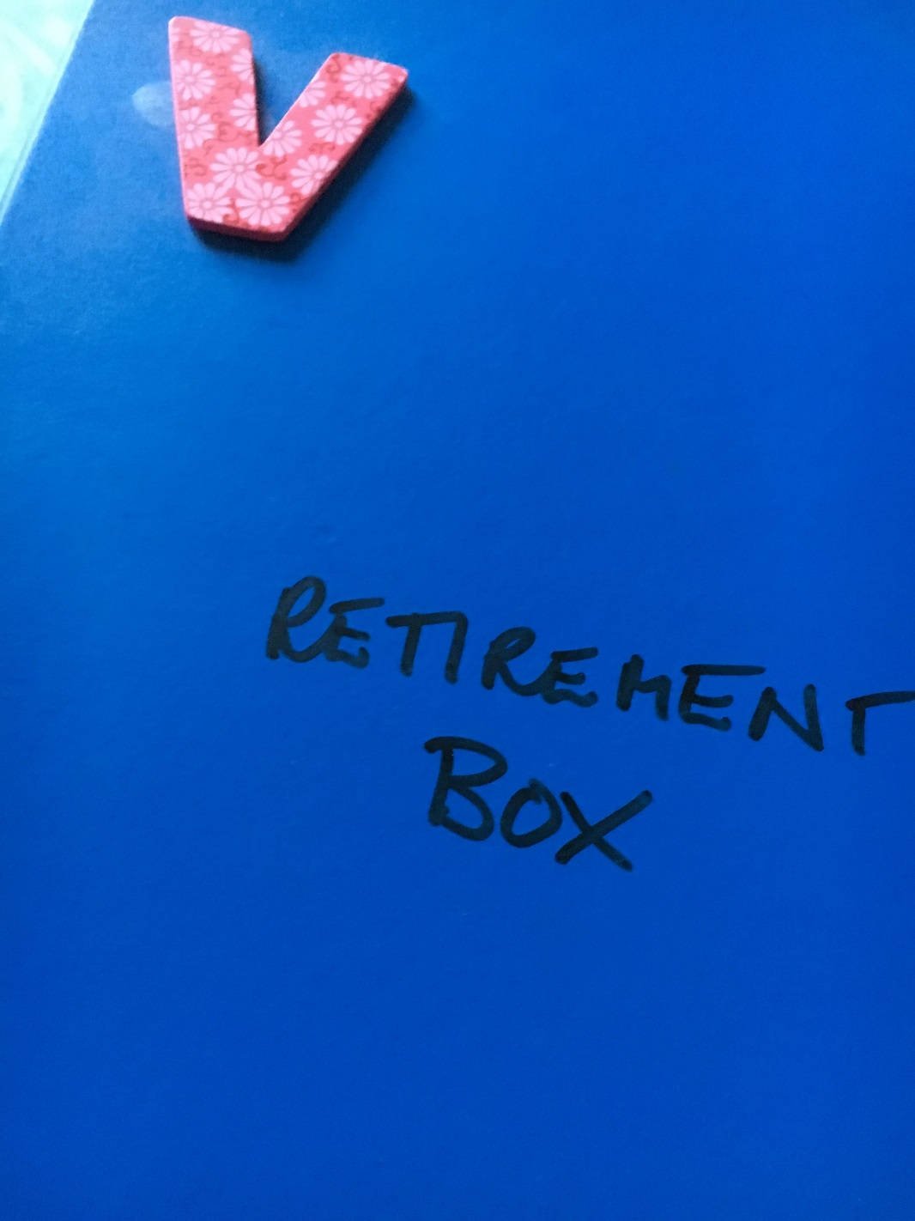
What is Work and Retirement For?
Refresh and complicate institutional policies
Need for attention to emotional aspect (of leaving) paid work
University’s relationship to its former staff? A cliff edge or soft/exit?
Socially useful feminist academics?

Slide 7
Final Thoughts
Consider the meaning of work in terms of identity, purpose & the wider public good
Question why we accept the normative division of ‘good’ and ‘bad’ jobs
Question HE’s complicity in reproducing this neo-liberal norm.

