Slide 1

Higher Education Internationalisation and Mobility - Inclusions, Equalities and Innovations (HEIM)
Diversity, Democratisation and Difference: Theories and Methodologies
Marie Skłodowska-Curie Action
Research and Innovation Staff Exchange (RISE)
www.sussex.ac.uk/education/cheer

Slide 2
University of Seville, Spain
Umeå University, Sweden
University of Sussex, UK
Higher Education Internationalisation and Mobility - Inclusions, Equalities and Innovations (HEIM)
Roma Education Fund, Budapest Hungary

Slide 3

Aims
Apply principles of equity and inclusion to internationalization strategies and programmes in higher education.
Develop research and innovation capacity.
Focus on the Roma community in Europe as a critical example of a marginalised group at both staff and student levels.

Slide 4
HEIM Work Packages
Work Package |  | Main Activity | Person months | Timing
1 | Internationalisation with Equity and Diversity? | Research | 4 | Oct – Nov 2017
2 | Debating and Designing a module to encourage reflexive accounts of internationalisation | Training | 3 | Sep – Oct 2016
3 | Network of Roma Early Stage Researchers | Communication | 7 | May – Jun 2016
4 | Supporting Roma Students in Higher Education | Training | 6 | Mar – Apr 2015
5 | Researching Marginalised Minorities in Higher Education Institutions: Policies and Practice | Research | 6 | Sep –Nov 2015
6 | Research Methodologies Training for Equality and Diversity | Training | 20 | Jun – Nov 2015

Slide 5
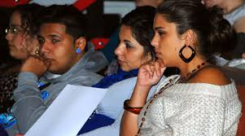
Key Questions
What are the policies, strategies and innovations for internationalisation in the partner
institutions and countries?
Who is/is not participating in internationalisation opportunities eg. marginalised
communities in Europe such as the Roma?
Where are different groups of people going and why?
How do lived experiences of internationalisation compare with policy aspirations and implementation?
What are the different networks and their practices which sanction emergent or substantive border crossings e.g. who is a preferred partner/mobile subject?
What values shape the border crossings eg. economic, social, pragmatic?
What are the significant dilemmas of internationalisation, eg. affective/sustainability issues involved in mobility?
What methodologies have been employed to research and evaluate internationalisation programmes?
What innovations exist to promote and support inclusive internationalisation?

Slide 6
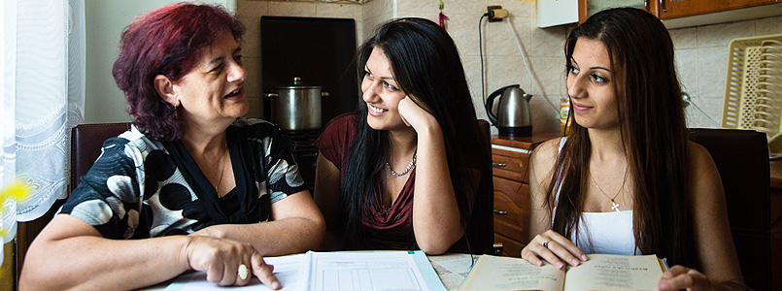
Deliverables
Training materials/Guidelines of reflexive and inclusive internationalisation
Journal articles
Policy papers
Country-specific briefing papers on Roma access to higher education
A web/resource base
Research training programme for Roma researchers
Dissemination and impact events

Slide 7
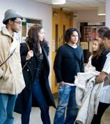
Project Team
CHEER, University of Sussex
Professor Louise Morley: Principal Investigator
Dr Barbara Crossouard
Dr Tamsin Hinton-Smith
Dr Alison Phipps
Professor John Pryor
Early Stage Researchers
Emily Danvers
Tanja Jovanovic
Kourosh Kouchakpour
Caterina Mazzilli
Paul Roberts
Universidad de Sevilla
Dr Mayte Padilla Carmona
Dr José González-Monteagudo
Early Stage Researcher
Alejandro Soria
Umeå University
• Professor Nafsika Alexiadou
Early Stage Researcher
• Anders Norberg
Roma Education Fund
• Judit Szira
•Dr Stela Garaz

Slide 8

Value of Project
Partnerships
Knowledge Creation/ Exchange
Capacity building
Co- authorship across levels cultures, sectors
Cross fertilization of academic and NGO perspectives on topic
Lead-in to further work
Impact and Change

Slide 9
www.sussex.ac.uk/education/cheer/heim

