Slide 1
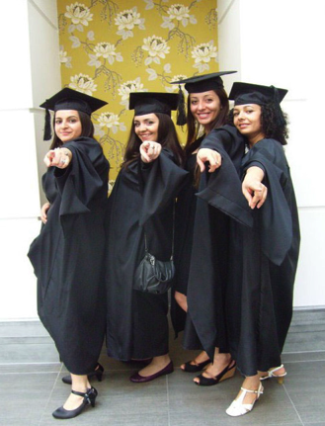
Higher Education Internationalisation and Mobility (HEIM) Project: Experts’ Meeting
Introduction
Professor Louise Morley
Director, Centre for Higher Education and Equity Research (CHEER), University of Sussex, UK

Slide 2
Why the HEIM Project?
GRT in policy and research = in relation to compulsory education (EHRC Report, 2016; EU, 2016).
National strategies for widening participation in higher education often exclude specific consideration of GRT communities.
Lack of research/scholarship/ knowledge on the GRT in higher education.
Disaggregated data on the Gypsies, Roma and Travellers and Higher Education unevenly collected/ disseminated across Europe.

Slide 3
UK
2015-16: Proportion of Gypsies and Travellers who were students in higher education was approximately 11 times lower than the whole population.
Office for Fair Access (OFFA) requires education institutions to consider targeting additional groups in their Access Agreements such as ‘students from Gypsy and Traveller communities’ who are ‘currently under-represented and/or disadvantaged in higher education at a national level’. (OFFA, 2016:13).
Categorisation challenges in the UK/disclosure in national census data, GT = white.

Slide 4

UK
The Equality Act (2010)
Romany Gypsies and Irish Travellers recognised ethnic groups with legal protections from discrimination.
NGOs/ Advocacy Groups e.g.
Friends, Families and Travellers
Gypsy Council
UK Roma Support Group
Advisory Council for the Education of Romany and Other Travellers
Sussex Travellers and Gypsies
Policy Activity
Cross Ministerial Working Group on Gypsy and Traveller Inequalities (CMWG).
UK House of Commons Women and Equalities Committee inquiry into ‘Tackling inequalities faced by Gypsy, Roma and Traveller Communities’.

Slide 5

What Value is HEIM Adding?
Policy Learning/ Knowledge Exchange across diverse constituencies:
Academic/ NGOs/ Policymakers
Central & Eastern Europe/ Western/Northern Europe
Experienced and Early Stage Researchers
Co-ordinating/ Creating Knowledge on GRT in Higher Education.

Slide 6
What HEIM is Doing?
Examining GRT access to higher education in Spain, Sweden and the UK.
Analysing European, National, Organisational Policy Frameworks/ Solutions that regulate the access of Roma young people to education.
Training professionals working with Roma communities in CEE in research methodologies for equity, diversity and social inclusion.
Producing a film Gypsy, Roma and Traveller (GTR) Communities in Higher Education.
Interviewing GRT academics and doctoral researchers about their experiences of higher education internationalisation.
Developing a Social Media Network to support GRT researchers and students in higher education.
Providing a Training Module on Internationalisation.
Publishing, Disseminating, Networking and Promoting Impact from the findings.

Slide 7
University of Seville, Spain
Umeå University, Sweden
University of Sussex, UK
Higher Education Internationalisation and Mobility - Inclusions, Equalities and Innovations (HEIM)
Roma Education Fund, Budapest Hungary

Slide 8
Good Practices
Policy
EU Framework for National Roma Integration Strategies (to 2020)
(education, employment, healthcare and housing).
Roma Decade of Inclusion (2005-2015).
Affirmative Action policies support Roma students to access higher education (access, bursaries, mentoring)
Central European University’s Access Programmes
Roma Education Fund’s Scholarships
Roma International Scholarship Scheme (RISP)
Transparent and accessible information/ support for higher education opportunities
Romaversitas
Promotes and encourages Roma access to higher education/ strengthens social relationships
between Roma and non-Roma students in order to remove prejudices and stereotypes within society.

Slide 9
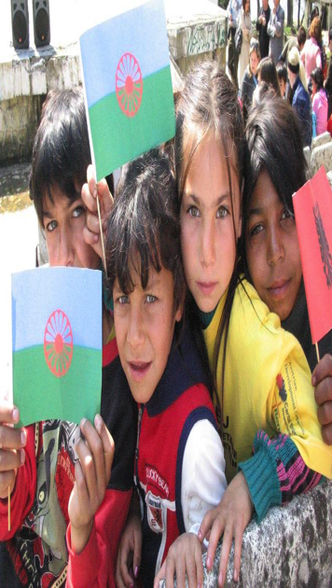
The Future?
Disaggregated Statistics
Analysis
Support Programmes
Co-ordination of Networks, Research, Resources, Interventions.
Inclusion of GRT communities
in Higher Education Policies
and Practices.

Slide 10
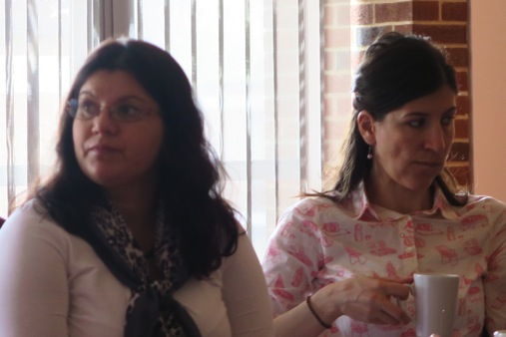
HEIM Impact
What main messages did you hear today?
How do you intend to apply them to your professional practices?

Slide 11
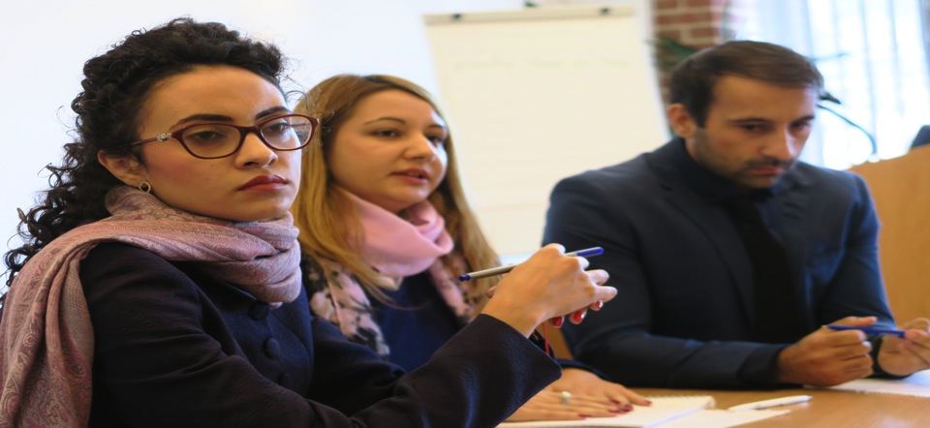
HEIM Website http://www.sussex.ac.uk/education/cheer/researchprojects/rise.

