Slide 1
Graduate School Managers: Affective Lives in the Neoliberal University
CENTRE FOR HIGHER EDUCATION AND EQUITY RESEARCH
Paul Roberts, University of Sussex

Slide 2

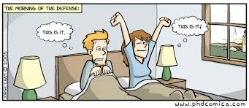
The UK Doctorate: Policy, Power and Professionals in the Neoliberal University
A thesis based on interviews with eight individuals who served as Graduate School Managers (combined service 42 years) in eleven different UK institutions (eight Pre-1992 institutions and three Post-1992 institutions).
Data collected over a period of six months starting in August 2016.
Sample predominantly female (87.5%), ages of 25-44 (62%) and ‘British White’ (75%).

Slide 3
Graduate School Managers: Affective Lives in the Neoliberal University
CENTRE FOR HIGHER EDUCATION AND EQUITY RESEARCH
Neoliberal University?
Graduate School Managers?
Affective lives?
Questions?

Slide 4
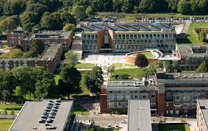


The neoliberal university = an institution subject to neoliberal reason.
Neoliberal reason is not static but imbibed with a fluidity that allows it to adapt.
‘All conduct is economic conduct; all spheres of existence are framed and measured by economic terms and metrics, even when those spheres are not directly monetized’ (Brown, 2015:10)
FINANCIALISATION
MARKETISATION
METRIFICATION
AUDIT CULTURE

Slide 5
Neoliberal reason → Graduate School Managers
Discussions about the neoliberal university tend to focus on the ‘macro-processes’ (e.g. Olssen & Peters, 2007; Holmwood, 2014).
The gaze tends to fix on the ascendancy of neoliberal reason, and its associated discourses, and the consequences for: government policy; higher education as a sector; and individual higher education institutions.
By contrast, there has been little consideration given to everyday affective experiences especially those of professional services members of staff such as Graduate School Managers.

Slide 6
Who are Graduate School Managers?
Professional Services Managers
Middle Managers, ‘unsung professionals in the academy yet they interact and participate with students, faculty members and the public and reflect the institutions overall spirit and vitality’ (Rosser, 2004:317).
Graduate School Manager roles, new senior professional services posts created to:
  Ensure successful doctoral completion;
  Evidencing quality (e.g. meeting audit process of the Quality Assurance Agency for Higher Education or UK Research Councils);
  Grow student numbers, especially grant funded students and international students.
Vice-Chancellors/Presidents/Chief Executives
https://www.tandfonline.com/doi/full/10.1080/07294360.2020.1841741
University Leadership Teams
Academic
Managers
Professional Services
Managers

Slide 7
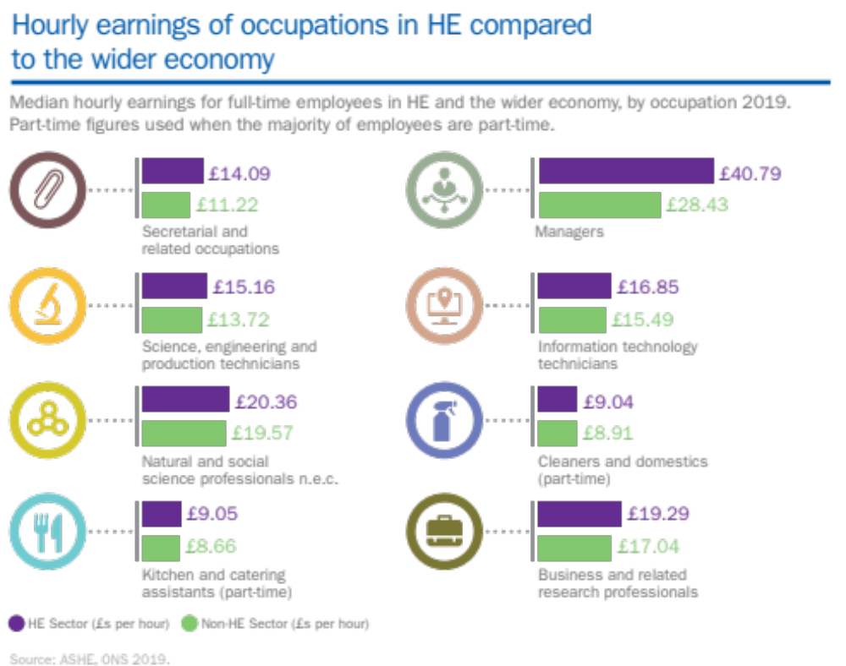
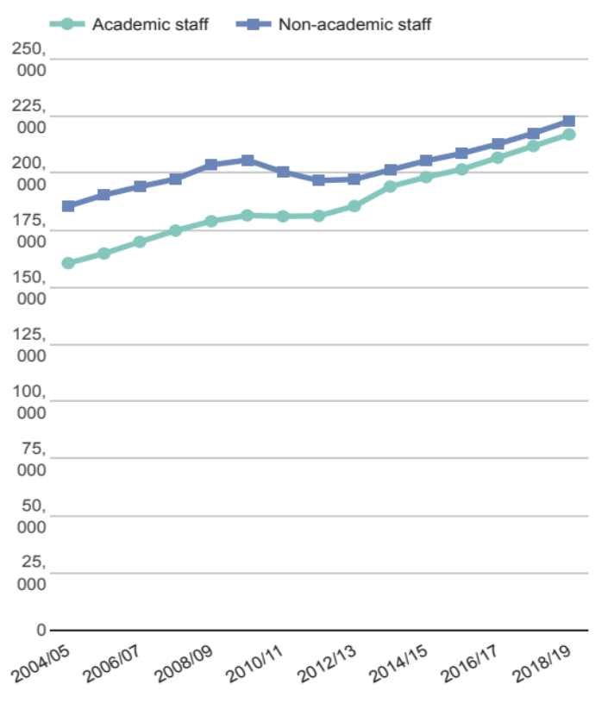
Graduate School Managers as metrics
In 2016-17, Graduate School Manager posts ranged from £38,183 - £55,998

Slide 8
Graduate School Managers
Positioned as leadership roles expected to deliver transformational change/radical improvement to doctoral education.
Implicit assumption that such appointees would possess the personal agency to act as ‘change-agents’.
A cadre of ‘change-orientated administrators’, which Clark (2004: 176) argues are key ingredient for the success of the entrepreneurial or neoliberal university
A wider process of professionalisation of staff in higher education administration. (Gornitzka and Larsen, 2004). Providing:
  Rise in formal status
  A growth in educational requirements for appointment
  Common cognitive basis (e.g. belief in managerialism)
  Growth of professional networks

Slide 9

Graduate School Managers as beneficiaries?
I have a pretty good job because it’s interesting and it’s a lot of different bits and it brings a lot of things together, and I think that’s true. It is interesting to be central and to be involved in so many different aspects of the university, and I think I made a pretty good choice in coming here. (Deborah)
So, yes it feels good to be the Graduate School Manager…I really enjoy my job and I enjoy the fact that I can make, I can help to make a difference to some of my students… So, I hang on to the fact that I’m useful, I have a purpose in this university, I have a use… I need to feel that I’m making a difference. (Heather)

Slide 10



Affective lives

Slide 11

What is affect?
More than emotions, individual psychological states or feelings.
Burkitt (2014) emotions go beyond individual feelings they are relational to others and situated in the lived experience.
Ahmed (2004) focuses on the impact of emotions (i.e. what they do rather than what they are).
It is ‘dynamic, interacting composite or assemblage of autonomic bodily responses (e.g. sweating, trembling, blushing), other body actions (approaching or avoiding), subjective feelings and other qualia, cognitive processing (e.g. perception, attention, memory, decision-making), the firing and projecting of neural circuits (e.g. from the thalamus to the cortex and the amygdala), verbal reports (from exclamations to narratives) and communicative signals such as facial expressions’. Wetherall (2012:62)

Slide 12


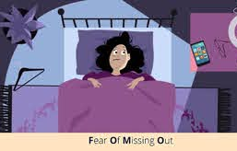
Affective economy of academia (Morley, 2018)
PRESTIGE
BESET BY CRISIS DISCOURSE
COMPETITIVE ANXIETY
A sector with an insatiable drive for distinction and differentiation
Ruins (Readings 1996)
Avalanches (Barber et al, 2013)
Tsunamis (Popenici 2014)
Crisis narrative (Baron, 2017)
Benchmarking
Metrification
Likes!

Slide 13
Affective Intensity for Graduate School Managers?
UNCERTAINTY
Future Career
Contrast to young men in a hurry (Collinson and Hearn, 2005)
SELF MAXIMISATION
Deficit human capital
‘Hyper-competitive world of higher education’ (Hey, 2004:33)
RESILIENCE
Isolation
Isolation and negative health consequences (Leigh-Hunt et al.,2017)
‘I don’t know, I suppose I’d only got as far as this. I don’t know really.’ (Annabel)
‘What am I going to do afterwards because what is there after this?’ (Deborah)
‘There is no real sort of path…anybody at a lower level than I am, I tell them if you really like Post Graduate Research then fine, but there is no career. There is no progression.’ (Heather)
‘I can see at a lower-level people who we’re hiring at the moment, quite a few are PhDs…so it is getting to that point where it’s… yes, if I want to stay in a university environment, then having a PhD would be useful. So, that’s something I’m looking at starting.’ (Deborah)
You know, I’ve only got an undergraduate degree, and I manage the PhD programme, so, I’m slightly under qualified. (Elizabeth)
‘I’ve said loads of time before, if you’re the only person in the institution doing the role, it can be quite lonely’ (Annabel)
You do feel sometimes you were just flailing around in a vacuum… you are basically left on your own. (Francis)
I think it can be a lonely and isolated and an isolating role because everything rests on your shoulders. (Heather)

Slide 14
Technologies of Self
PROFFESSIONAL DEVELOPMENT
The responsibility for professional development was left with the Graduate School Managers.
‘Professional Support?...I suppose it would be quite useful to have some... I could probably do with some... I could do with some coaching, or, probably, mentoring would be good.’ (Annabel)
‘Well, yes, it’s, kind of... that would just be my initiative, I think, to do that.’ (Elizabeth)
Up to them to self-maximise and develop as an entrepreneur. This became a ‘technology of self’ leading to anxiety and self-doubt.
POLICY
‘Responsibilised’.
They have taken ‘responsibility for working harder, faster and better as part of [their] sense of personal worth and [their] estimation of the worth of others.’ (Ball, 2015:2)
‘I have to be expert in everything.’ (Elizabeth)
‘I have to know about everything; admission, recruitment admissions, data, quality and management…But then that means sometimes I’m the only one that holds the community together. I’m the only one who understands how things work…And you make a mistake it’s a whole person whose life can be affected.’ (Heather)

Slide 15
Implications
My readings of the narratives of Graduate School Managers are not a truth but provide a way in which to explore the conjunction between the discursive power and affect .
Highlight how neoliberal reason is differently felt, resisted, imagined, mediated, negotiated and desired.
Graduate School Managers subjected themselves to technologies of self. Exercises of ‘cruel optimism’ (Berlant, 2018) that result in a more governable neoliberal university to the detriment of its employees.
Technologies of self reduce our capability to reflect and declare what needs to be done differently.
Neoliberal logics would have us frame the ideal Graduate School Manager as a neutral individual – unburdened by embodiment, social difference or affect, this was not the case.
Graduates School Managers were both subjects and agents of affective practices.
Moments of affective intensity disrupt the veneer of the neoliberal university.

Slide 16

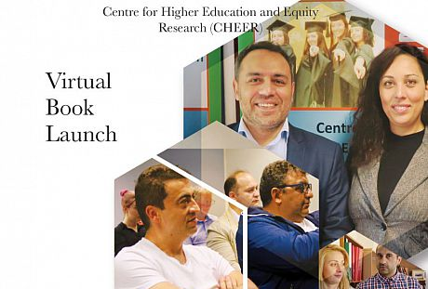
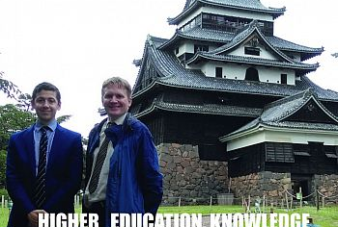
More from CHEER
INCLUSION & EXCLUSION
Date: Tuesday 8 December 2020
Time: 2-4.30pm
Zoom Meeting ID: 924 2024 8110
https://www.bloomsbury.com/uk/the-roma-in-european-higher-education-9781350109643/
AFFECT
https://link.springer.com/article/10.1007/s10734-020-00593-4
MENTAL HEALTH & HIGHER EDUCATION
https://systematicreviewsjournal.biomedcentral.com/track/pdf/10.1186/s13643-020-01443-1.pdf
https://www.sciencedirect.com/science/article/pii/S0883035519323845?via%3Dihub

Slide 17
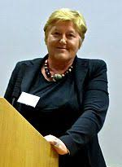









Thank you!
INTELLECTUALLY STIMULATING
EMOTIONAL LABOUR – PERSEVERANCE & SUPERVISION AS THERAPY
BELIEF
INTERNATIONAL
Professor Louise Morley

Slide 18

Thanks for listening

