Slide 1

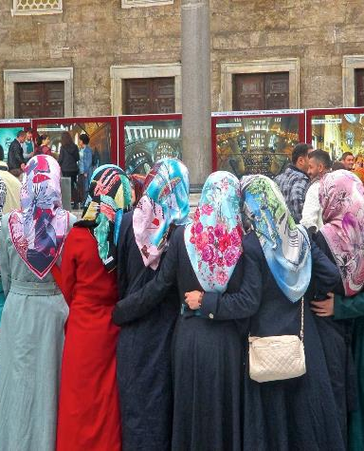
Sister-Matic: Gender Mainstreaming in Higher Education
Methodologies
Professor Louise Morley
Centre for Higher Education and Equity Research (CHEER)
University of Sussex, UK
http://www.sussex.ac.uk/education/cheer

Slide 2
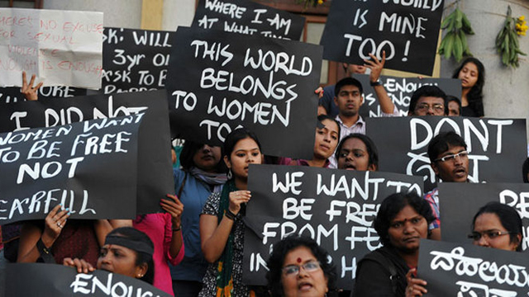
What is Gender Mainstreaming?
Linguistic antithesis of gender marginalisation.
New conceptual grammar for reform.
International phenomenon.
Widely used tool of the policy world.
Strategy originally informed by feminist theory.
Long-term strategy, with different stages of development.
Rescuing gender from invisibility in:
organisational planning
resource allocation
institutional practices.

Slide 3

Essential Ingredients
Data
Accountability/Evidence
Policy Action/Implementation, not symbolism
Strategic Planning NOT crisis or grievance management
Systematic Change Interventions
Professional Development
Review/ Impact Evaluation

Slide 4

Challenges
Gender = access, disadvantage and remediation (fix the women).
HE products and processes = gender neutral.
Power and privilege = under-theorisation.
Gender rarely intersected with other structures of inequality.
Sustainability

Slide 5

What Gender Mainstreaming is Not?
Just Quantitative Change/Gender as a Noun
Simply counting more women into existing:
Structures
Scripts
Systems
Gendered cultures
Representation not the only goal for gender equality.
Problem = the gendered world.

Slide 6
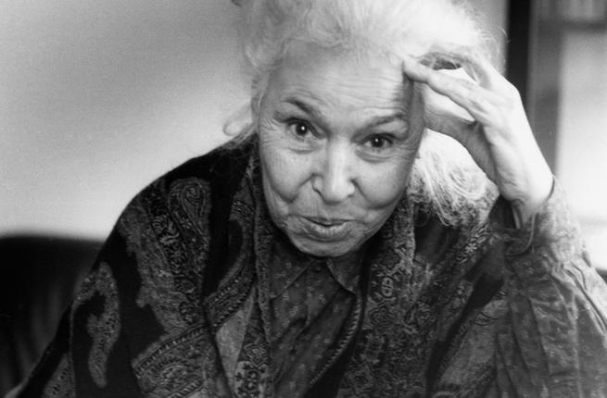
Gender as a Verb
Gendered power relations:
Symbolically/ materially
Construct
Regulate
women’s everyday experiences.
Gender is:
formed and reformed
in organisational cultures and social contexts.

Slide 7
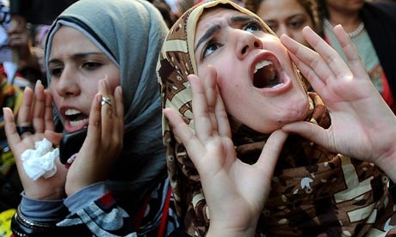
Tools/Interventions
Gender audit
Gender-disaggregated statistics
Equality indicators
Engendered budgets
Gender-impact assessments
Gender monitoring and evaluation
Visioning

Slide 8
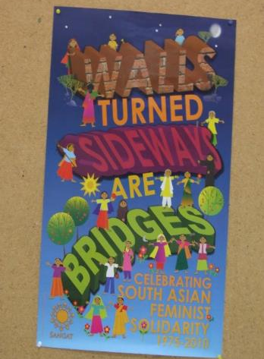
Change Interventions
Excellentia, Austria
(Leitner and Wroblewski, 2008)
Gender Programme, Association of Commonwealth Universities
(Morley et al., 2006)
Norwegian University of Science and Technology (NTNU)
(Benediktsdotir, 2008)
Athena Swan/ Gender Charter Marks/ Aurora (http://www.ecu.ac.uk/our-projects/gender-charter-mark)

Slide 9
Norwegian University of Science and Technology
(NTNU) Gender Mainstreaming
Gender analysis;
Gender policy development;
Appointment of equality advisors;
Committees for equality issues that report to high level management;
The allocation of a budget for equal opportunity;
Quotas for recruitment;
Qualification stipends;
Mentoring for female PhD students, Postdoctoral staff and associate professors;
Networking;
A start package for women in male dominated fields;
Career planning support for women;
Mentoring and career counselling support is offered for women entering HE management.
Impact
55% increase in the numbers of women professors in 5 years (rising
from 9% to 14%), and parity in the numbers of males and females recruited
(Benediktsdotir, 2008).

Slide 10
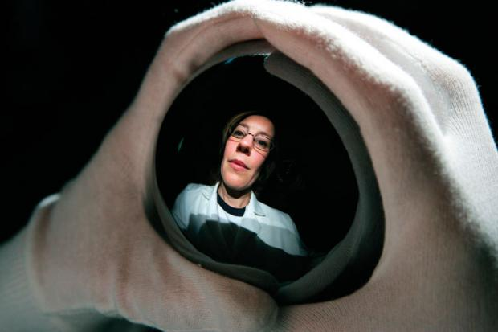
UK Athena SWAN/ Gender Equality Charter
Established 2005 by UK’s Equality Challenge Unit for STEMM.
Humanities and Social Sciences in 2015.
Methodology of self-assessment, peer-review and continuous progression.
3 levels of awards for institutions and individual departments: Bronze, Silver and Gold.
Awards for increasing levels of good practice in recruiting, retaining and promoting women in higher education.

Slide 11

Impact
Increased job satisfaction/ visibility for gender issues
Familiarity with promotion procedures
Workload management
Data Collection
(www.ecu.ac.uk/publications/evaluating-athena-swan)
Contracts Compliance/ Leverage
2011 - Dame Sally Davies (Chief Medical Officer)
Medical schools without a silver award would not be eligible for Department of Health research funding.

Slide 12
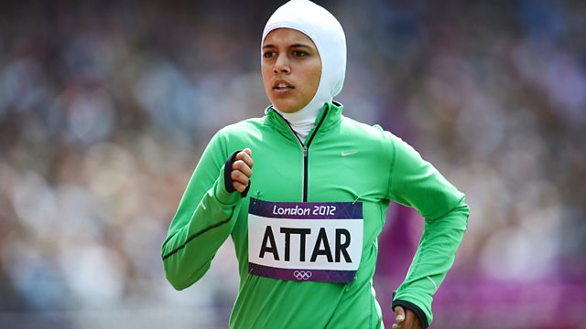
Moving On
Accountability of gender in quantitative and qualitative terms.
Leverage e.g. financial/ reputational
Gender to be taken out of crisis mode and into proactive, resourced, strategic interventions e.g. affirmative action.
Action, monitoring and impact evaluation.
Ultimate Vision = organisations, societies and socio-cultural practices to be gender free.

Slide 13
Follow Up?
Kwesiga, J., and Ssendiwala, E., (2006). "Gender mainstreaming in the university context: Prospects and challenges at Makerere University, Uganda." Women's Studies International Forum 29(6): 592-605.
Morley, L. K., J., Lihamba, A., Odejide, A., Shackleton, L., and Sorhaindo, A. (2006). Gender Equity in Selected Commonwealth Universities. Researching the Issues Report No. 65. London, DFID.
Morley, L. (2007). "Sister-matic: Gender Mainstreaming in Higher Education." Teaching in Higher Education 12(5/6): 607-620.
Morley, L. (2011). "Gender mainstreaming: myths and measurement in higher education in
Ghana and Tanzania." Compare 40(4): 533–550.
Morley, L. (2013) Women and Higher Education Leadership: Absences and Aspirations. Stimulus Paper for the Leadership Foundation for Higher Education.
Wickramasinghe, M. Introduction to Gender Mainstreaming Universities. https://www.acu.ac.uk/membership/gender-programme/intro-gender-mainstreaming-universities
Working Group on Higher Education (WGHE) (2006) Module - Gender Disaggregated Data, in A
Toolkit for Mainstreaming Gender in Higher Education in Africa, Association for the
Development of Higher Education in Africa, (accessed on 7th July 2008)
http://www.ungei.org/resources/1612_1722.html

