Slide 1

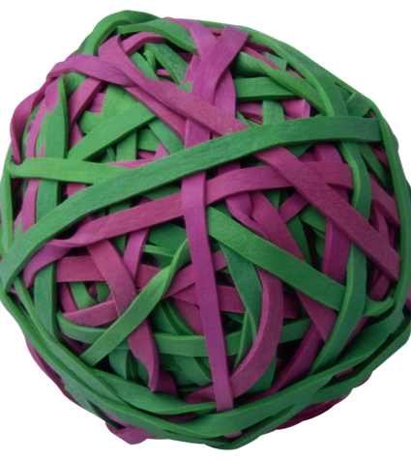
Future Directions for
UK Higher Education
Diversity, Democratisation and Difference: Theories and Methodologies
Professor Louise Morley
Centre for Higher Education
and Equity Research (CHEER)
University of Sussex, UK
www.sussex.ac.uk/education/cheer

Slide 2
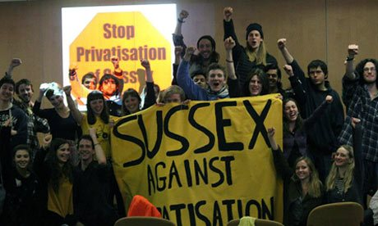
Futurology: a la Cassandra
Intensification of political rationality/ forms of governance of neoliberalism:
Privatisation
Deregulation
Financialisation
Globalisation
Uber-isation

Slide 3

Homo Oeconomicus
All conduct is economic conduct; all spheres of existence are framed and measured by economic terms and metrics, even when those spheres are not directly monetized (Brown, 2015: 10).

Slide 4
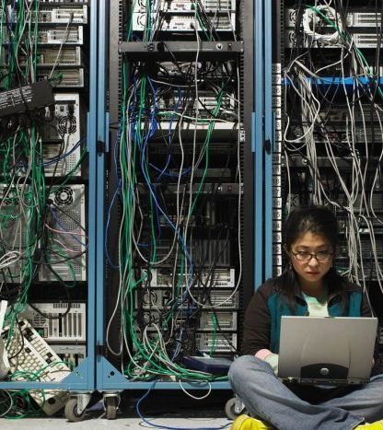
Entangling Neoliberalism and Higher Education
Narratives of state failure
Generalisation of economic form to social fields
Human Beings = Human Capital
Rankings/ ratings systems determine value
Ratings govern pedagogy/ research
Live and Let Die
Education = Attracting Investors
Values reinforced via Funding Regimes
Beneficence of state patronage only for those sharing/ performing the values of the new times
Privatised higher education = anti-critical spaces of learning
Erasure of intelligible, legitimate alternatives to economic rationality.

Slide 5

Resisting Resistance
Stealth Revolution
Neoliberalization is generally more termitelike than lionlike
(Brown 2015: 35/36)
Norms/Hegemonies
Normative order of reason disseminated via governing rationality
Democracy
Neoliberalism assaults the principles, practices, cultures, subjects, and institutions of democracy
Appropriation of Vocabulary
Choice, Growth, Empowerment?

Slide 6
Heat Up The Floor To See Who Can Keep Hopping The Longest
(Davies 2014).
Governing Through Unhappiness

Slide 7
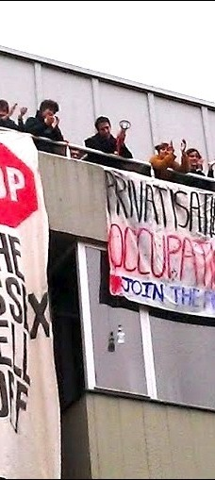
Why Does it Matter?
Individuated agency is privileged
Logic of collective political struggle against structures of inequality undermined
The social disintegrates into the entrepreneurial
Metrics imply norms (Lynch 2014)
Which norms are evoked in judging value? (Butler 2006)

Slide 8
What is the Future of Counter-Hegemonic Knowledge?

Slide 9
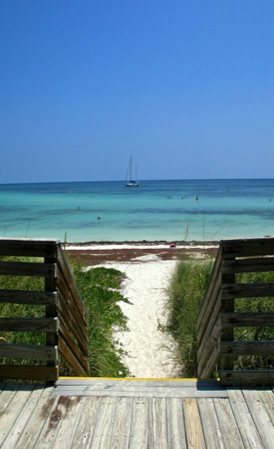
Pollyanna: Making Alternativity Imaginable
Trouble neoliberal realism
Resist being co-opted by narrow policy agendas
Inform policy with evidence, not vice versa
Challenge and expose increasing socio-economic inequalities/ exclusions
Re-invigorate knowledge production as a site of transformation/ possibility
Transgress and re-signify
Identify new optics/ discursive formations for viewing the social world
Imagine the future that you want to see.

Slide 10
http://www.sussex.ac.uk/education/cheer

