Slide 1
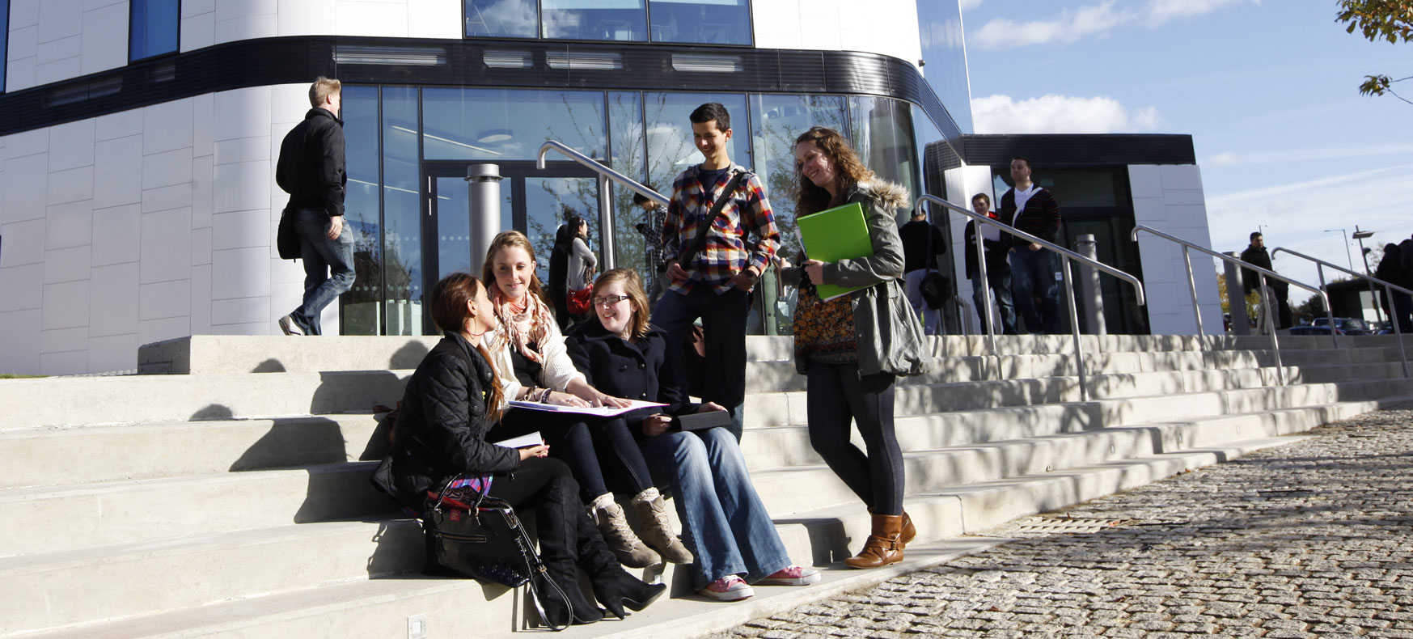

Neoliberal transitions? An artful inquiry into the personal histories and transitions of underrepresented students at Southeastern University
Stéphane Farenga
s.farenga@herts.ac.uk
@HotDogFrog

Slide 2
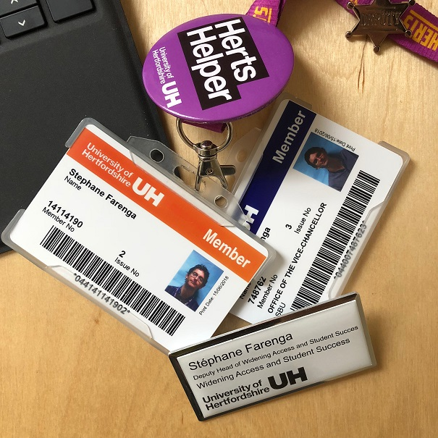
About me
5 years in Widening Participation
Deputy Head Widening Access & Student Success
EdD student since 2014

Slide 3
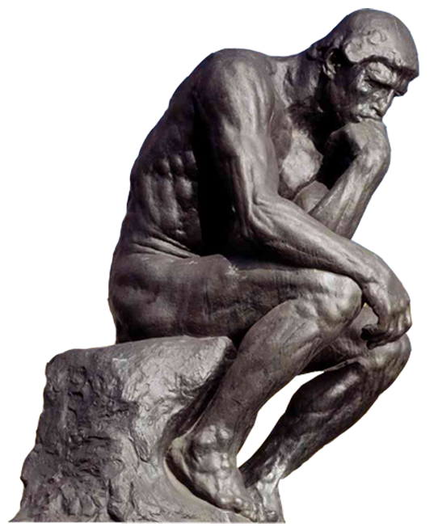

Today’s focus
Neoliberalism, student experience and a different way to research
The extent to which neoliberalism is embedded in higher education
Why?
Notes:
Student experience
Conception of university
Research

Slide 4




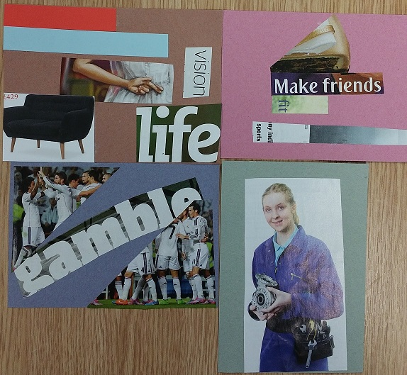
Thesis breakdown
Notes:
Who, what, where?
1st year students from underrepresented backgrounds
Transition into and during their 1st year at UH
Why?
1st year is crucial for determining persistence (Andrew et al., 2008)
Particular concern for students from widening participation backgrounds (Gale and Parker, 2014) and their continuation (Kift, 2009)
At UH: 14% attrition compared to 6% average
Aim?
Give a voice to a potentially institutionally marginalised group
Elevate experience of non-traditional students
Recommendations
How?
Artful inquiry (collage)
Participatory Pedagogy

Slide 5
Neoliberal transitions? An artful inquiry into the personal histories and transitions of underrepresented students at Southeastern University…
Key elements
Neoliberal: socio-political and economic policies and practices that shape society, sectors (e.g. HE) and institutions (e.g. HEIs) (Olssen and Peters, 2005; Wilkins, 2012)
Transition: nuanced concept embracing the multiplicity of student life (Ecclestone, Biesta and Hughes, 2010; Gale and Parker, 2014)
Artful inquiry: collage, cutting and pasting of materials to express phenomenon, experience and emotion (Butler-Kisber, 2009)
Personal history: subset of ‘habitus’ and part of ‘practice’ (Bourdieu, 1990; Bourdieu and Passeron, 1993; Reay, 2004; Reay et al., 2009)
Under-represented individuals: (Burke, 2012; Southeastern University)

Slide 6


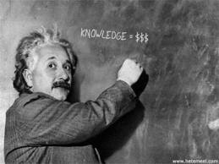

Neoliberalism in 60 seconds
It’s the economy, stupid!
“Conscious action” for state and individual (Olssen and Peters, 2005, p. 319)
Notes:
Synonymous with deregulation, privatisation and knowledge as capital/commodity) (Olssen and Peters, 2005)
Knowledge Based Economy (managerial, labour markets and skills) (Brown et al., 2003)
Changing role of Government and “positive power” (Zepke, 2015, p. 701)
Individuals as active agents (economically self-interested and competitive) (McKean, 1974; Olssen and Peters, 2005)
“Conscious action” for state and individual (Olssen and Peters, 2005, p. 319)

Slide 7



What has neoliberalism got to do with today’s higher education?
Economy and higher education
Education
Notes:
Education positioned as means to develop skilled, flexible workforce (Burton-Jones, 1999)
New Labour promote higher education as the space to transfer knowledge and skills (Burke, 2012)
Overlaid with social justice rhetoric of (economic) self-improvement and social mobility
Expansion/massification of higher education to fill employment gaps of fast growing KBE
Policy documents reinforce this: Dearing Report (1997) and 2003, 2011 and 2016 White Papers

Slide 8




What has neoliberalism got to do with higher education?
The neoliberal student
“Neoliberal project of self-improvement” (Burke, 2012, p. 30)
aspirations, knowledge and skills
Notes:
“Neoliberal project of self-improvement” (Burke, 2012, p. 30)
Students as consumers
Student engagement influenced by wider economic agenda (Zepke, 2015)
Applied learning of practical knowledge fit for KBE
Geared towards employment success
Input/output model
Privileging of the successful, normalised middle-class student (Burke, 2007 and 2012)
Pathologising of the “deviant” other those who re-make their identity (Archer and Yamashita, 2003, p.130)
Deficit-model constructions around aspirations, knowledge and skills (Burke, 2012)
Macro: Expansion of student numbers; Managerialist and performance culture; New types of utilitarian knowledge; Monitoring related tools)
“Neoliberal project of self-improvement” in wider context of neoliberal society that privileges skill development and education as key to economic socio mobility
Students as consumers supported by performance-related and comparison tools leads students to make economic/consumer transactional decisions

Slide 9
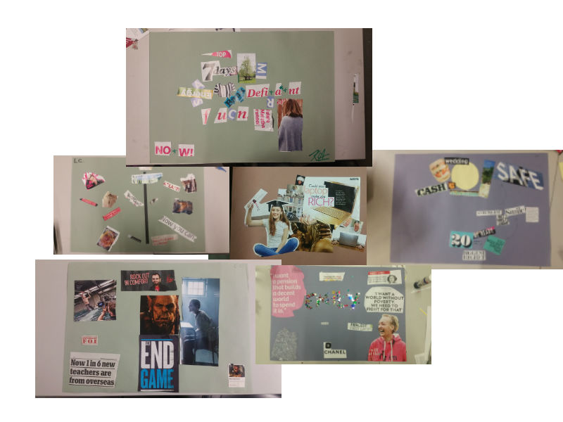
Key research questions
What can we learn from all this?
What are the personal histories of this cohort of underrepresented students at Southeastern?
What are the transitional experiences of these students?
What are their conceptions of higher education?
What role does neoliberalism play in shaping these histories, experiences and conceptions?

Slide 10


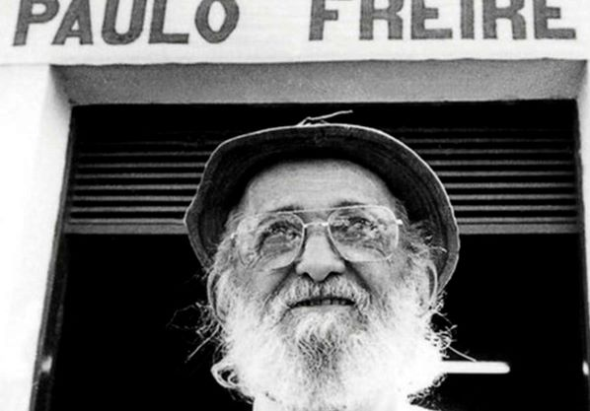



Methodology
Artful inquiry, collage and Participatory Pedagogy
Artful inquiry and collage
Participatory Pedagogy (Burke, 2012)
experience, emotions and feelings (Eisner, 2008)
Limit power issues
(Weber, 2008, Butler-Kisber, 2009)
Effective tool in widening participation context of normalised/marginalised
Notes:
Artful inquiry and collage
Explore experience, emotions and feelings (Eisner, 2008)
Deliteralisation of knowledge (Eisner, 2008)
“New connections” (Butler-Kisber, 2010: 104)
Each participant can explore a phenomenon in their own way
Visual, constructivist tool
Limit power issues
(Weber, 2008, Butler-Kisber and Poldma, 2009)
Participatory Pedagogy (Burke, 2012)
Counter deficit-model constructs
Freieran roots of emancipation
More equal research relationship
Co-production of research process and knowledge
Effective tool in widening participation context of normalised/marginalised

Slide 11

Conceptions of higher education
“I see it like a race”
Competition
Race/ Competition
(Steven)
Notes:
Neo-liberal backbone (Ball, 2003)
Goals
$$$ motivation
Success
Gaming
Competition
Personal development/investment

Slide 12
Conceptions of higher education
“I see it like a race”
“[I] see it like, in a race, everyone starts off at the same point, but there are certain people who might be starting a few metres back and might have to run a longer race to get to the same place as someone else, and that’s why I need to go out there and find opportunities, make opportunities, and go and grab them, not just wait for something to come to me because that will be very unlikely.” – Kiki
Notes:
Neo-liberal backbone (Ball, 2003)
Goals
$$$ motivation
Success
Gaming
Competition
Personal development/investment

Slide 13
Conceptions of higher education
Self-improvement
“That’s why I did Computer Science because I’m one of few girls and they’re all looking for girls at the moment, […] I think I’m guaranteed more of a job than any other person.” – Ada
“I think the status is quite important […] no disrespect to people who work in shops but, you know, I want an actual title to the job that I’m in, so I just think that’s quite an important thing.” – Milly
Notes:
Neo-liberal backbone (Ball, 2003)
Goals
$$$ motivation
Success
Gaming
Competition
Personal development/investment

Slide 14
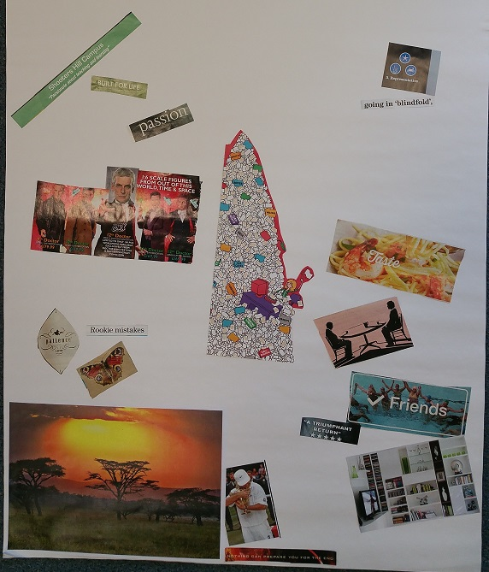
Student experience
Difficult early transitions
“[Milly] See, like everyone says you make friends for life at uni… [Eva] I ain’t found them friends for life, yet” – Milly and Eva
Notes:
Unprepared
Overwhelming
Loneliness

Slide 15
Student experience
Peer groups to the rescue
“I think the best way to ensure that you have a good university experience and then that you have a good smooth transition is to make sure that you have a good group of friends.” – Kiki

Slide 16

Conclusions
The neoliberal student?
“Neoliberal project of self-improvement” (Burke, 2012, p. 30)

Slide 17
Conclusions
Redefining student engagement
experience, emotions and feelings (Eisner, 2008)
“When you actually sit down and think about your experiences […] it gives a bit of a deeper meaning as to actually like why you’re actually here.” – Ellora
“Yeah thinking deeply […] I'm now able to make sense of it all.”
– Dawn
Participatory Pedagogy (Burke, 2012)
Notes:
Student numbers are expanding and a lot of that is happening in groups of non-trad stu
Can’t just be an access approach
Think carefully about how uni is set-up, what T&L env are like
Using PP approach has helped re-define traditional research
Give students a voice
Co-producers of K
Allowed them to think deeply about experience and self-reflect
In T& L setting using PP would make students co-producers, might allow for the values/exp/K of non-trad students to elevated alongside more trad privileged peers
Might redress some of those deficit models

Slide 18
References
Andrew, S., Salamonson, Y., Weaver, R., Smith, A., O’Reilly, R. and Taylor, C. 2008. “Hate the course pr hate to go: Semester differences in first year attrition”. Nurse Education Today. 28 (7) 865-872.
Archer, L. and Yamashita, H. (2003). “Theorising Inner-city Masculinities: ‘race’, class, gender and education”. Gender & Education, 15(2), 115-132.
Archer, L., Hutchings, M. and Ross, A. 2003. HE and social class: issues of exclusion and inclusion. London: Routledge Farmer.
Ball, S. J. 2003. “The Teacher’s Soul and the Terrors of Performativity.” Journal of Educational Policy. 18 (2) 215-228.
Ball, S. J. 2015. “Accounting for a sociological life: influences and experiences on the road from welfarism to neoliberalism”. British Journal of Sociology of Education. 1-15.
Bourdieu, P. 1990. The Logic of Practice. Cambridge: Polity Press.
Bourdieu, P. 1993. The Field of Cultural Production: Essays on Art and Lierature. Cambridge: Polity Press.
Bourdieu, P. and Passeron, J-C. 1990. Reproduction in Education, Society and Culture. 2nd ed., London: Sage.
Bourideu, P. and Wacquant, L. 1992. An invitation to reflexive sociology. Chicago: University of Chicago.
Brown, P. and Hesketh, A. 2004. The Mismanagement of Talent. Oxford University Press: Oxford.
Burke, P.J. (2007). “Men accessing education: masculinities, identifications and widening participation”. British Journal of Sociology of Education, 27(4), 441-424.

Slide 19
References
Burke, P.J. 2012. The Right to Higher Education. Routledge: London.
Butler-Kisber, L. 2010. Qualitative Inquiry: Thematic, Narrative and Arts-Informed Perspectives. London: Sage.
Butler-Kisber, L. and Poldma, T. 2009. “The power of visual approaches in qualitative inquiry: the use of collage making and concept mapping in experiential research”. Journal of Research Practice. 6 (2)
Eisner, E. 2008. “Art and Knowledge”, in J. G. Knowles and A. L. Cole (eds.), Handbook of the Arts in Qualitative Research. London: Sage, pp 3-12.
Ecclestone, K., Biesta, G and Hughes, M. 2010. Transitions and Learning through the Lifecourse. Routledge: London.
Farenga, S. A. (2015). How going beyond financial support contributes to student success and retention: an institutional case study of the National Scholarship Programme. Widening Participation and Lifelong Learning. 17(3).
Farenga, S. A. (2018). Early struggles, peer groups and eventual success: an artful inquiry into unpacking transitions into university of widening participation students. Widening Participation and Lifelong Learning. 20(1), pp. 60-78. DOI: http://doi.org/10.5456/WPLL.20.1.60
Gale, T. and Parker, S. 2014. “Navigating change: a typology of student transition in higher education”. Studies in Higher Education, 39(5), 734–753, http://dx.doi.org/10.1080/03075079.2012.721351
Kift, S. 2009. “Articulating a transition pegaogy to scaffold and to enhance the first year student learning experience in Australian higher education: Final report for ALTC Senior Fellowship Program”. Strawberry Hills, NSW: Australian Learning and Teaching Council.

Slide 20
References
McKean, R. (1974). Property rights within government, and devices to increase governmental efficiency, in: E. G. Furubotn & S. Pejovich (Eds) The economics of property rights (Massachusetts, Ballinger).
Naidoo, R. (2003). Repositioning Higher Education as a Global Commodity: Opportunities and challenges for future sociology of education work. British Journal of Sociology of Education. 24:2, pp. 249-259, DOI: 10.1080/01425690301902
Olssen, M. and Peters, M. A. (2005). Neoliberalism, higher education and the knowledge economy: from the free market to knowledge capitalism. Journal of Education Policy. 20:3, pp. 313-345. DOI: 10.1080/02680930500108718
Reay, D. 2004. “’It’s all becoming a habitus’: beyond the habitual use of habitus in educational research”. British Journal of Sociology of Education 25 (4): 431-444.
Reay, D., Crozier, G., Clayton, J. 2009. “’Strangers in Paradise’? Working-class Students in Elite Universities”. Sociology. 43 (6). pp: 1-19.
Reay, D., Crozier, G., Clayton, J. 2010. “’Fitting in’ or ‘standing out’: working-class students in UK higher education”. British Educational Research Journal. 36 (1). pp: 107-124.
Weber, S. 2008. “Visual Images in Research”, in J. G. Knowles and A. L. Cole (eds.), Handbook of the Arts in Qualitative Research. London: Sage. pp 41-54.
Wilkins, A. (2012). The spectre of neoliberalism: pedagogy, gender and the construction of learner identities. Critical Studies in Education, 53(2). pp. 197-210. DOI: 10.1080/17508487.2012.672332
Zepke, N. (2015). Student engagement and neoliberalism: mapping an elective affinity. International Journal of Lifelong Education. 34(6), pp. 696-709. DOI: 10.1080/02601370.2015.1096312

