Slide 1
CENTRE FOR HIGHER EDUCATION AND EQUITY RESEARCH
Exploring international student responses to surveillance within the UK student visa system

Slide 2
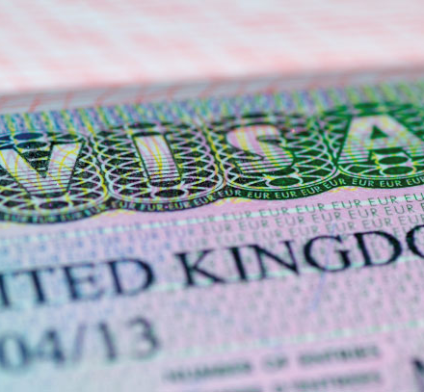
Aim of this paper
Introduce Tier 4 visa – history and realities of navigation
Unveil six examples of surveillance within the Tier 4 visa
Discuss individual experiences under differentiated rules
Explore participants experience of this surveillance
Analyse negative positioning of international students

Slide 3
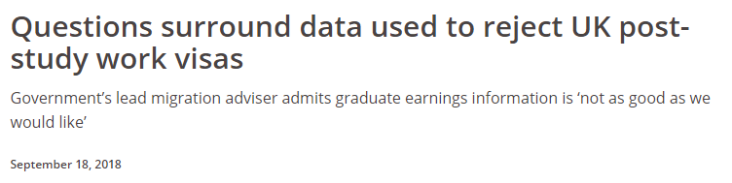
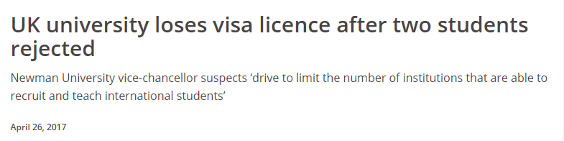
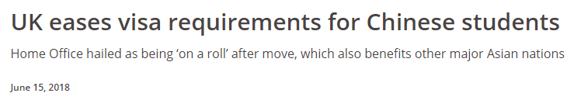
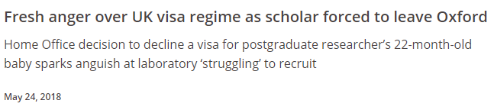
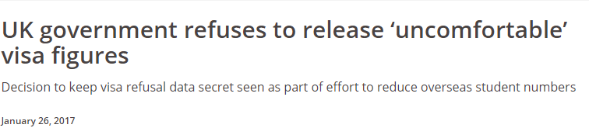
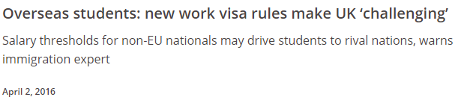
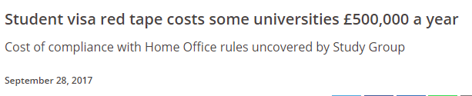
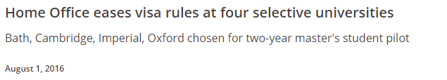
History of the Tier 4 visa
2009 Introduction of points based visa system
        Student visas = Tier 4
2011 Introduction of Confirmation of Acceptance of Studies (CAS)
2011 Credibility interviews
2012 Removal of PSW visa
2015 Immigration health surcharge
Also English and Financial requirements increased a number of times
Rules are introduced with no prior warning

Slide 4
Navigating a Tier 4 Visa
Before arrival
Comprehensive application form
IELTS exam
On Arrival
Separate queue for international students (sometimes)
Questioned (sometimes)
During studies
Police registration
Heath screening (for some)
Produce supporting documentation (sometimes)
Biometrics
Credibility interview (for some)
Confirmation of Acceptance of Studies
Mark attendance
Work restrictions
Abide by rules
Threat of deportation?
Financial statements
Pay for visa

Slide 5
Methodology
29 international students – visa required
Call for participants and promotion on Twitter and UKCISA website
Semi-structured interviews
21 countries represented;
  12 countries of citizenship, 18 countries of domicile
6 participants where citizenship was different to that of domicile
Qualitative design with thematic analysis
Coding NVivo – inductive and deductive strategies
Risk
Surveillance
Mobility
Identity
Fear

Slide 6
Differentiated rules
applied by Tier 4 visa
RULE: Not all international students are visa required – UK and EEA students exempt
RULE: Low risk nationals (citizens of 30 countries) are subject to differential documentary requirements
RULE: Not all students are called for a credibility interview – why some? Unclear justification
RULE: Students domiciled in 102 countries are required to undertake TB test
RULE: Students citizens of 42 countries are required to register with police
Notes:
TB test countries: Afghanistan
Algeria
Angola
Armenia
Azerbaijan
Bangladesh
Belarus
Benin (get tested in Nigeria)
Bhutan
Bolivia
Botswana
Brunei
Burma
Burkina Faso (get tested in Ghana)
Burundi (get tested in Rwanda)
Cambodia
Cape Verde (get tested in Gambia or Senegal)
Central African Republic (get tested in Cameroon)
Chad (get tested in Cameroon)
Cameroon
China
Congo (get tested in Democratic Republic of the Congo)
Côte d’Ivoire
Democratic Republic of the Congo
Djibouti (get tested in Ethiopia)
Dominican Republic
East Timor (get tested in Indonesia)
Ecuador
Equatorial Guinea (get tested in Ghana)
Eritrea (get tested in Kenya)
Ethiopia
Gabon (get tested in Cameroon)
Gambia
Georgia
Ghana
Guatemala
Guinea (get tested in Sierra Leone)
Guinea Bissau (get tested in Gambia or Senegal)
Guyana
Haiti
Hong Kong
India
Indonesia
Iraq
Kazakhstan
Kenya
Kiribati (get tested in Fiji)
Kyrgyzstan (get tested in Kazakhstan)
Laos (get tested in Thailand)
Lesotho (get tested in South Africa)
Liberia (get tested in Ghana)
Macau (get tested in Hong Kong)
Madagascar
Malawi
Malaysia
Mali (get tested in Gambia or Senegal)
Marshall Islands (get tested in Fiji)
Mauritania (get tested in Morocco)
Micronesia (get tested in Fiji)
Moldova
Mongolia
Morocco
Mozambique
Namibia
Nepal
Niger (get tested in Ghana)
Nigeria
North Korea
Pakistan
Palau (get tested in Philippines)
Papua New Guinea
Panama
Paraguay
Peru
Philippines
Russia
Rwanda
São Tomé and Principe (get tested in Angola)
Senegal
Sierra Leone
Solomon Islands (get tested in Papua New Guinea)
Somalia (get tested in Kenya)
South Africa
South Korea
South Sudan (get tested in Kenya)
Sri Lanka
Sudan
Suriname (get tested in Guyana)
Swaziland (get tested in South Africa)
Tajikistan
Tanzania
Togo (get tested in Ghana)
Thailand
Turkmenistan
Tuvalu (get tested in Fiji)
Uganda
Ukraine
Uzbekistan
Vanuatu (get tested in Fiji)
Vietnam
Zambia
Zimbabwe

Slide 7

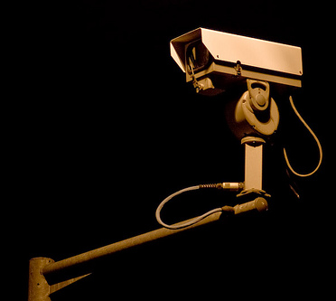
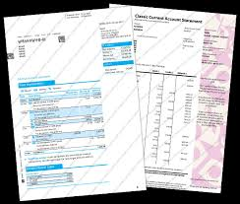
Examples of surveillance
Application form
Attendance Monitoring
Credibility interviews
Questioning at Border
Financial Statements
Police Registration

Slide 8

Constant questioning undermines credibility
“I think once I was coming back from Algeria and the lady asked me, "so why have you come into the UK." I gave her all my documents and stuff and she goes "why have you come into the UK?" And I'm like, I'm here to finish my studies.
And she looked at me and she goes, "have you now?"[Laughs.] And I'm like what do I respond that? I've got my visa, I've got my student letter, I've got everything. Why are you responding to me in a condescending tone.”

Slide 9
Paranoia, criminalised and embarrassed?
“I was kind of paranoid. You become paranoid, because, I don’t know, you need to give them so much information about you, about your life, about your past, things that you just not remember, you know?” (Application form)
“They also asked me, like, some questions that were in the application, the online application, already, like about committing crimes or being jailed or whatever.” (Credibility interview)
“”I do feel like a lot of students have said that they feel like they are being treated like criminals”
“They separate you in between European Union or British citizens and the rest of the world.” (Arriving)
“And so then I thought it was slightly embarrassing that I had to go and produce myself at the police, and even worse that some people do and some people don't have to register.”
(Police registration)

Slide 10
“Undesirable, risky immigrants”
Current hostile policy environments constructs international students as “undesirable, risky immigrants” (Lomer, 2018 p.321)
I guess, like, international students are categorised as migrants as well now, and you make us sound like this dirty little things

Slide 11
Negative positioning of
international students
Q: What is the value for universities for universities treating international students like this?
Q: How are international students valued? (£££)
Q: Who is the ideal global citizen? (Ideal international subject?)
The stranger is stopped by being questionable (Ahmed, 2016)
    International students are continually being questioned
    International students are being positioned as strangers through this questioning
British policies construct representations of international students, affecting the ways in which they are perceived (Lomer 2018 pg. 2)
      Risky, Criminals, Untrustworthy
      More so, these policies affect how they perceive themselves
Notes:
Low risk = Argentina, Australia, Bahrain, Barbados, Botswana, Brunei, Cambodia, Canada, Chile, China, the Dominican Republic, Indonesia, Japan, Kuwait, Malaysia, the Maldives, Mexico, New Zealand, Qatar, Serbia, Singapore, South Korea, Thailand, Trinidad and Tobago, United Arab Emirates, United States of America • Hong Kong (SAR) passport holders, Macao (SAR) passport holders, Taiwan passport holders (with residence card no. in passport) + British National Overseas passport holders

Slide 12
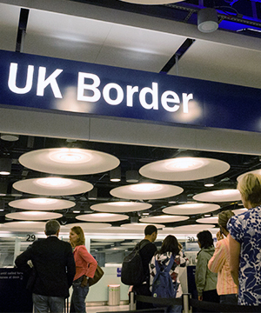
Borders are spaces of surveillance
Borders act as mechanisms that determine membership through process of inclusion and exclusion (Villegas 2018)
Universities as bordering spaces and bordering places

Slide 13
Thank you
CENTRE FOR HIGHER EDUCATION AND EQUITY RESEARCH
EMAIL: a.tiernan@sussex.ac.uk
TWEET: @Aisling_Tiernan
FOLLOW: www.sussex.ac.uk/education/cheer

