Slide 1
Entangling Gender and Neoliberalism in the Global Academy
CENTRE FOR HIGHER EDUCATION AND EQUITY RESEARCH
Professor Louise Morley

Slide 2
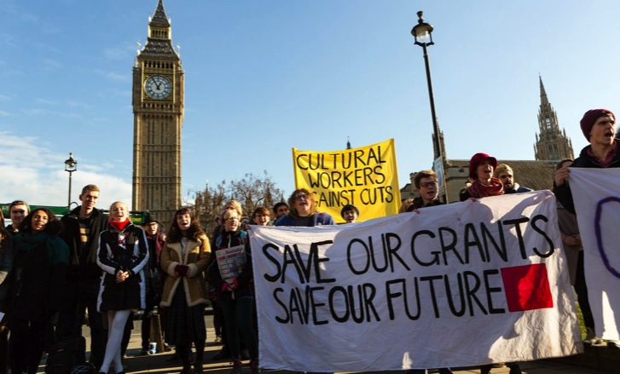


The Political Economy of Neoliberalism: Whose Imaginary?
Privatisation
Deregulation
Financialisation
Globalisation
Uberisation

Slide 3

Entangling and Installing Neoliberalism in Higher Education
MATERIAL
Funding: linked to policy narratives/priorities
Audit: condensed quality indicators
Employment Regimes/ Precarity: Performance pay/ tenure/ promotion = epistemic hierarchies
DISCURSIVE
Truth-telling: peer review/ impact/ appraisal/ search agencies/ esteem/ reputation
Closure of the political universe/ TINA Effect
Performative Repetition
Reputation and Impression Management
AFFECTIVE
Guilt / pride / shame / fear/ desire
Success / failure narratives
Competition erodes solidarity?

Slide 4

Cognitive Capitalism
Market Dominance
Accounts and Accountability
Academic identity/ Subjectivity = (disposable) entrepreneurs
Higher Education = skills training for employment
Knowledge = innovation/ applied/ wealth creation
Funding = linked to policy narratives/ priorities
Learning = outcomes
Intellectual value = economic
Competitive global prestige economy.

Slide 5

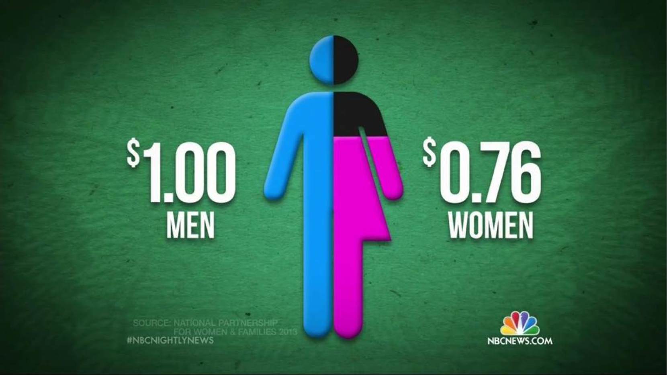

Measurement and Metrification: Ideology posing as a technology?
Desire for Global Spaces of Equivalence
Competitive measuring = essence of the global prestige economy
Academic labour, activity and productivity = made intelligible via dominant metrics and norms.
What is not measured?

Slide 6

(Lack of) Resistance?
Neoliberalization is generally more termitelike than lionlike (Brown 2015: 35/36)
Capillary Power
Fatalistic Resignation
Cognitive Triage/ Accelerated Academy
Audit Society/ Prestige Economy
Monetarising desires
Sacrifice/Austerity
Money and Minds (Ball 2015)
Illusio = investing in the game
(Bourdieu 1977; Colley 2013)

Slide 7

Gender and Neoliberalism:
A Complex Assemblage?
Neoliberalism is not ...
Essentially male.
Neoliberal Feminism
Women = ideal neoliberal subjects (aspirational and capacious).
(McRobbie 2009)
Gender Equality = cognitive and behavioural restructuring.
(Sandberg 2013)
Recognition of economic achievement rather than resource redistribution.
(Fraser 2013)
Cover up of sexism/harassment/ violence in the interests of marketing.
(Phipps and Young 2015)
The new feminist = responsible for her professional success, wellbeing and work/life balance.
(Rottenberg 2014)

Slide 8

Womenomics
Has Neoliberalism Colonised/Provided a New Variant of Feminism/ Feminist Subjectivity?
Commodification of Social Struggles?
Driver for gender equality = economic, not social.
Women = New Market.
The ills of the global economy/organisations can be fixed by the incorporation of women.
Unit of analysis = individual, not collective, social structures.
How do these concerns relate to indigenous groups in the Arctic?

Slide 9

New Epoch for Feminism:
Right Wing Cultural Capital?
Right-wing Women Self-Identifying
as Feminists
Theresa May
Marine Le Pen
Ivanka Trump
Mantras
Work/Family Balance
Lean In
Having It All
Empowerment/Confidence-Building
Women’s Rights Justify Xenophobic Politics
Gender Equality = Smart Economics/ Business Case/ Wasted Talent.

Slide 10
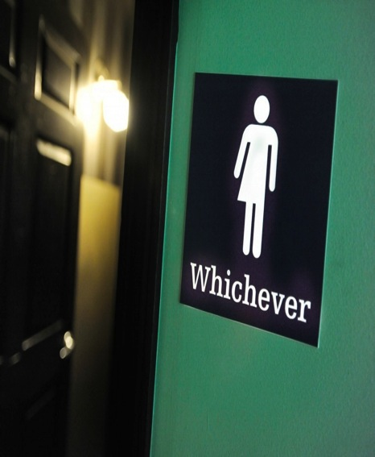
Gender:
More than a Demographic Variable
Gender as a Noun
Quantitative Change
Gender as a Verb
Gendered Power Relations =
Symbolically/ Materially
Construct/Regulate
Everyday Experiences.
Gender = formed/ re-formed in:
Organisational Cultures
Academic Disciplines
Social Relations
Postgenderism / Post Binary / Gender Fluidity
Eliminating / moving beyond gendered identities / roles / signifiers.

Slide 11

Neoliberalism is…
Normative order of reason
Fluid, capricious, stealthy
Market fundamentalism
Harnessing desires/ aspirations to the needs of the economy
Absorbed into professional identities
A policy and affective installation
Disarticulating structural inequalities
Promoting competitive individualism
Beneficial for those who comply with the performance indicators.
Valuing and rewarding the areas and activities in which elite groups have traditionally succeeded.
Neoliberalism is not…
An external, material entity
A seamless monolithic apparatus
Easily identified and resisted
Non-human
Essentially male
Just about injury or subjectification
Binary opposite of an absent, pure ‘other’/ golden age?

Slide 12

Resisting the Neoliberal Gaze/ Making Alternativity Imaginable
Challenge the notion that the insertion of any woman, regardless of her values, is a victory for feminism.
Refuse to reinterpret feminism in market-friendly terms e.g. smart economics.
Avoid celebrating economic achievement rather than redistribution of resources.
Identify and expose increasing socio-economic/ gender inequalities / exclusions.
Re-invigorate knowledge production as a creative site of gendered transformation.
Imagine and research the future of higher education that we want to see.
Trouble neoliberal realism and work to make higher education more generous, generative and ultimately, gender-free.

Slide 13

Follow Up?
Morley, L. (2015): Troubling Intra-actions: Gender, Neo-liberalism and Research in the Global Academy.
Journal of Education Policy 31(1): 28-45.
Morley, L. (2018): Gender in the Neoliberal Research Economy: An Enervating and Exclusionary Entanglement? In, Kahlert, H. (ed) Gender Studies and the New Academic Governance. Global Challenges, Glocal Dynamics, and Local Impacts. Wiesbaden: Springer VS.
CHEER Website: www.sussex.ac.uk/education/cheer
Twitter:
@SussexCHEER
Facebook: www.facebook.com/groups/CHEERSussex/

