Slide 1
Entangling Gender and Neoliberalism in the
Global Academy
CENTRE FOR HIGHER EDUCATION AND EQUITY RESEARCH
Professor Louise Morley

Slide 2

Women in Leadership: A Two-Way Gaze?
How are women being seen
eg. as deficit men?
How are women viewing leadership e.g. unliveable lives?
What narratives circulate about:
Women’s Capabilities?
Leadership?

Slide 3
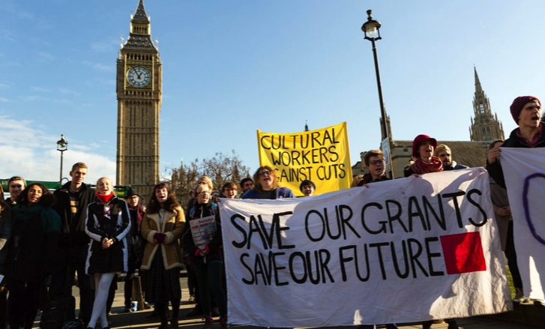
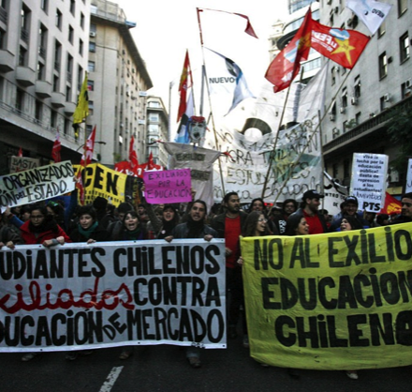

The Political Economy of Neoliberalism: Whose Imaginary?
Privatisation
Deregulation
Financialisation
Globalisation
Uberisation

Slide 4

Gender and Neoliberalism:
A Complex Assemblage?
Neoliberalism is not ...
Essentially male.
Neoliberal Feminism
Women = ideal neoliberal subjects (aspirational and capacious).
(McRobbie 2009)
Gender Equality = cognitive and behavioural restructuring.
(Sandberg 2013)
Recognition of economic achievement rather than resource redistribution.
(Fraser 2013)
Cover up of sexism/harassment/ violence in the interests of marketing.
(Phipps and Young 2015)
The new feminist = responsible for her professional success, wellbeing and work/life balance.
(Rottenberg 2014)

Slide 5

Womenomics
Has Neoliberalism Colonised/Provided a New Variant of Feminism/ Feminist Subjectivity?
Commodification of Social Struggles?
Driver for gender equality = economic, not social.
Women = New Market.
The ills of the global economy/organisations can be fixed by the incorporation of women.
Unit of analysis = individual, not collective, social structures.

Slide 6

New Epoch for Feminism:
Right Wing Cultural Capital?
Right-wing Women Self-Identifying
as Feminists
Theresa May
Marine Le Pen
Ivanka Trump
Mantras
Work/Family Balance
Lean In
Having It All
Empowerment/Confidence-Building
Women’s Rights Justify Xenophobic Politics
Gender Equality = Smart Economics/ Business Case/ Wasted Talent.

Slide 7
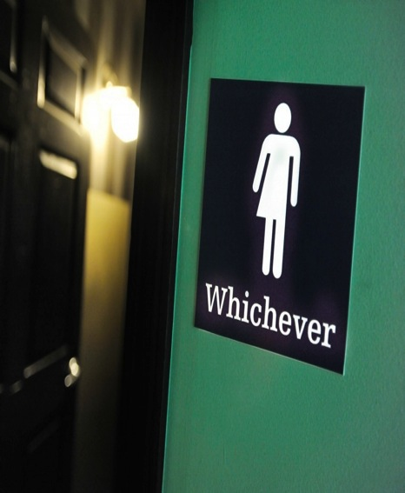
Gender:
More than a Demographic Variable
Gender as a Noun
Quantitative Change
Gender as a Verb
Gendered Power Relations =
Symbolically/ Materially
Construct/Regulate
Everyday Experiences.
Gender = formed/ re-formed in:
Organisational Cultures
Academic Disciplines
Social Relations
Postgenderism / Post Binary / Gender Fluidity
Eliminating / moving beyond gendered identities / roles / signifiers.

Slide 8

The Affective Economy
of Identity Work
Expectation of Excoriation (Roth 2016)
Working with resistance, recalcitrance, truculence, ugly feelings
Authority - Does not ‘stick’ to (some) women?
Colonising colleagues’ subjectivities towards the goals of managerially inspired discourses
Managing self-doubt, conflict, anxiety, disappointment & occupational stress
=
Restricting not
Building capacity and creativity

Slide 9

Willfulness and Willingness (Ahmed, 2014)
Leadership often experienced as:
Fragile
Precarious
Conflict-ridden
Refusal to aspire to leadership:
Strategic decision-making
Resistance
Women as ‘broken’ leaders/ expectation of failure.

Slide 10

Evidence
South Asia
Literature/ Policy Review
Interviews- 19 women and 11 men
Afghanistan, Bangladesh, India, Nepal, Pakistan and Sri Lanka
(Morley & Crossouard, 2016)
Malaysia
36 Questionnaires/ 1 Focus Group (Morley et al, 2016)
East Asia and MENA
20 Questionnaires/ 3 Discussion Groups
Australia, China, Egypt, Hong Kong, Indonesia, Japan, Jordan, Kuwait, Malaysia, Morocco, Pakistan, Palestine, the Philippines, Singapore, Thailand and Turkey (Morley, 2014, 2015).
What makes leadership attractive/unattractive to women?
What enables/ supports women to enter leadership positions?
Personal experiences of being enabled/ impeded from entering leadership??

Slide 11
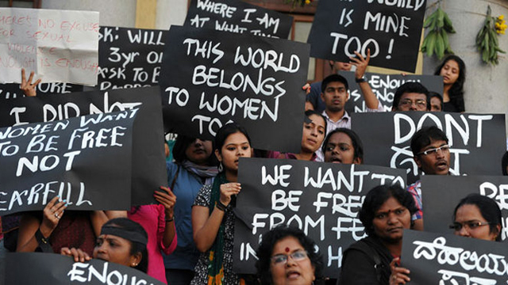
What Attracts Women to Senior Leadership?
Power
Influence
Values
Rewards
Recognition

Slide 12

Why is Senior Leadership Unattractive
to Women?
Neoliberalism/
Performance Cultures
Being ‘other’ in
male-dominated cultures
Misogyny
Gendered authority
Disrupting the symbolic order
Financialisation
Pre-determined scripts

Slide 13

Moving On:
What are we asking women to lead?
Women are
Rejected
Refusing/ Self-Excluding
Reluctant
Change
Not counting more women into existing structures/ scripts/systems/gendered cultures.
Can Leadership:
Narratives
Practices
Be more than discursive performances/repetitions of:
Values
Regulative norms
of the neoliberal global academy?
Need for
Re-visioning of Leadership

Slide 14
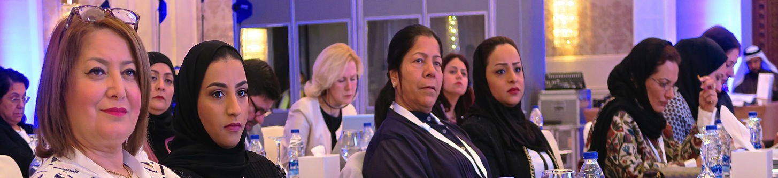
Neoliberalism is…
Normative order of reason
Fluid, capricious, stealthy
Market fundamentalism
Harnessing desires/ aspirations to the needs of the economy
Absorbed into professional identities
A policy and affective installation
Disarticulating structural inequalities
Promoting competitive individualism
Beneficial for those who comply with the performance indicators.
Valuing and rewarding the areas and activities in which elite groups have traditionally succeeded.
Neoliberalism is not…
An external, material entity
A seamless monolithic apparatus
Easily identified and resisted
Non-human
Essentially male
Just about injury or subjectification
Binary opposite of an absent, pure ‘other’/ golden age?

Slide 15

Making Alternativity Imaginable:
How can we …. ?
Create a sociology of absences.
Identify new lexicons/ vocabularies for intersecting gender and leadership.
Imagine, exchange knowledge and research the future of gender-free universities that we want to see.

Slide 16

Follow Up?
Morley, L. (2015): Troubling Intra-actions: Gender, Neo-liberalism and Research in the Global Academy.
Journal of Education Policy 31(1): 28-45.
Morley, L. (2018): Gender in the Neoliberal Research Economy: An Enervating and Exclusionary Entanglement? In, Kahlert, H. (ed) Gender Studies and the New Academic Governance. Global Challenges, Glocal Dynamics, and Local Impacts. Wiesbaden: Springer VS.
CHEER Website: www.sussex.ac.uk/education/cheer
Twitter:
@SussexCHEER
Facebook: www.facebook.com/groups/CHEERSussex/

