Slide 1
Entangling Gender and Neoliberalism in the
Global Academy
CENTRE FOR HIGHER EDUCATION AND EQUITY RESEARCH
Professor Louise Morley

Slide 2

Making Women Intelligible as Scientists?
Why so few?
Why so few globally?
Why such regional differences?
What is it that people don’t see?
Why don’t they see it?

Slide 3

Explanatory Variables
Fix the Women
Empowerment, self-efficacy, internal narratives, poor choosers
Fix the Organisations
Gender bias, stereotyping, discrimination
Fix the Knowledge
Male-dominated culture of science
Fix the Context?
Political economy of neoliberalism in higher education.

Slide 4

A Two-Way Gaze?
How are women being seen e.g. as deficit men?
How are women viewing STEMM e.g. unliveable lives/ territory marked out for/ by men?
What narratives circulate about:
Women’s Capabilities
STEMM?

Slide 5
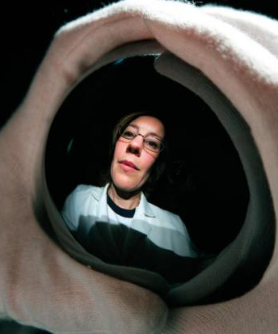
STEMM Potential
Observable
Separate
Static structure?
OR
Contingent
Contextual
Co-produced?

Slide 6

Provocations
Scientific authority does not stick to women/ unreliable knowers.
Dominant Discourse = Under-representation/ count more women into STEMM.
Essentialised/ heteronormative assumptions of gendered transformation of STEMM.
Is diversity in science appropriated for corporate branding?
Athena Swan (UK); SAGE (Australia)
Marketing Device/ Contract Compliance/ Income-Generation/ Gender Olympics?
Women and STEMM = serve neoliberal agendas?

Slide 7

The Political Economy of Neoliberalism: Cognitive Capitalism
Market Dominance
Accounts and Accountability
Meritocracy Ethic
Investment and Enterprise
Academic identity = entrepreneurs
Knowledge = innovation/ applied/ wealth creation
Funding = linked to policy narratives/ priorities.

Slide 8

Neoliberalism is…
Market fundamentalism
Harnessing desires/ aspirations to the needs of the economy
Absorbed into professional identities
A policy and affective installation
Promoting competitive individualism
Beneficial for those who comply with the performance indicators.
Valuing and rewarding the areas and activities in which elite groups have traditionally succeeded.
Neoliberalism is not…
An external, material entity
A seamless monolithic apparatus
Easily identified and resisted
Non-human
Essentially male
Just about injury or subjectification
Binary opposite of an absent, pure ‘other’/ golden age?

Slide 9

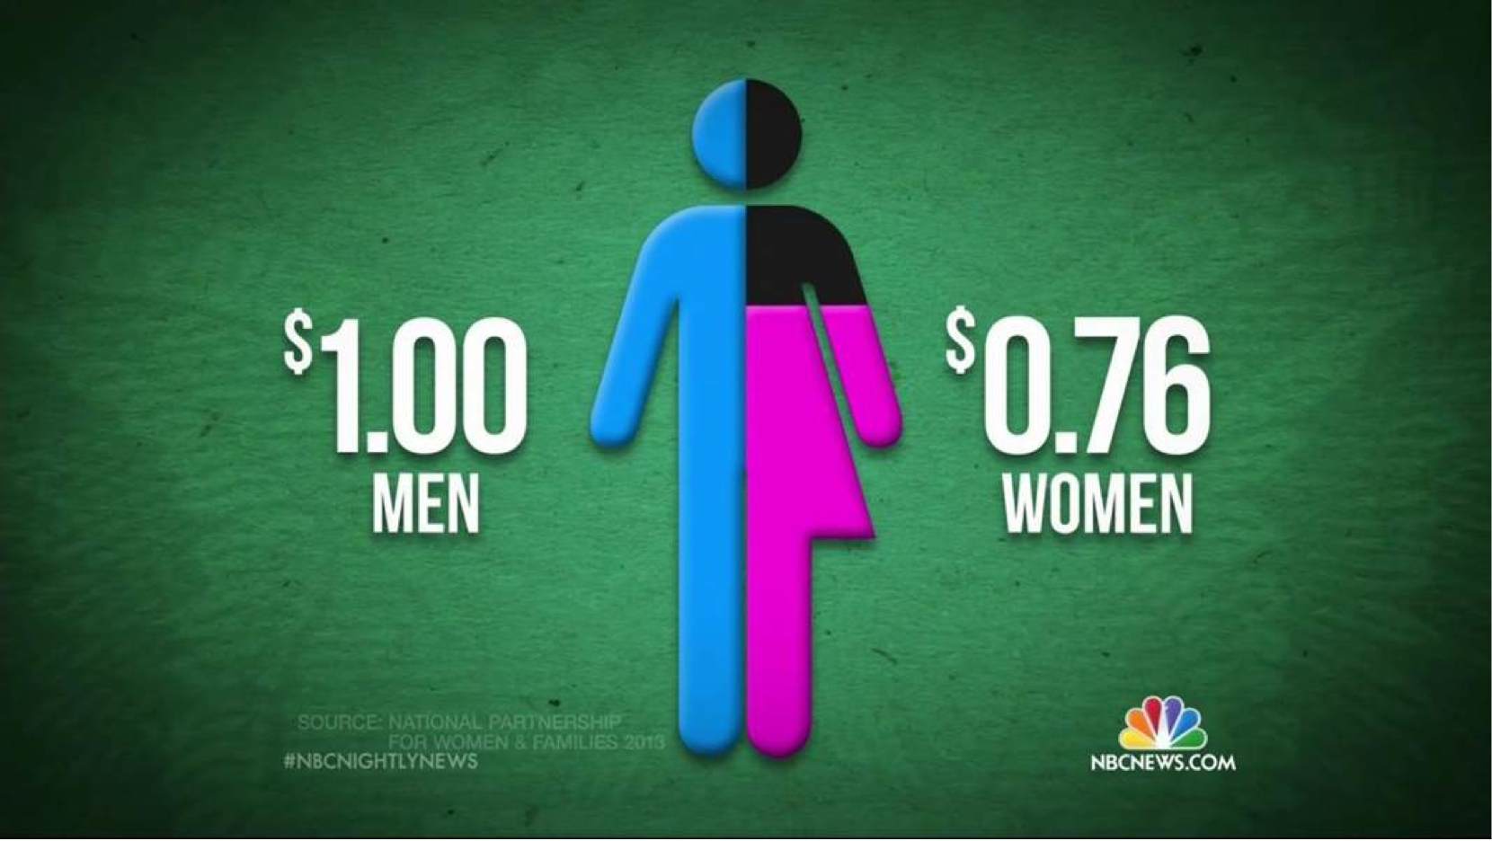

Measurement and Metrification: Ideology Posing as a Technology?
Desire for Global Spaces of Equivalence
Competitive measuring = essence of the global prestige economy
Academic labour, activity and productivity =
made intelligible via dominant metrics and norms.
What is not measured?

Slide 10
Women Vice-Chancellors:
Leading or Being Led?
SWD | UK | EU | HK | JAP | USA
50% | 22% | 15.5% | 0% | 2.3% | 26%

Slide 11

Women’s Credibility Deficit
in the Global Research Economy
Women less likely to be:
Journal editors/cited in top-rated journals (Tight 2008)
Principal investigators (EC 2011)
Awarded large grants (Husu 2014)
Awarded research prizes (Nikiforova 2011)
Conference keynote speakers
(Schroeder et al. 2013)
On high salaries in STEMM research (New Scientist 2018)
= Epistemic Injustice.

Slide 12
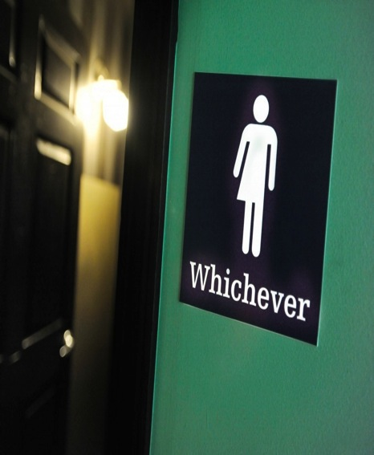
Gender:
More than a Demographic Variable
Gender as a Noun
Quantitative Change
Gender as a Verb
Gendered Power Relations:
Symbolically/ Materially
Construct/Regulate
Everyday Experiences.
Gender = formed/ re-formed in:
Organisational Cultures
Academic Disciplines
Social Relations
Postgenderism / Post Binary / Gender Fluidity
Eliminating / moving beyond gendered identities / roles / signifiers.

Slide 13

Gender and Neoliberalism:
A Complex Assemblage?
Neoliberalism is not ...
Essentially male.
Neoliberal Feminism
Women = ideal neoliberal subjects (aspirational and capacious).
(McRobbie 2009)
Gender Equality = cognitive and behavioural restructuring.
(Sandberg 2013)
Recognition of economic achievement rather than resource redistribution.
(Fraser 2013)
The new feminist = responsible for her professional success, wellbeing and work/life balance.
(Rottenberg 2014)

Slide 14

Womenomics
Has Neoliberalism Colonised/Provided a New Variant of Feminism/ Feminist Subjectivity?
Commodification of Social Struggles?
Driver for gender equality = economic, not social.
Women = New Market.
The ills of the global economy/organisations can be fixed by the incorporation of women.
Unit of analysis = individual, not collective, social structures.

Slide 15

New Epoch for Feminism:
Right Wing Cultural Capital?
Right-wing Women Self-Identifying
as Feminists
Theresa May
Marine Le Pen
Ivanka Trump
Mantras
Work/Family Balance
Lean In
Having It All
Empowerment/Confidence-Building
Women’s Rights Justify Xenophobic Politics
Gender Equality = Smart Economics/ Business Case/ Wasted Talent.

Slide 16
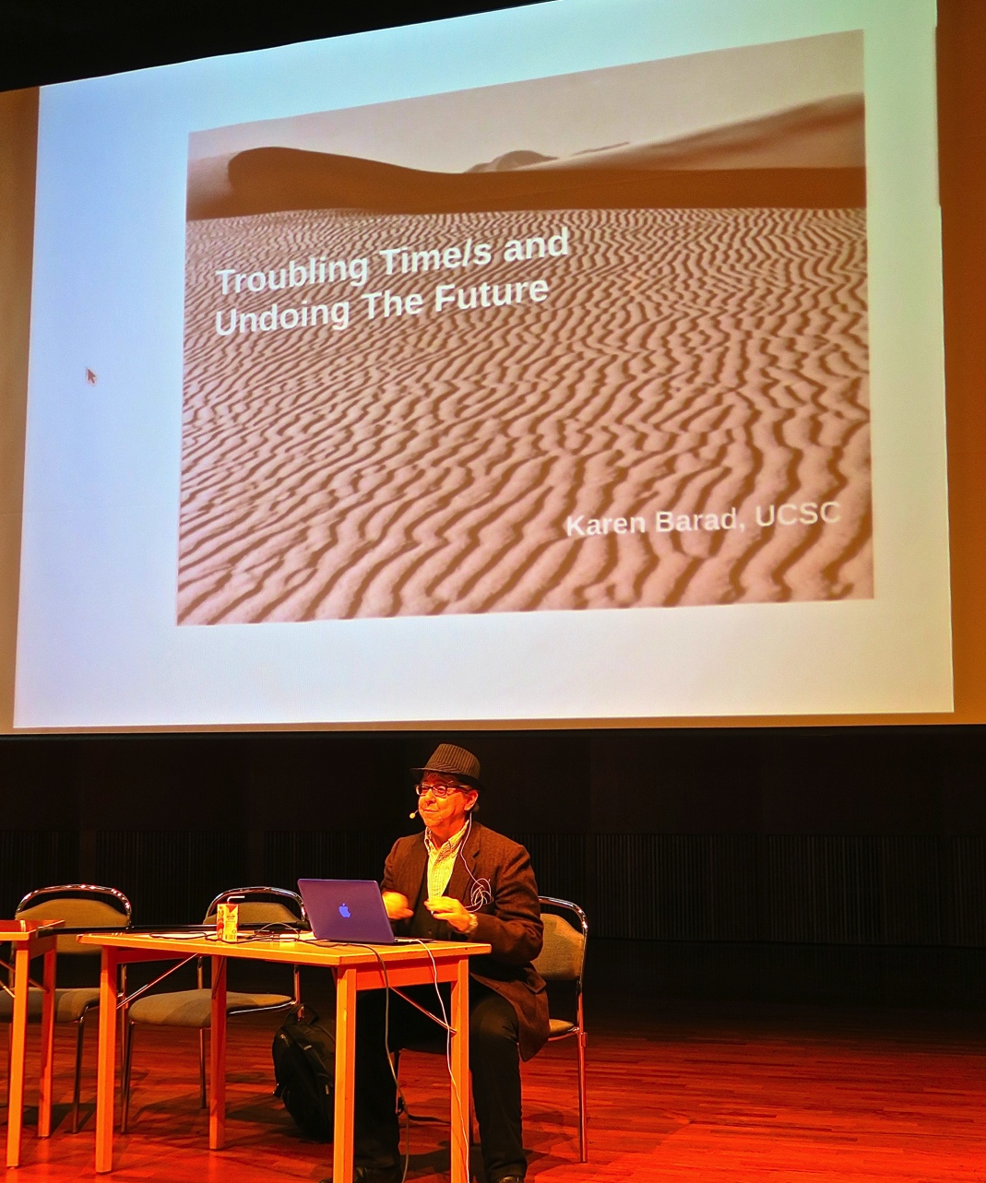
STEMMinism
Feminism is transforming STEMM
Everyday Sexism campaigns
Women’s March for Science
Larry Summers debacle
Biology is not Destiny
STEMM is transforming feminism
Karen Barad’s work on matter; and how measurement is inseparable from its ontology;
New Materialisms that link the social and the natural worlds.

Slide 17
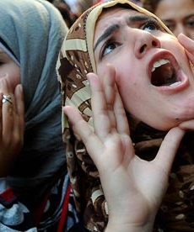
Policy Leverage
Countries with high levels of gender equality have some of the largest STEMM gaps in secondary and tertiary education.
Nordic countries = fewer than 25% of STEMM graduates are women.
Percentage of girls who would likely be successful and enjoy further STEMM study = higher than the percentage of women graduating in STEMM fields.
Why so many women in STEMM in the MENA region?
(Stoet & Geary 2018)
Interrogating Paradoxes?

Slide 18

Making Alternativity Imaginable:
How Can We ….
Create a sociology of absences
Balance increasing women’s representation with epistemic justice in STEMM
Re-invigorate STEMM knowledge production as a creative site of gendered transformation
Identify new lexicons/ vocabularies for intersecting gender and STEMM
Construct STEMMinism
Imagine, exchange knowledge and research the future of gender-free STEMM that we want to see.

Slide 19

Follow Up?
Morley, L. (2015): Troubling Intra-actions: Gender, Neo-liberalism and Research in the Global Academy.
Journal of Education Policy 31(1): 28-45.
Morley, L. (2018): Gender in the Neoliberal Research Economy: An Enervating and Exclusionary Entanglement? In, Kahlert, H. (ed) Gender Studies and the New Academic Governance. Global Challenges, Glocal Dynamics, and Local Impacts. Wiesbaden: Springer VS.
www.sussex.ac.uk/education/cheer

