Slide 1
Doing research in a feminist way? Utilising feminist methods in empirical research
Umea Doctoral Seminar,
Tuesday 15th March 2016, 11:00-12:30
Tamsin Hinton-Smith, Senior Lecturer in Higher Education and Co-Director, Sussex Centre for Gender Studies
j.t.hinton-smith@sussex.ac.uk

Slide 2
What this session will explore…
Perceived relevance of feminist perspectives to our own research – including the perhaps unanticipated
A quick (non-exhaustive) tour of feminism and methodology
Reading-based Freewriting activity
Feedback and take-home reflections

Slide 3
What are we all doing??
Explicitly feminist research?
Operationalising understandings of feminist and gender research
Unanticipated relevance of feminist methodological approaches?

Slide 4
A quick (non-exhaustive) tour of feminism and methodology including…
Feminist research pays particular attention to how identities and subjectivities are involved in the research process, for example:
  The power dynamics of the research relationship
Feminist research recognises knowledge as an intersubjective negotiation, e.g.
  The emotional impact of the research on research participants and the researcher
Feminist research frequently has political undertones and sets out to help and empower
(Contemporary!) feminist research recognises the researcher’s responsibility to exercise cultural sensitivity

Slide 5
‘doing rapport’ and ‘faking-friendship’ as perceived ‘skills’ in conducting qualitative research
Duncombe, J. and Jessop, J. (2012) ‘Doing rapport’ and the ethics of faking friendship. In: Miller, T. Ethics in qualitative research. Los Angeles and London: Sage, 2nd edn.; 108-121.

Slide 6
Benefits of feminist methodological insights to all research:
Key contributions include:
Exposing androcentrism of focus and approaches in disciplines
Critique of ‘gender-blind’ research
Early focus on exclusion
Developed focus on:
  oppressive practices in research process
  oppressive ends of research
  Research should be on, for, and by/with subordinate groups.

Slide 7
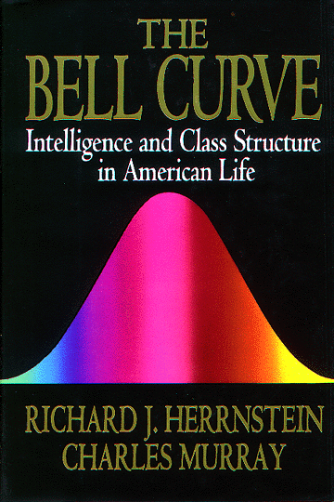

Slide 8
Critique of ‘feminist as tourist model ’ (p.518)
Mohanty, C. (2003) “Under wstern eyes” revisited: Feminist solidarity through anti-capitalist struggles.’ Signs 28(2): 499-535
Researcher as ‘traveller’ rather than tourist, ‘wandering together with’ participants in the process of arriving at insight (Kvale, 1996: 4).
Kvale S (1996) InterViews: An Introduction to Qualitative Research Interviewing. London: Sage.
‘Speaking nearby’ rather than ‘for’ marginalised groups
Chen, N. (1992). Speaking Nearby: A Conversation with Trinh T. Minh–ha. Visual Anthropology Review 8(1), pp. 82-91.

Slide 9
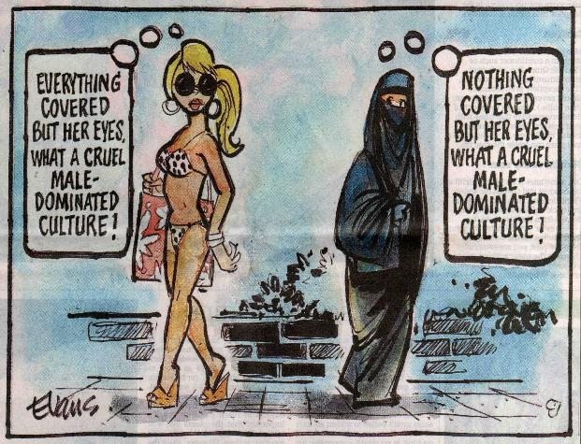

Slide 10
Critique of objectivity:
Objectivity as a masculine concept.
Objectification of researched.
Researcher as ‘expert’.
Objectivity as unattainable.
But research can be honest and systematic

Slide 11
Awareness of power relations:
Research relationship as shot through with power
  Feminism and reinvention of the research relationship
The complexity of power relations - the potential for inversion
- LAC mentoring & knowledge-flow (O’Shea, S. (2015) ‘Avoiding the manufacture of ‘sameness’: first-in-family students, cultural capital and the higher education environment.’ Higher Education, p. 1-20.
Power and responsibility (Guillemin, M. & Gillam, L. (2004) ‘Ethics, Reflexivity, and ''Ethically Important Moments'' in Research.’ In Qualitative Inquiry 10: 261.)

Slide 12
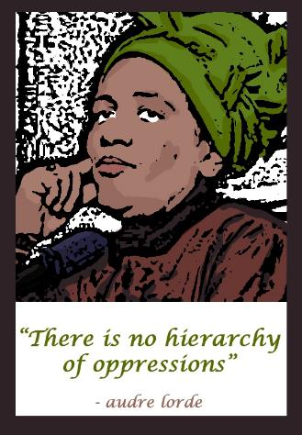
The relevance of power to our research (including methodologies)

Slide 13
Personal experience:
The personal is political
Rejection of excessively ‘rational’ research approaches
Power to participants as knowledge agents
Significance of researcher’s experience
But:
Experience not an end in itself

Slide 14
Scott et al. (2012) have noted a ‘flurry of reflexive, confessional tales about experiences in the field… emerging in contrast to the empiricist repertoire that had provided formal, sanitised accounts of data collection’ (p.716).
Scott, S. Hinton-Smith, T., Härmä, V. and Broome, K. (2012) ’The reluctant researcher: shyness in the field.’ Qualitative Research 12(6) 715-734

Slide 15
Including the researcher:
Researcher reflexivity - research design, conduct and analysis
Critique of ‘hygienic’ research write-up.
Contrast with real research
Strength of acknowledging problems
Creation of shared meanings through negotiation with research participants

Slide 16
Textbook interviewing
One-way, interviewee passive
Interviewee as objectified data
Content to be quantified
Rapport = loss of objectivity
Neutrality – keep researcher out
Value-free
Academic dissemination
Feminist interviewing
Two-way, interviewee active
Interviewee as knowledge agent
Meanings to be analysed
Rapport aids investigation
Openness/controlled informality
Politically committed
Use of research to empower

Slide 17
Practical activity based on readings
Mohanty, C. (2003) “Under wstern eyes” revisited: Feminist solidarity through anti-capitalist struggles.’ Signs 28(2): 499-535
Oprea, A. (2004) ‘Re-envisioning Social Justice from Ground Up: Including the Experiences of Romani Women.’ Essex Human Rights Review 1(1), pp.29-39.

Slide 18
Freewriting the relevance of feminist perspectives to our own research
To what extent does your research currently incorporate methodological elements that are either consciously feminist, or inline with feminist methodological values?
How are/might feminist epistemological perspectives and methodologies be further relevant to your research? Does incorporation of these imply any changes to your approach?

Slide 19
Small group discussion
How did you find the freewriting process?
Have you used this before and are there any new ways you think it could be useful for your HE practice? (planning research and writing; collecting data; teaching?)
What ideas did the process generate for you, including but not restricted to, your current research and the relevance of feminist methodological approaches to this

Slide 20

Take-home thoughts?

