Slide 1

Aurora Alumni Conference
Wednesday 27 April 2016
Radisson Blu Portman, London
TITLE:
LOCATION:
DATE:
XXXXXX
XXXXXX
XXXXXX

Slide 2

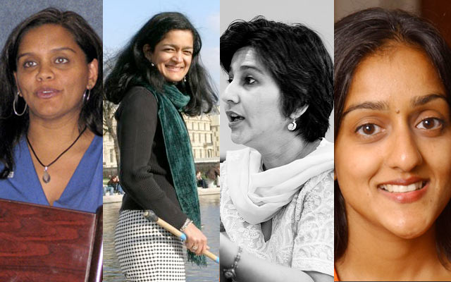
Diversifying Higher Education Leadership
Professor Louise Morley
CHEER
(Centre for Higher Education and
Equity Research)
University of Sussex, UK
http://www.sussex.ac.uk/education/cheer

Slide 3
Women Vice-Chancellors: Leading or Being Led?
NOR | US | UK | INDIA | JAPAN | HONG KONG
31.8% | 26% | 17% | 3% | 2.3% | 0%

Slide 4
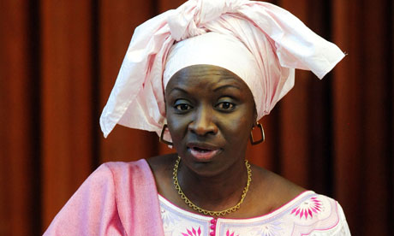
Making Women Intelligible as Leaders?
What is it that people don’t see?
Why don’t they see it?
What do current practices reveal and obscure?
Women leaders = contextual discontinuity/interruptive in their shock quality.
Aminata Touré, Prime Minister of Senegal, 2013-14

Slide 5

Leadership Potential
Observable
Separate
Static structure?
OR
Contingent
Contextual
Co-produced?

Slide 6

A Two-Way Gaze?
How are women being seen e.g. as deficit men?
How are women viewing leadership e.g. unliveable lives?
What narratives circulate about:
women’s capabilities?
leadership?

Slide 7

Diversity = Representational Space?
Norm-saturated (essentialising/homogenising) policy narratives
Add under-represented groups into current systems
=
distributive justice/ smart economics
organisational and epistemic transformation.
Gender = demographic variable
Diversity = business case?
Sociology of absences?

Slide 8
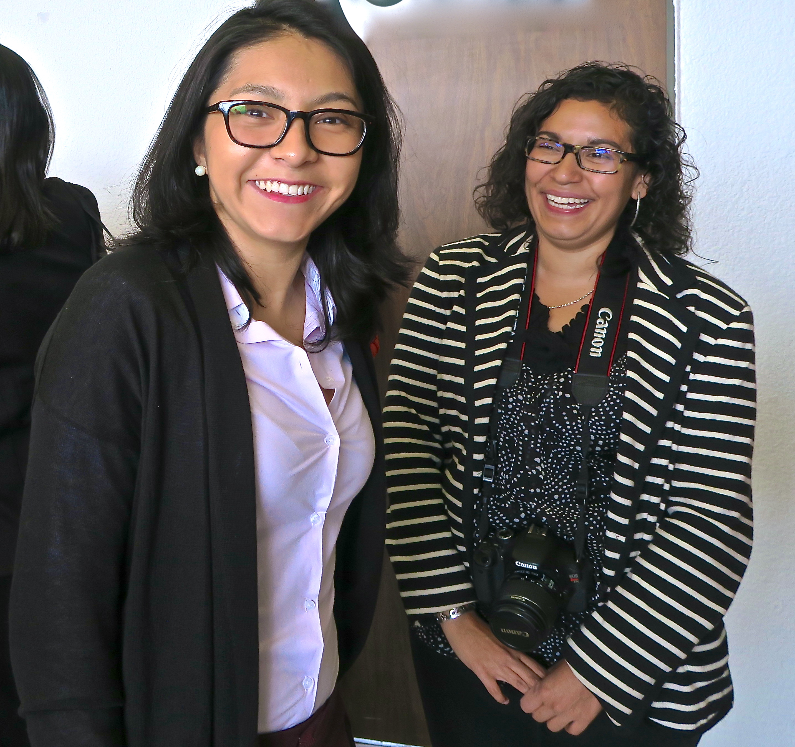
Diversity
Values, not just Bodies
A Verb + a Noun
Gender = social practice:
Produced
Reproduced
Relayed
Negotiated
Reshaped
Contested
Via quotidian transactions/practices.

Slide 9

Researching Women in Leadership
International Literature Reviews (Morley, 2013)
South Asia Project
Policy/ Statistical/ Literature Review/Interviews- 19 women and 11 men (Morley & Crossouard 2015, 2016)
Malaysia Project
36 Questionnaires/ 1 Focus Group (Morley et al 2016)
East Asia and MENA Project 20 Questionnaires/ 3 Discussion Groups: Australia, China, Egypt, Hong Kong, Indonesia, Japan, Jordan, Kuwait, Malaysia, Morocco, Pakistan, Palestine, the Philippines, Singapore, Thailand, Turkey , UK (Morley, 2014).
What makes leadership attractive/unattractive to women?
What enables/supports women to enter leadership positions?
Personal experiences of being enabled/ impeded from entering leadership?

Slide 10
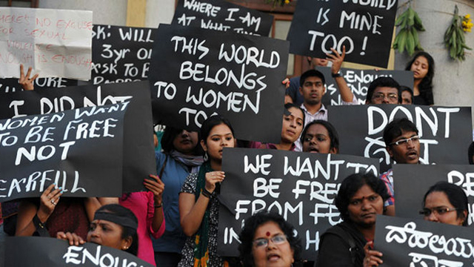
What Attracts Women to Senior Leadership?
Power
Influence
Values
Rewards
Recognition

Slide 11

Why is Senior Leadership Unattractive to Women?
Policy Context
Neo-liberalism/ Performance/Audit Cultures/Financialisation/Prestige Economy/Pre-determined Scripts
Intellectual
Passionate commitment to research/ academic discipline
The Affective Economy
Being ‘Other’ in male-dominated cultures
Rejection Disrupting the symbolic order
Working with resistance, recalcitrance, truculence, ugly feelings
Unhealthy
Restricting
not
Building capacity and creativity.

Slide 12
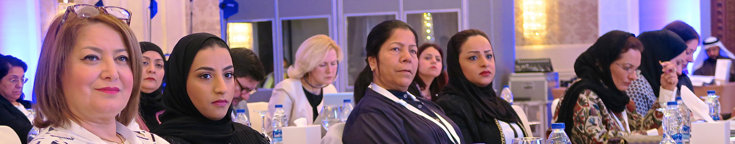
Provocations
Gender
Escapes the policy logic of the turbulent global academy?
Women’s capital
Devalued/misrecognised in the knowledge economy?
Cultural scripts for leaders
Coalesce/collide with normative gender performances?
Decision-making and informal practices
Lack transparency/accountability/reproduce privilege?

Slide 13

Reimagining Higher Education
Who Should Lead?
What Do We Wish to Lead?
What is Our Vision of the University of the Future?
How do we transform leadership narratives/ discourses/ practices
Generative
Generous
Gender-free

Slide 14
Follow Up?
Morley, L. and Crossouard, B. (2016). "Gender in the Neoliberalised Global Academy: the Affective Economy of Women and Leadership in South Asia." British Journal of Sociology of Education 37(1): 149-168.
Morley, L. et al. (in press, 2016) Managing Modern Malaysia: Women in Higher Education Leadership. In, Eggins, H. (Ed) The Changing Role of Women in Higher Education: Academic and Leadership Challenges. Dordrecht: Springer Publications.
Morley, L. & Crossouard, B. (2015) Women in Higher Education Leadership in South Asia: Rejection, Refusal, Reluctance, Revisioning. Pakistan: British Council.
Morley, L. (2015). Troubling Intra-actions: Gender, Neo-liberalism and Research in the Global Academy. Journal of Education Policy 31(1): 28-45.
Morley, L. (I2014) Lost Leaders: Women in the Global Academy. Higher Education Research and Development 33 (1) 111–125.
Morley, L. (2013) "The Rules of the Game: Women and the Leaderist Turn in Higher Education " Gender and Education. 25(1):116-131.
Morley, L. (2013) Women and Higher Education Leadership: Absences and Aspirations. Stimulus Paper for the Leadership Foundation for Higher Education.
Morley, L. (2013) International Trends in Women’s Leadership in Higher Education In, T. Gore, and Stiasny, M (eds) Going Global. London, Emerald Press.

