Slide 1
Prevent/ing Criticality? Critical Thinking in the Politics Classroom
Dr Emily Danvers
Department of Education, Centre for Higher Education and Equity Research (CHEER)

Slide 2
Re-thinking critically
Research into critical thinking and its application in pedagogic practice often presume a decontextualised critical ‘subject’ who applies a series of rational, cognitive processes to interrogate truth claims objectively.
Who is a critical thinker and what critical thinking is intersects with students’ identities and the socio-political context in which criticality is performed (Danvers, 2018)
The Counter-Terrorism and Security Act 2015 imposes a legal duty upon UK universities to develop strategies and monitoring mechanisms to prevent students from being drawn into radicalisation and to report those deemed vulnerable (HEFCE, 2016). How might we re-think the context in which critical thinking takes place using the Prevent Duty as an analytical lens?

Slide 3
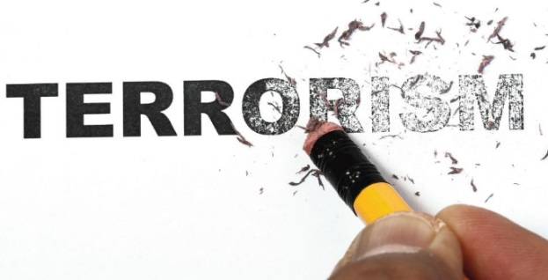
Research provocations
Greer and Bell (2018) - Concerns around Prevent based on myths and misconceptions. Lack of evidence to support the claim that it jeopardises free inquiry and debate.
But also the securitisation of educational settings inevitably limits freedom of expression (Taylor & Soni, 2017; Saeed and Johnson, 2016). Linked to teacher risk-avoidance and student silence, particularly among ‘suspect communities’ adding a racialised dynamic to its agenda (McGarry & Mythen, 2015).
Prevent as a context in which to re-think critical thinking raises questions about:
  Whose ideas/bodies are ‘at home’ within higher education (Ahmed, 2012)
  What are the conditions of intelligibility that render certain moral claims/debates legible and others mute’? (Mahmood, 2009)

Slide 4
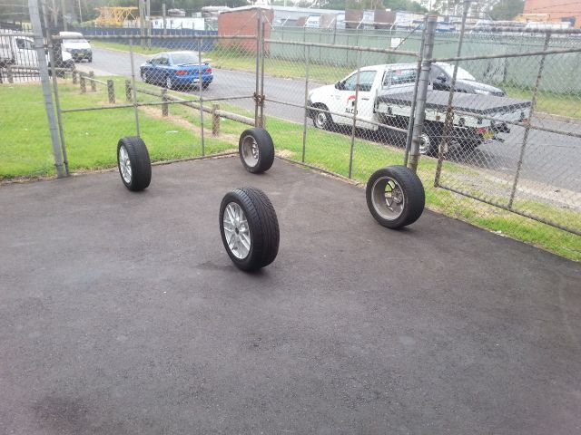
The research (in progress)
Small-scale scoping research into the impacts of Prevent on ‘critical’ higher education teaching and learning practices.
Semi-structured interviews with 15 academics of diverse backgrounds, career levels and in 3 institutions.
Focus on ‘Politics’ classrooms as a space in which ‘Prevent’ might substantively emerge and be contested.
Progress stalled but some early reflections.

Slide 5

1. Instrumentalising logic
Prevent operationalised alongside consumer/inclusion discourses as a ‘common-sense’ risk-averse logic for higher education pedagogies:
‘When the module was being evaluated, the concern from our Head of Department was that it would upset Muslims, and given that Muslims make up a constituent part of the post graduate student body, it seemed to be self-defeating to have that kind of content discussed…the ironic thing is that those modules have attracted a significant number of Muslim students who have taken part fully in those discussions have been a lot more comfortable dealing with those topics than anyone, any well-meaning politically correct academic would have given them credit for’

Slide 6

2. Reflexivity and academic distaste
Decisions around prevent provoked a reflexive ‘policing’ as they rubbed up against personal views, identities, social relations and pedagogies:
‘The guy who was flagged up was someone who was expressing a lot of views that were unpalatable to us, as left wing academics, whereas the person who expressed a defence of violence extremism was, I suppose, just seen as being a bit of an eccentric and the thought was well, that’s a view which is unpalatable, but if we report this person, it looks like we’re being Islamaphobic or racist’.

Slide 7
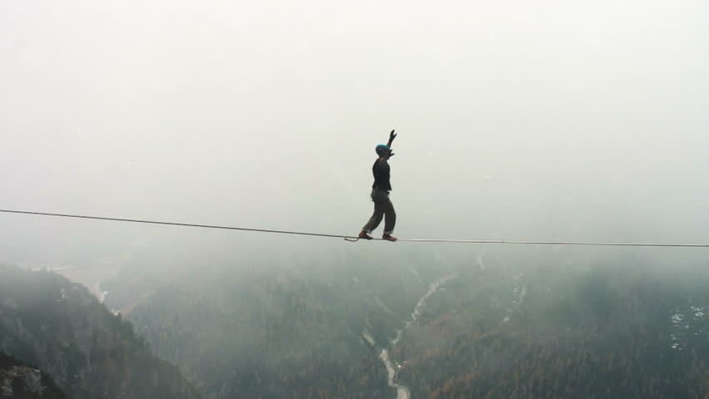
3. Speaking mind/minding speech
Students and their critical thinking emerged in highly political (but often implicit) classroom contexts of both implicit and explicit rules alongside the encouraged ‘freedom’ to express:
‘I'm a politically engaged sociologist and that means that, you know, I do wear my politics on my sleeve, but I also try and give the students the best sense of what I think the evidence show….So when it comes to evidence to the cause of terrorism for example, I don’t feel the need to sort of stress the official line as much … So I think to a certain extent I'm always trying to give students a balanced view…And I'm certainly making an effort not to propagandise in the classroom’

Slide 8
Reflections on the data
Prevent using a narrow logic for pedagogic complexity
‘Objective’ judgement based on contextual, reflexive policing
Critical thinking as speaking mind but also minding speech

Slide 9
Emerging thoughts and questions
Prevent as affectively loaded - self-policing of interview narratives as indicative of sensitivities emerging from Prevent – from surveillance to concerns around ‘political correctness’.
Who/what gets legitimated and who/what is silenced within educational spaces emerges through relations with broader structures of departmental politics, pedagogical relations, institutional cultures. Need to move beyond faculty accounts.
White students with problematic views pathologised as ‘troubled’, Muslim students as ‘dangerous’ - identity clearly shaped perceptions of both risk and vulnerability as well as whose views could be made legible/mute (Mahmood, 2009).
Specific parallels between Prevent and critical thinking in that they can be seen as neutral technologies but are contextual, contingent and shaped by who is ‘at home’ (Ahmed, 2012) in higher education institutions, disciplines and classrooms.

Slide 10
References
Ahmed, S. (2012) On Being Included: Racism and Diversity in Institutional Life. Durham NC: Duke University Press.
Danvers, E. (2018) Who is the critical thinker in higher education? A feminist re-thinking. Teaching in Higher Education.
Greer, S & Bell, L (2018). Counter-terrorist law in British Universities: A review of the 'Prevent' debate. Public Law: 84-105.
HEFCE (2016). Updated framework for the monitoring of the Prevent duty in higher education in England. Bristol: HEFCE.
Mahmood, S. (2009). Religious Reason and Secular Affect: An Incommensurable Divide?," Critical Inquiry 35 (4): 836-862.
McGarry, R., & Mythen, G. (2015, 2nd March). Beware the security creep in British universities. The Conversation. Retrieved from beware-the-security-creep-into-british-universities-37867
Saeed, T., & Johnson, D. (2016). Intelligence, Global Terrorism and Higher Education: Neutralising Threats or Alienating Allies? British Journal of Educational Studies, 64(1): 37-51. doi:10.1080/00071005.2015.1123216
Taylor, L., & Soni, A. (2017). Preventing radicalisation: a systematic review of literature considering the lived experiences of the UK’s Prevent strategy in educational settings. Pastoral Care in Education, 35(4): 241-252. doi:10.1080/02643944.2017.1358296

