Slide 1
Covid-19 and Higher Education: Never Let a Good Crisis Go to Waste!
CENTRE FOR HIGHER EDUCATION AND EQUITY RESEARCH
Professor Louise Morley

Slide 2

* Inequalities
* Vulnerabilities
* Power asymmetries
* Exclusionary practices
* Affective antagonisms
* Violence
* Socio-material entanglements.
It is not the agentic capacity of the virus that has caused the current chaos.
Rather
The crisis has exposed a global vulnerability, and strengths and weaknesses of the dominant imaginaries and infrastructures underpinning the symbolic norms they represent
(Fotaki et al, 2020; Morley & Leyton, forthcoming).
The Covid-19 Pandemic as a Non-Human Force: Magnifier and Intensifier

Slide 3
Berlant’s Prediction
The genre of crisis is itself a heightening interpretive genre, rhetorically turning an ongoing condition into an intensified situation in which extensive threats to survival are said to dominate the reproduction of life. (2011: 7)

Slide 4
Ruthlessness and fragilities of the neoliberal economy revealed.
* University closures
* Staff redundancies
* Increased privatisation
* Pandemic pedagogy
* Courses rapidly migrated online
* The Home = The Workplace
* International mobility interrupted
* International students reimagined from commodities to biohazards.
Higher Education Crisis Responses

Slide 5
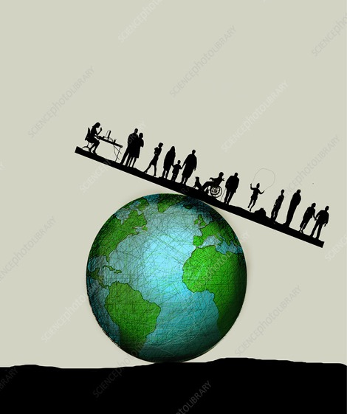
* Casualised workers losing their contracts and the threat of hiring freezes (Neilson 2021).
* Early, mid, and late-career scholars are threatened with compulsory redundancy in the UK, for example (Fazackerley, 2021).
* More than 17,000 people have lost their jobs, across all grades in Australian universities (Zhou, 2021).
Pandemic Precarity

Slide 6
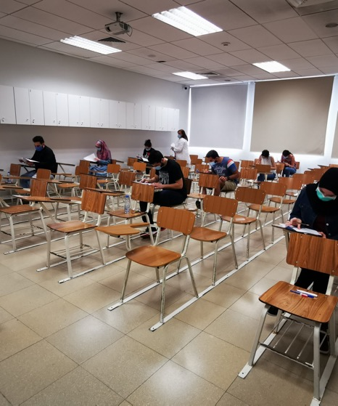
Pandemic legitimated:
* Austerity
* Purging
* Reshaping
The good life promised by engagement with the life of the mind, and its associated:
* Cosmopolitanism
* Credentialisation
* Social networking
* Employability
Disrupted by the introduction of the new and unforeseen bodily fragilities and vulnerabilities.
Higher Education in Survival Mode

Slide 7
Academics in the Epistemics of Obliteration
Academics gaining visibility and accolades as anointed public intellectuals through their scientific expertise, and professional flexibility in migrating courses online.
Academics as ungrievable, disposable bodies of little or no value in neoliberal universities’ cost-cutting exercises.

Slide 8
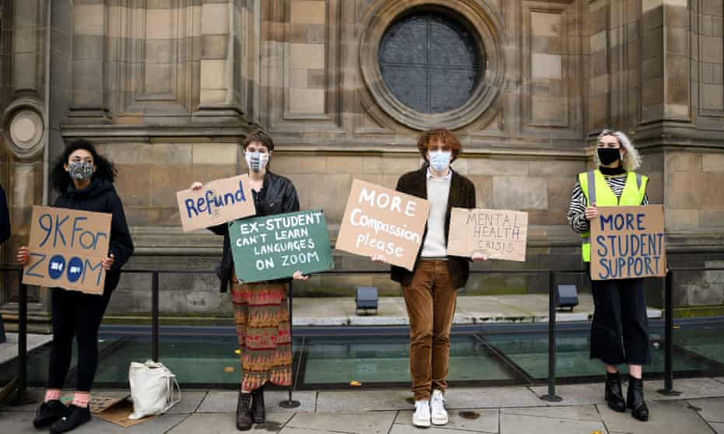
* Victims of the disruption to face-to-face teaching and age-appropriate socialising (Anderson, 2020).
* Vulnerable to mental health challenges (Villani et al, 2021).
* Guilty of cavalier attitudes to lockdown, with pandemic partying widely reported (Lyden, 2020).
* ‘Invincibles’ with self-extinguishing tendencies, and belief in the invulnerability of the young (Lam, 2021).
Almost a third (31%) of students reported being dissatisfied with their academic experience since the start of the autumn term 2020;…Over half (55%) reported being dissatisfied with their social experience since the start of the autumn term 2020 (ONS UK survey, 2021: np.)
Students: Dissatisfied Consumers?

Slide 9

Despite long-term social disruption, including:
* Increased sickness
* Unemployment
* Bereavement
* Mental health crises
* Financial insecurity
Business as usual, or toxic productivity, has triumphed in higher education (Smith, 2020).
Toxic Productivity

Slide 10

* Globalisation = provided the vectors for the neoliberalism’s thriving.
* Neoliberalism = enabled and promoted globalisation.
* Globalisation = facilitated the ideal preconditions for going viral.
We’re All in This Together? The Politics of Vulnerability

Slide 11
The current virus, with its:
* Mutation
* Repetition
* Transformation
* Transmission
Mimics the network society by demonstrating:
* Porosity
* Interdependence
* Connectivity
* Global commodity chains
Dislocation of the entire global economy.
The Network Society/ Age of Contagion

Slide 12
The pandemic has highlighted:
* Biopower
* Social class and racialised hierarchies (Butler, 2015).
Disposable bodies = necropolitics in action (Mbembe, 2011).
Reinforcement of ageist, classist and racist discourses of ‘the other’.
Unequal health and spatial arrangements.
Vaccine Inequalities.
Necropolitics: Whose Lives Matter?

Slide 13
Naomi Klein (Viner, 2020: np) observed: ‘And if you were disposable before, you’re sacrificial now’.
Mike Davis (2020 np) argued that twenty-first-century capitalism points to “a permanent triage of humanity…dooming part of the human race to eventual extinction.”
Braidotti (2013) also reminded us: ‘we are all humans, but some of us are just more mortal than others’ (p. 15).
* Necropolitics applies to bodies and to institutions.
* Which universities are disposable?
* Does this relate to socio-economic privilege?
Disposable Bodies?

Slide 14
Potent affective economy of:
* Fear
* Grief
* Anxiety
* Anger
* Shame
* Frustration
Congregation has been digitised, and tech is mediating many of our relationships.
Mass Global Sensorium

Slide 15
Home has been revised to contain and assemble:
* Schooling
* Working
* Shopping
* Digitised Sociality
* Shielding
The discursive construction of home as a place of safety in the face of contagion has unmasked further boundaries between privileged and abject communities.
Reports of the increase of domestic violence, homophobia, and gender-normative divisions of labour.
Home, Sweet Home?

Slide 16
USA Survey on why students turned off their cameras in online lectures among under-represented minorities:
* 38% said they were concerned about other people being seen behind them
* 26% were concerned about their physical location being visible
(Castelli and Sarvary, 2021).
Lockdown assumes:
* that everyone has a home
* it is capacious and not over-populated
* the home or household is a space of shelter and protection.
Exposing Domestic Life

Slide 17
The pandemic =
* Is a form of violence – unequally distributed across different social groups.
* Allows biopolitics to degenerate into necropolitics, as some lives are seen as more dispensable than others.
* Exacerbates norms and continuities.
* Enables university managers and policymakers to accelerate neoliberal values in higher education via crisis discourse.
Moving On?

Slide 18
Can the Great Pause facilitate new imaginaries for breathable epistemic and social futures in higher education that disrupt the stale, tired repetitions of cognitive capitalism, heteronormativity, and tediously predictable social exclusions?

Slide 19
Morley, L. & Leyton, D. (forthcoming) Queering Higher Education:
Troubling Norms in the Global Knowledge Economy. London: Routledge.

Slide 20
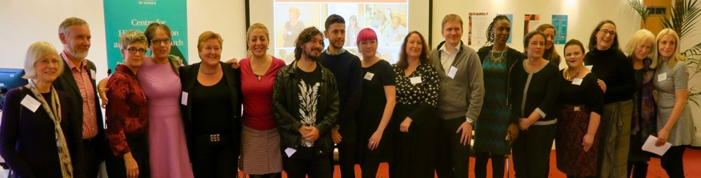
CHEER Website: www.sussex.ac.uk/education/cheer
Twitter: @SussexCHEER
Facebook: www.facebook.com/groups/CHEERSussex/

