Slide 1

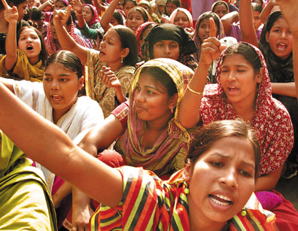
Women in Higher Education
Leadership in South Asia:
Rejection, Refusal, Reluctance, Re-visioning
Diversity, Democratisation and Difference: Theories and Methodologies
Professor Louise Morley
Dr Barbara Crossouard
Centre for Higher Education
and Equity Research (CHEER)
University of Sussex, UK
www.sussex.ac.uk/education/cheer

Slide 2
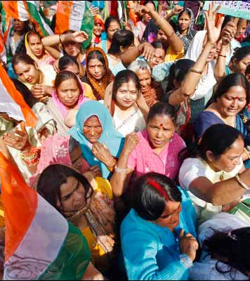
Provocations:
Identifying Women Leaders
What is it that people don’t see?
Why don’t they see it?
What do current practices reveal and obscure?

Slide 3
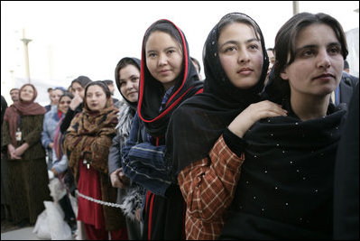
Making Women Intelligible as Leaders: A Two-Way Gaze?
How are women being seen e.g. as deficit men?
How are women viewing leadership e.g. unliveable lives?
What narratives circulate about:
women’s capabilities?
leadership?

Slide 4
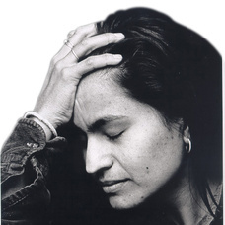
The Affective Economy of
Higher Education Leadership
Affect
Historically dismissed in Western thought
Devalued in binary thinking
Revisited in post-structural writers (Ahmed 2004, 2010)
‘Sticks’ to objects and bodies e.g. shame, hatred, love
Works as a form of capital/ ‘affective economy’
Is intensified / accrues value through circulation
Integral to the production of social and material realities.

Slide 5
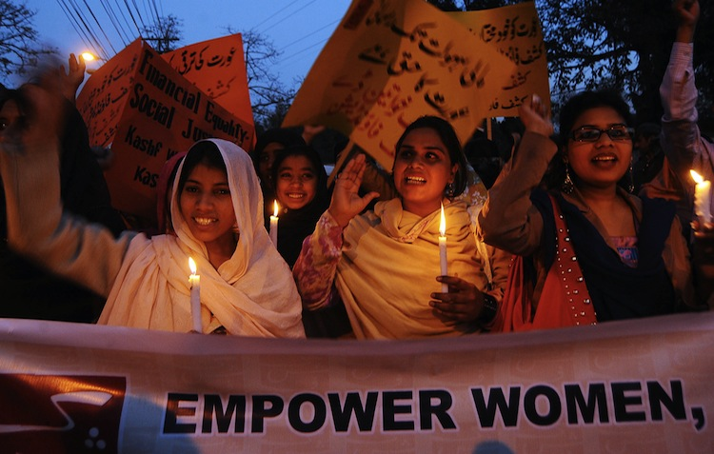
Evidence
Literature and Policy Review
Statistical Review
30 Interviews
(19 women and 11 men) Afghanistan, Bangladesh, India, Nepal, Pakistan, Sri Lanka.
What makes leadership attractive/unattractive to women?
What enables/ supports women to enter leadership positions?
Personal experiences of being enabled/ impeded from entering leadership?

Slide 6
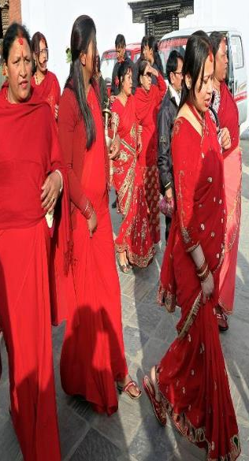
Where are the Women?
Lack of Gender-Disaggregated Statistics
No linear trends in women’s representation
Numbers of female academics have increased
Gender distribution of male to female academics unchanged
Significant differences by disciplinary field of studies
Absent from Senior Leadership

Slide 7
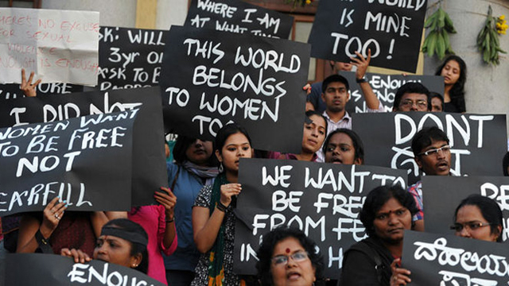
Policy Silences
Gender = category of analysis for female students, not staff.
Quality, not Equality = knowledge economy, good governance, STEM, digital economy.
Lack of Research-based Evidence.

Slide 8
Where are the Women?
Academic staffing of HEIs in Afghanistan, 2004-2012, data courtesy of British Council
Numbers of female academics have increased
No linear trends in women’s representation
Gender distribution of male to female academics unchanged

Slide 9
Where are the Women?
% of Female Academics per Field of Study
UGC Sri Lanka, 2010, 2011, 2012
Significant differences by disciplinary field of studies
No linear trends in women’s representation

Slide 10
Where are the Women?
% of Female Academics by academic position
UGC Sri Lanka, 2010, 2011, 2012
Women equally represented only at lecturer level
Significant gender inequalities continuing at all other levels

Slide 11
Women Vice-Chancellors: Leading or Being Led?
UK | NOR | INDIA | NEPAL | PAK | SRI LANKA
17% | 31.8% | 3% | 0% | 0.04% | 21.4%

Slide 12
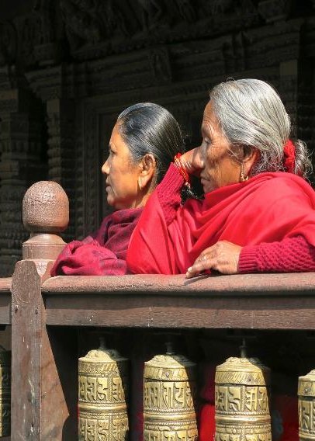
Narrating Difference
Recruitment and Selection
(Political/lacking transparency)
Passionate attachment
(Disciplines/ research)
Authority
(Does not ‘stick’ to women)
Gendered Divisions of Labour
(Women = domestic domain)
Exclusionary Networks
(Male Domination/ sexual propriety)
Hostile cultures
(Toxic/ stressful)

Slide 13
Men Cloning Themselves
I think it’s to do with liking this gender power relationship. Some of the senior male academics who always want to have it go, even for an acting position, to another male…I think it is something to do with this gender power relationship…A lot of males in Sri Lanka believe that for women administration is not right. (Female Dean, Sri Lanka)
They are used to seeing men as leading, right? So they are uncertain how will it be if it is a woman? Because they have not seen many. So I think it’s a fear of uncertainty. And the society is not ready to take that risk so a known evil is better than unknown. (Female Professor, Sri Lanka)

Slide 14
Entitlement Cultures and Knowing One’s Place
The men they also do not like the female to be a leader, that I have also faced the problem…They want to see the male as the leader, not the female.
(Female Dean, Nepal)
I have presented three papers abroad… People get jealous instead of feeling pride that’s she growing…I realised that people are so jealous of people who, especially women, who were growing and getting out of the institution.
(Female Senior Lecturer, Pakistan)

Slide 15
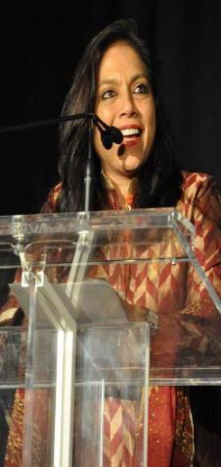
Passionate Attachments to Research
So there was one Senior Professor I was talking to, a very dynamic lady, very good researcher and internationally known and I said: ’Why are you not taking Headship of the Department?’ and she says: ’It is too much of headache, too much of politics to manage and this will hamper my research. This will hamper my work/life balance’, and she says: ‘Anyway I’m not inclined’ okay? (Female Director, India)
I have been advised that I should forget about my disciplinary advances, which I'm not ready to, as yet, let go, so. I think for the next five years I will still trade off or balance these two roles. If I had the choice of moving to another place as a director and leave my lab behind, I don't think I'm ready for that. I would continue doing my research and work in the lab. (Female Dean, India)

Slide 16
Self-doubt and Isolation
You have to keep proving every time yourself okay? Whereas somebody sits in that position of power, he need not prove, but a lady has to prove every time. (Female Director, India)
I think it’s the burden and the stress of working in a senior leadership position, which makes it unattractive. Most of the people and most of the women realise that it’s a very lonely job up there. (Female Registrar, Pakistan)
I'm alone, even today I'm the only university-wide woman dean, I'm the only woman in the series of directors, deputy directors, university-wide deans and associate deans…then in these evenings when there's a networking dinner, you are completely left out. (Female Dean, India)

Slide 17
Corruption Fears
Also in Sri Lanka this administration is somehow a dirty game…Rightly or wrongly, many of them are blamed for financial irregularities and things like that so I think women are more sensitive. We might be thinking okay, why go into that mess?...Corruption leading to all kinds of remarks and all kinds of things like that. (Female Professor, Sri Lanka)
I think that good governance should be there… the governing body. Some of the members are from the government officials, so there is also chance of the corruption there ...So these kinds of policies… personal interest, government affiliations, political affiliations, also the politics, these are the factors, you know, that discourage the women to come to the higher leadership positions. (Male Assistant Professor, Pakistan)

Slide 18
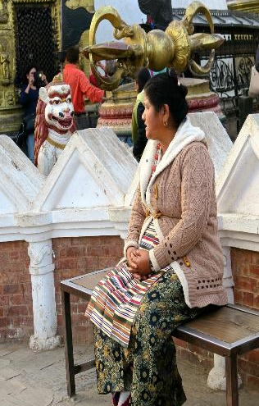
Gendered Dispositions
This stereotype definition of leadership, probably that is what matters. …. But the way society understands is probably for certain roles a person has to be really aggressive or something, which the woman could have handled in a different way, not showing that kind of aggression per se. But then you are not selected for the role in the interview if you don’t look like you can kill something
(Female Assistant Professor, India)

Slide 19
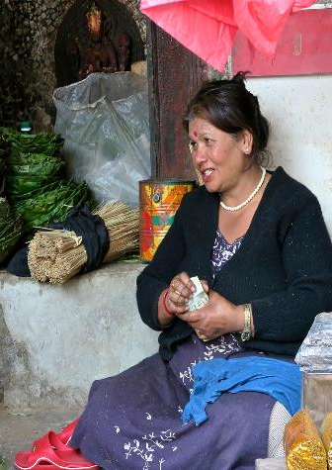
Gendered Divisions of Labour
I need to spend about 8 hours a day just on administration, on really quite useless things. And of course I also have my research – however in my situation, as a man I can manage both, and spend time on those other aspects when I get home. However, when a woman gets home, she is involved with the family – so women will avoid those kinds of admin posts – they are doing very well as associate professors, as assistant professors, as students, as doctoral students, but their inclination is to the family, and not to put themselves forward for these kinds of posts where there is a lot of administration.
(Male Head of Department, Pakistan)

Slide 20
Gender Appropriate Behaviour
There is not closed culture for the men, they are free to go outside but the women cannot because it’s prohibited in some place of my country, for the women go alone abroad without their husband. (Female Vice Dean, Afghanistan)
You know a woman if she’s networking and lobbying then immediately she’s branded as being very ambitious and very pushy. (Female Pro-Vice Chancellor, Bangladesh)
One of our PVCs dresses quite flamboyantly… you know, wearing trousers is frowned upon in the university... So now, when she applied for the VCship, she stopped wearing trousers and got a sari. So I want a place where you don’t have to make such choices, make such compromises. (Female Professor, Sri Lanka)

Slide 21
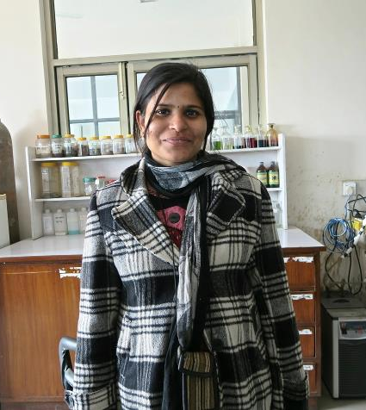
What Attracts Women to Senior Leadership?
Power
Influence
Values
Rewards
Recognition

Slide 22
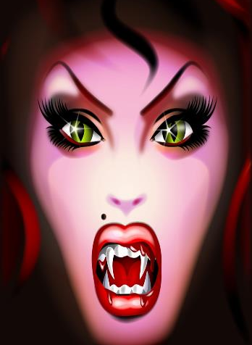
Why is Senior Leadership Unattractive to Women?
Neo-liberalism/ Performance Cultures
Being ‘Other’ in male-dominated cultures
Disrupting the symbolic order
Corruption/ Financialisation
Pre-determined Scripts
Women lack capital (economic, political, social and symbolic) to redefine the requirements of the field?

Slide 23
Barriers Enablers
Internationalisation
Policies
(affirmative action, gender mainstreaming, work/life balance)
Women-only Provision
(leadership development/ universities)
Mentoring
Professional Development
Family
Evidence
(Research/ Gender-Disaggregated Statistics)
The Power of the Socio-Cultural/ Gender Appropriate
Social Class and Caste
Lack of Investment in Women
Organisational Cultures
Perceptions of Leadership
Recruitment and Selection
Family
Gender and Authority
Corruption

Slide 24
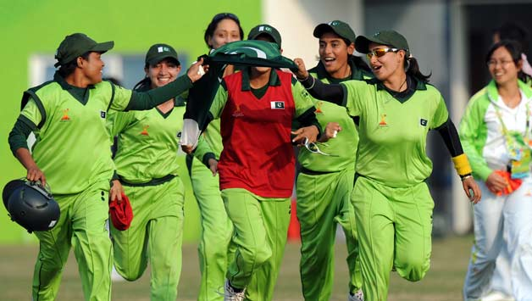
Moving On
Women are
Rejected
Refusing/ Self Excluding
Reluctant
Change
Not representation alone/
counting more women into
existing structures/ systems.
Need for
Re-visioning of Leadership- more generative, generous and gender-free.

Slide 25
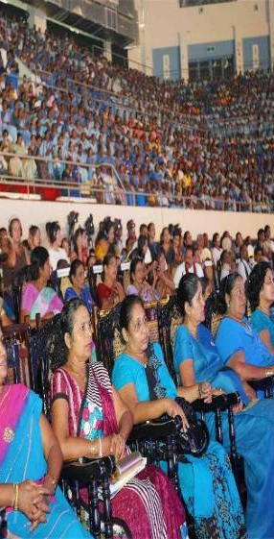
Follow Up?
Morley, L. & Crossouard, B. (2015) Women in Higher Education Leadership in South Asia: Rejection, Refusal, Reluctance, Revisioning. Pakistan: British Council.
https://www.sussex.ac.uk/webteam/gateway/file.php?name=women-in-higher-education-leadership-in-south-asia---full-report.pdf&site=41
Morley, L. et al. (in press, 2015) Managing Modern Malaysia: Women in Higher Education Leadership. In, Eggins, H. (Ed) The Changing Role of Women in Higher Education: Academic and Leadership Challenges. Dordrecht: Springer Publications.
Morley, L. (I2014) Lost Leaders: Women in the Global Academy. Higher Education Research and Development 33 (1) 111–125.
Morley, L. (2013) "The Rules of the Game: Women and the Leaderist Turn in Higher Education " Gender and Education. 25(1):116-131.
Morley, L. (2013) Women and Higher Education Leadership: Absences and Aspirations. Stimulus Paper for the Leadership Foundation for Higher Education.
Morley, L. (2013) International Trends in Women’s Leadership in Higher Education In, T. Gore, and Stiasny, M (eds) Going Global. London, Emerald Press.

