Slide 1

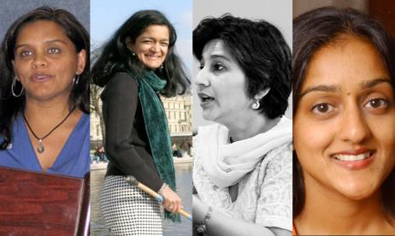
Women in Higher Education
Leadership: Rejection,
Refusal, Reluctance, Re-visioning
Diversity, Democratisation and Difference: Theories and Methodologies
Centre for Higher Education
and Equity Research (CHEER)
University of Sussex, UK
Professor Louise Morley
http://www.sussex.ac.uk/education/cheer

Slide 2

Evidence
South Asia
Rigorous Literature Review
Interviews- 19 women and 11 men
Afghanistan, Bangladesh, India, Nepal, Pakistan and Sri Lanka.
Malaysia
36 Questionnaires/ 1 Focus Group
East Asia and MENA
20 Questionnaires/ 3 Discussion Groups Australia, China, Egypt, Hong Kong, Indonesia, Japan, Jordan, Kuwait, Malaysia, Morocco, Pakistan, Palestine, the Philippines, Singapore, Thailand and Turkey (Morley, 2014).
What makes leadership attractive/unattractive to women?
What enables/ supports women to enter leadership positions?
Personal experiences of being enabled/ impeded from entering leadership?

Slide 3
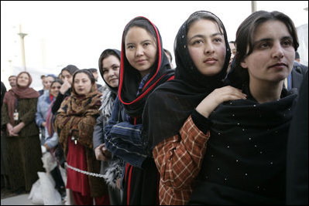
Making Women Intelligible as Leaders: A Two-Way Gaze?
How are women being seen e.g. as deficit men?
How are women viewing leadership e.g. unliveable lives?
What narratives circulate about women’s capabilities?
What narratives circulate about leadership?

Slide 4
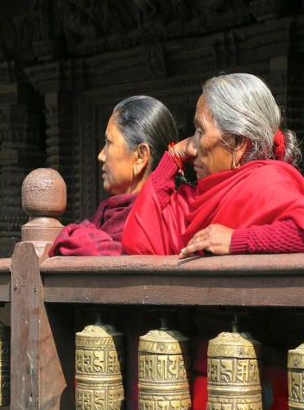
Narrating Difference
Recruitment and Selection
(Political/lacking transparency)
Passionate attachment
(Disciplines/ research)
Authority
(Does not ‘stick’ to women)
Gendered Divisions of Labour
(Women = domestic domain)
Exclusionary Networks
(Male Domination/ sexual propriety)
Hostile cultures
(Toxic/ stressful)

Slide 5

What Attracts Women to Senior Leadership?
Power
Influence
Values
Rewards
Recognition

Slide 6
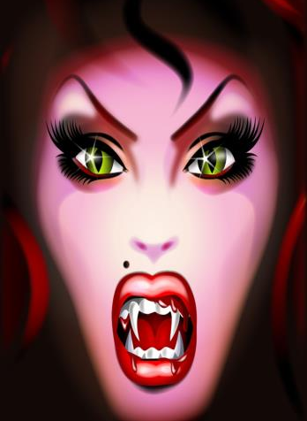
Why is Senior Leadership Unattractive to Women?
Neo-liberalism
Being ‘Other’ in male-dominated cultures
Disrupting the symbolic order
Corruption/ Financialisation
Pre-determined Scripts
Do women lack capital (economic, political, social and symbolic) to redefine the requirements of the field?

Slide 7

Enablers
Legislative Frameworks and Policy Contexts
Gender Mainstreaming
Gender Budgeting/ Auditing
Gender Impact Assessment
Affirmative Action
Work/Life Balance
Professional Development/ Investment
Capacity-Building
Mentorship, Advice and Sponsorship
Women-only Leadership Development e.g. Aurora/ ACU Programme
International Networks
Accountability/ Sanctions/ Rewards
Excellentia, Austria
Athena Swan/ Gender Charter Marks, UK
Evidence
Research/ Gender-Disaggregated Statistics

Slide 8
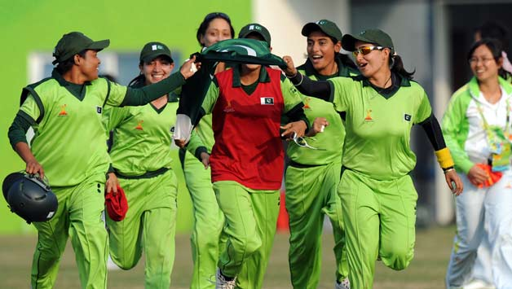
Moving On
Women are
Rejected
Refusing/ Self Excluding
Reluctant
Change
Not counting more women into existing structures/ systems.
Need for
Re-visioning of Leadership- more generative, generous and gender-free.

Slide 9
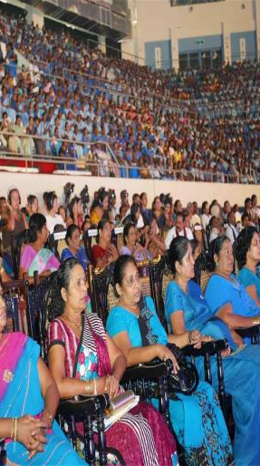
Follow Up?
Morley, L. & Crossouard, B. (2015) Women in Higher Education Leadership in South Asia: Rejection, Refusal, Reluctance, Revisioning. Pakistan: British Council.
Morley, L. et al. (in press, 2015) Managing Modern Malaysia: Women in Higher Education Leadership. In, Eggins, H. (2015) (Ed) The Changing Role of Women in Higher Education: Academic and Leadership Challenges. Dordrecht: Springer Publications.
Morley, L. (I2014) Lost Leaders: Women in the Global Academy. Higher Education Research and Development 33 (1) 111–125.
Morley, L. (2013) "The Rules of the Game: Women and the Leaderist Turn in Higher Education " Gender and Education. 25(1):116-131.
Morley, L. (2013) Women and Higher Education Leadership: Absences and Aspirations. Stimulus Paper for the Leadership Foundation for Higher Education.
Morley, L. (2013) International Trends in Women’s Leadership in Higher Education In, T. Gore, and Stiasny, M (eds) Going Global. London, Emerald Press.

